Slide 1

Orchestrating low-frequency VLBI on LOFAR scales
Frits Sweijen
Durham University
21–25 Oct 2025
Veras gräsmatta, Chalmers, Gothenburg
Collaborators
Emmy Escott, Christian Groeneveld, Neal Jackson, Jurjen de Jong, Vijay Mahatma, Leah Morabito, James Petley, Roland Timmerman, Reinout van Weeren, Matthijs van der Wild and many others in the LOFAR-VLBI working group

Slide 2
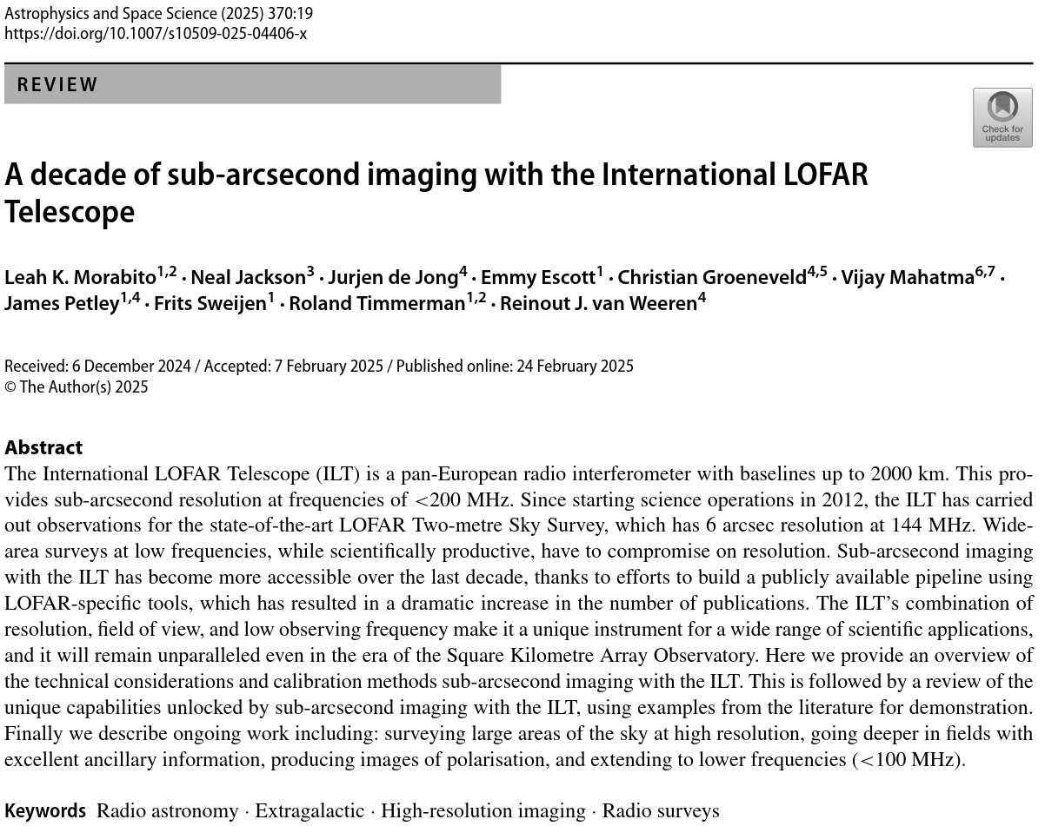
Setting the scene

Slide 3
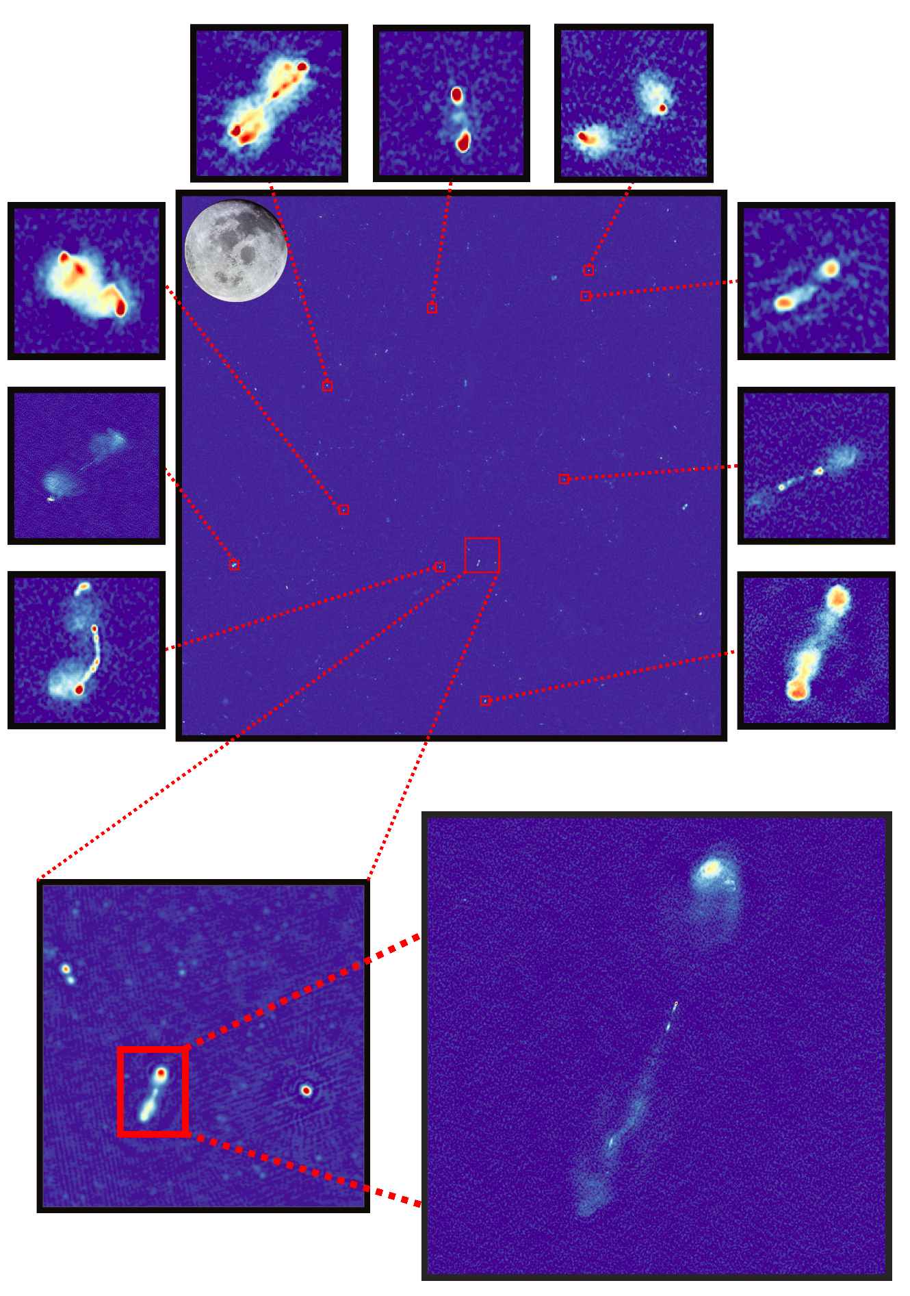
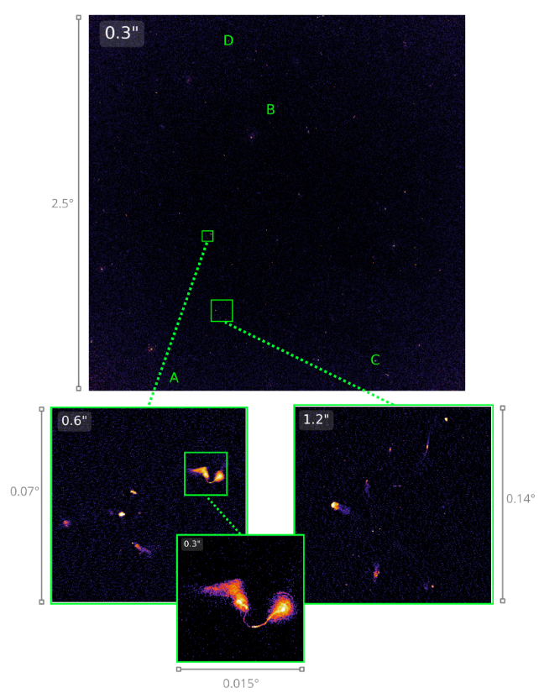
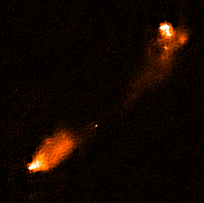
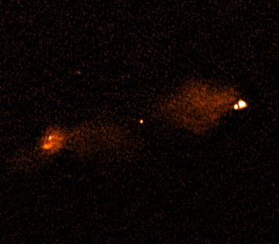
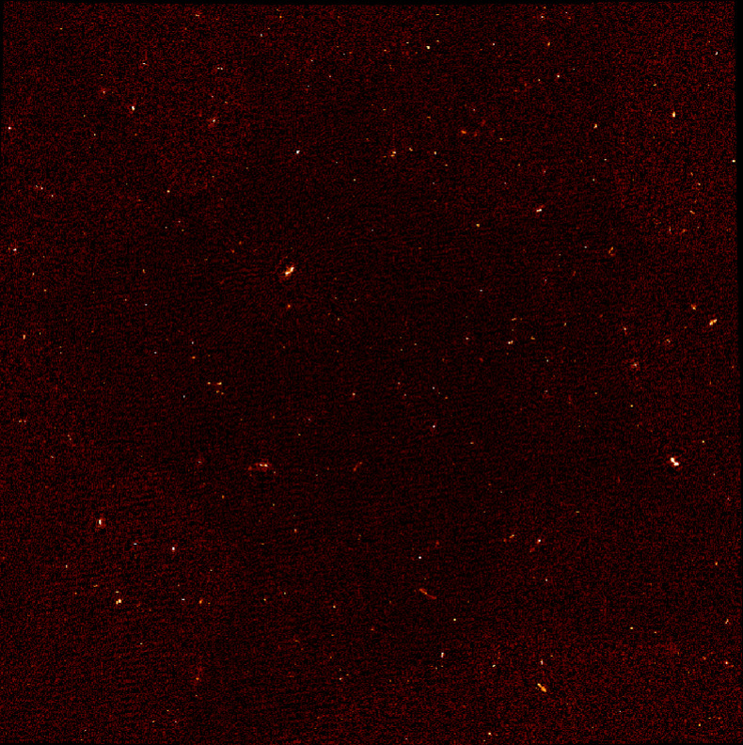
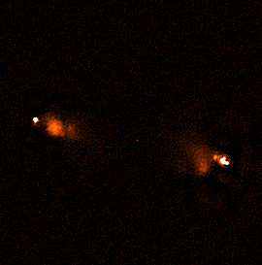
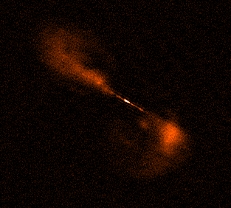
Setting the scene
Sweijen et al. 2022
de Jong et al. 2024
Escott et al. subm.

Slide 4
Outline
International VLBI Technology Workshop
Frits Sweijen
VLBI with the International LOFAR Telescope
Orchestration with the Common Workflow Language
PILoT: an end-to-end ILT VLBI pipeline
Future outlook & developments

Slide 5
VLBI with the International LOFAR Telescope
“Traditional” VLBI
ILT VLBI
International VLBI Technology Workshop
October 22nd, 2025 // Chalmers, Gothenburg
Frits Sweijen
Phase reference
Phase reference
arcminutes
Science
target
Science
target
degrees

Slide 6
VLBI with the International LOFAR Telescope
International VLBI Technology Workshop
October 22nd, 2025 // Chalmers, Gothenburg
Frits Sweijen
“Traditional” GHz VLBI
ILT VLBI
Phase errors dominated by tropospheric and instrumental effects
Calibration is interpolated between science target and phase reference
Time and bandwidth smearing is limited due to always pointing on-source
Baseline coverage tends to be sparse -> very restricted spatial scales covered
Phase errors dominated by dispersive ionospheric effects
Calibration matches 1:1 between science target and phase reference
Time and bandwidth smearing set by data averaging (i.e. your storage capacity)
Spatial scales from ~1 deg to 0.3 arcsec sampled with a single observation
Phase reference
Phase reference
Science
target
Science
target

Slide 7
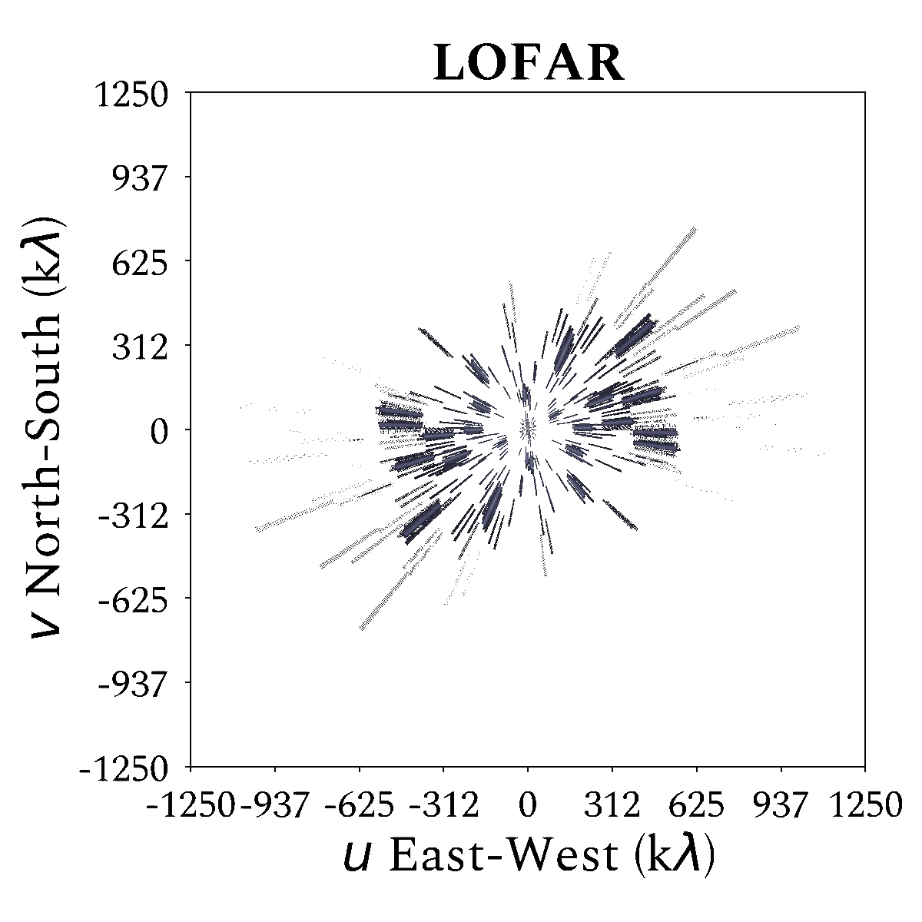
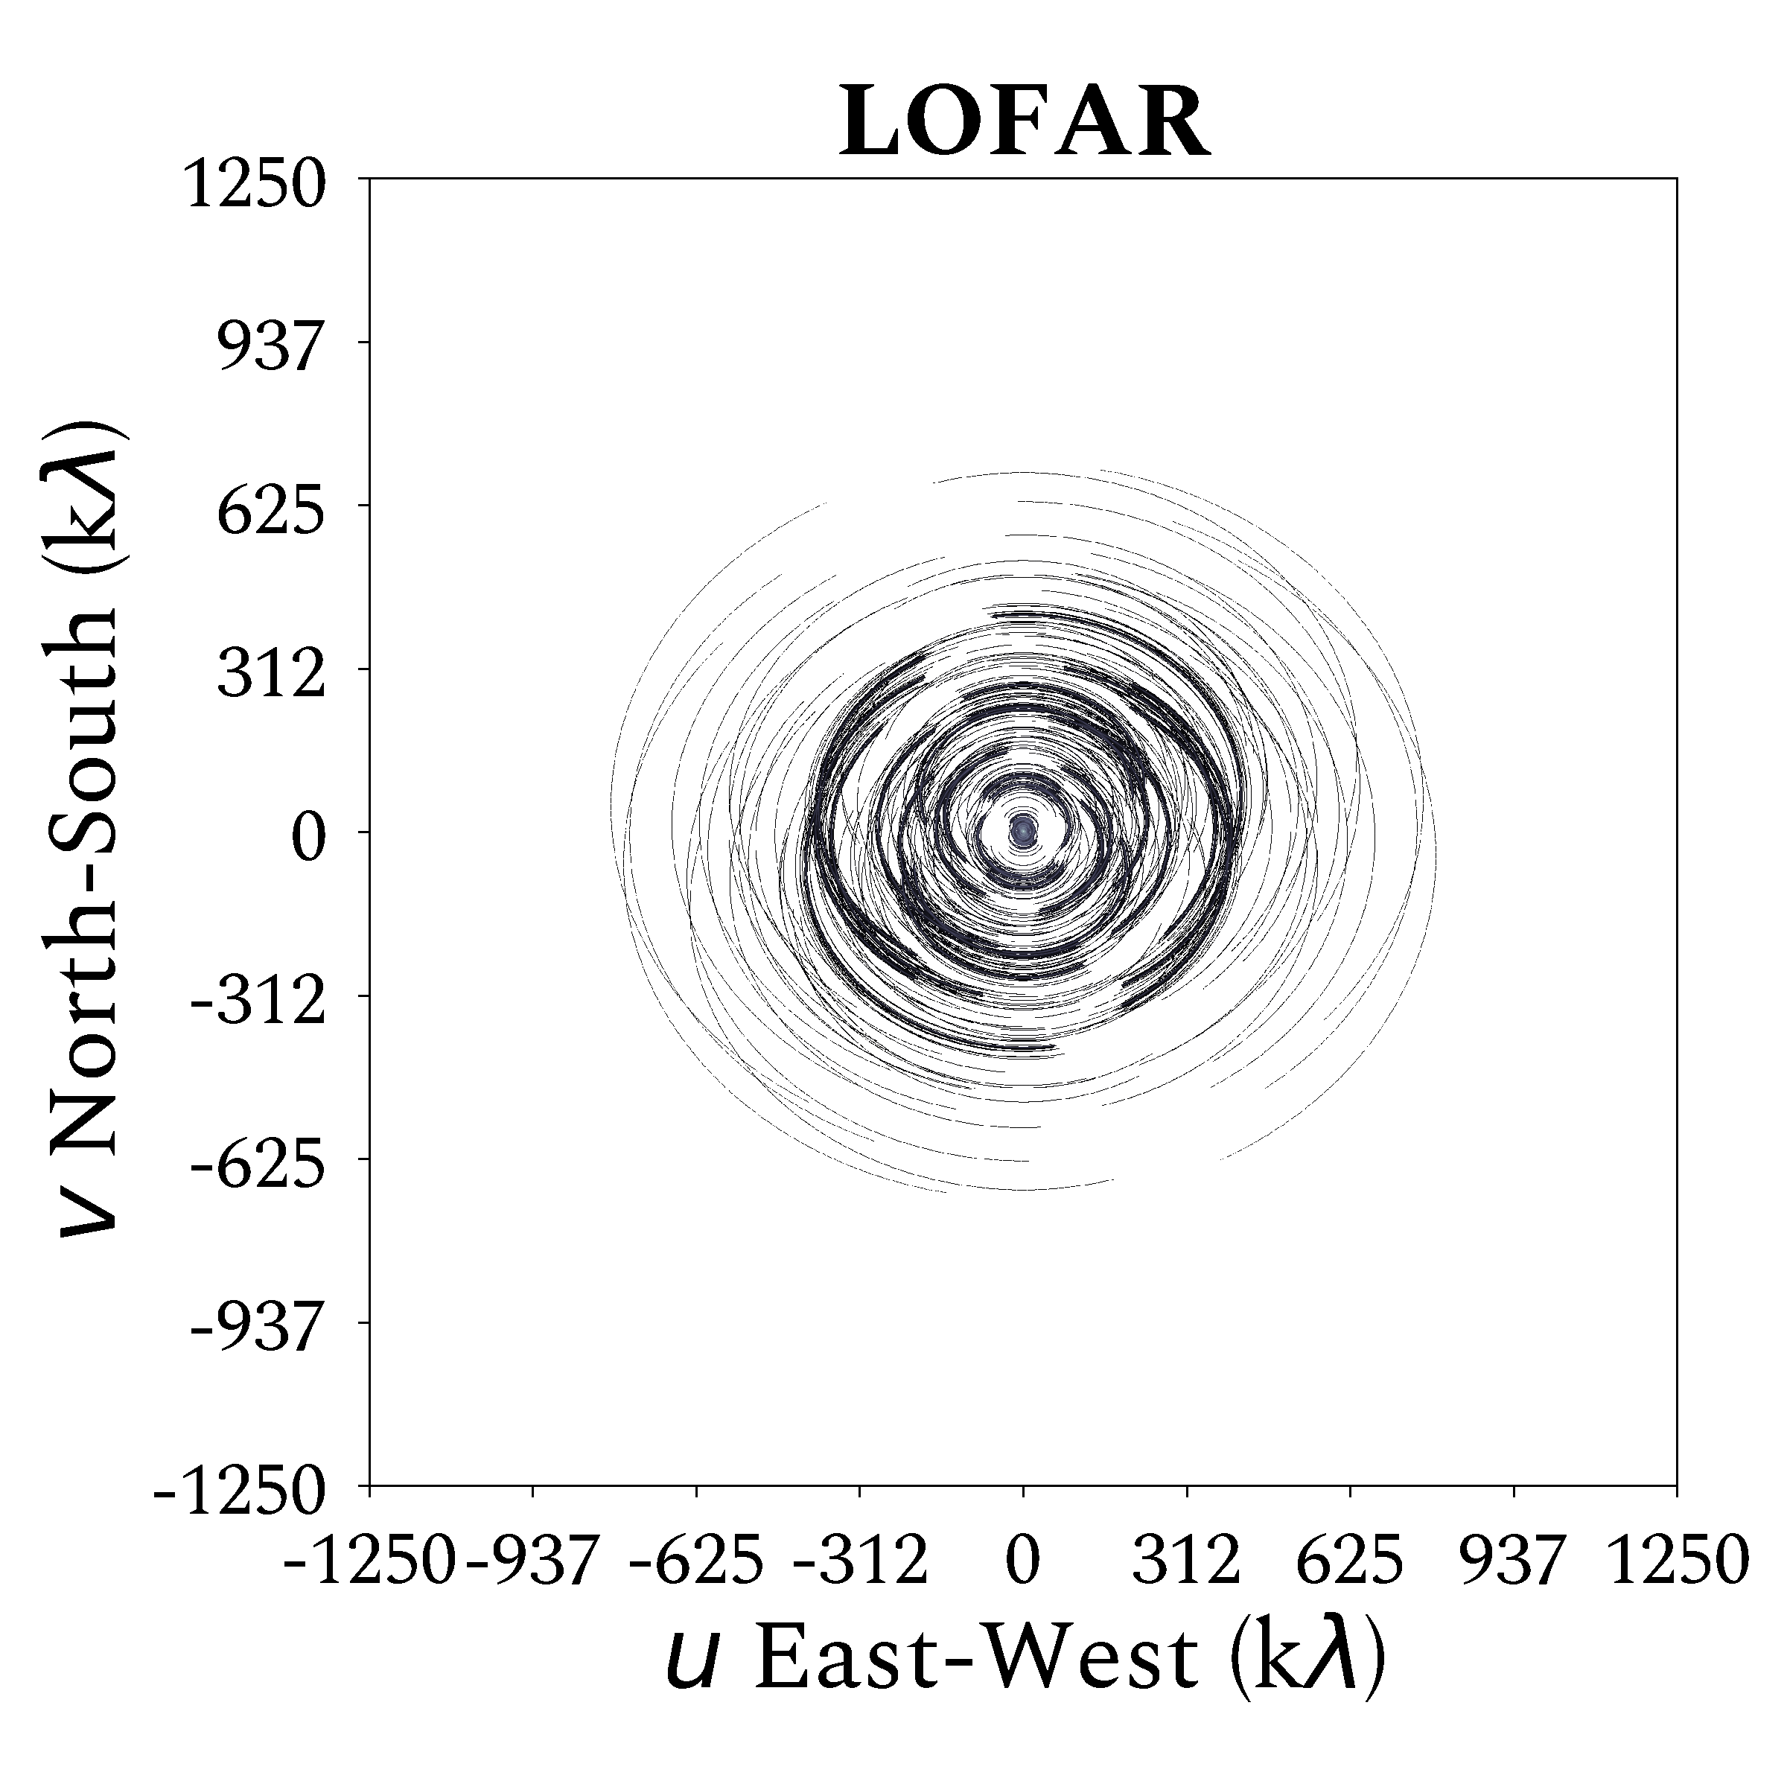
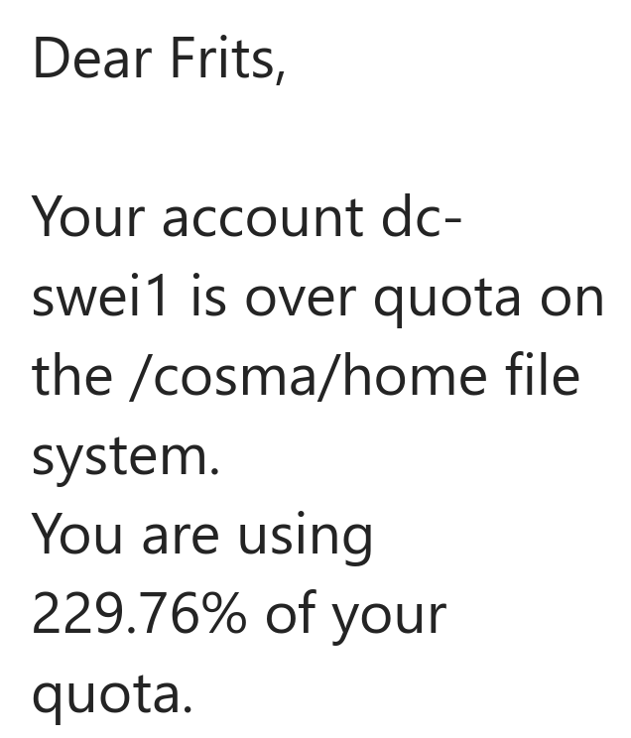
VLBI with the International LOFAR Telescope
8 hour synthesis
1 s integration time
120-168 MHz
12.205 kHz channel resolution
~240 subbands of 195kHz
5 TB per observation ~6,000 observations needed (northern hemisphere)
International VLBI Technology Workshop
October 22nd, 2025 // Chalmers, Gothenburg
Frits Sweijen

Slide 8
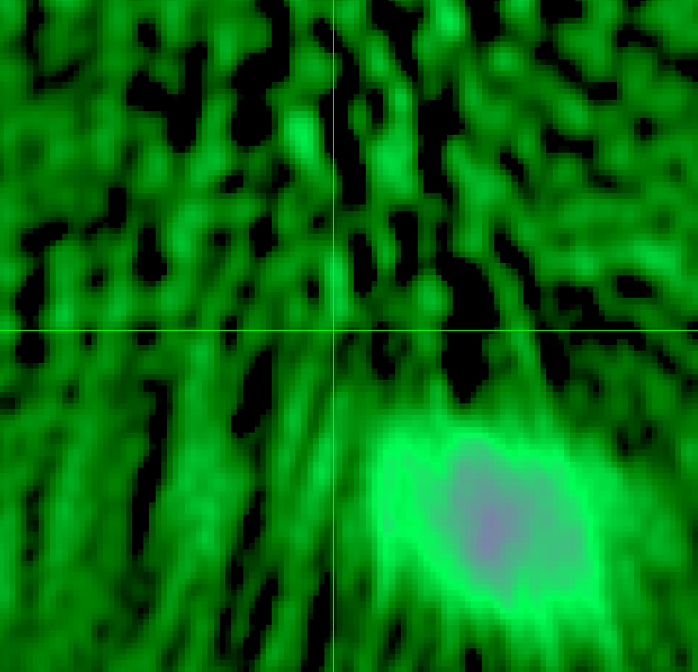
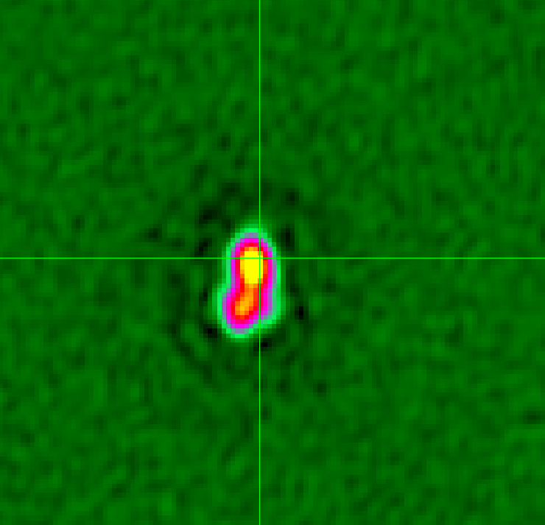
VLBI with the International LOFAR Telescope
International VLBI Technology Workshop
October 22nd, 2025 // Chalmers, Gothenburg
Frits Sweijen
Systematics and Dutch calibration
Polarisation alignment, clock offsets and bandpasses for all stations
Direction-dependent calibration of full NL-station FoV for NL stations
High quality, deep 6” resolution sky image
5 TB
Primary “delay” calibration
Bright (>0.1 Jy) compact source to correct bulk ionosphere, primary beam variations and astrometry + polarisation (where possible)
Self-calibration, no fringe fitting*
5 TB
Direction dependent calibration
Faint (>0.025 Jy) secondary sources to correct differential ionosphere and primary beam variations
Calibrators form Voronoi tesselation for facet imaging
20-50
Imaging
~1-2” intermediate resolution image (~1.5 GB)
~0.6” intermediate-high resolution image (~10 GB)
~0.3” high-resolution image (~40 GB)
~400 GB per facet

Slide 9
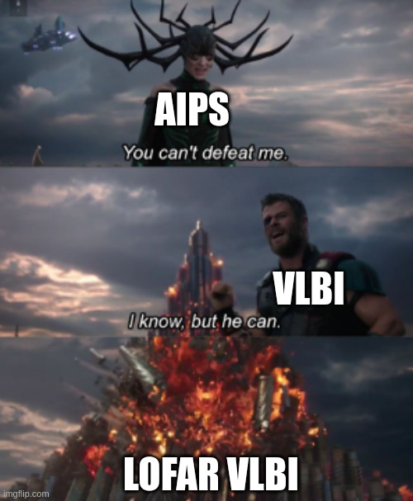
Large-scale orchestration
International VLBI Technology Workshop
October 22nd, 2025 // Chalmers, Gothenburg
Frits Sweijen
Managed clusters for distributed processing (e.g. Slurm)
Parallelise over frequency chunks
DD calibrators can be treated independently
Facets can be imaged independently
Open standards for defining pipelines
Decouple software from pipelining
Easier integration with schedulers like Slurm
Industry support

Slide 10
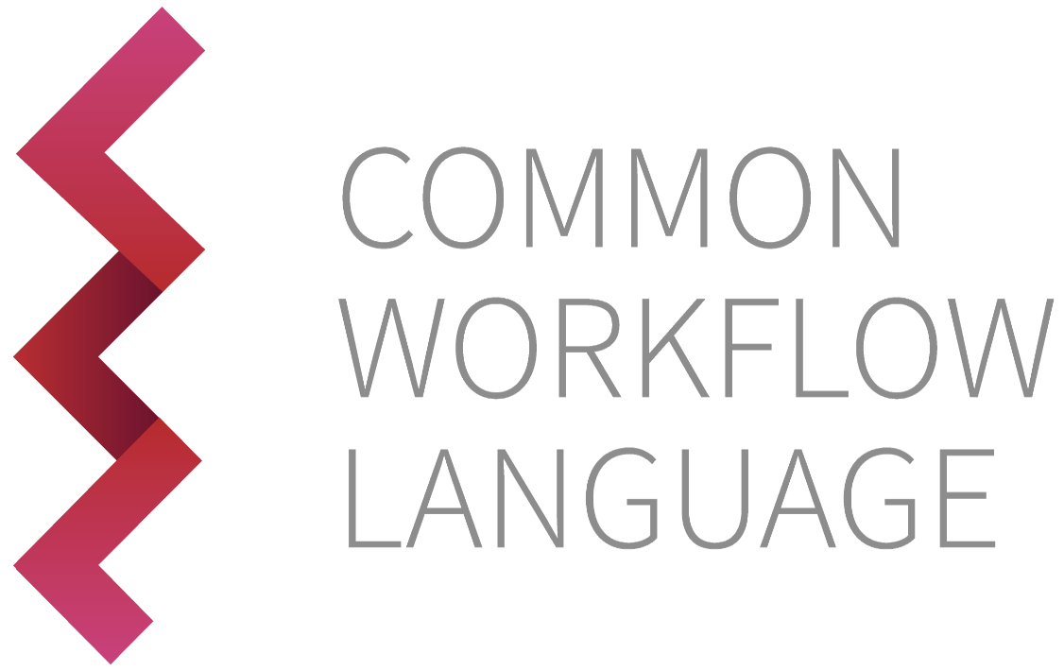
Common Workflow Language
International VLBI Technology Workshop
October 22nd, 2025 // Chalmers, Gothenburg
Frits Sweijen
A declarative language to describe inputs and outputs of “steps”
Per-step resource requirements
Supports containerised execution (Docker or Apptainer)
Used across many science areas
Open standard
class: CommandLineTool
cwlVersion: v1.2
id: aoflagging
label: AOflagger
doc: Runs the AO-flagging module of DP3.
baseCommand: aoflagger
inputs:
- id: msin
type: Directory
inputBinding:
position: 0
doc: Data to be processed in MeasurementSet format.
outputs:
- id: msout
doc: Output MeasurementSet.
type: Directory
outputBinding:
glob: $(inputs.msin.basename)
requirements:
- class: InitialWorkDirRequirement
listing:
- entry: $(inputs.msin)
writable: true
- class: ShellCommandRequirement
- class: InlineJavascriptRequirement
- class: ResourceRequirement
coresMin: 6
ramMin: $(inputs.memory)
hints:
- class: DockerRequirement
dockerPull: vlbi-cwl
stdout: aoflag.log
stderr: aoflag_err.log

Slide 11
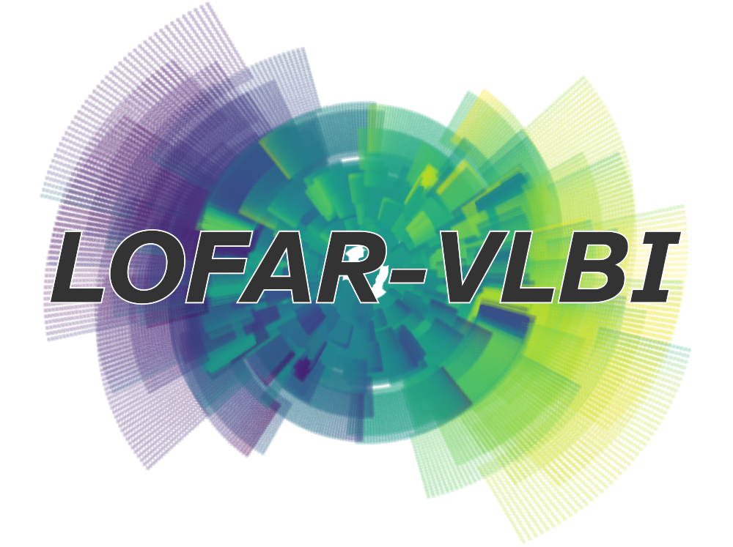
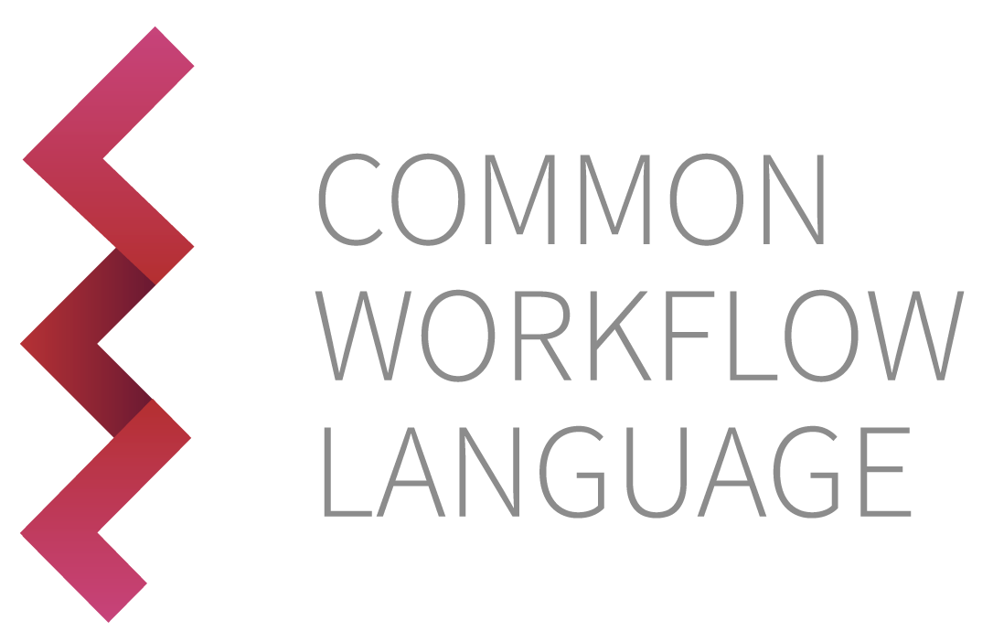
An end-to-end pipeline
International VLBI Technology Workshop
October 10th, 2025 // Chalmers, Gothenburg
Frits Sweijen
PILOT - Pipeline for the International LOFAR Telescope https://github.com/LOFAR-VLBI/VLBI-cwl van der Wild in prep.
Common Workflow Language as “definition glue”
Toil CWL runner for easy exploitation of Slurm clusters

Slide 12
Common Workflow Language
International VLBI Technology Workshop
October 10th, 2025 // Chalmers, Gothenburg
Frits Sweijen
Varying levels of parallelism throughout processing
Individual resource requirement can be scheduled efficiently with Toil
individual operations
combined
operationsoperations
full-band operations
individual operations
full-band operations
subband 1
band 1
target 1
subband 2
band 2
target 2
subband 3
band 3
full dataset
full dataset
…..
…..
target 3
…..
subband 231
band 24
target 150
individual operations
combined operations
full-band operations
individual operations
full-band operations
8 cpus
24 cpus
64 cpus
8 cpus
24 cpus
64 cpus
8 cpus
24 cpus
2TB memory
2TB memory
…..
…..
64 cpus
…..
8 cpus
24 cpus
64 cpus

Slide 13
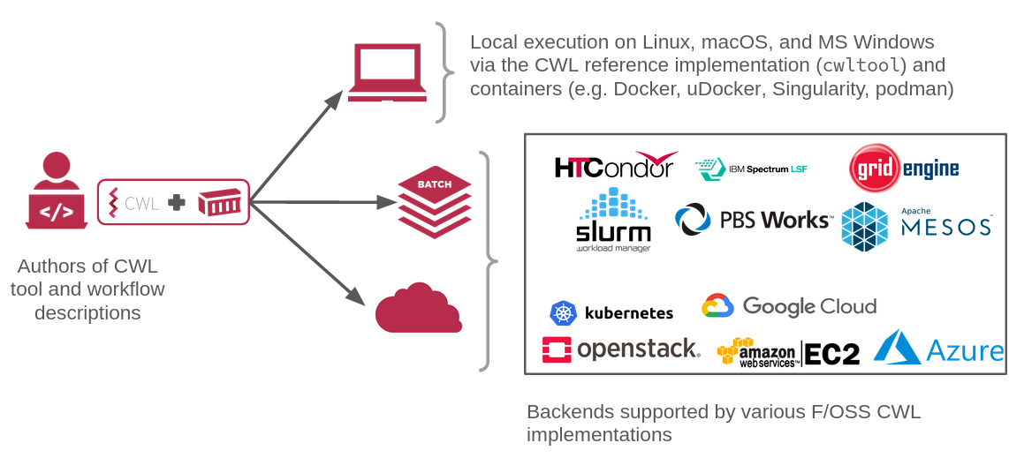
Large-scale orchestration
Image credit: CWL documentation

Slide 14
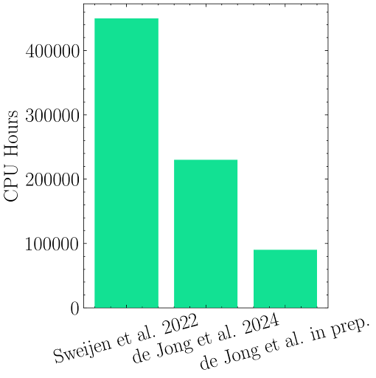
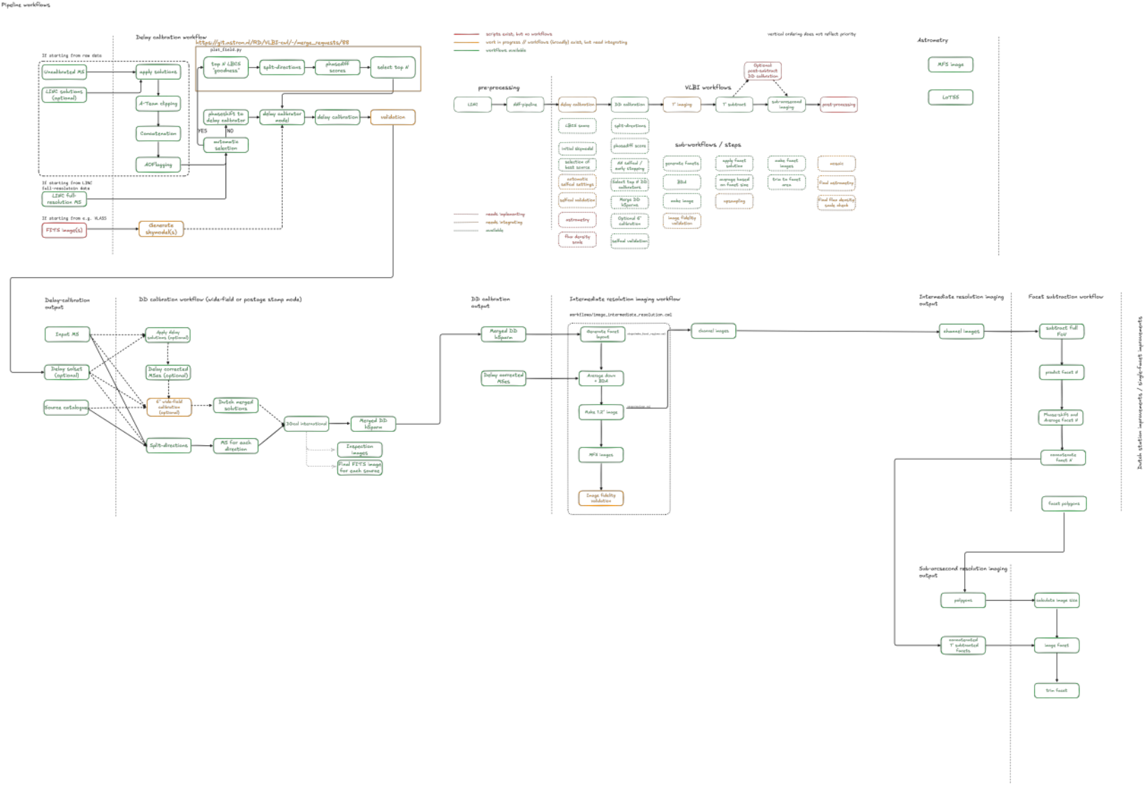
but.... it’s complicated and expensive!
International VLBI Technology Workshop
October 10th, 2025 // Chalmers, Gothenburg
Frits Sweijen
extrapolated
Image credit: Jurjen de Jong
120,000 core hours per observation is still 156 days on 32 cores!
Furter optimisation still needed

Slide 15
Summarising & what’s next?
International VLBI Technology Workshop
October 10th, 2025 // Chalmers, Gothenburg
Frits Sweijen
This talk
ILT VLBI pipeline is rapidly stabilising as an end-to-end pipeline
Efficient resource usage with CWL and Toil
What’s next?
Profiling and optimisation: processing is stable and manageable, but still computationally expensive (see also next talk by Jurjen)
Italy and Bulgaria stations will join with LOFAR2.0, creating baselines up to 2700 km
LoTSS-HR: postage-stamp imaging of >10 mJy LoTSS sources
iLoTSS: full FoV imaging high-resolution counterpart to LOTSS
LOFAR2.0 Ultra-Deep Observation: ~3000 hours ILT imaging on EDF-N region

Slide 16
Thank you. Questions?
Frits Sweijen
Durham University
21–25 Oct 2025
Veras gräsmatta, Chalmers, Gothenburg
Orchestrating low-frequency VLBI on LOFAR scales

