Slide 1

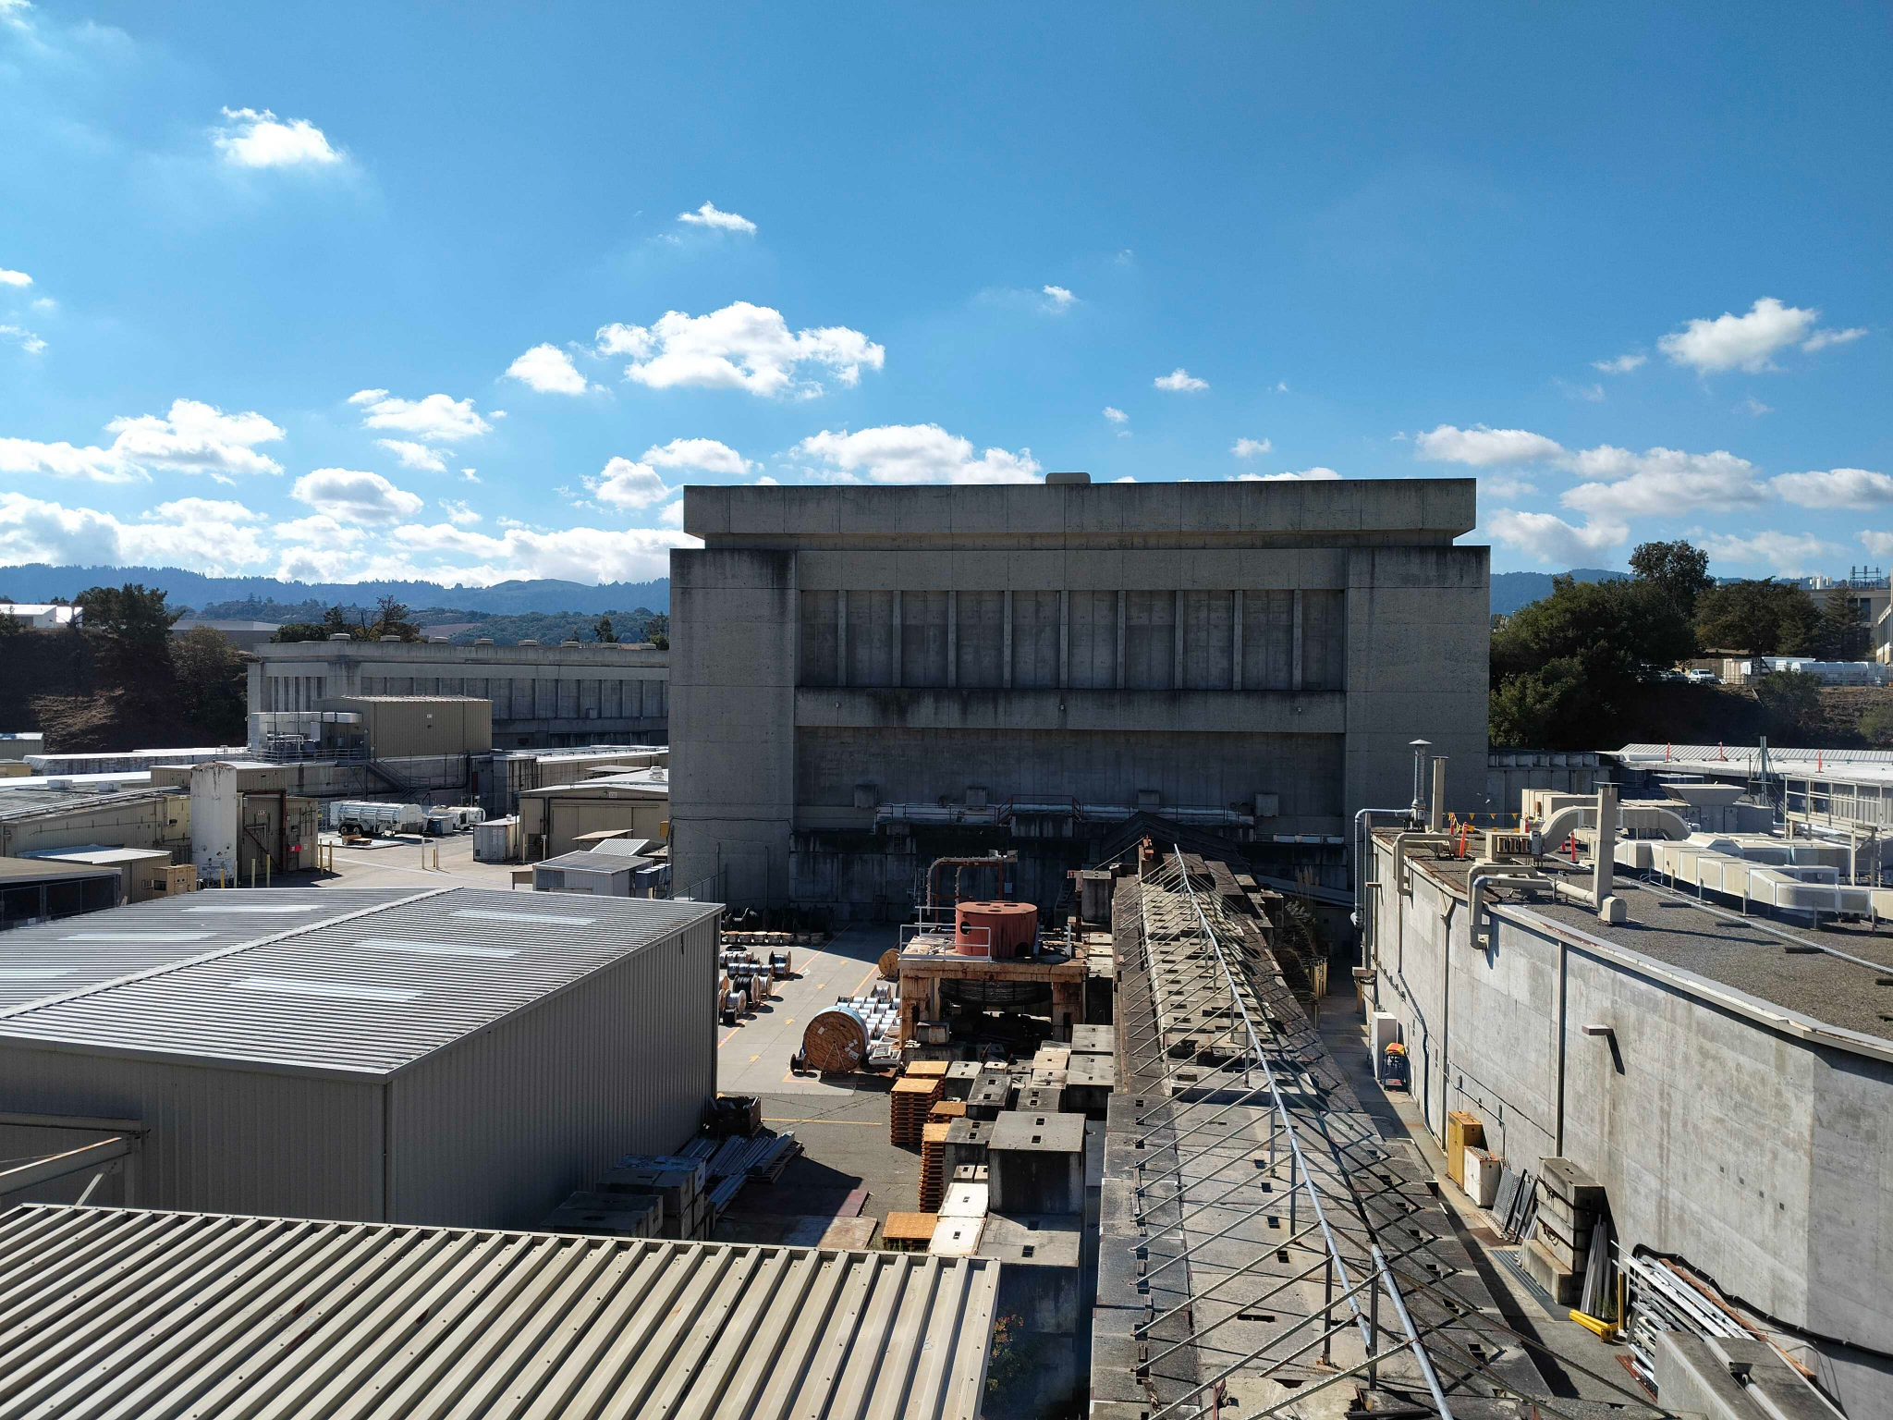
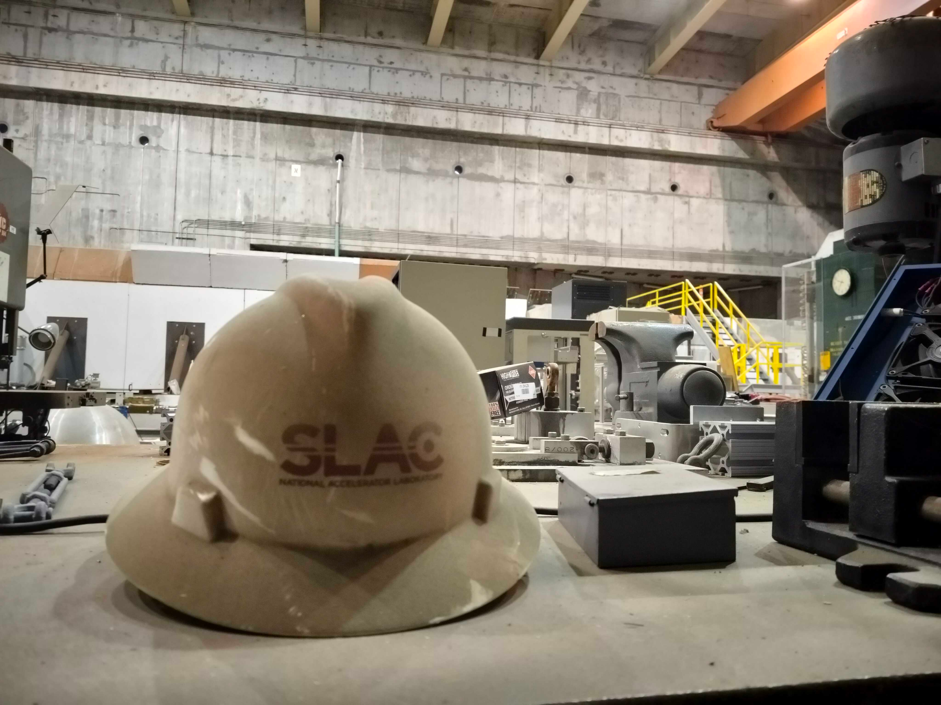



LDMX Status and Outlook
e
i a a p
g r t e
h k t r
t e i
r m
e
n
t
CJ Barton, Lund University

Slide 2
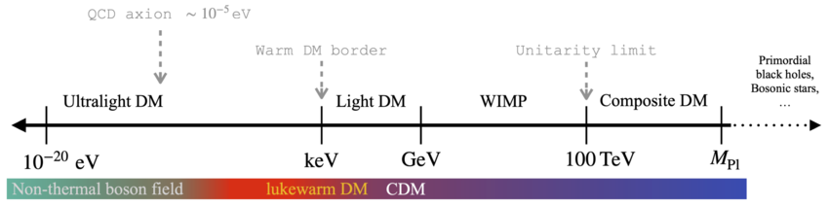
The case for light dark matter (LDM)
Image from Symmetry, DOI 10.3390/sym13101945
Thermal DM is an attractive candidate to explain relic DM abundance
Viable in the keV - TeV mass range
Largest efforts in this mass range for GeV-TeV ‘standard’ WIMPs
New parameter space for LDM searches relatively easy to access, physically well-motivated

Slide 3
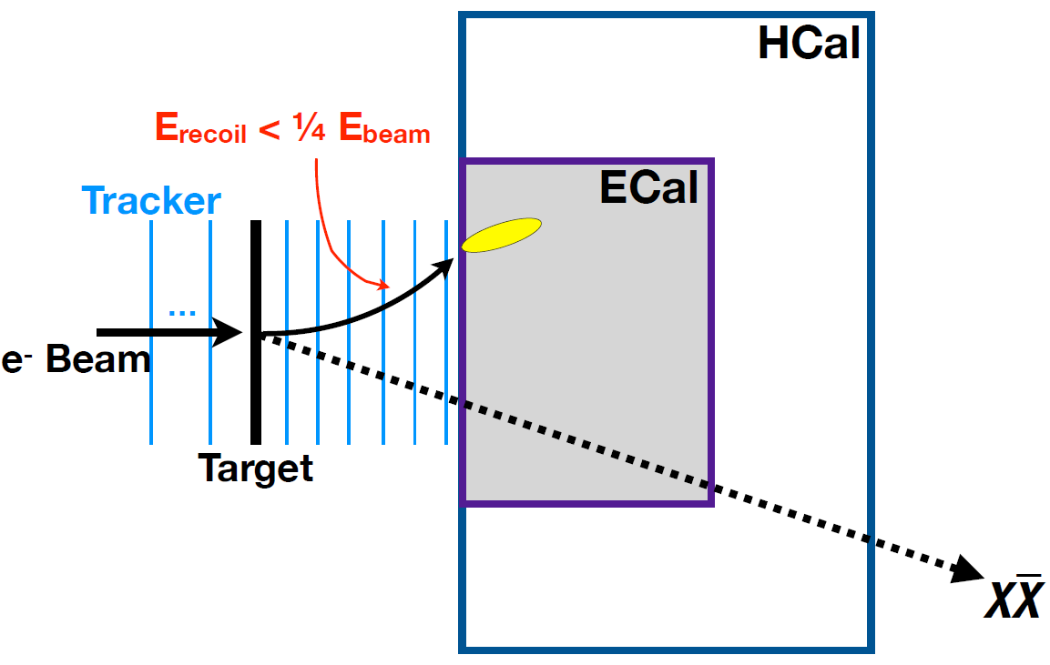
The Light Dark Matter eXperiment
LDMX is a ‘missing momentum’ DM production experiment searching for LDM in the MeV - GeV mass range with an e- beam on a heavy target

Slide 4
The Light Dark Matter eXperiment
LDMX is a ‘missing momentum’ DM production experiment searching for LDM in the MeV - GeV mass range with an e- beam on a high-Z target
With initial/final states + tracking, events with large missing momentum can be flagged as LDM candidates

Slide 5
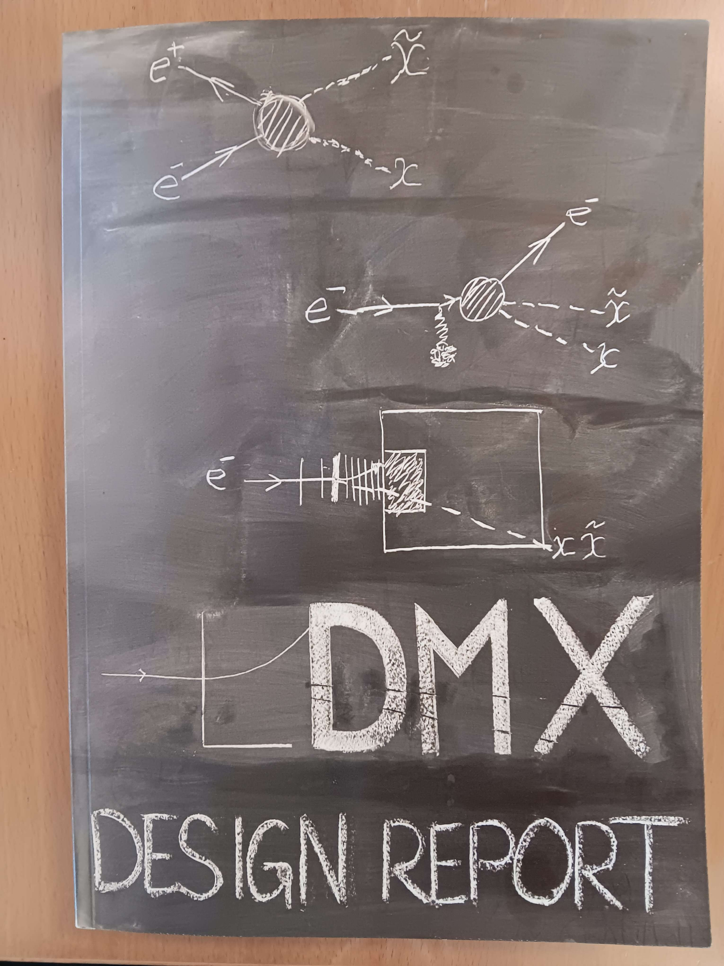
The LDMX Design Report
Completed Design Report August 2025 (arXiv:2508.11833)
300 page document with a complete functional plan for lifetime of LDMX
Major milestone for US DOE approval
Majority of this presentation directly from DR

Slide 6
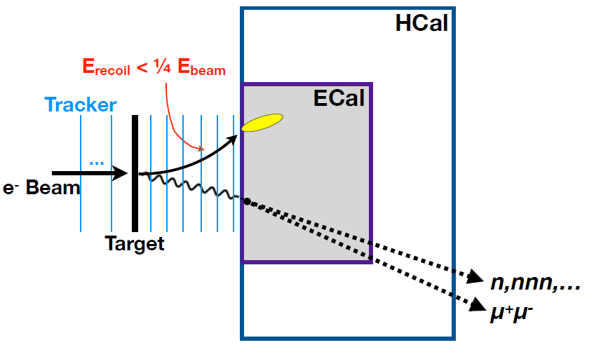
Analysis strategy
Bad
:^(
High-repetition, low current e-beam
Large (10¹⁴-10¹⁶) sample of electron events
Experimental program hinges on separating signal and background at proportionally high fidelity to event count

Slide 7
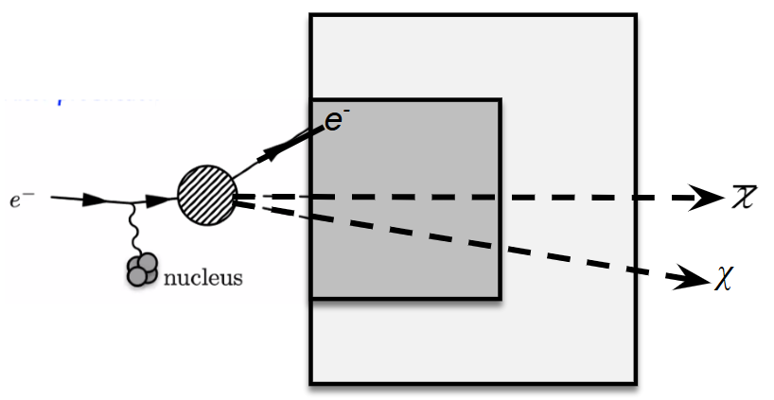
The LDMX signal characteristics
HCal
ECal
Well-behaved incoming e-
Large amount of missing energy
Large transverse momentum for e-
No other signals

Slide 8
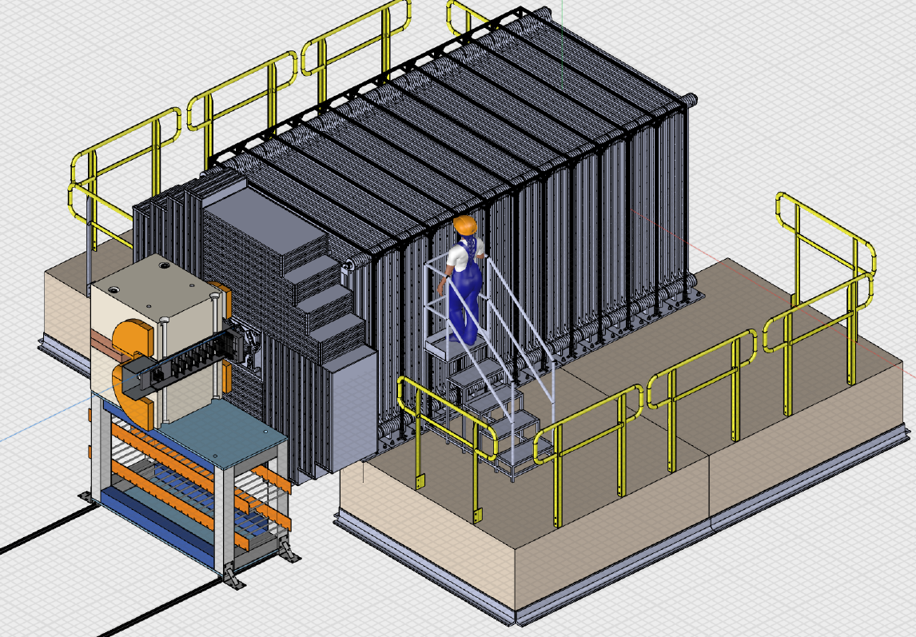
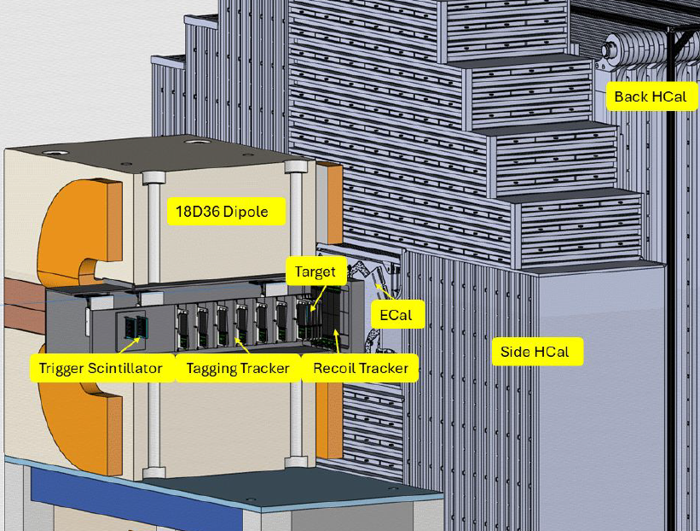
Anatomy of LDMX
Hadronic calorimeter ‘HCal’
Back HCal
magnet
target
Electromagnetic calorimeter (ECal)
Side HCal
e- tracking system

Slide 9
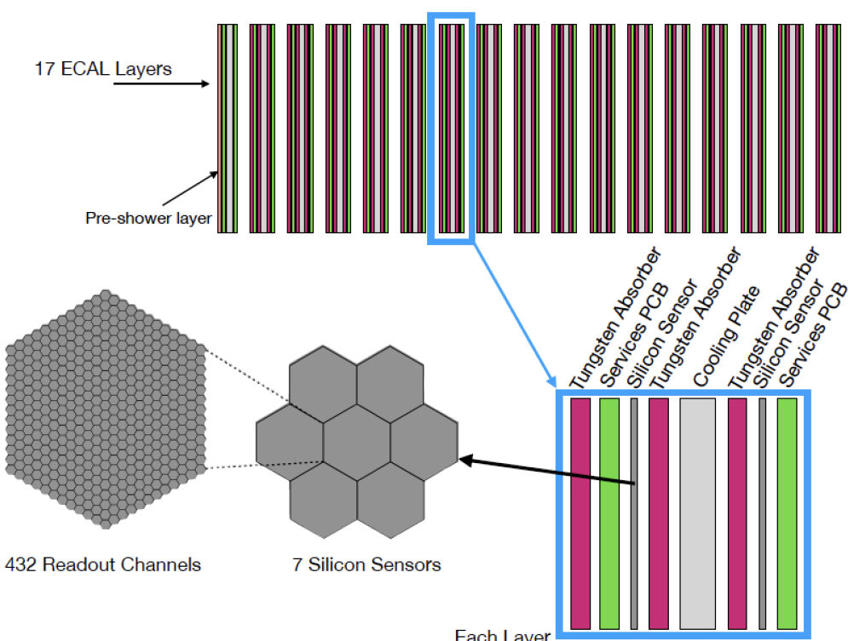
The ECal
Based on HGCal design for the CMS upgrade
40 X₀ calorimeter for EM particles
High-resolution position and energy -> track reconstruction, event identification

Slide 10
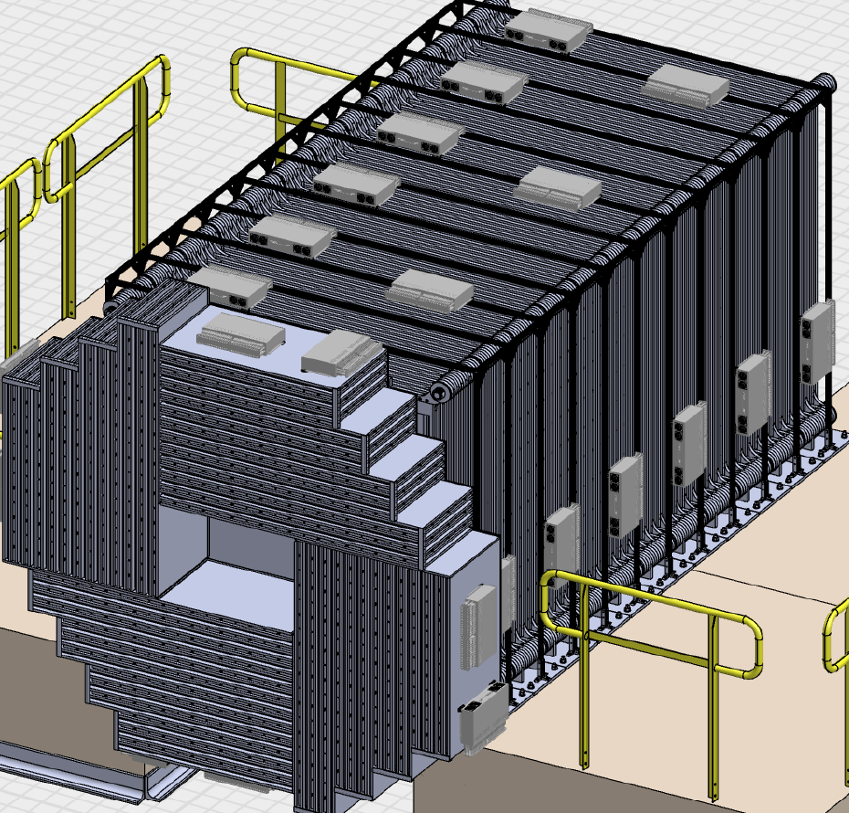
The HCal
Scintillating bars + SiPMs + absorber
Based on Mu2e designs
HGCROC readout electronics
Based on CMS upgrade
Much larger volume than ECal
Worse resolution than ECal
Still capable of some particle ID and track reconstruction

Slide 11
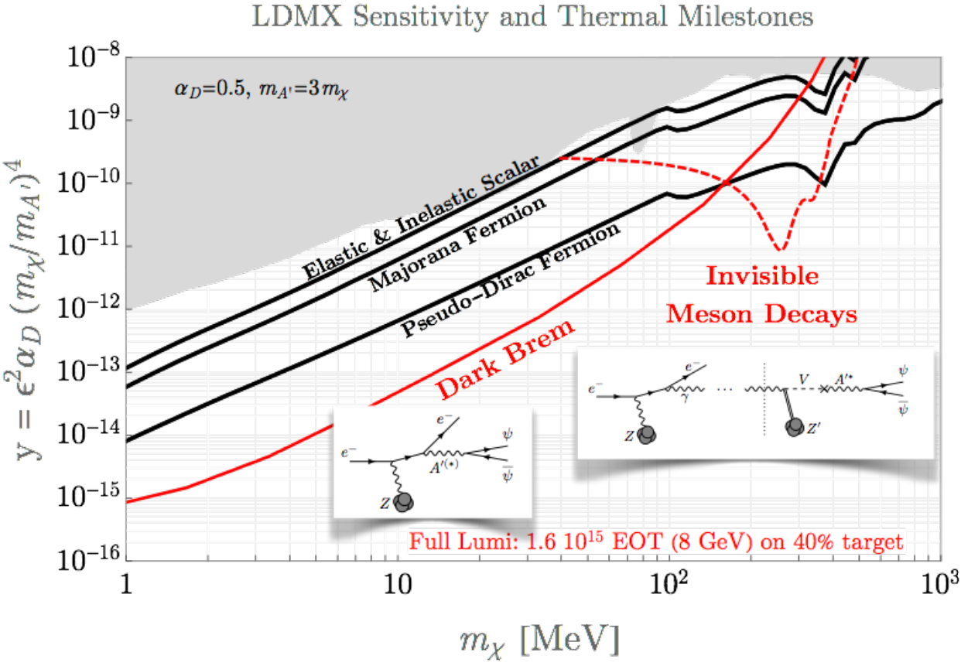
LDMX sensitivity projections
Search strategy is largely model agnostic
Coupling strength and therefore sensitivity is model dependent
Final sensitivity will cover new parameter space for multiple models

Slide 12
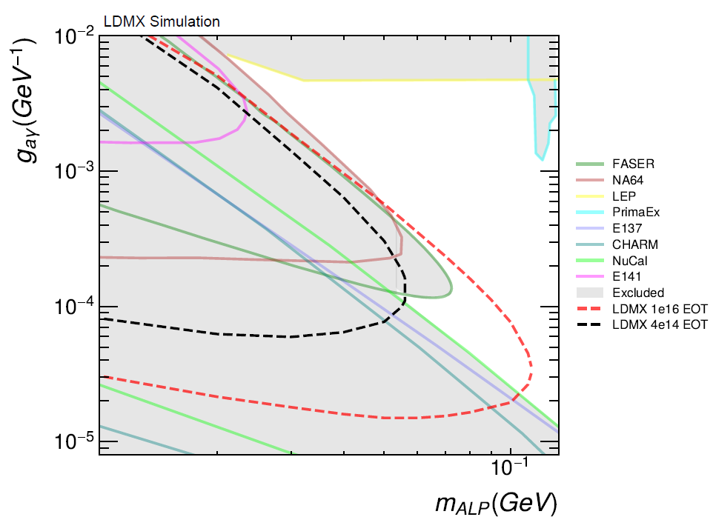
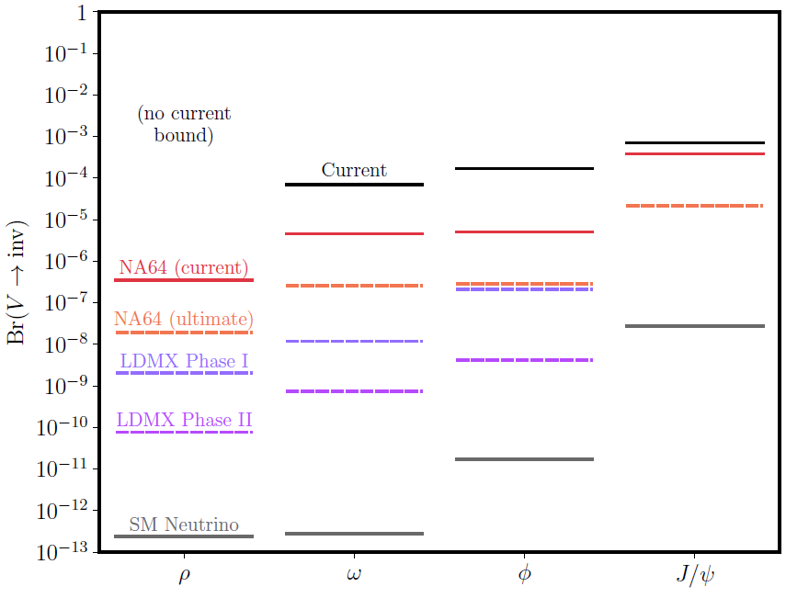
Other physics programs possible with LDMX
Axion-like particle searches (visible+invis)
Spin-1 DM (T. Gray’s talk in this session)
Other dark sector and BSM processes
Precision measurements of electro/photonuclear + other rare processes

Slide 13
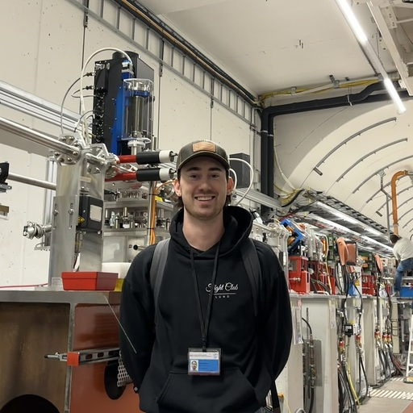
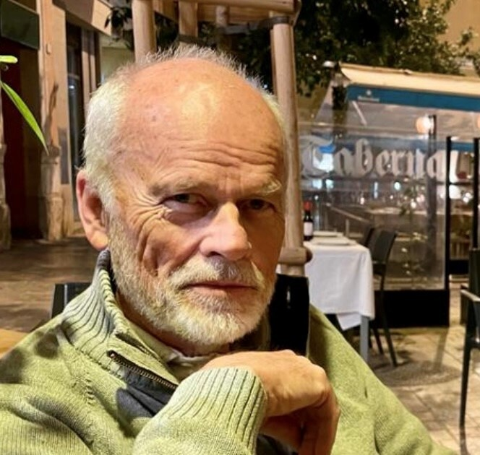
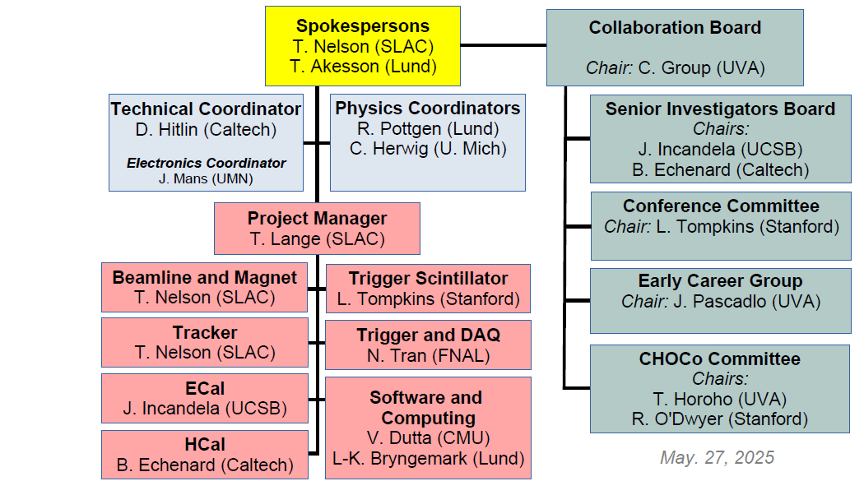

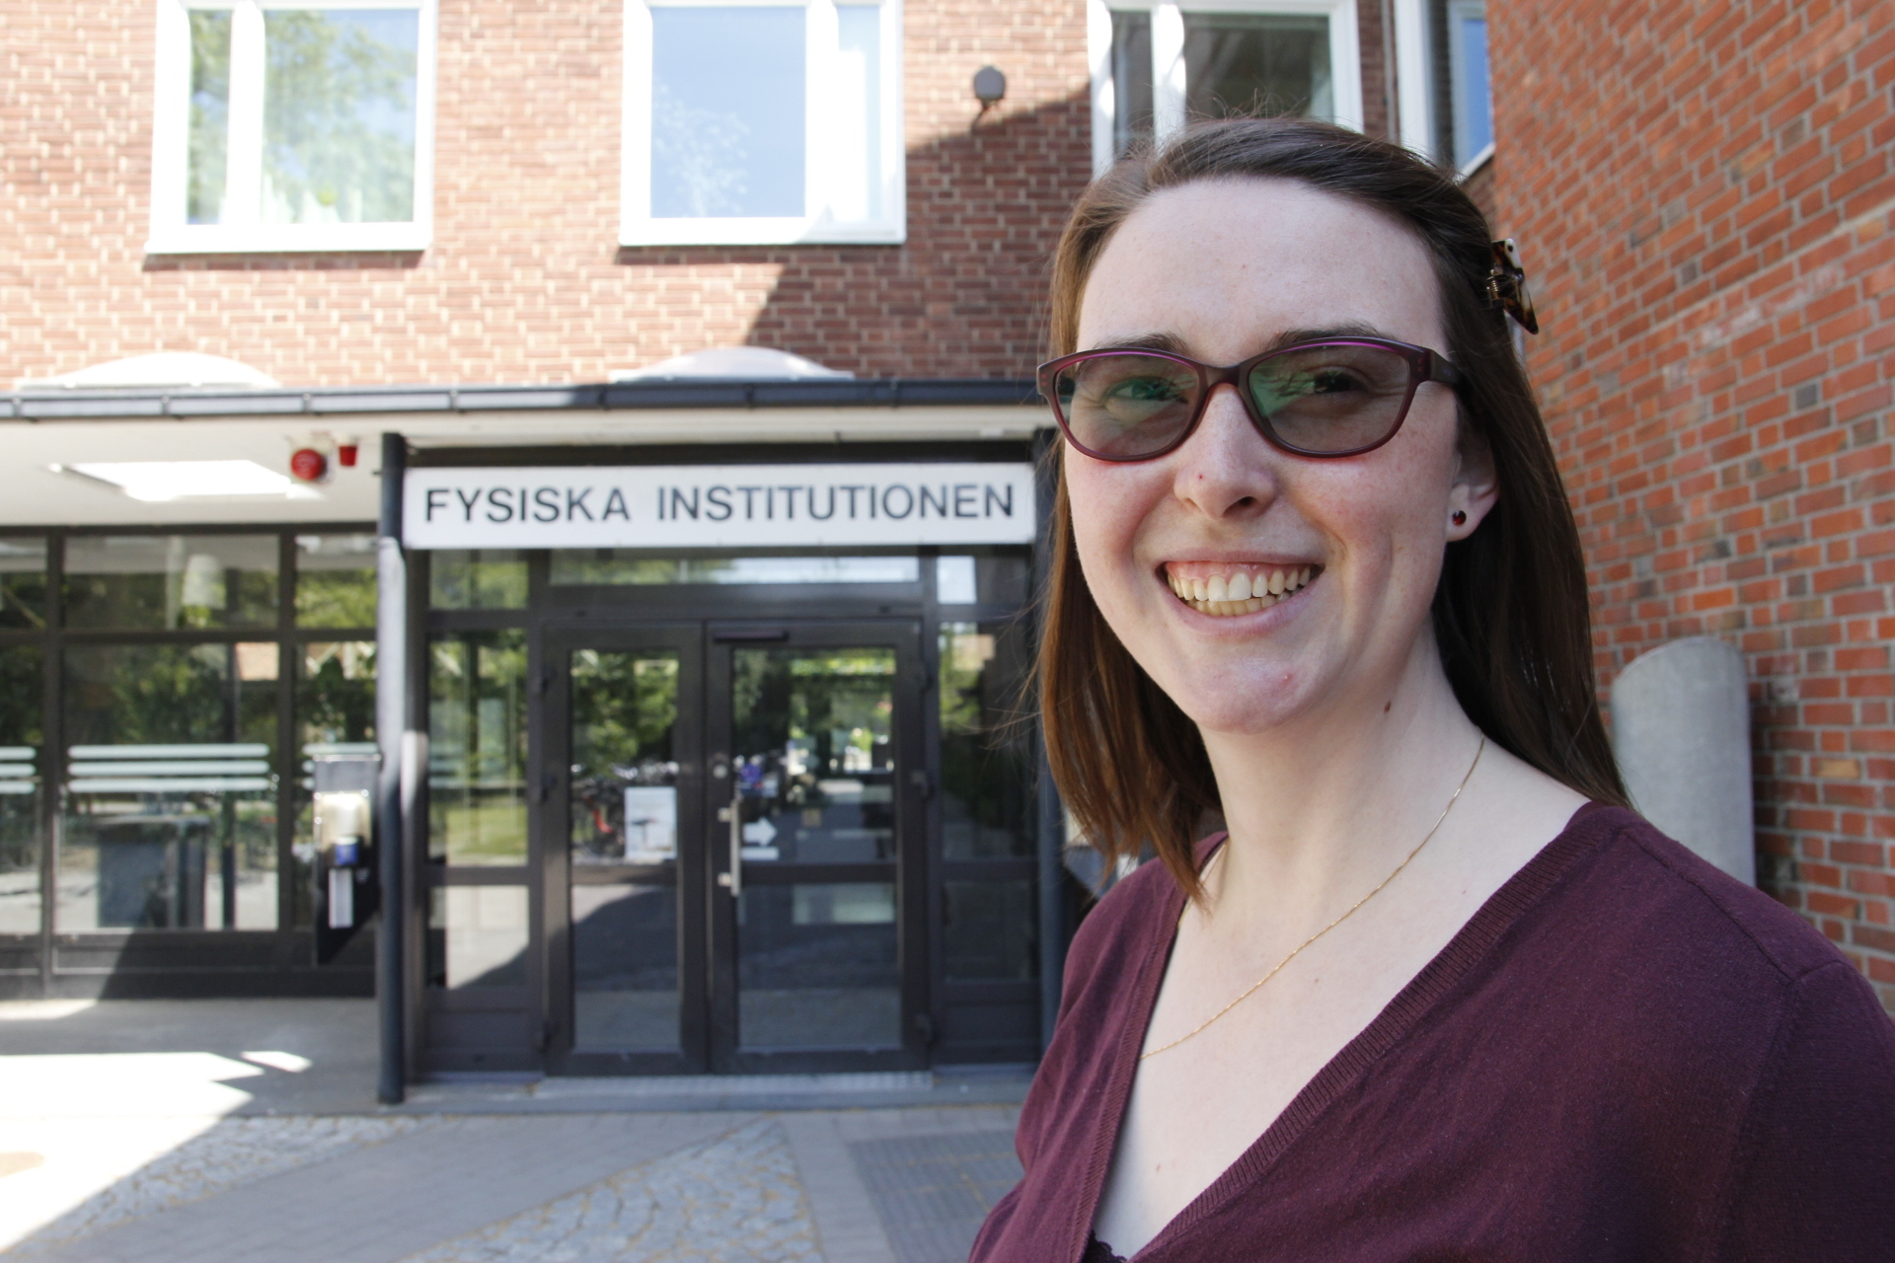
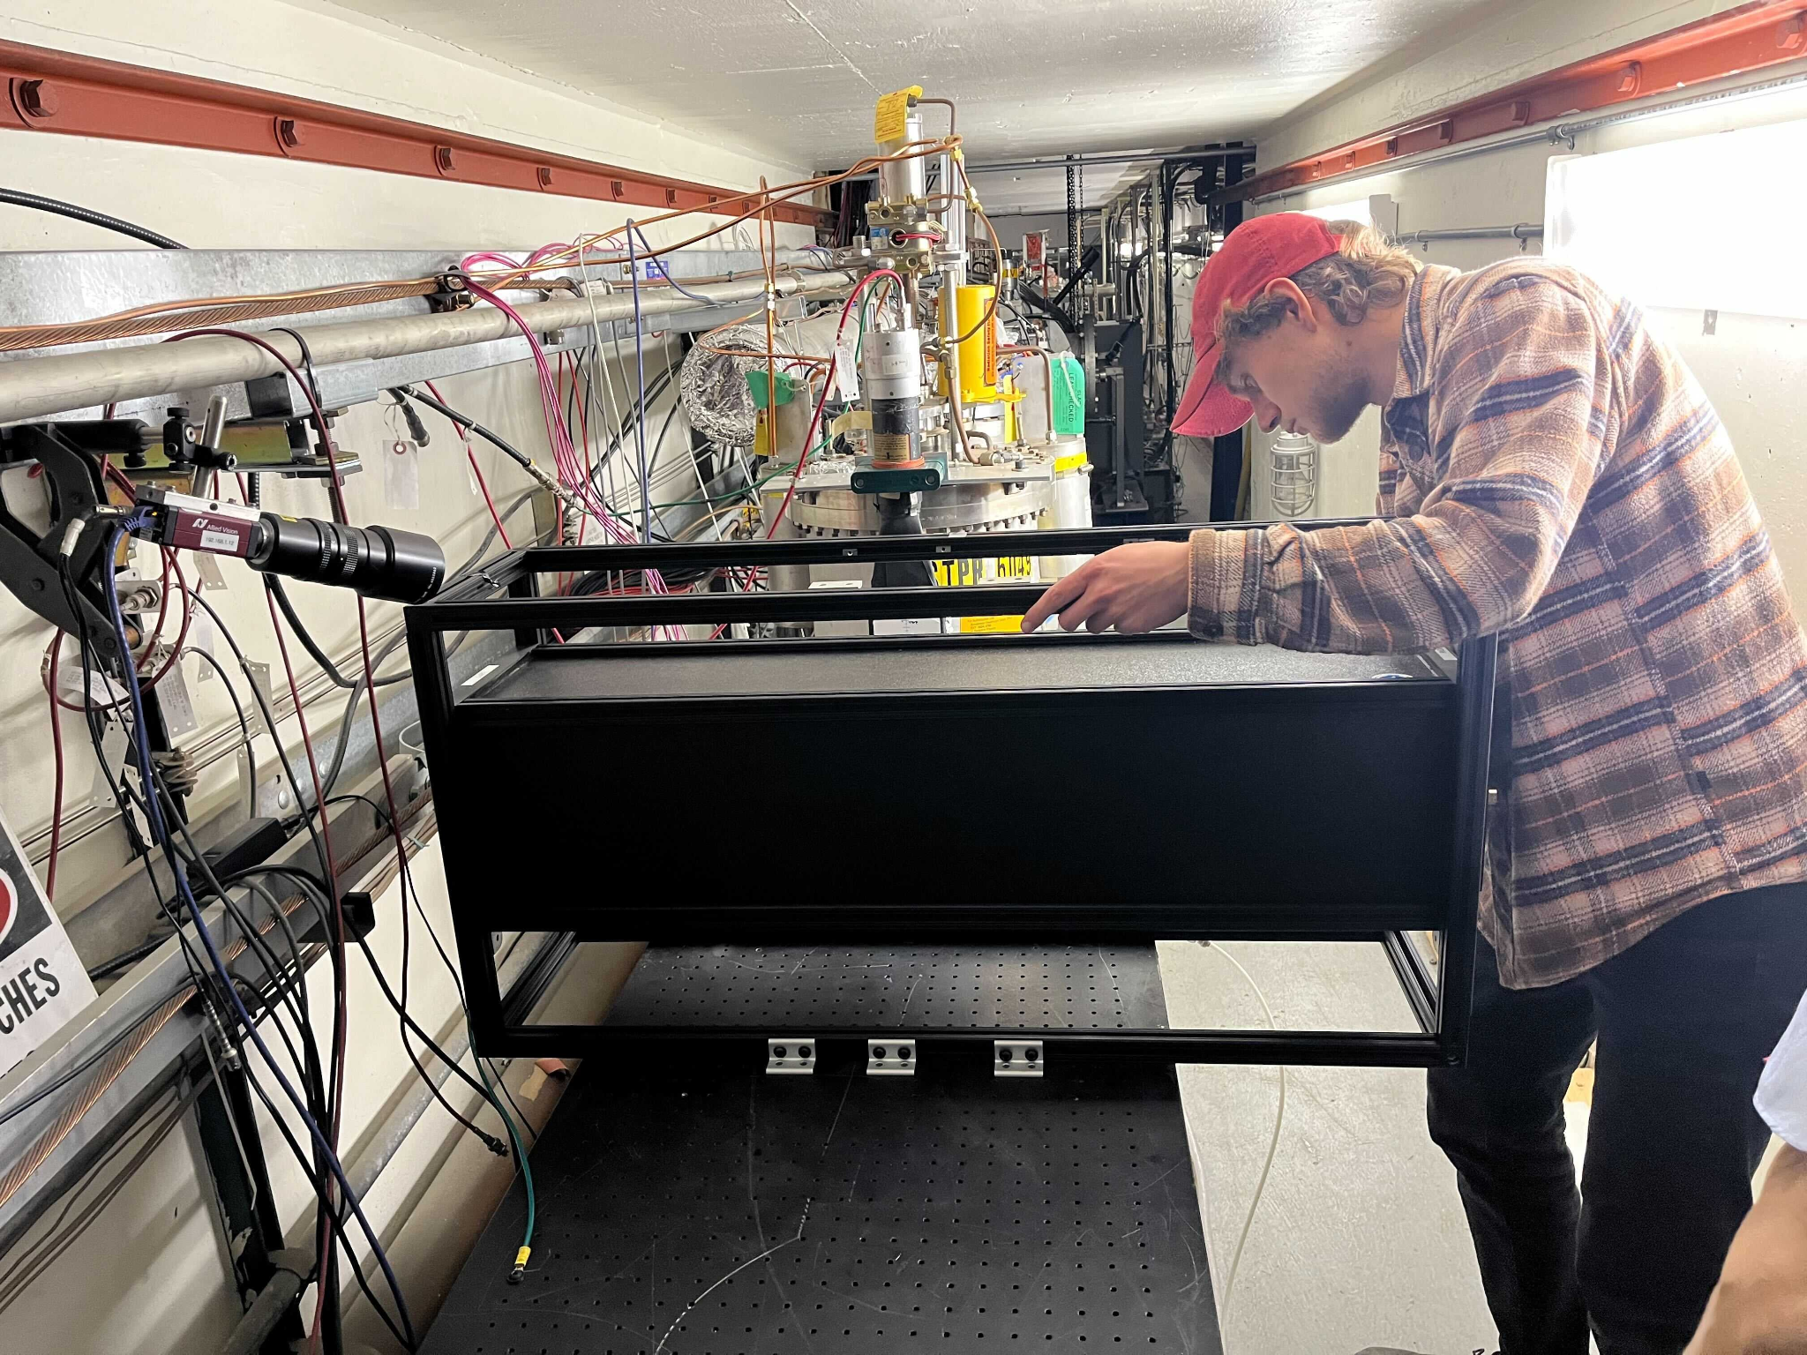


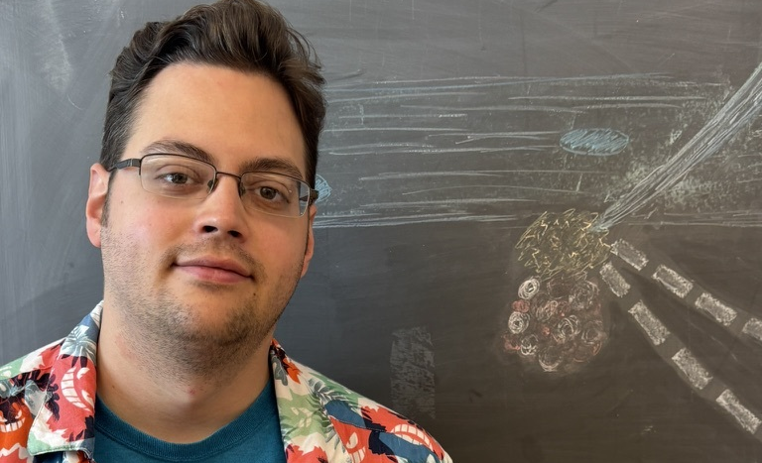
LDMX activities at Lund University
Andreas Pettersson
Slice Test
B. Echenard (Caltech)
H. Herde (Lund)
Torsten Akesson
Verena Hehl
Hannah Herde
Erik Wallin
Ruth Pöttgen
Lene Kristian Bryngemark
CJ Barton (me)

Slide 14
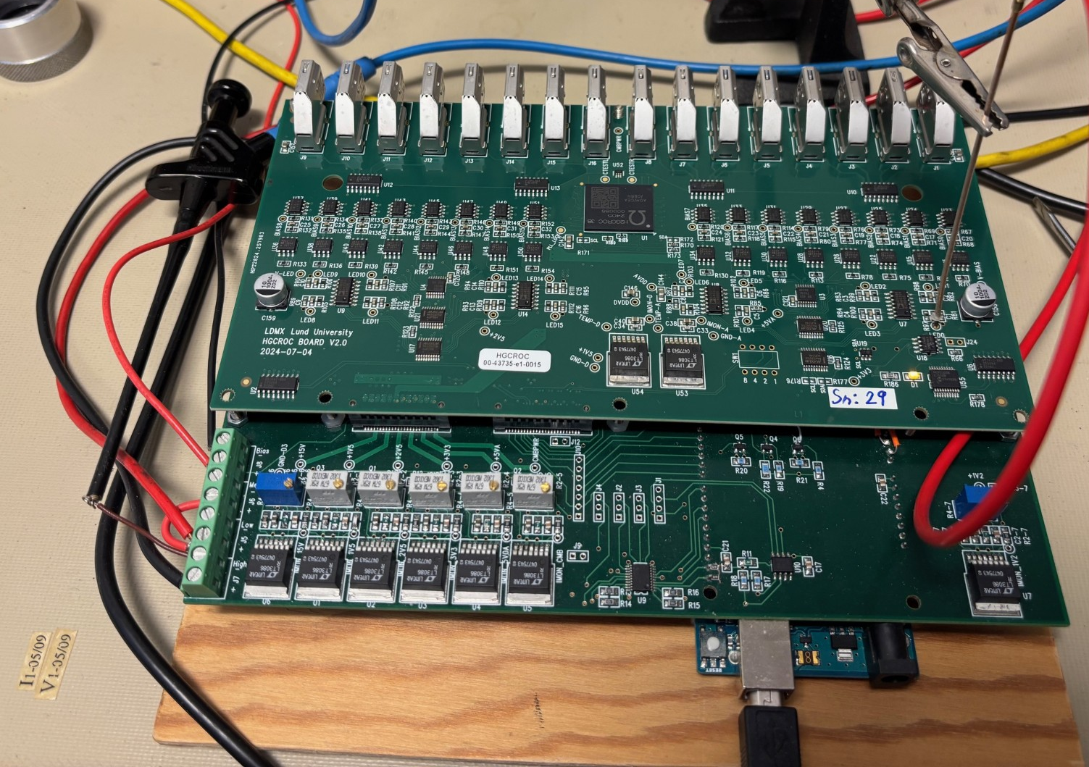
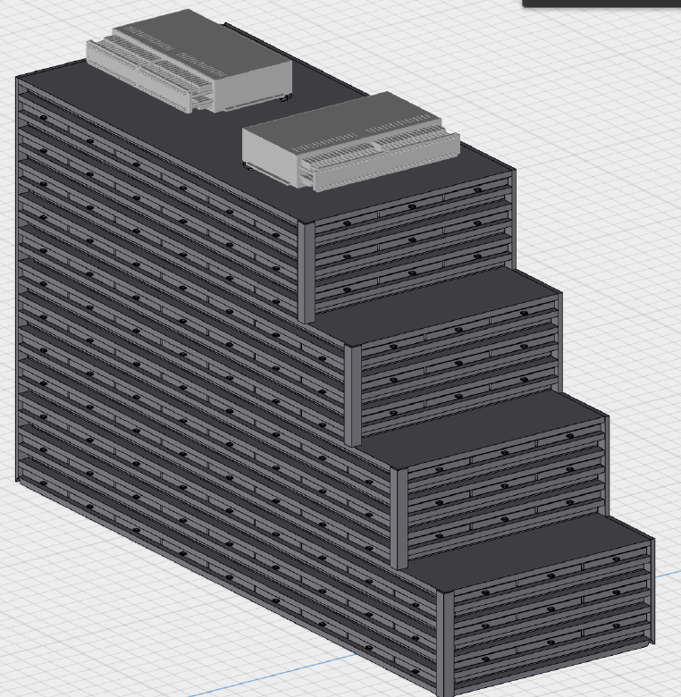
Recent contributions to LDMX from Lund
Electronics for the HCal system
New HGCROC boards (High Granularity Calorimeter Read Out Chip)
Characterization and testing ongoing
Topic of this session’s next talk (A. Pettersson and V. Hehl)

Slide 15
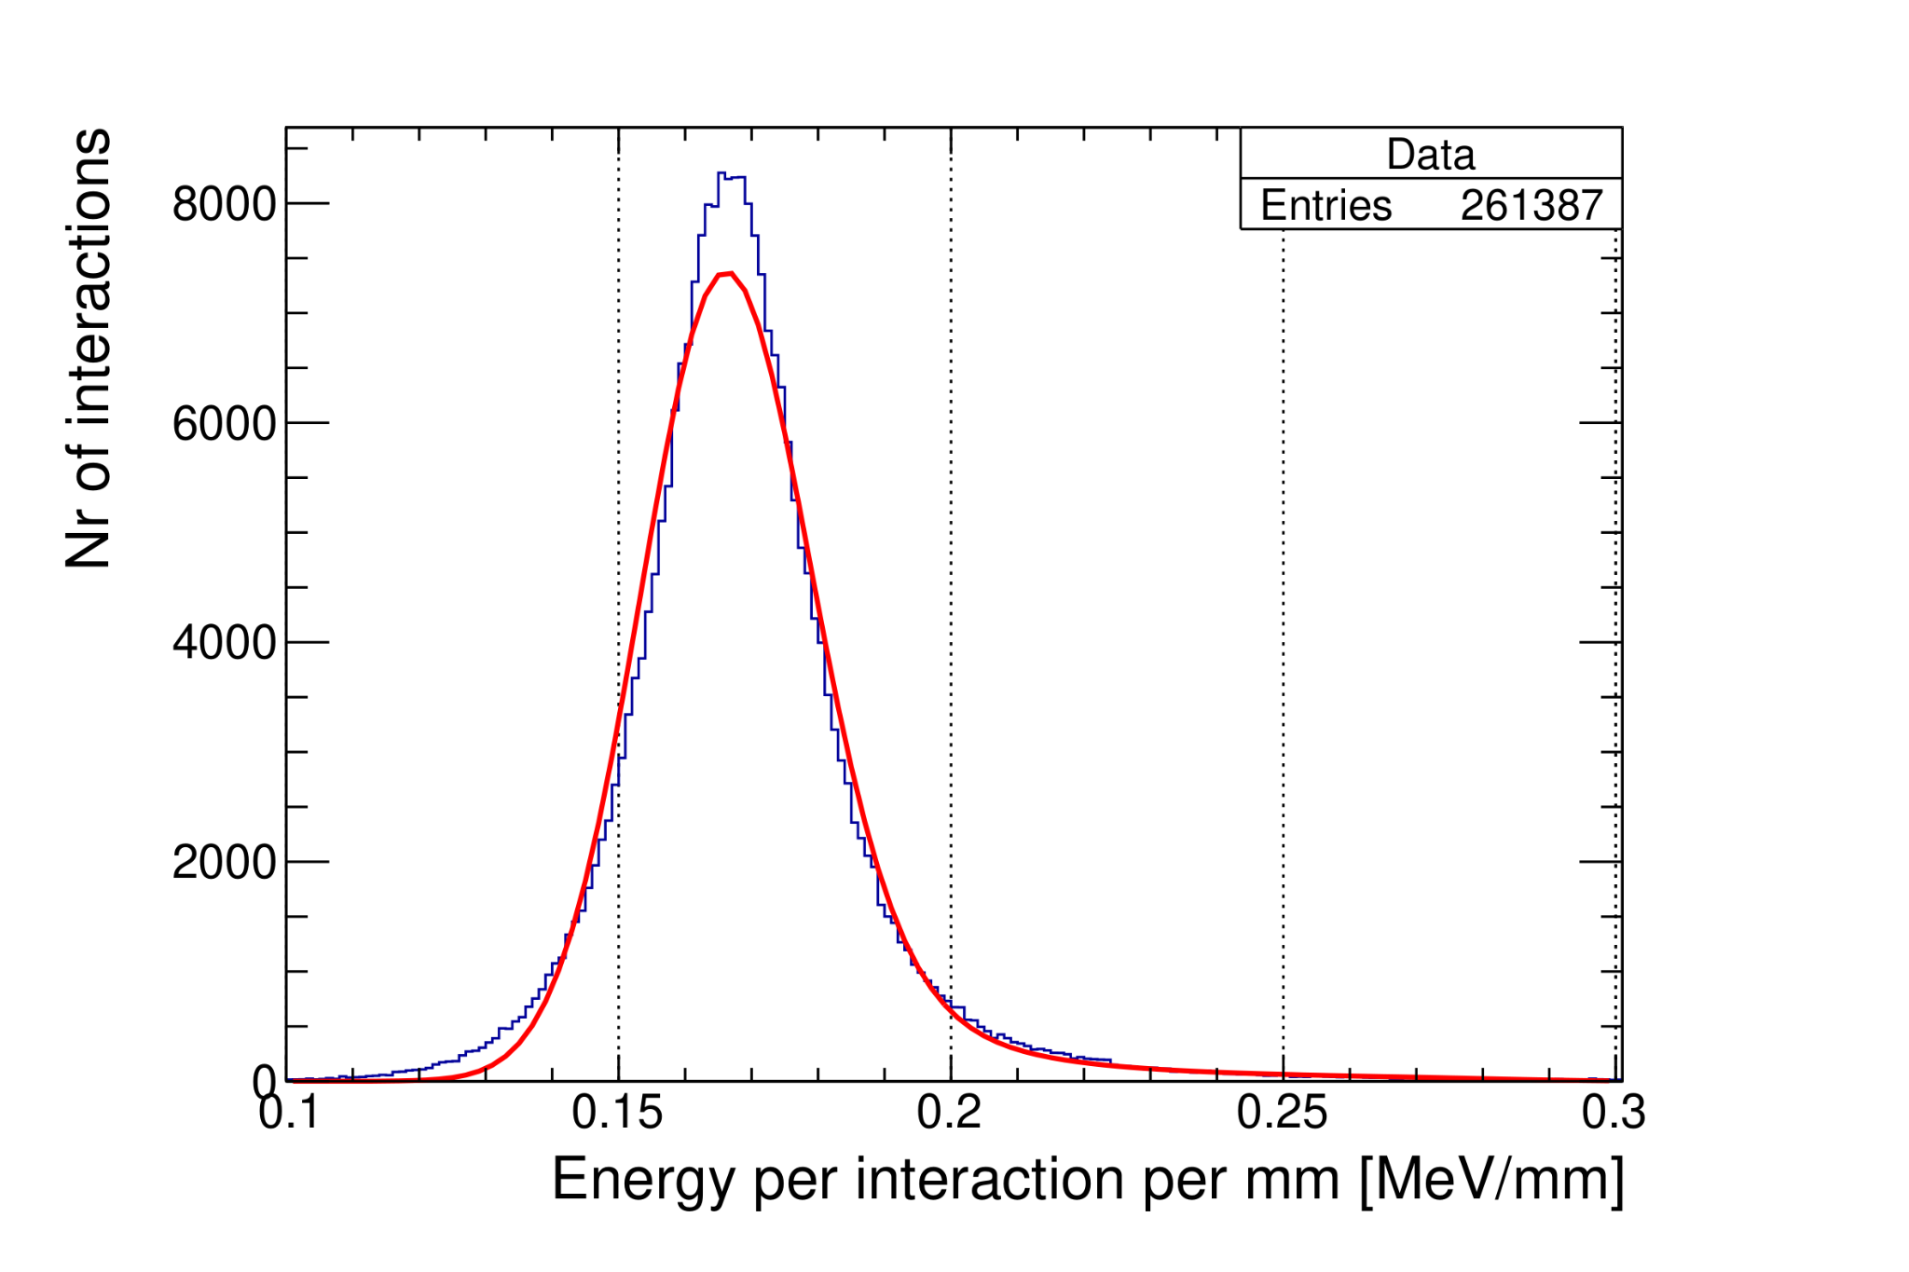
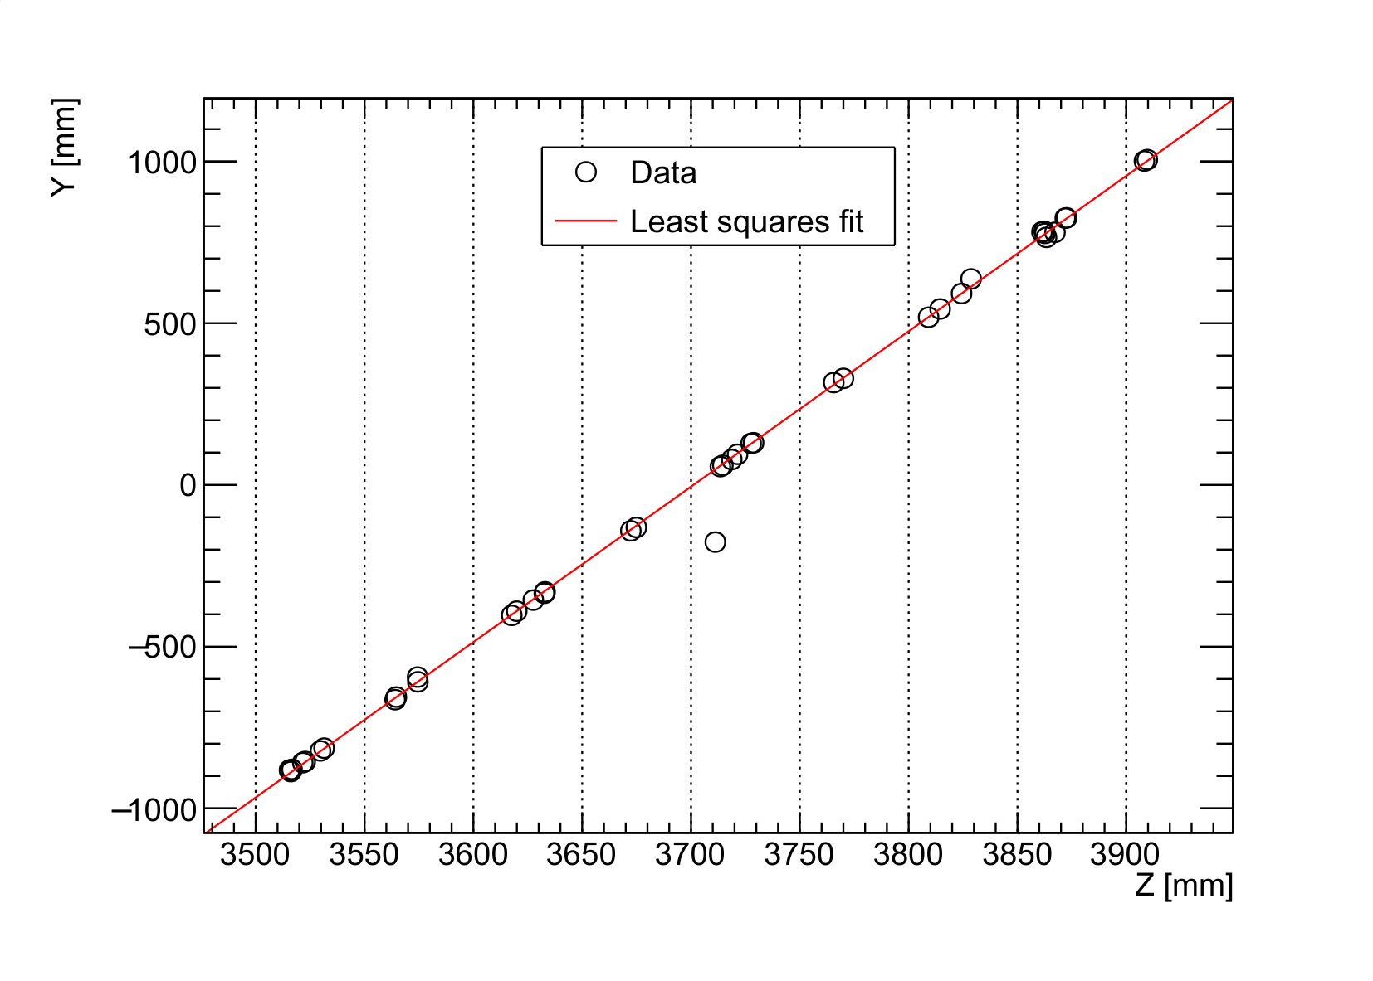
Recent contributions to LDMX from Lund
Cosmics for bar calibration - BsC A. Pettersson
Simulations of HCal cosmic ray calibration

Slide 16
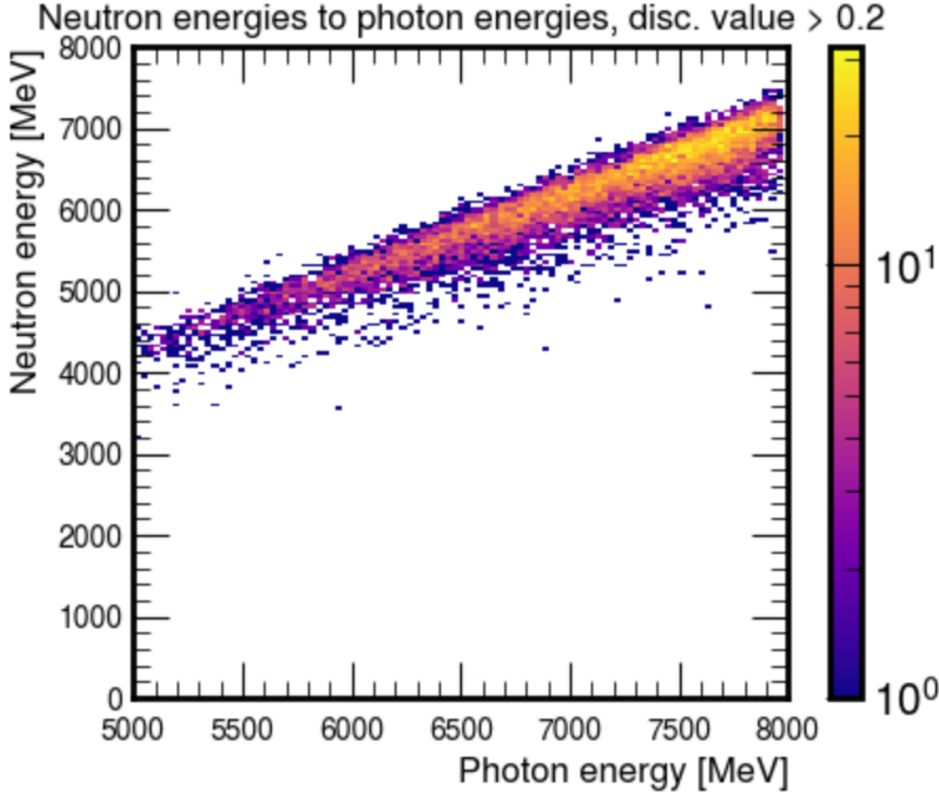
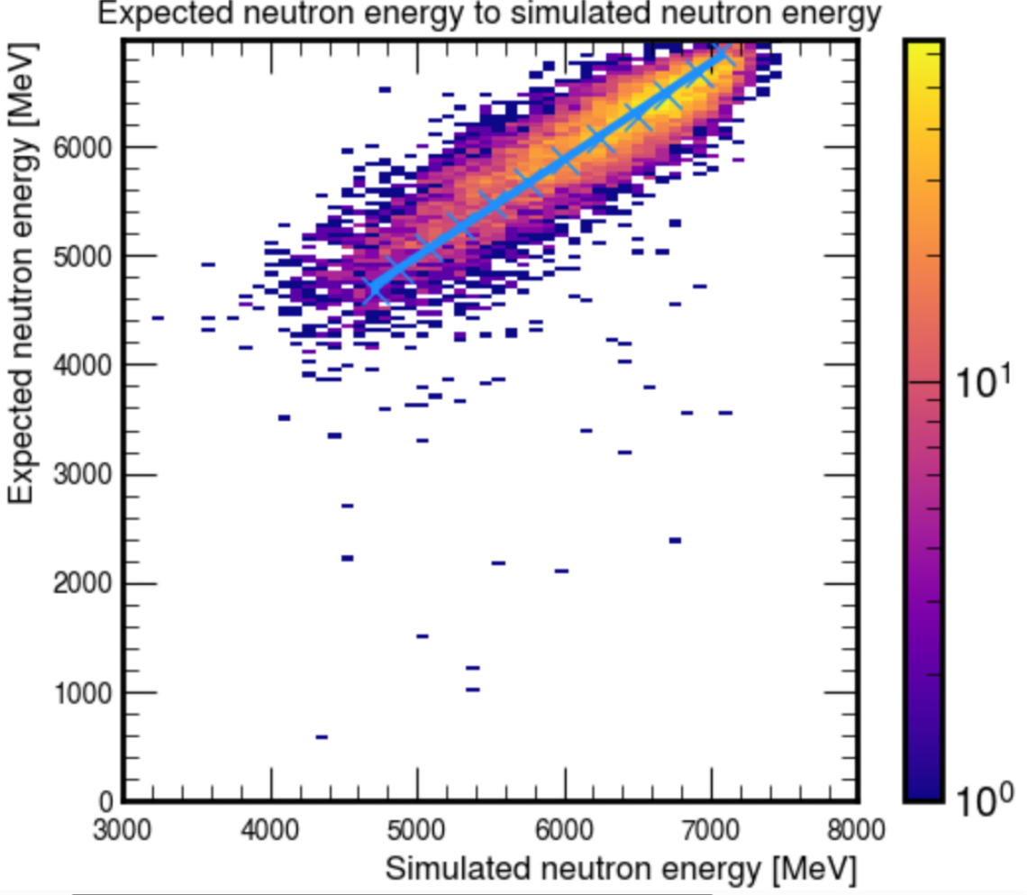
Recent contributions to LDMX from Lund
Single-neutron events for response calibration - MsC D. Sahlberg
Simulations of HCal response to events with high-E single neutrons

Slide 17
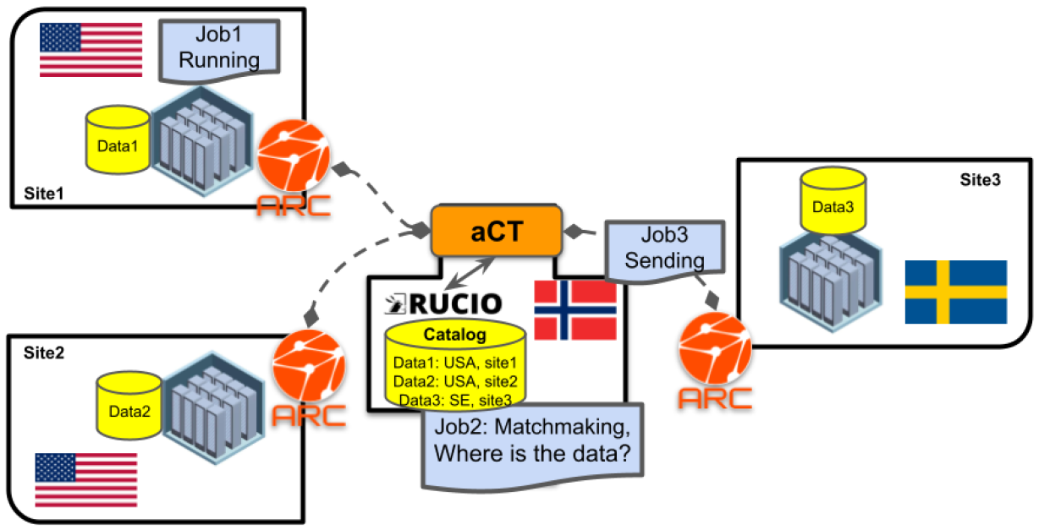
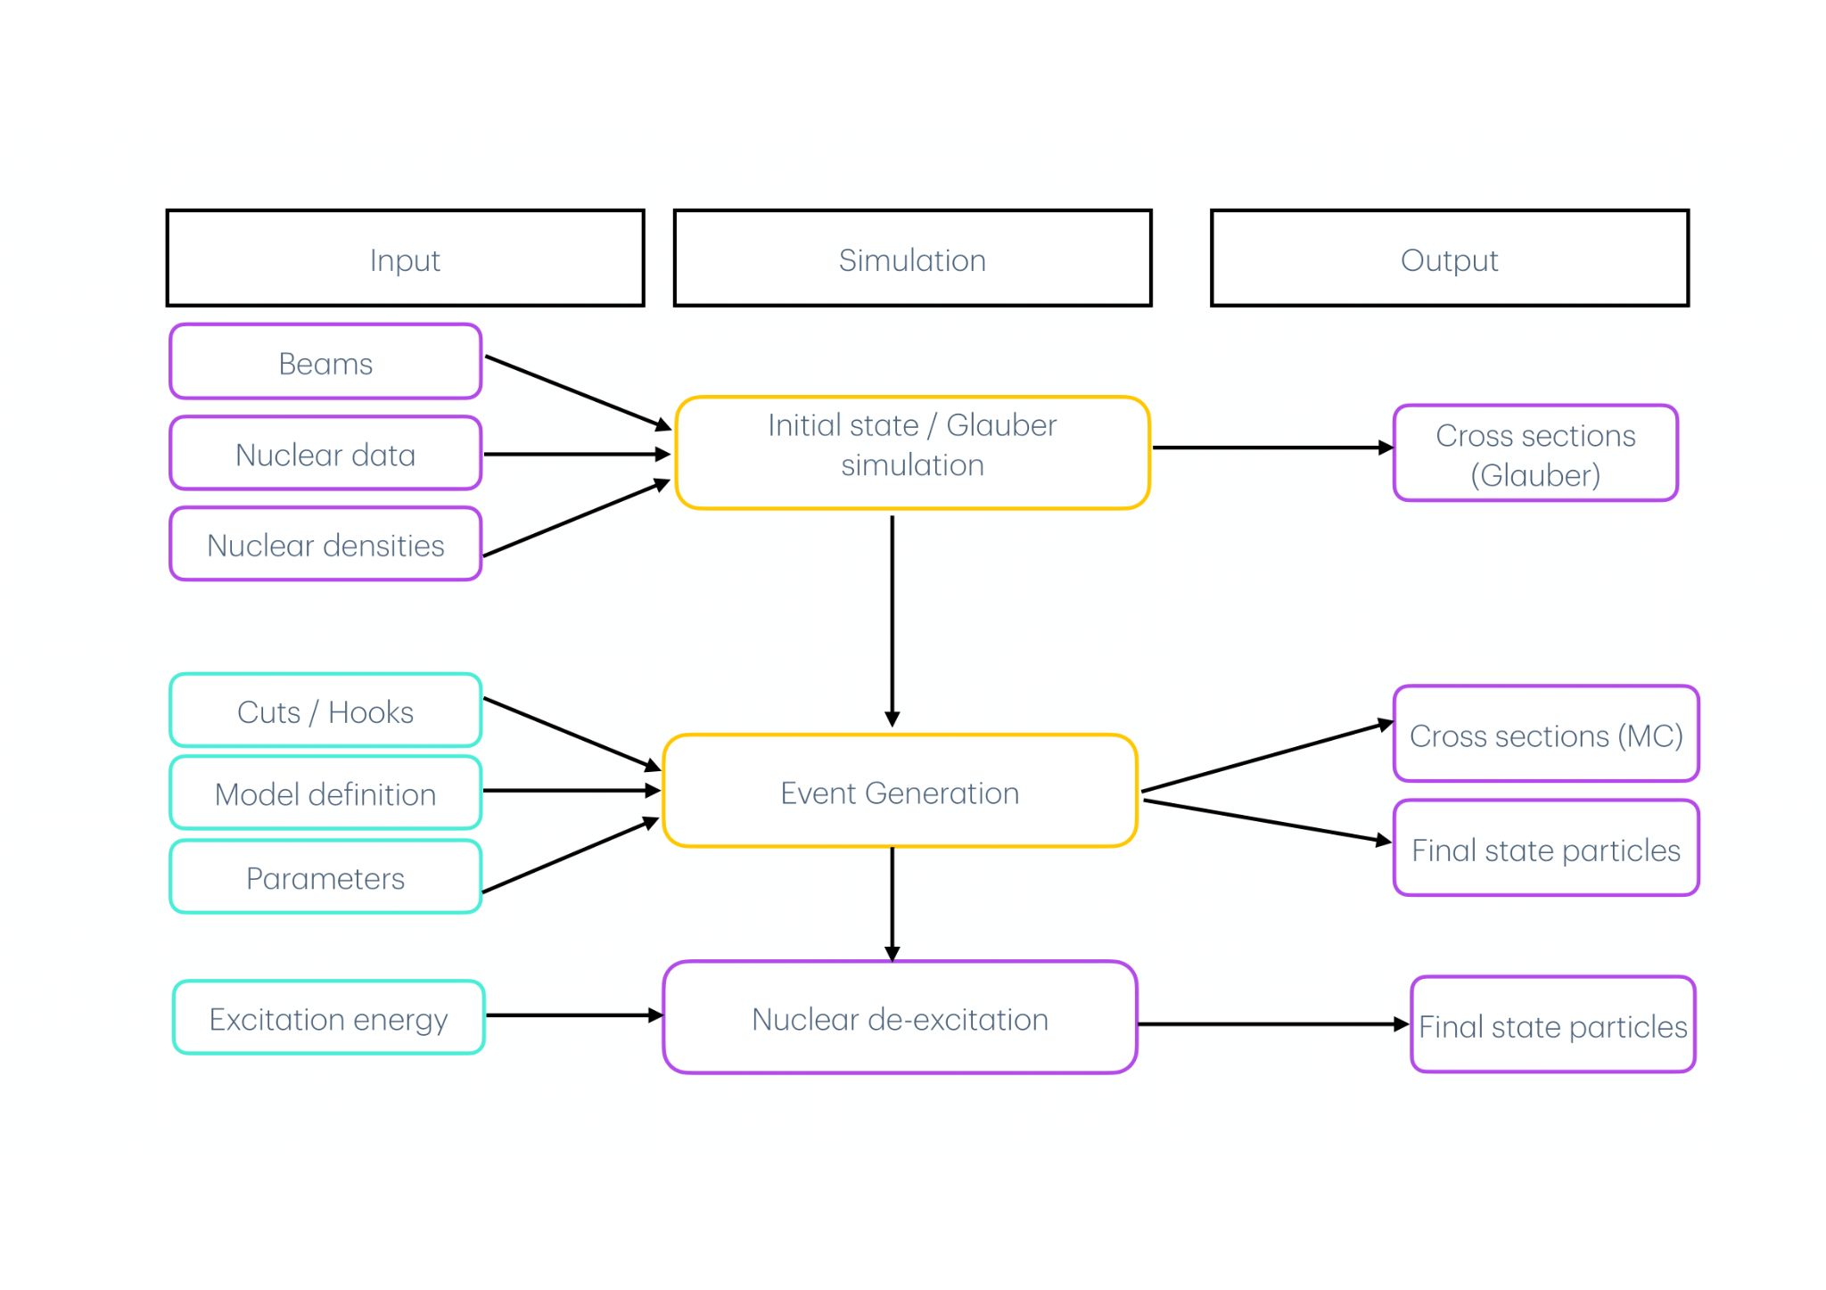


Recent contributions to LDMX from Lund
Software development in the LDMX-SoftWare suite
Simulation geometry updates
Pythia integration into Geant4
Lightweight Distributed Computing System (LDCS)
Simulation production and distribution
User input
Pythia
Geant4

Slide 18
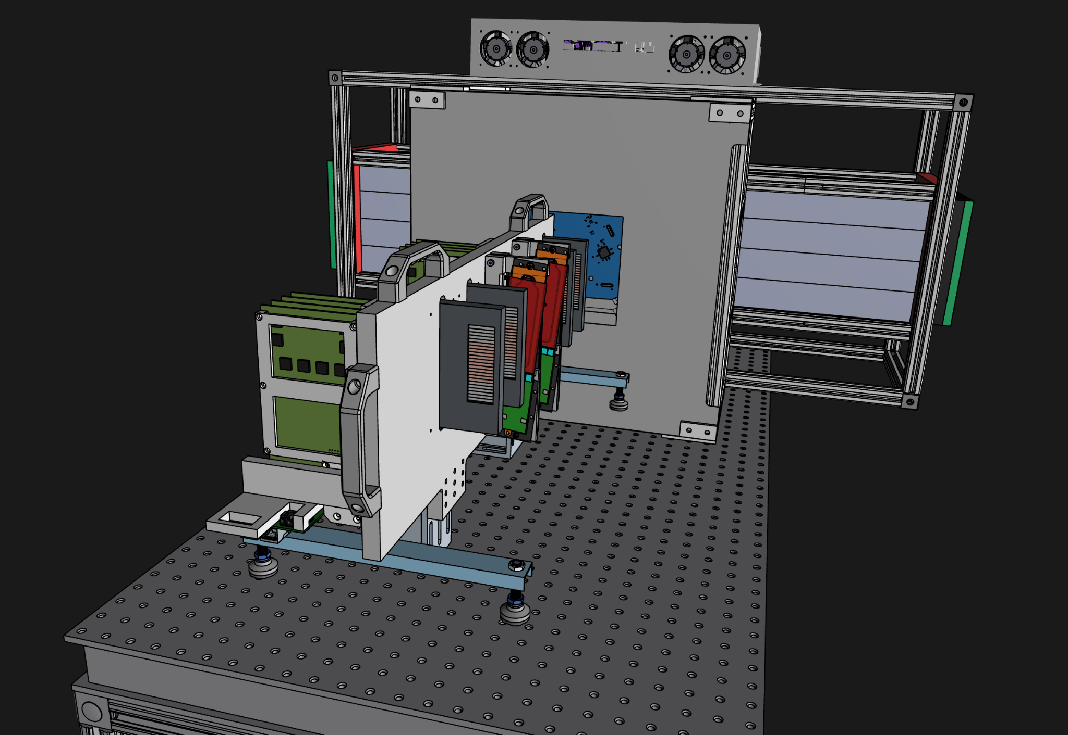
The upcoming prototype/’slice test’ Dec 2025
Next week, LDMX begins taking data with a prototype at SLAC using a 4 GeV e- beam
All detector systems, including latest HCal component prototypes, will be tested in an integrated environment

Slide 19
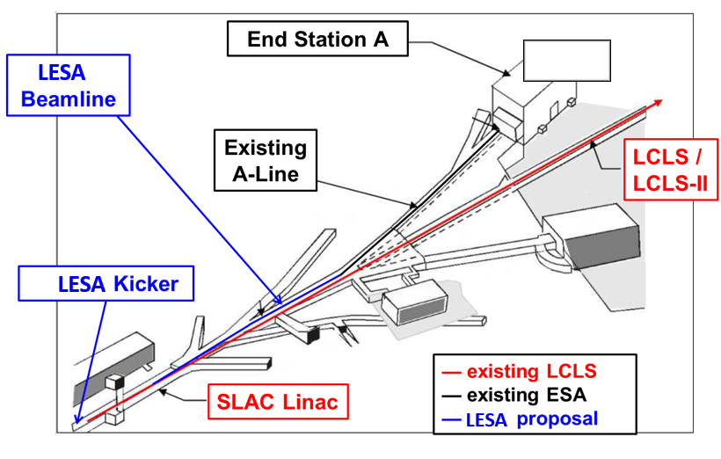
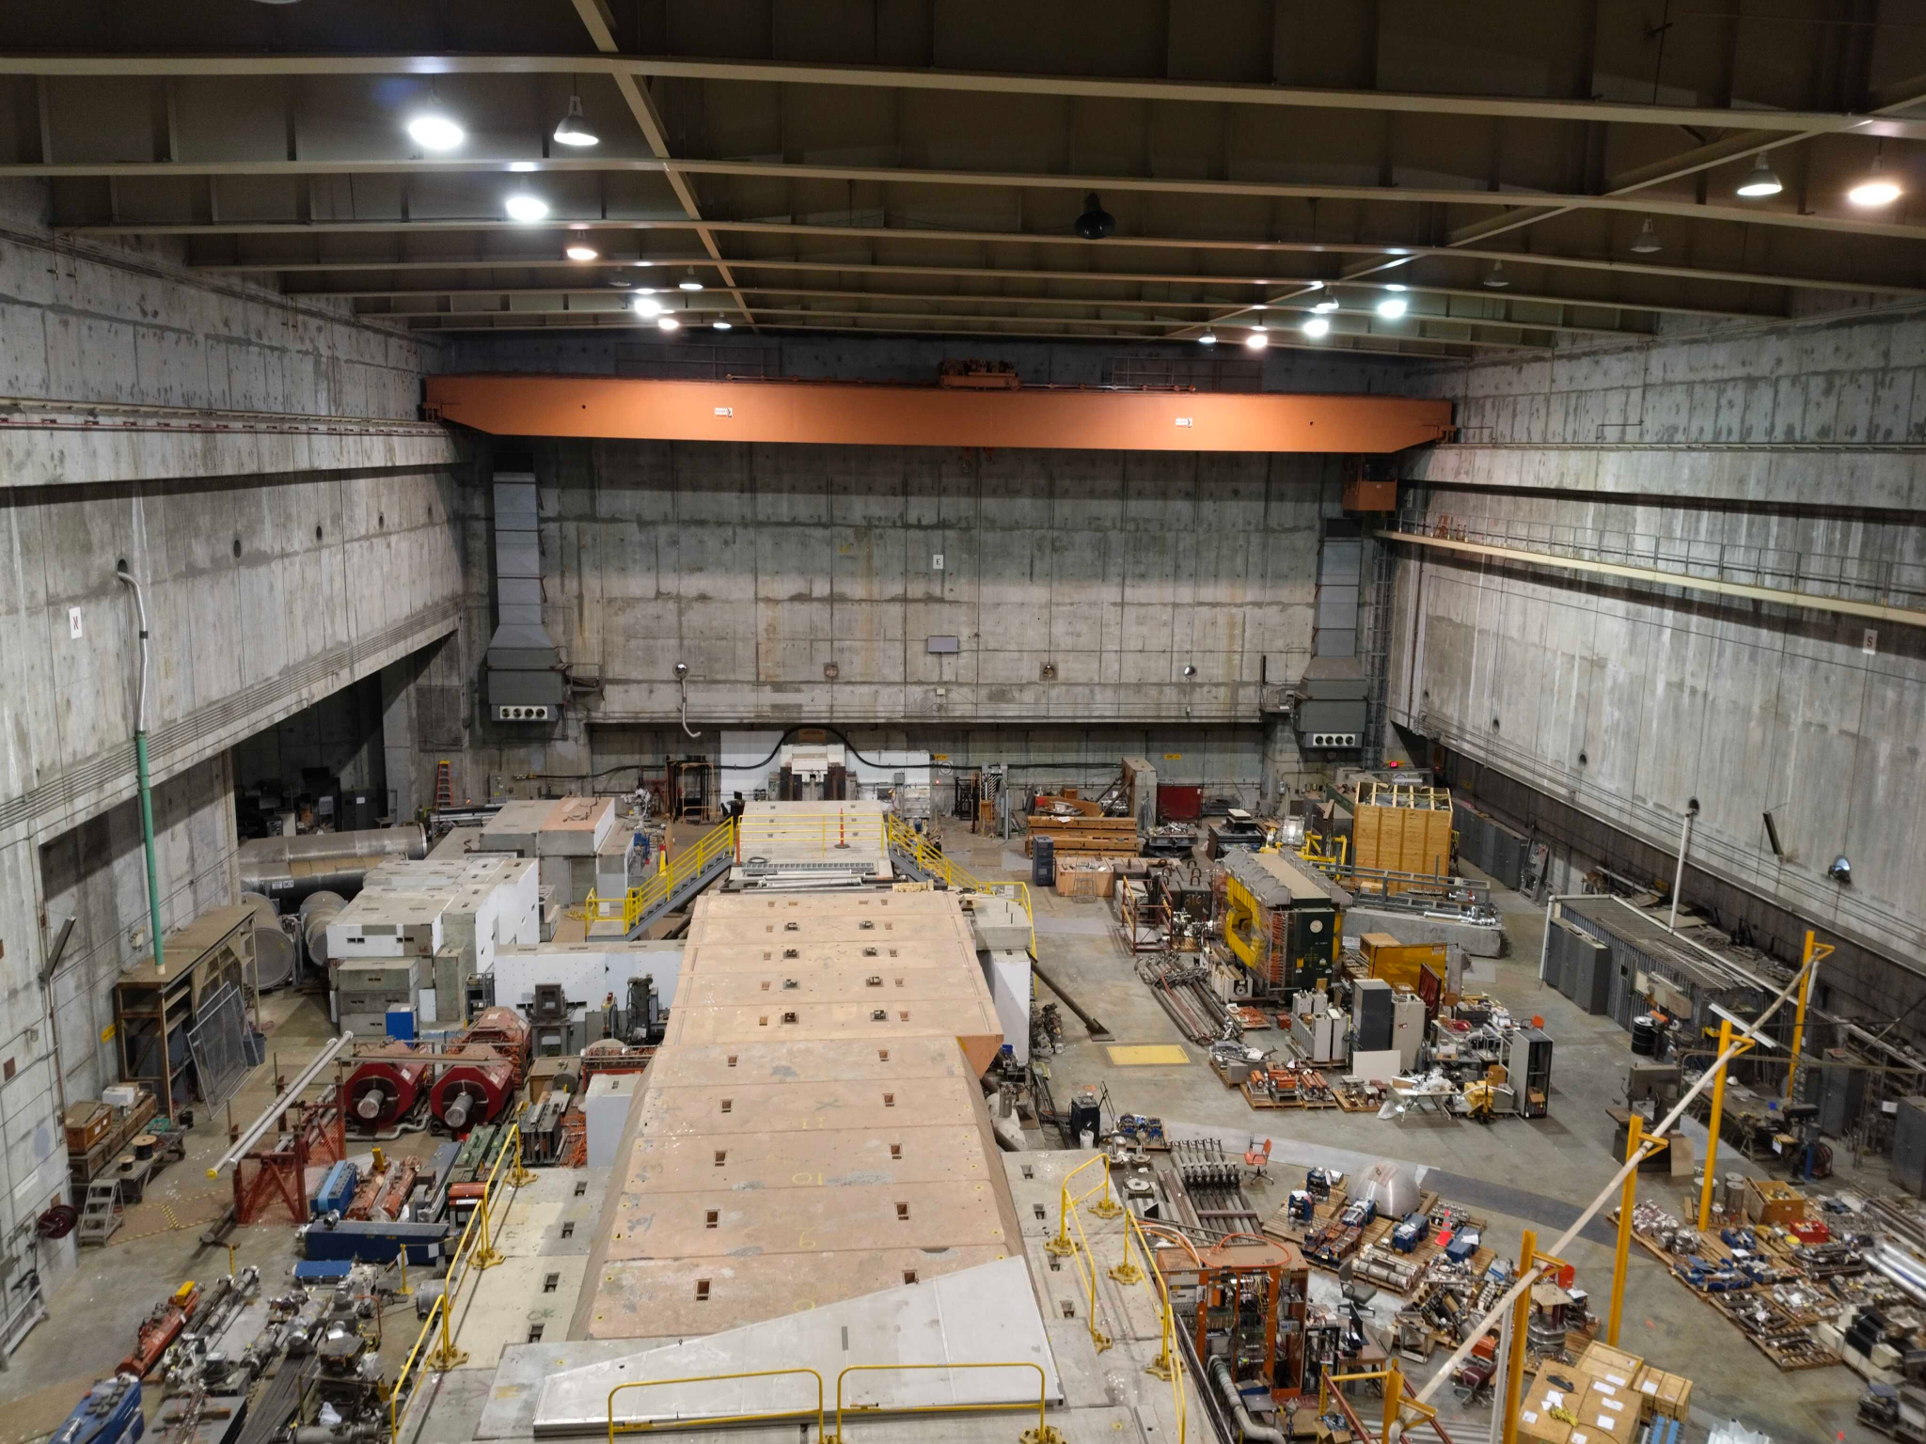
The upcoming prototype/’slice test’ Dec 2025
arXiv:2205.13215
LDMX

Slide 20
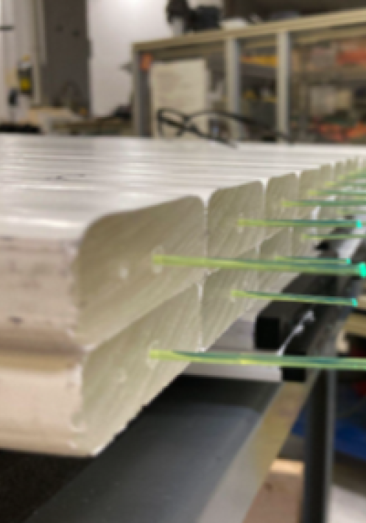
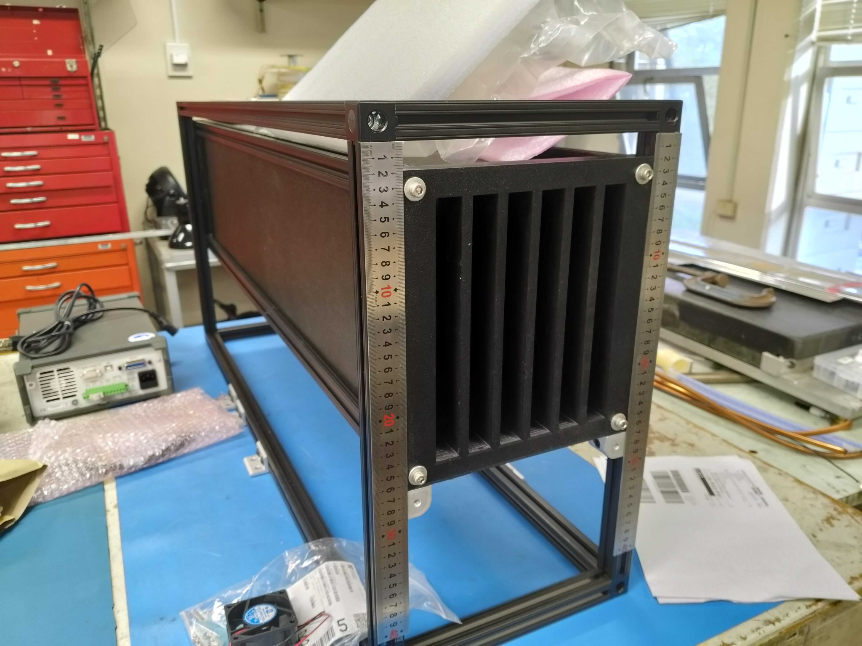
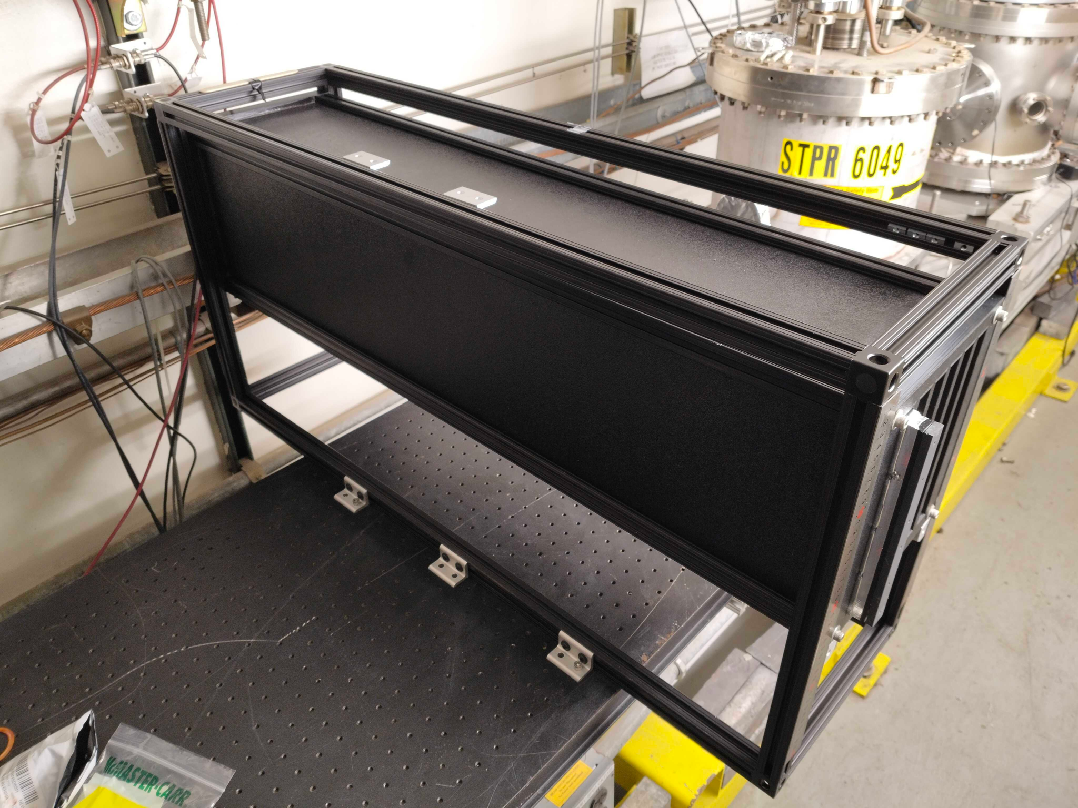
The upcoming prototype/’slice test’ Dec 2025
HCal prototype

Slide 21
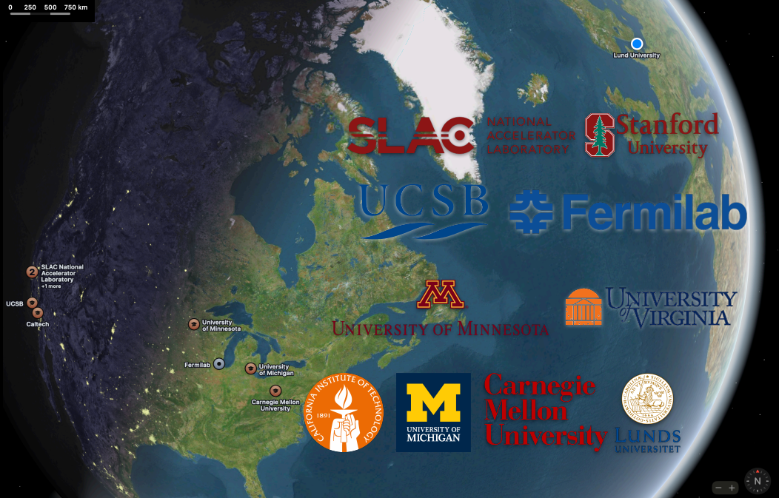
The LDMX Collaboration

Slide 22
Backups

Slide 23
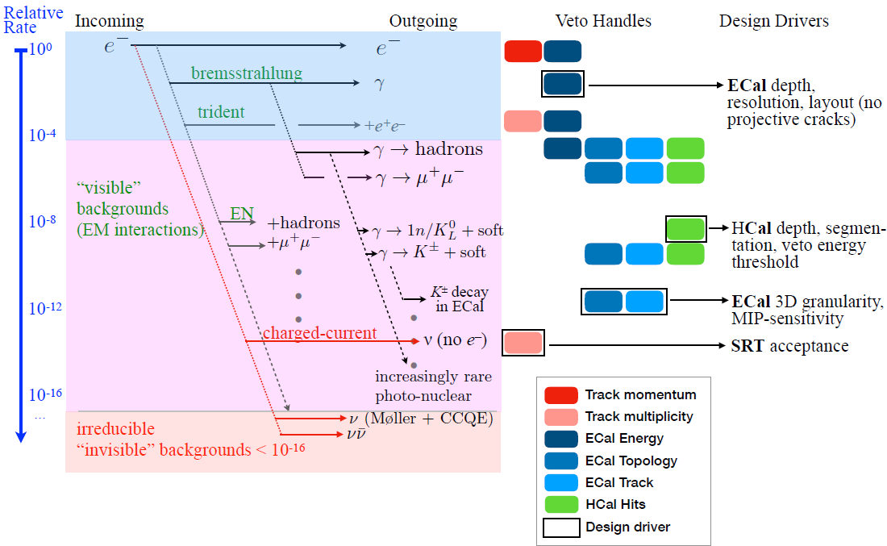
Background discrimination overview
Multiple detector systems work toge- ther to allow ident- ification of all event types

Slide 24
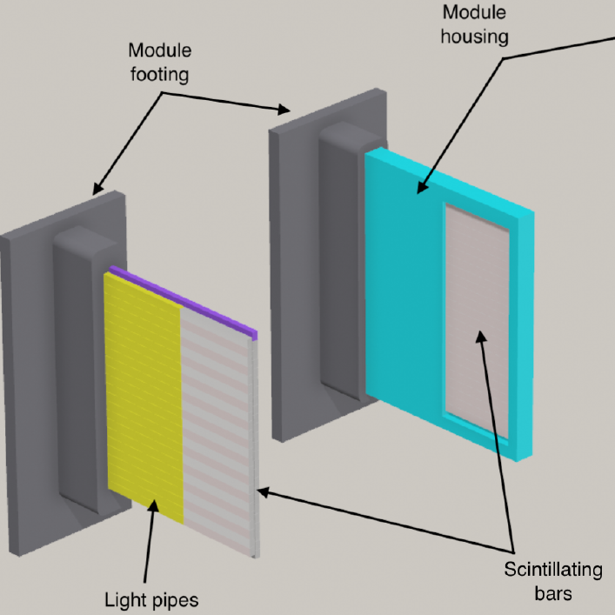
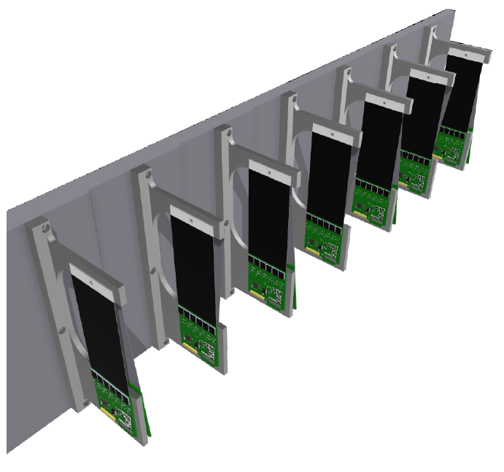
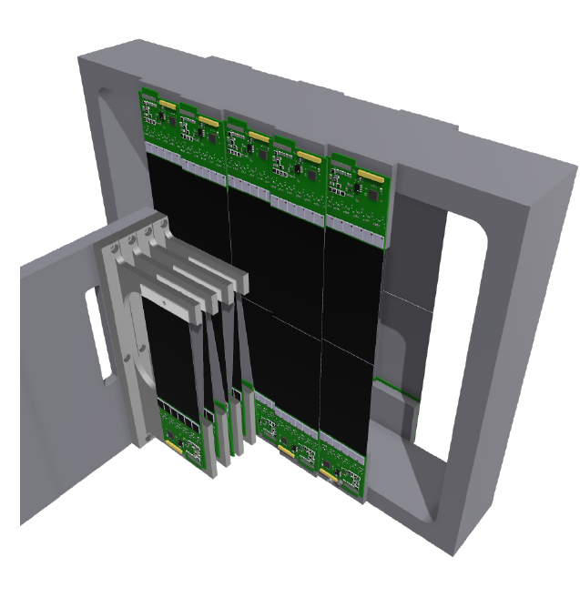
The tracking system
Based on the HPS experiment’s tracking system
‘Trigger scintillator’ pads: timing, count electrons
‘Tagger’ trackers: e- initial state
Target: e- (sometimes) interacts
‘Recoil’ trackers: final state

