Slide 1
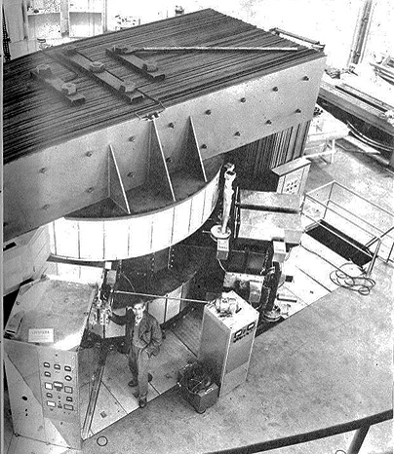
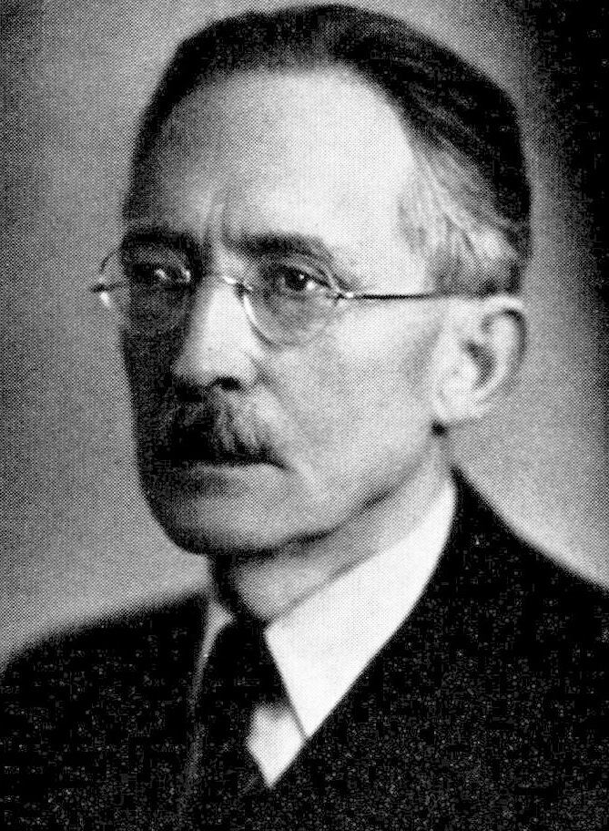
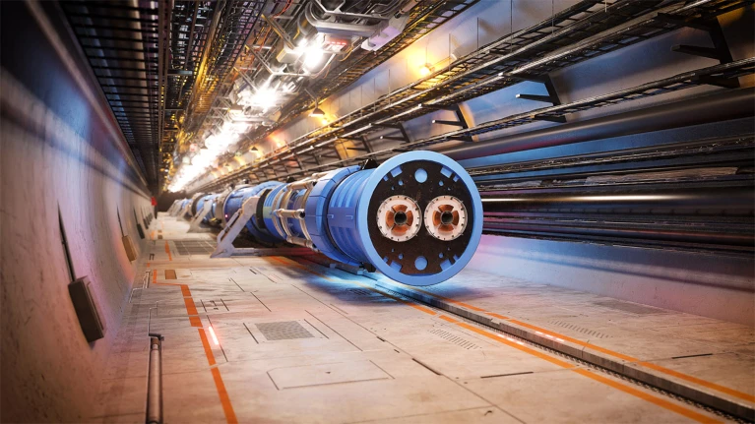
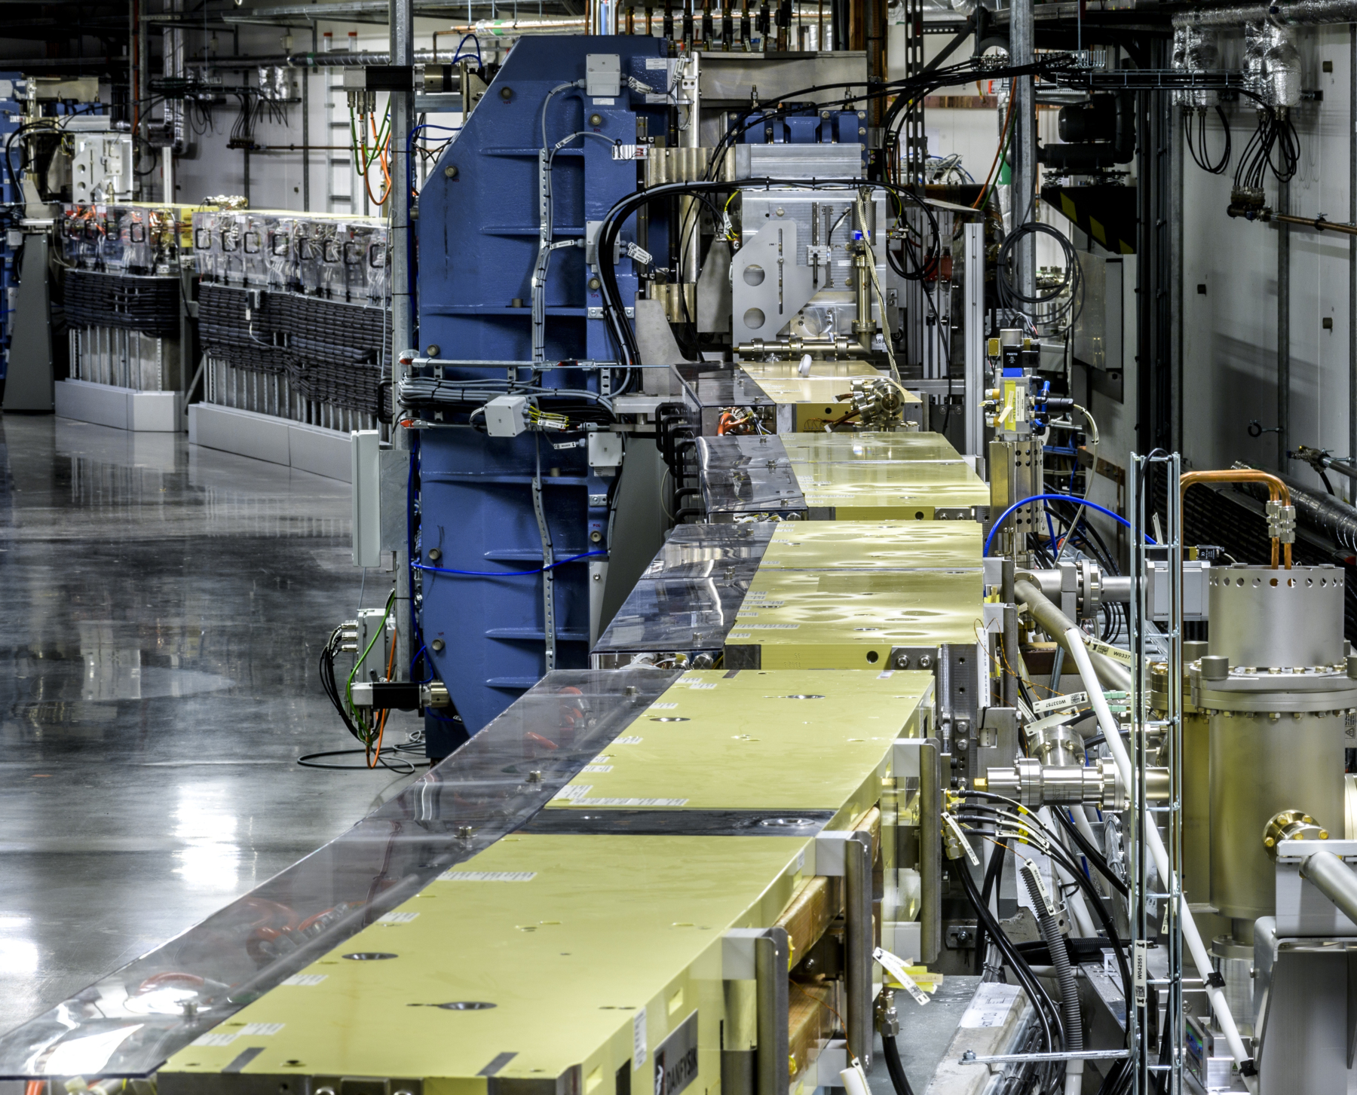
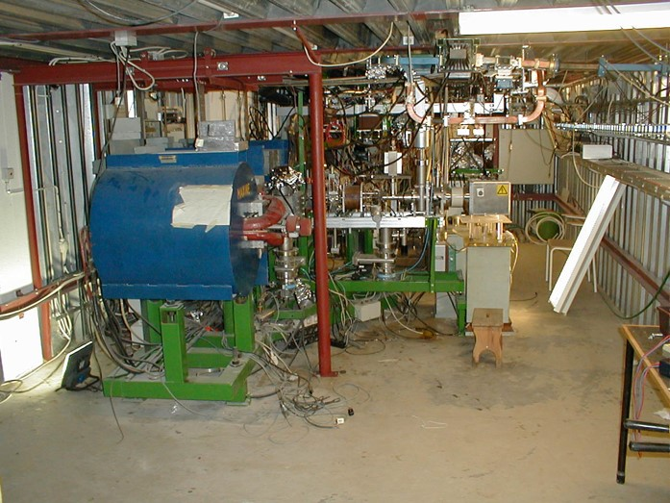
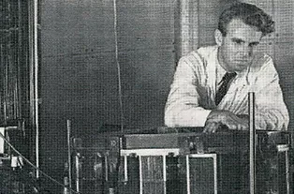
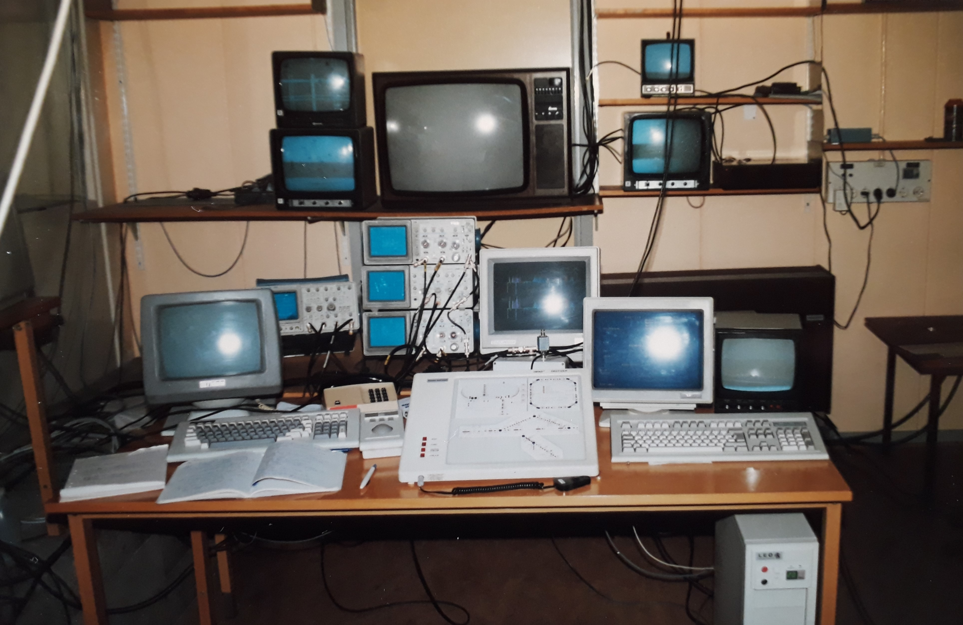
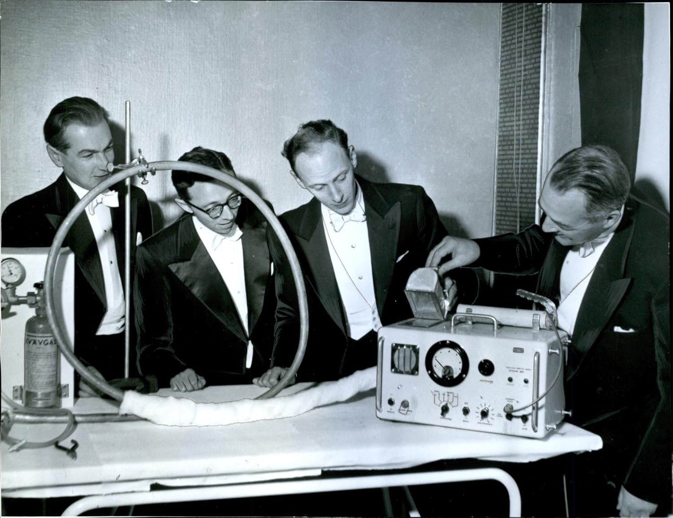
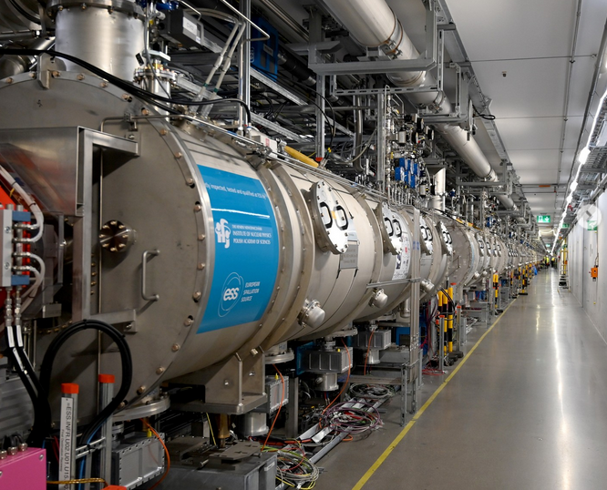
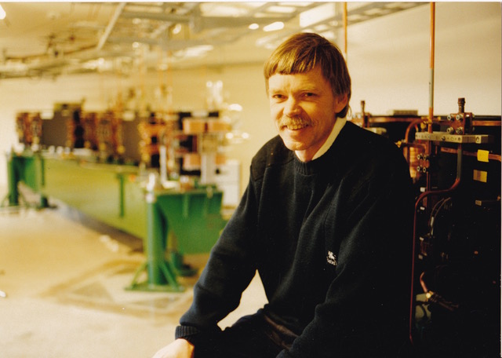
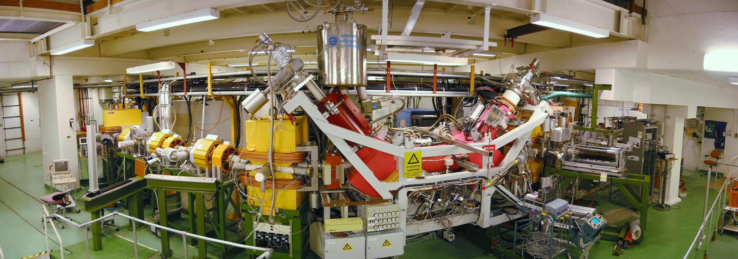
Accelerator physics a new section in SFS
Sverker Werin 24 November 2025
Gothenburg

Slide 2
Perspectives on Accelerator Physics in Sweden
Motivations and ideas for a new section
The new section in SFS
Collaboration and future
Accelerator physics a new section in SFS
Sverker Werin 24 November 2025
Gothenburg

Slide 3
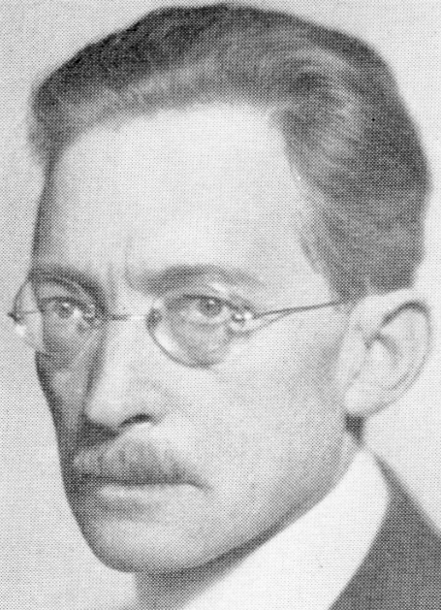
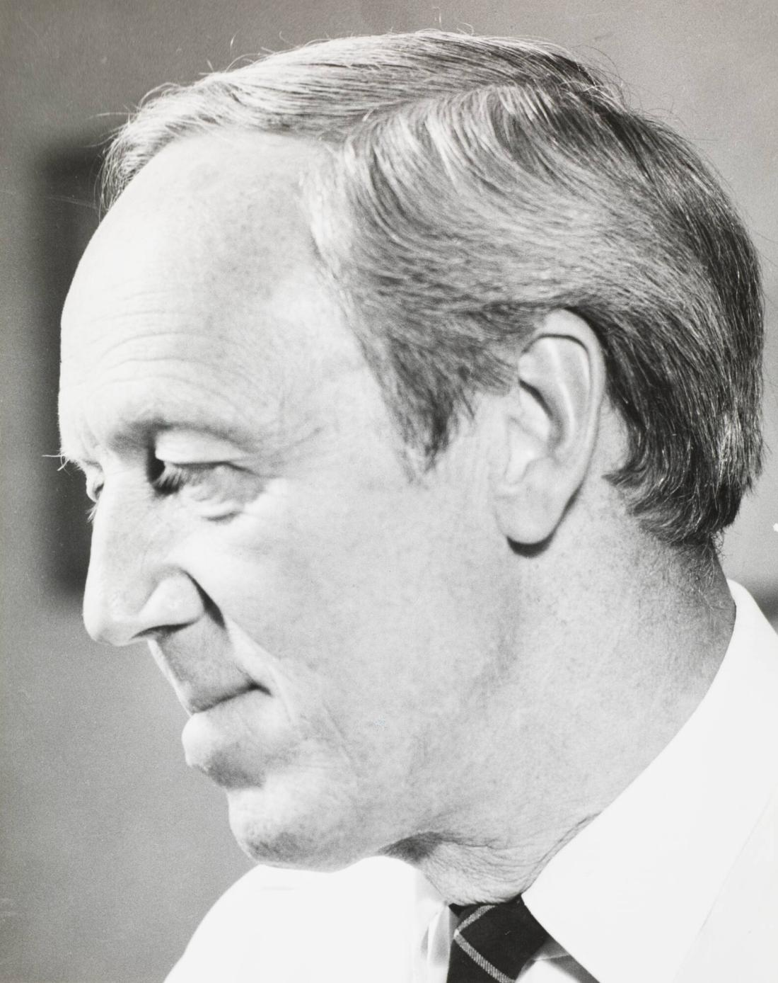
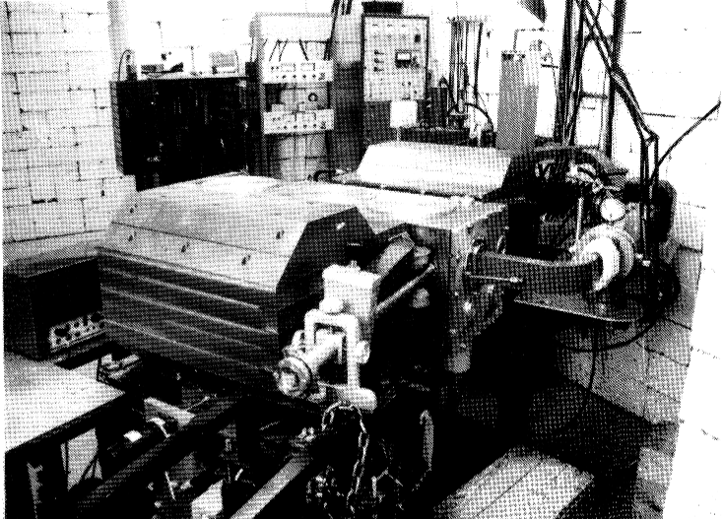
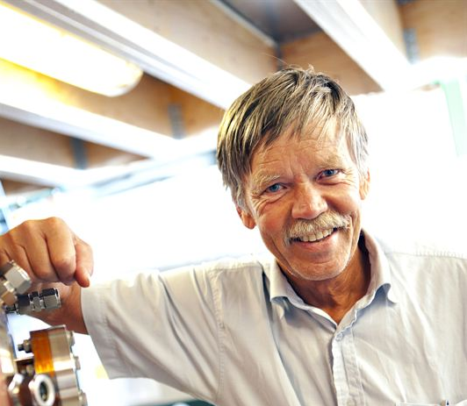
How did Accelerator physics begin in Sweden?
1924
Gustaf Ising
Formulated the idea of alternating fields and drift tubes for accelerating particles.
(Rolf Wideröe built the first device)
Olle Wernholm (under Hannes Alfvén)
1945 Betatron, KTH (Swedens first acc)
1953 Synchrotron 35 MeV, Lund
1962 LUSY (Lund)
1974 RTM 55 MeV (KTH)
1978 RTM 100 MeV (Lund)
Hannes Alfvén
Mikael Eriksson
1978 RTM 100 MeV (Lund)
1985-... MAX I, II, III
2016 MAX IV 1.5 GeV, 3 GeV
Uncle
S. Rosander, M. Sedlacek, O. Wernholm, H. Babic, TIRTA-EPP-81-06, 1981

Slide 4
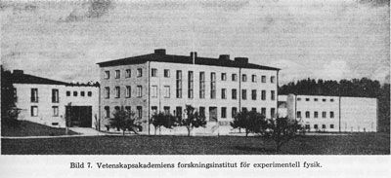
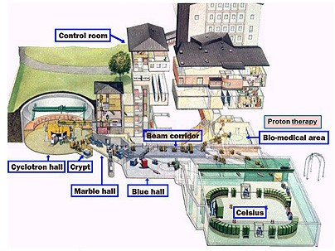
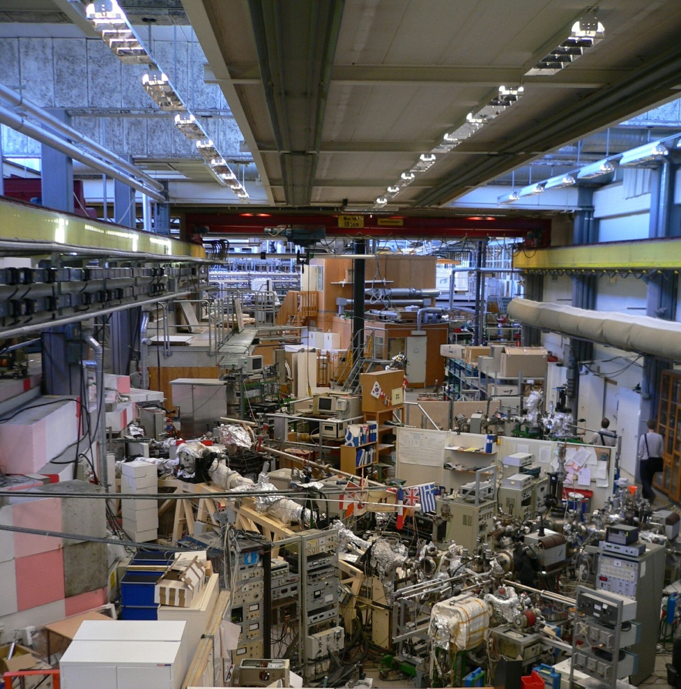
Turn of the century – National laboratories
Manne Siegbahn Laboratory
Stockholm
The Svedberg Laboratory
Uppsala
MAX-lab
Lund
Cryring
The (Gustaf Werner) Cyclotron
Celsius ring
MAX I
MAX II
Decision to end funding to MSL and The Svedberg as national laboratories.
(Onsala, Göteborg)

Slide 5

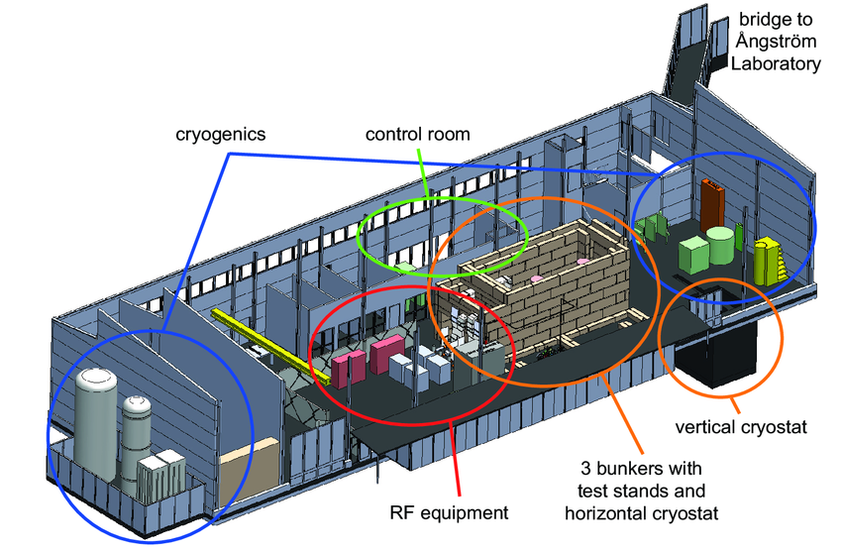
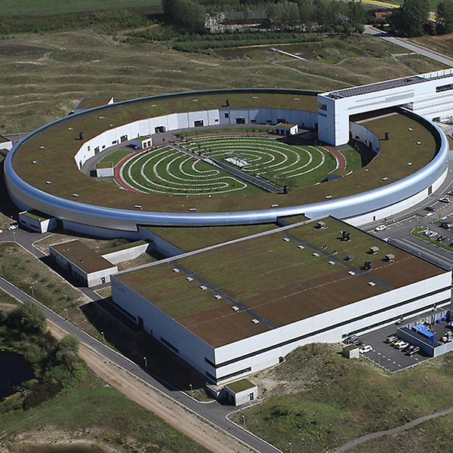
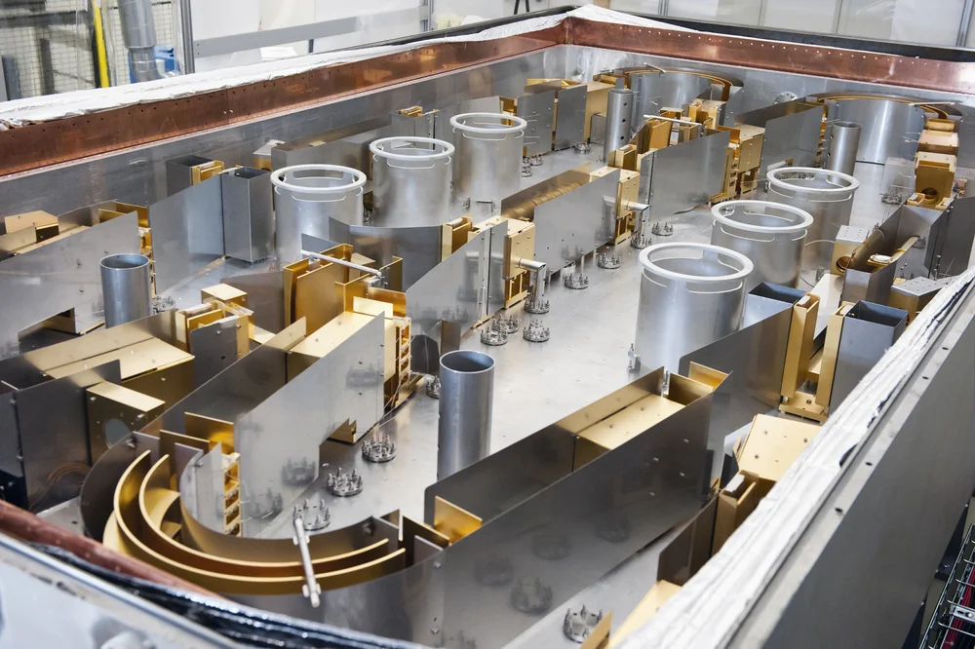
In a new century
Manne Siegbahn Laboratory
Stockholm
The Svedberg Laboratory
Uppsala
MAX-lab
Lund
MAX IV Laboratory
FREIA Laboratory
Cryring -> GSI-FAIR
New DESIREE

Slide 6
Beyond the national accelerator labs
In Sweden
Medical:
Electron accelerators (X-rays, electrons)
Proton accelerator (Skandion, Uppsala)
Cyclotrons (Radionuclide production)
Novel schemes
Laser plasma acceleration LWFA
Particle plasma acceleration PWFA
Industry
Scanditronix
Scandinova
...
International commitments based on accelerators
ESS, ESSnuSB
CERN: LHC, HL-LHC, FCC, LCF, CLIC,
Muon collider
GSI-FAIR (Cryring)
EuXFEL
DESY: PETRA III (IV)
ESRF

Slide 7

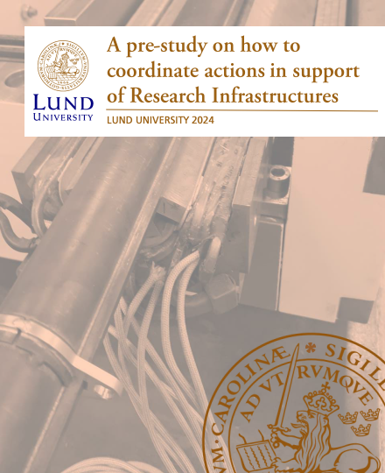
Support the base of Research Infrastructures
Research bill
Strategic research areas
Invest in RI
Report
Strategy support develop RI
Platform
Research institute
Roles by swedes in boards and councils
SCIENCE
RI

Slide 8
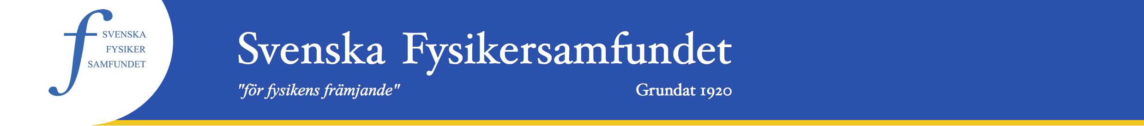
Section for Accelerator Physics
We need platforms for development and collaboration

Slide 9
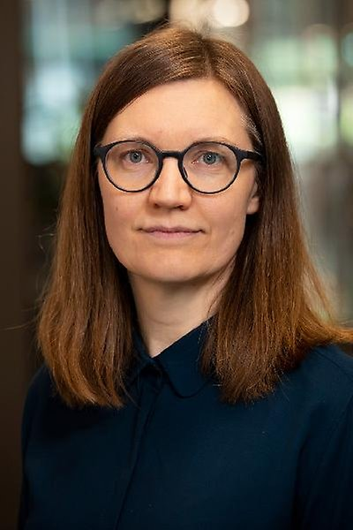
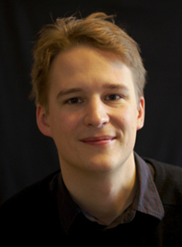
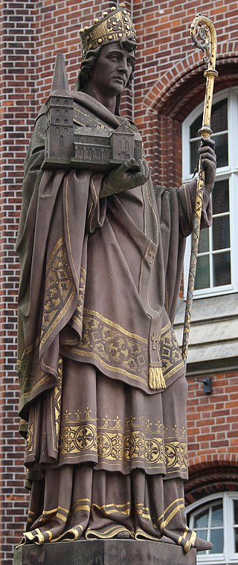
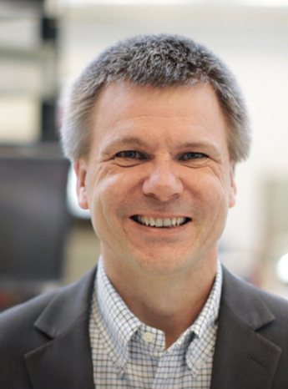
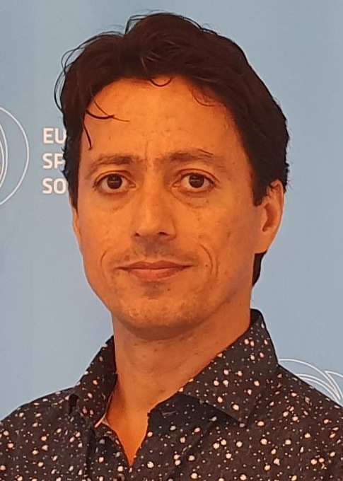
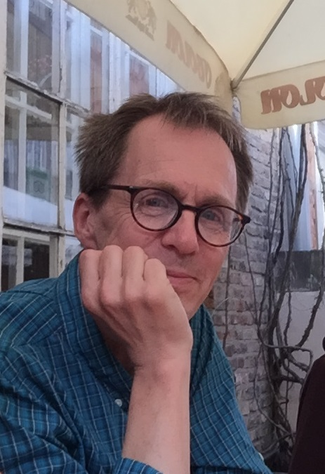
Section for Accelerator Physics, the Board
Olle Lundh, Lund University
Ansgar Simonsson, Stockholm University
Secretary
Maja Olvegård, Uppsala University
Mikael Lindholm, Scandinova
Mamad Eshraqi, ESS
Sverker Werin, Lund University/MAX IV
Chair

Slide 10
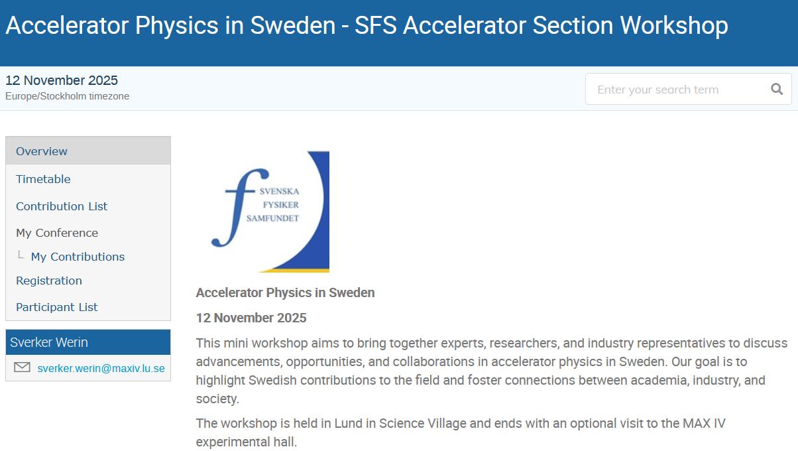
Workshop 12 November 2025, Lund
≈ 40 participants
ESS, MAX IV, DESIREE, FREIA, Plasma
Statistical properties of FEL
Diagnostics using ML
Vacuum arc breakdowns
Liouvillian proton injection
ESSnuSB, MAX 4U, FCC & LCF
ScandiNova, Skandion/IBA, BiSS
Discussion: The Future of Accelerator physics in Sweden
indico.maxiv.lu.se/event/5683
2026 @ Partikeldagarna????

Slide 11
Section for Accelerator Physics
Platform
Lift Accelerator Physics (teaching, research, impact, collaboration, funding...)
Role in Research Infrastructures
MAX IV and ESS made Swedish Accelerator Physics global, but there is much more!
➔ Collaborate more to Particle physics
Gain impact with more accelerator physics
Sweden can enter at another phase in projects
Improve connection instruments to accelerators
Increase “pay-back”, gain funding support
Let’s discuss how we get there!

Slide 12
END

