Slide 1



Novel Spiral tuning technique for metamaterial based cavity in axion dark matter searches.
Jacob Lindahl, Stockholm University

Slide 2
Outline of Talk
Why the Axion?
Haloscopes
Why Higher Mass?
Plasma Haloscopes
The Spiral Design
Prototype and Results
Dark Photon Run

Slide 3
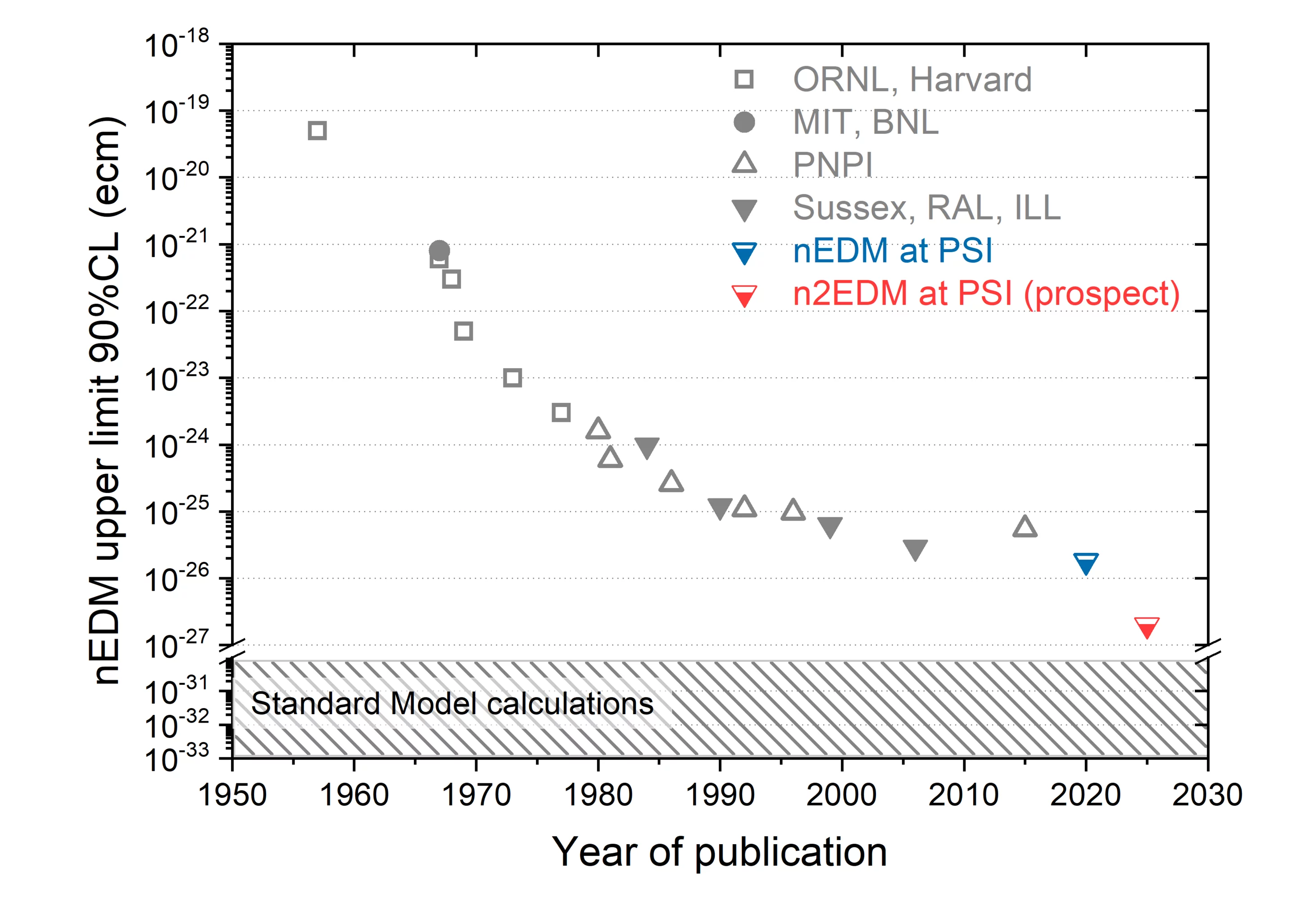
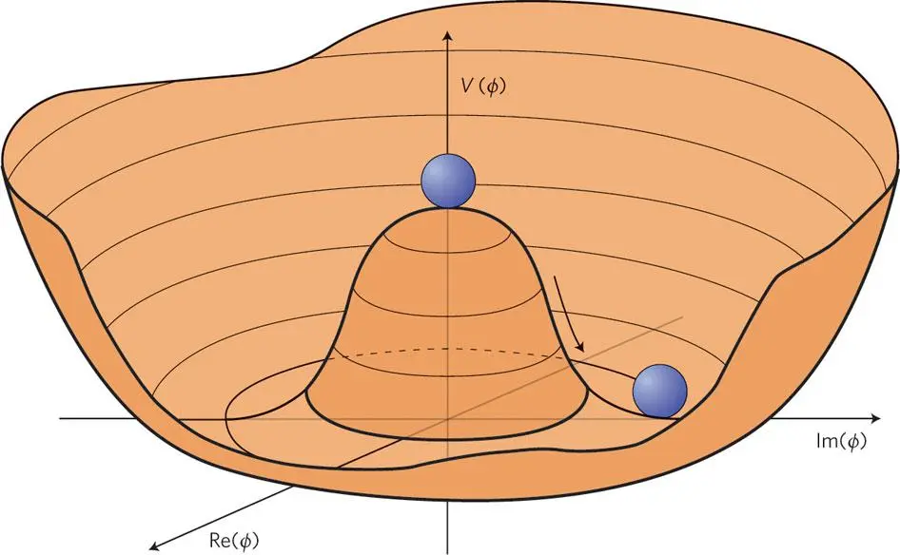
Why the Axion?
Neutron Electron Dipole Moment (nEDM)
Peccei-Quinn Theory
Credit: L. Albarez-Gaume & J. Ellis, Nature Physics, 2011
Credit: nEDM Search Collaboration at PSI

Slide 4
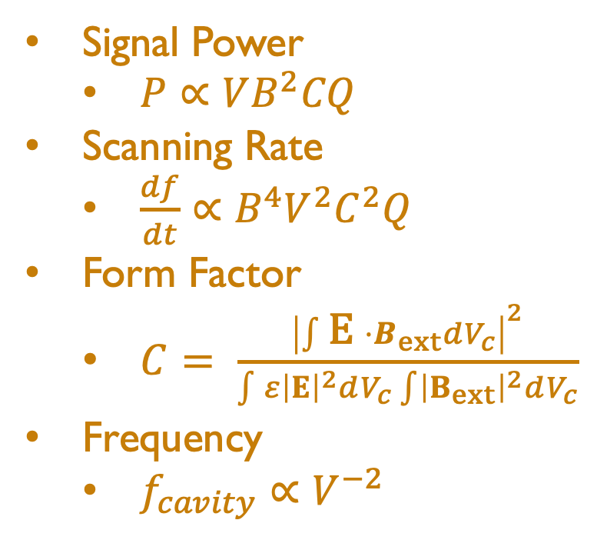

Haloscopes
VNA
$$\vec{B}$$
Cavity
Signal Power
$P∝VB^{2}CQ$
Scanning Rate
$\frac{df}{dt}∝B^{4}V^{2}C^{2}Q$
Form Factor
$C= \frac{{\left|\int{\text{E} ⋅B_{ext}dV_{c}}\right|}^{2}}{\int{ε{\left|E\right|}^{2}dV_{c}\int{{\left|B_{ext}\right|}^{2}dV_{c}}}}$
Frequency
$f_{cavity}∝V^{−2}$
Solenoid
Tuning Rod
Solenoid
Example Traditional Haloscope

Slide 5
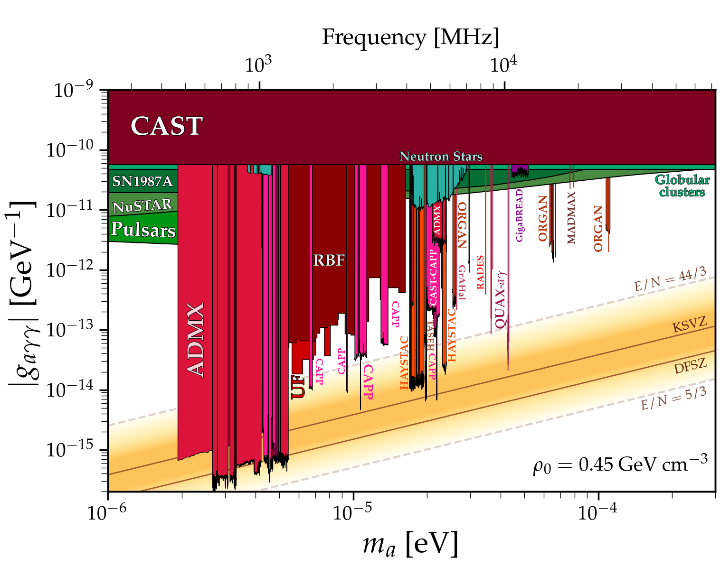
Credit: Ciaran O’Hare. cajohare/axionlimits: Axionlimits. https://cajohare.github.io/
AxionLimits/, July 2020

Slide 6
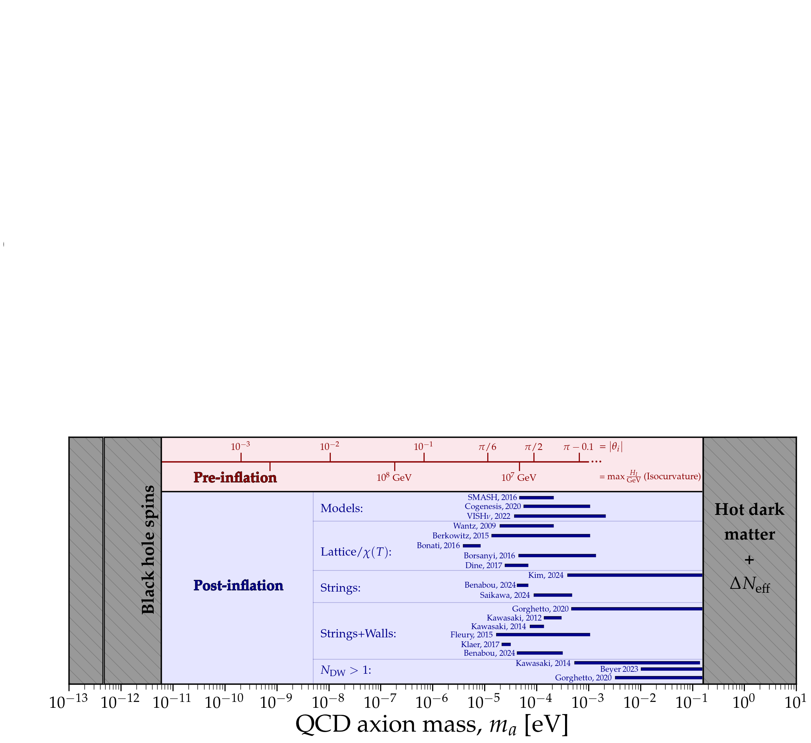
Why Higher Mass: Post-inflation
Credit: Ciaran O’Hare. cajohare/axionlimits: Axionlimits. https://cajohare.github.io/
AxionLimits/, July 2020

Slide 7
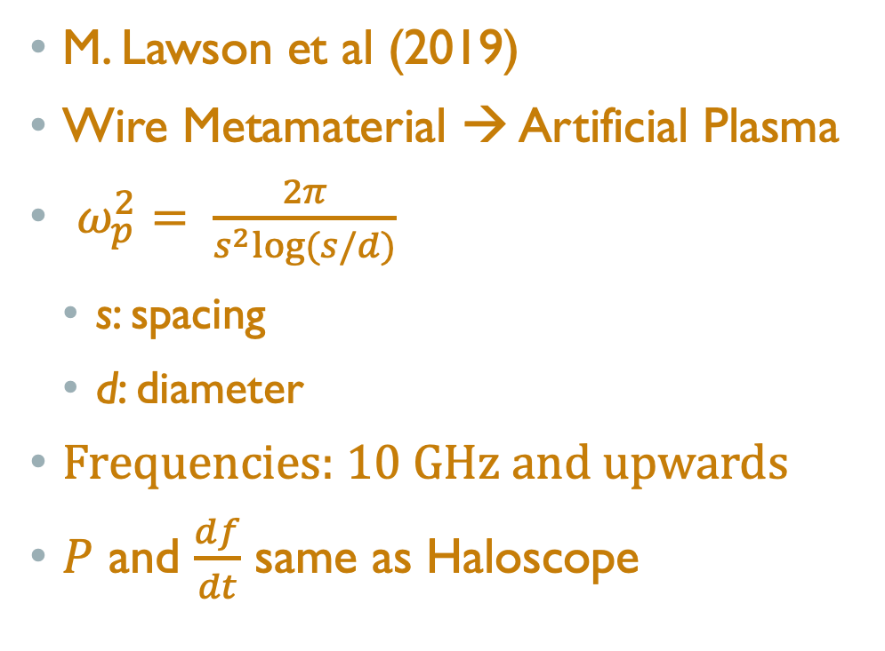
Plasma Haloscope: Wire Metamaterial
M. Lawson et al (2019)
Wire Metamaterial → Artificial Plasma
$ω_{p}^{2}= \frac{2π}{s^{2}log⁡(s/d)}$
s: spacing
d: diameter
Frequencies: 10 GHz and upwards
$P$ and $\frac{df}{dt}$ same as Haloscope
Conducting rods inside resonator

Slide 8
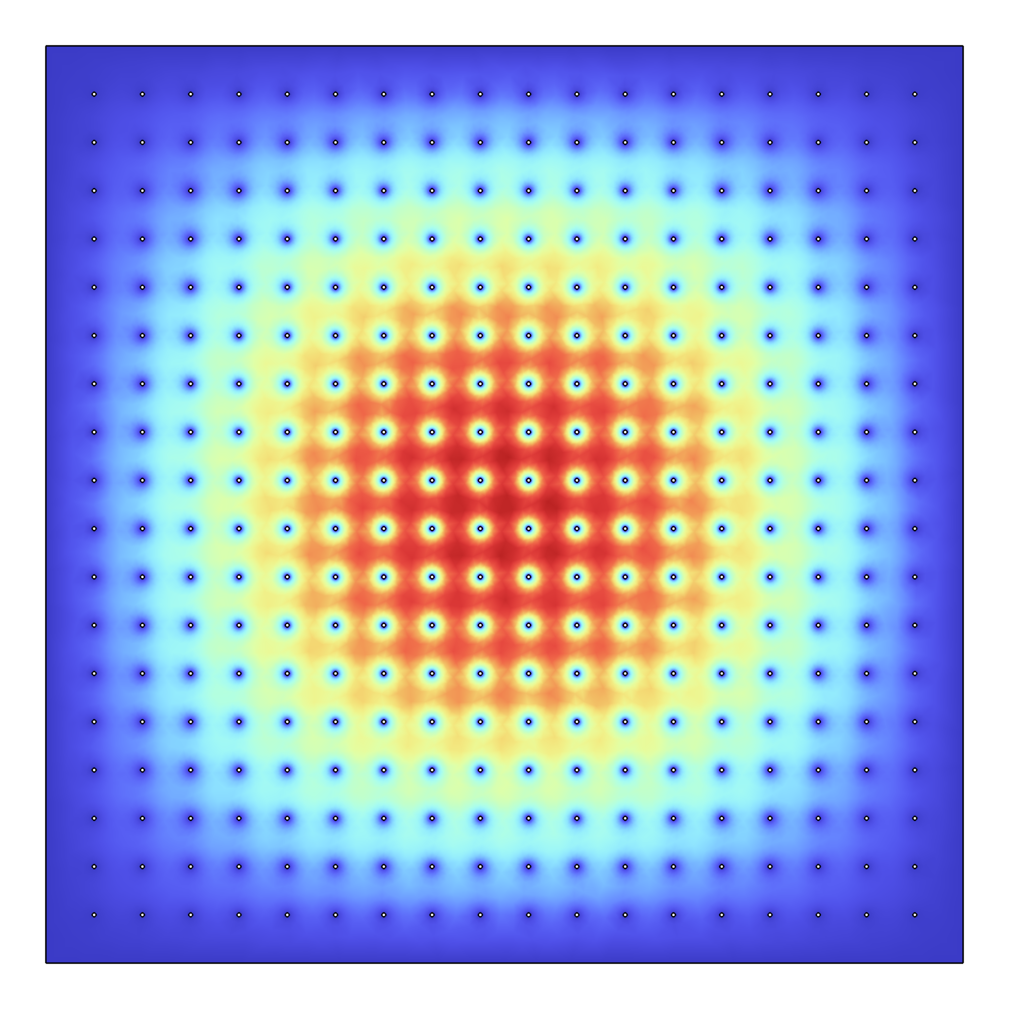
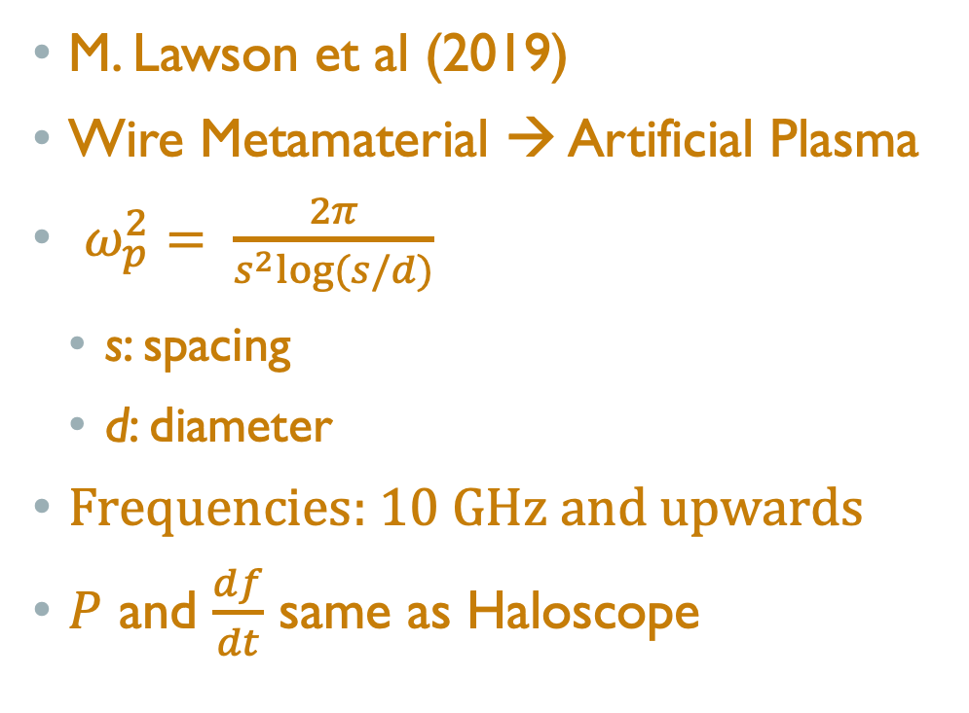
Plasma Haloscope: Electrical Field
M. Lawson et al (2019)
Wire Metamaterial → Artificial Plasma
$ω_{p}^{2}= \frac{2π}{s^{2}log⁡(s/d)}$
s: spacing
d: diameter
Frequencies: 10 GHz and upwards
$P$ and $\frac{df}{dt}$ same as Haloscope
Electrical Field [Credit: Junu Jeong]

Slide 9
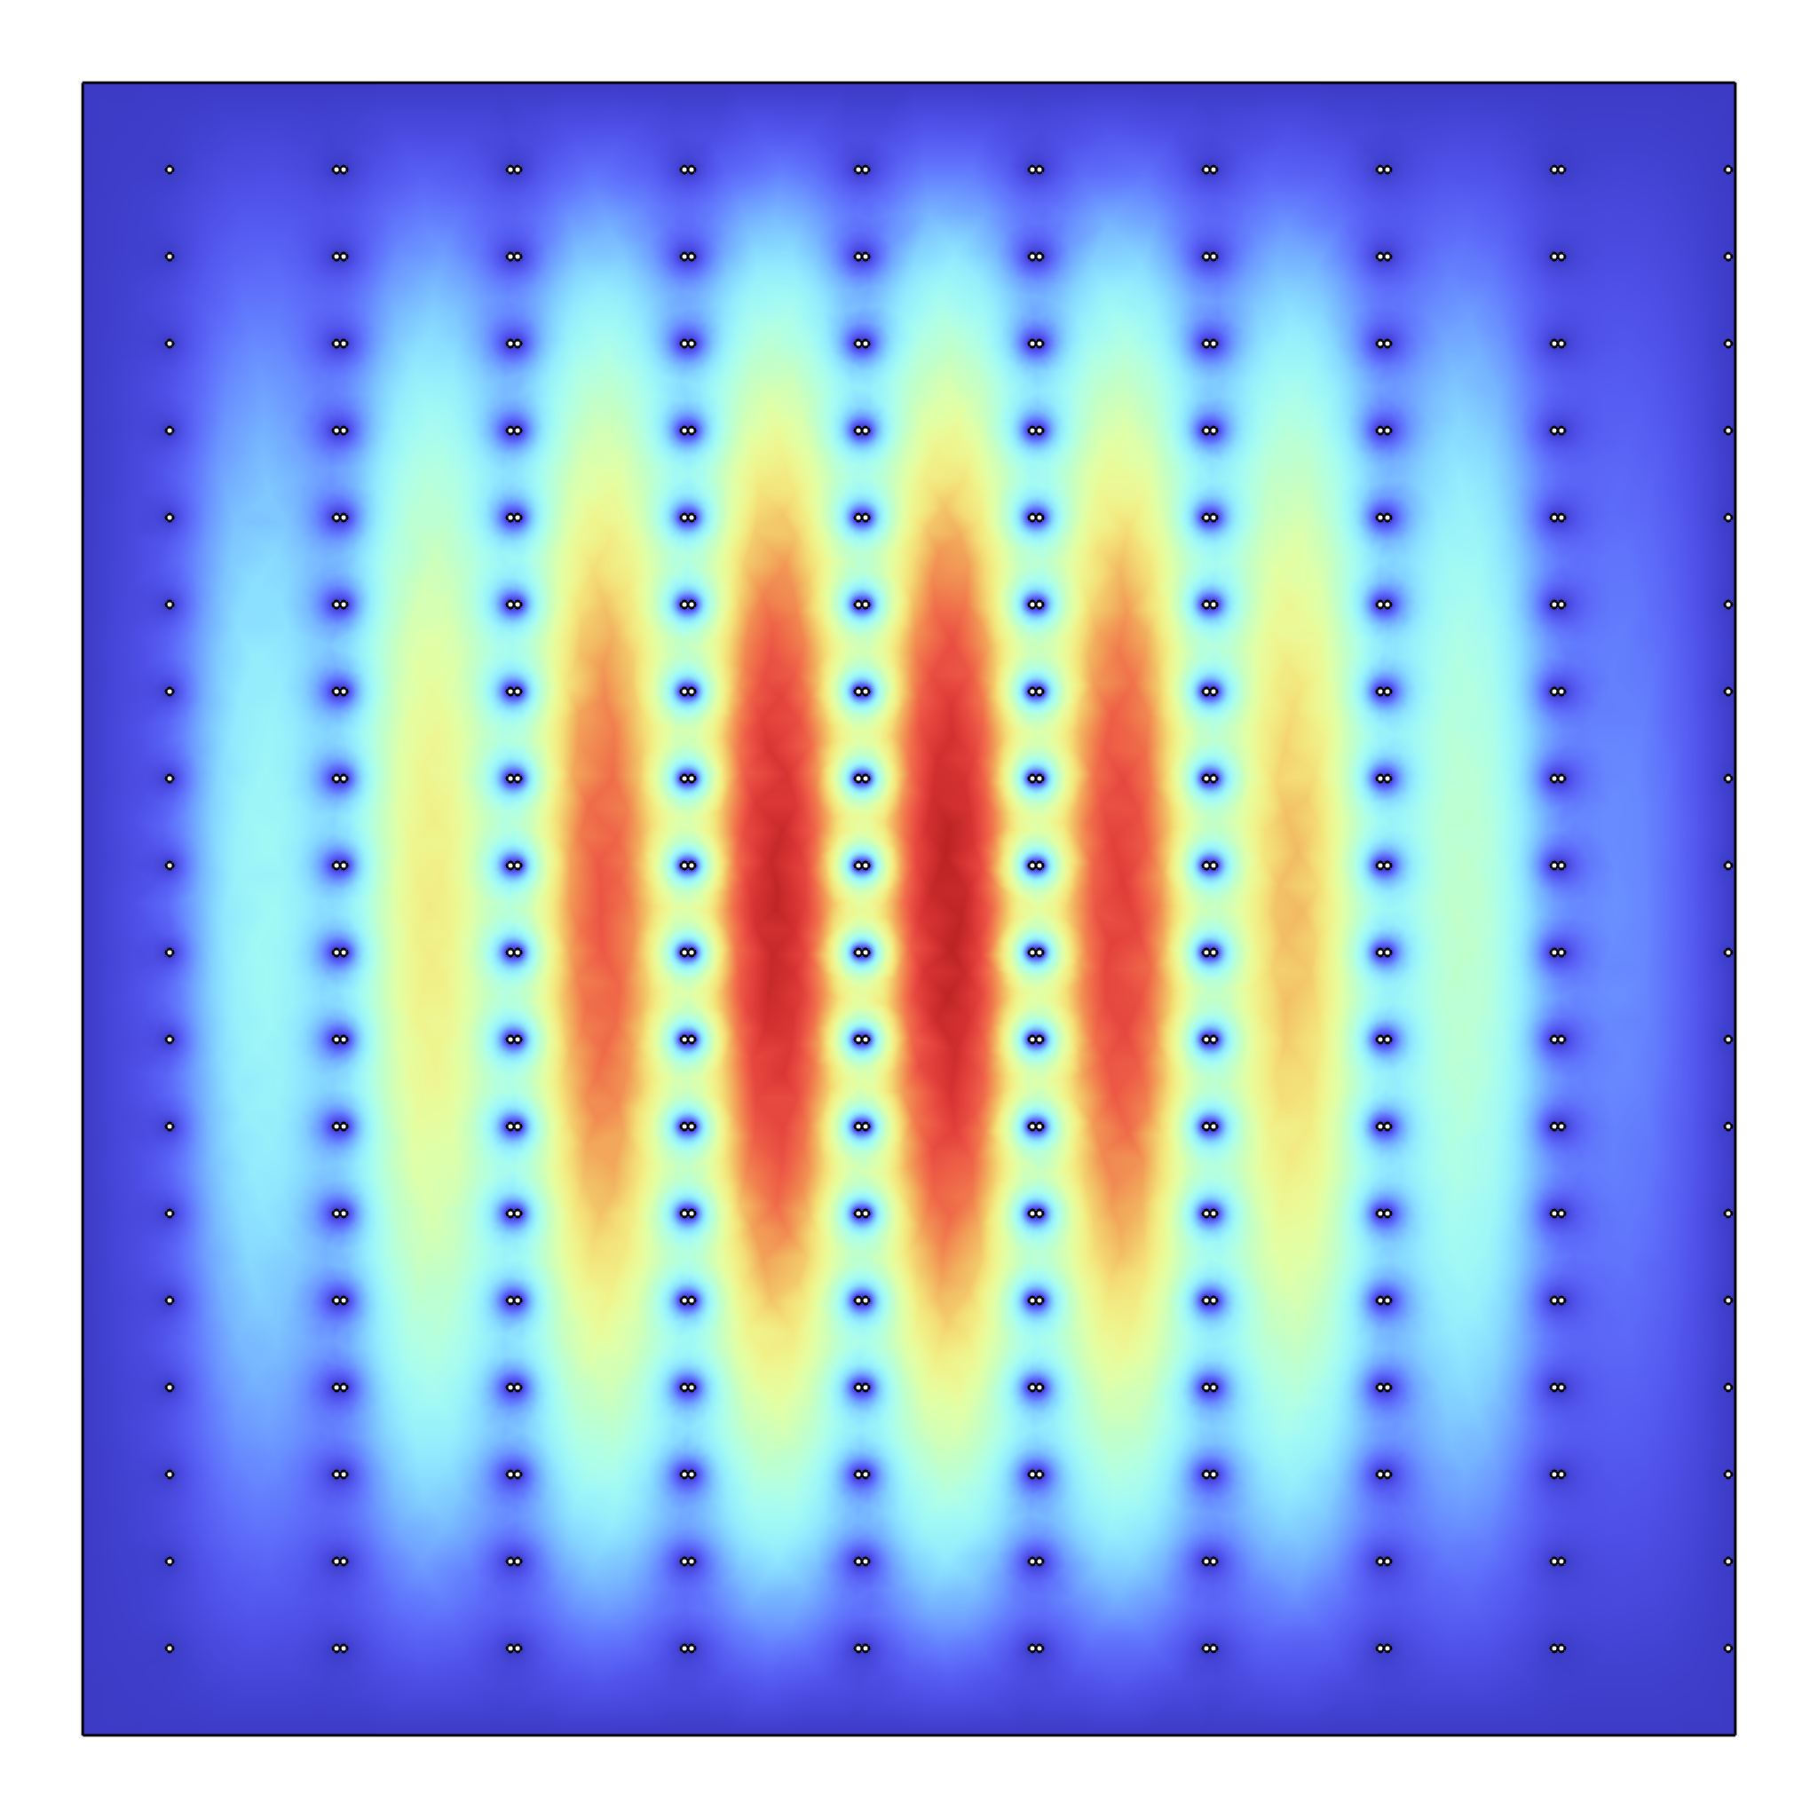
Plasma Haloscope: Mechanically Complex Tuning
Electrical Field Before and After Tuning [Credit: Junu Jeong]

Slide 10
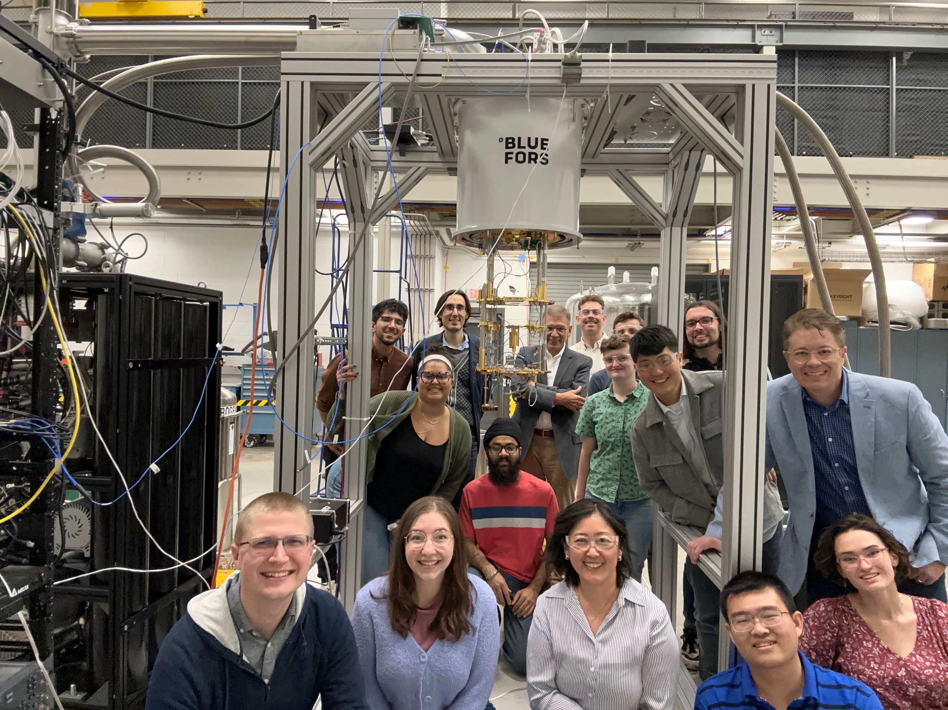
Axion Longitudinal Plasma HAloscope
Collaborating Institutes:
Yale University (Host University)
Arizona State University
University of California, Berkley
Cambridge University
Colorado University
University of Iceland
John Hopkins University
Massachusetts Institute of Technology
Oak Ridge National Laboratory
Stockholm University
Wellesley College
Credit: Reina Maruyama

Slide 11
Axion Longitudinal Plasma HAloscope
Stockholm University Group:
Resonator:
Junu Jeong (Resonator co-lead )
Jon E. Gudmundsson [former spokesperson](U of Iceland)
Rustam Balafendiev (U of Iceland)
Gagandeep Kaur
Gaganpreet Singh
Jianyang Qi
Jacob Lindahl
Analysis:
Jan Conrad (Deputy Spokesperson)
Andrea Gallo Rosso (Analysis co-lead)
Andy Meyer
Credit: Reina Maruyama

Slide 12
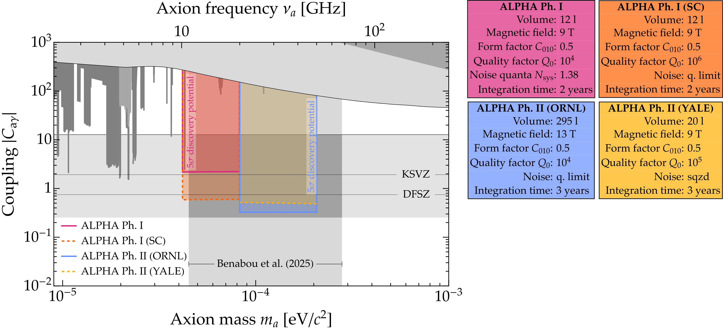
ALPHA Parameter Space
Ph. I: 2027 - (Fully funded)
Ph. II: 2029 -

Slide 13
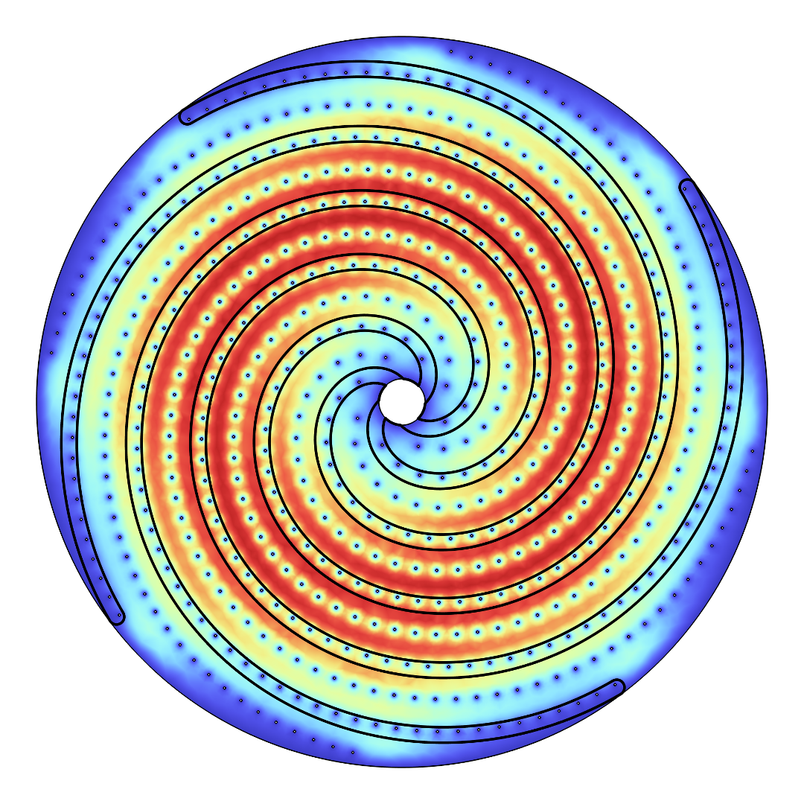
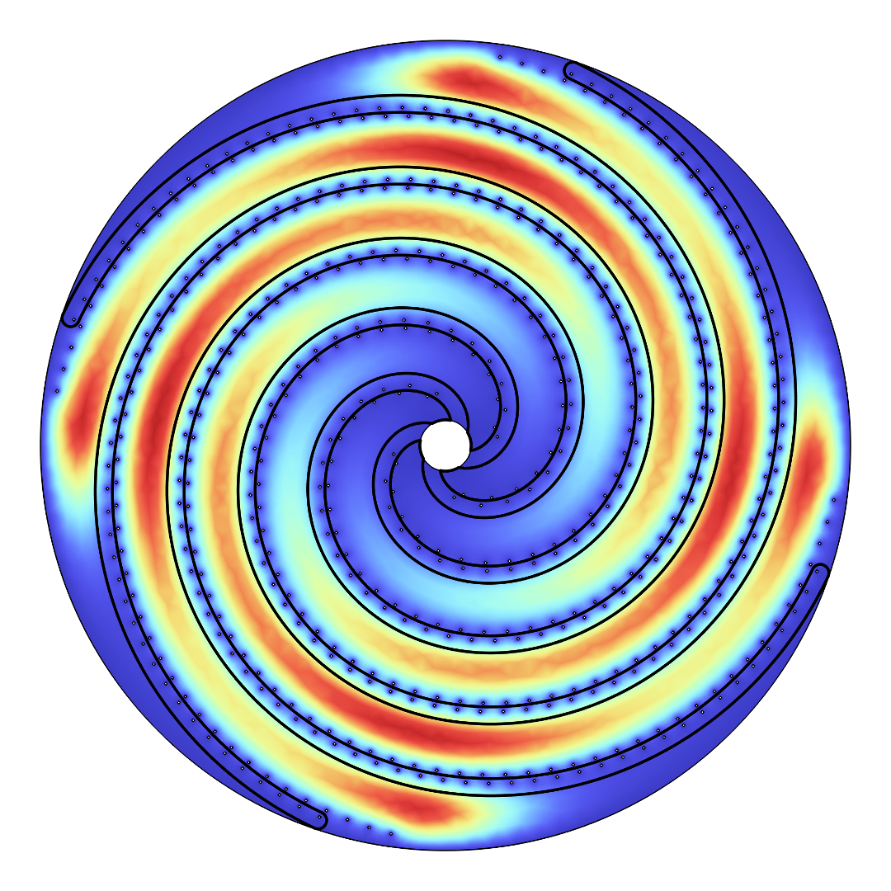
Spiral Method
8-arm Spiral Electrical Field [Credit: Junu Jeong]

Slide 14
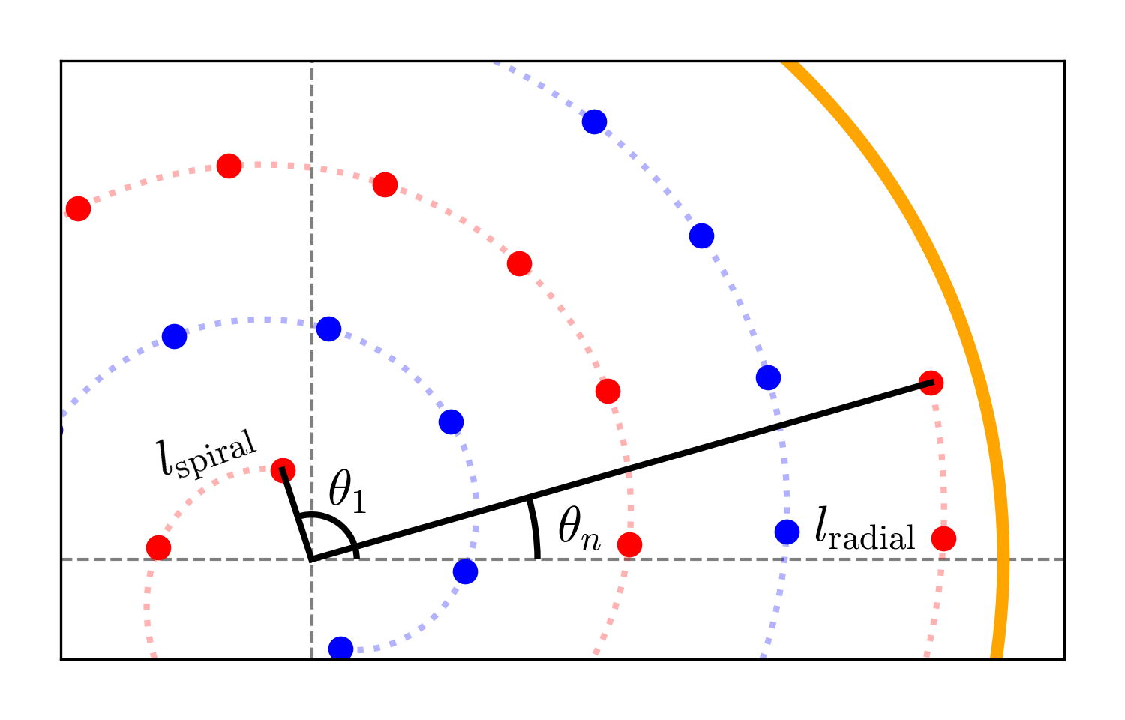
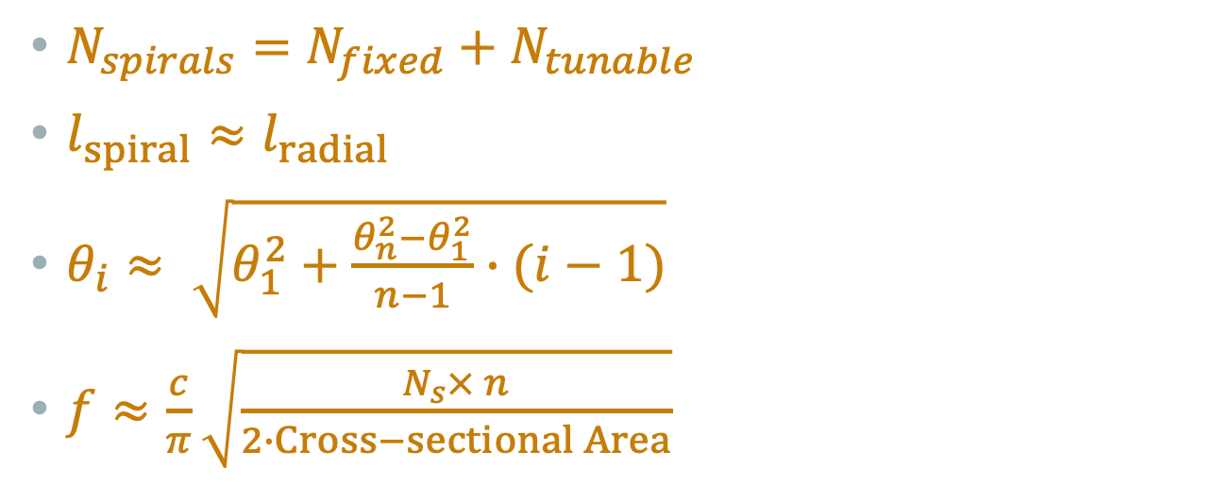
Spiral Distribution
$N_{spirals}=N_{fixed}+N_{tunable}$
$l_{spiral}≈l_{radial}$
$θ_{i}≈ \sqrt{θ_{1}^{2}+\frac{θ_{n}^{2}−θ_{1}^{2}}{n−1}∙(i−1)}$
$f≈\frac{c}{π}\sqrt{\frac{N_{s}× n}{2∙Cross−sectional Area}}$

Slide 15
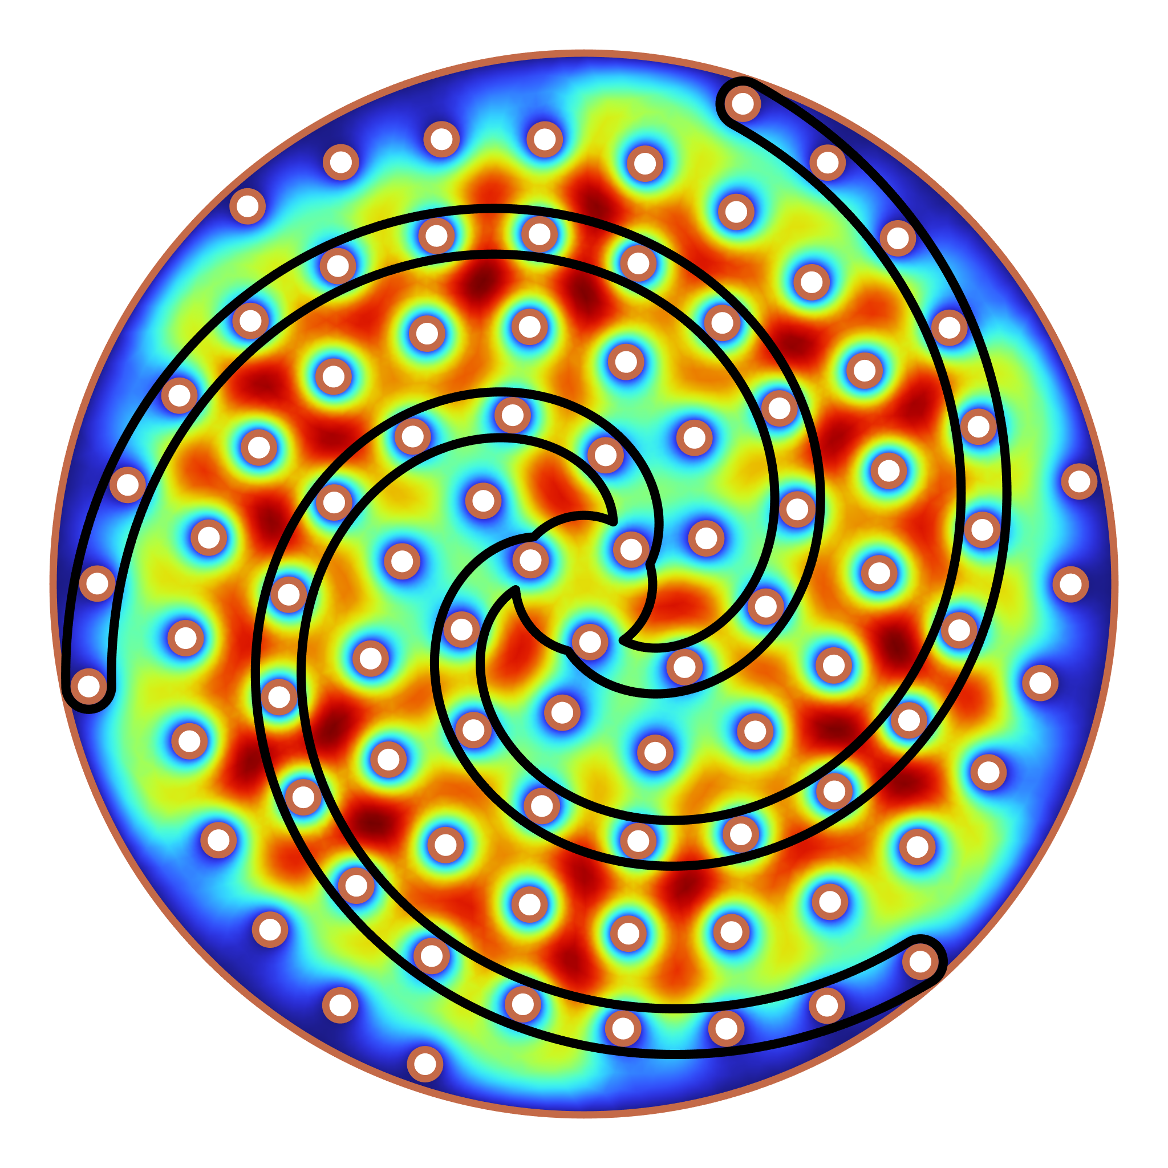
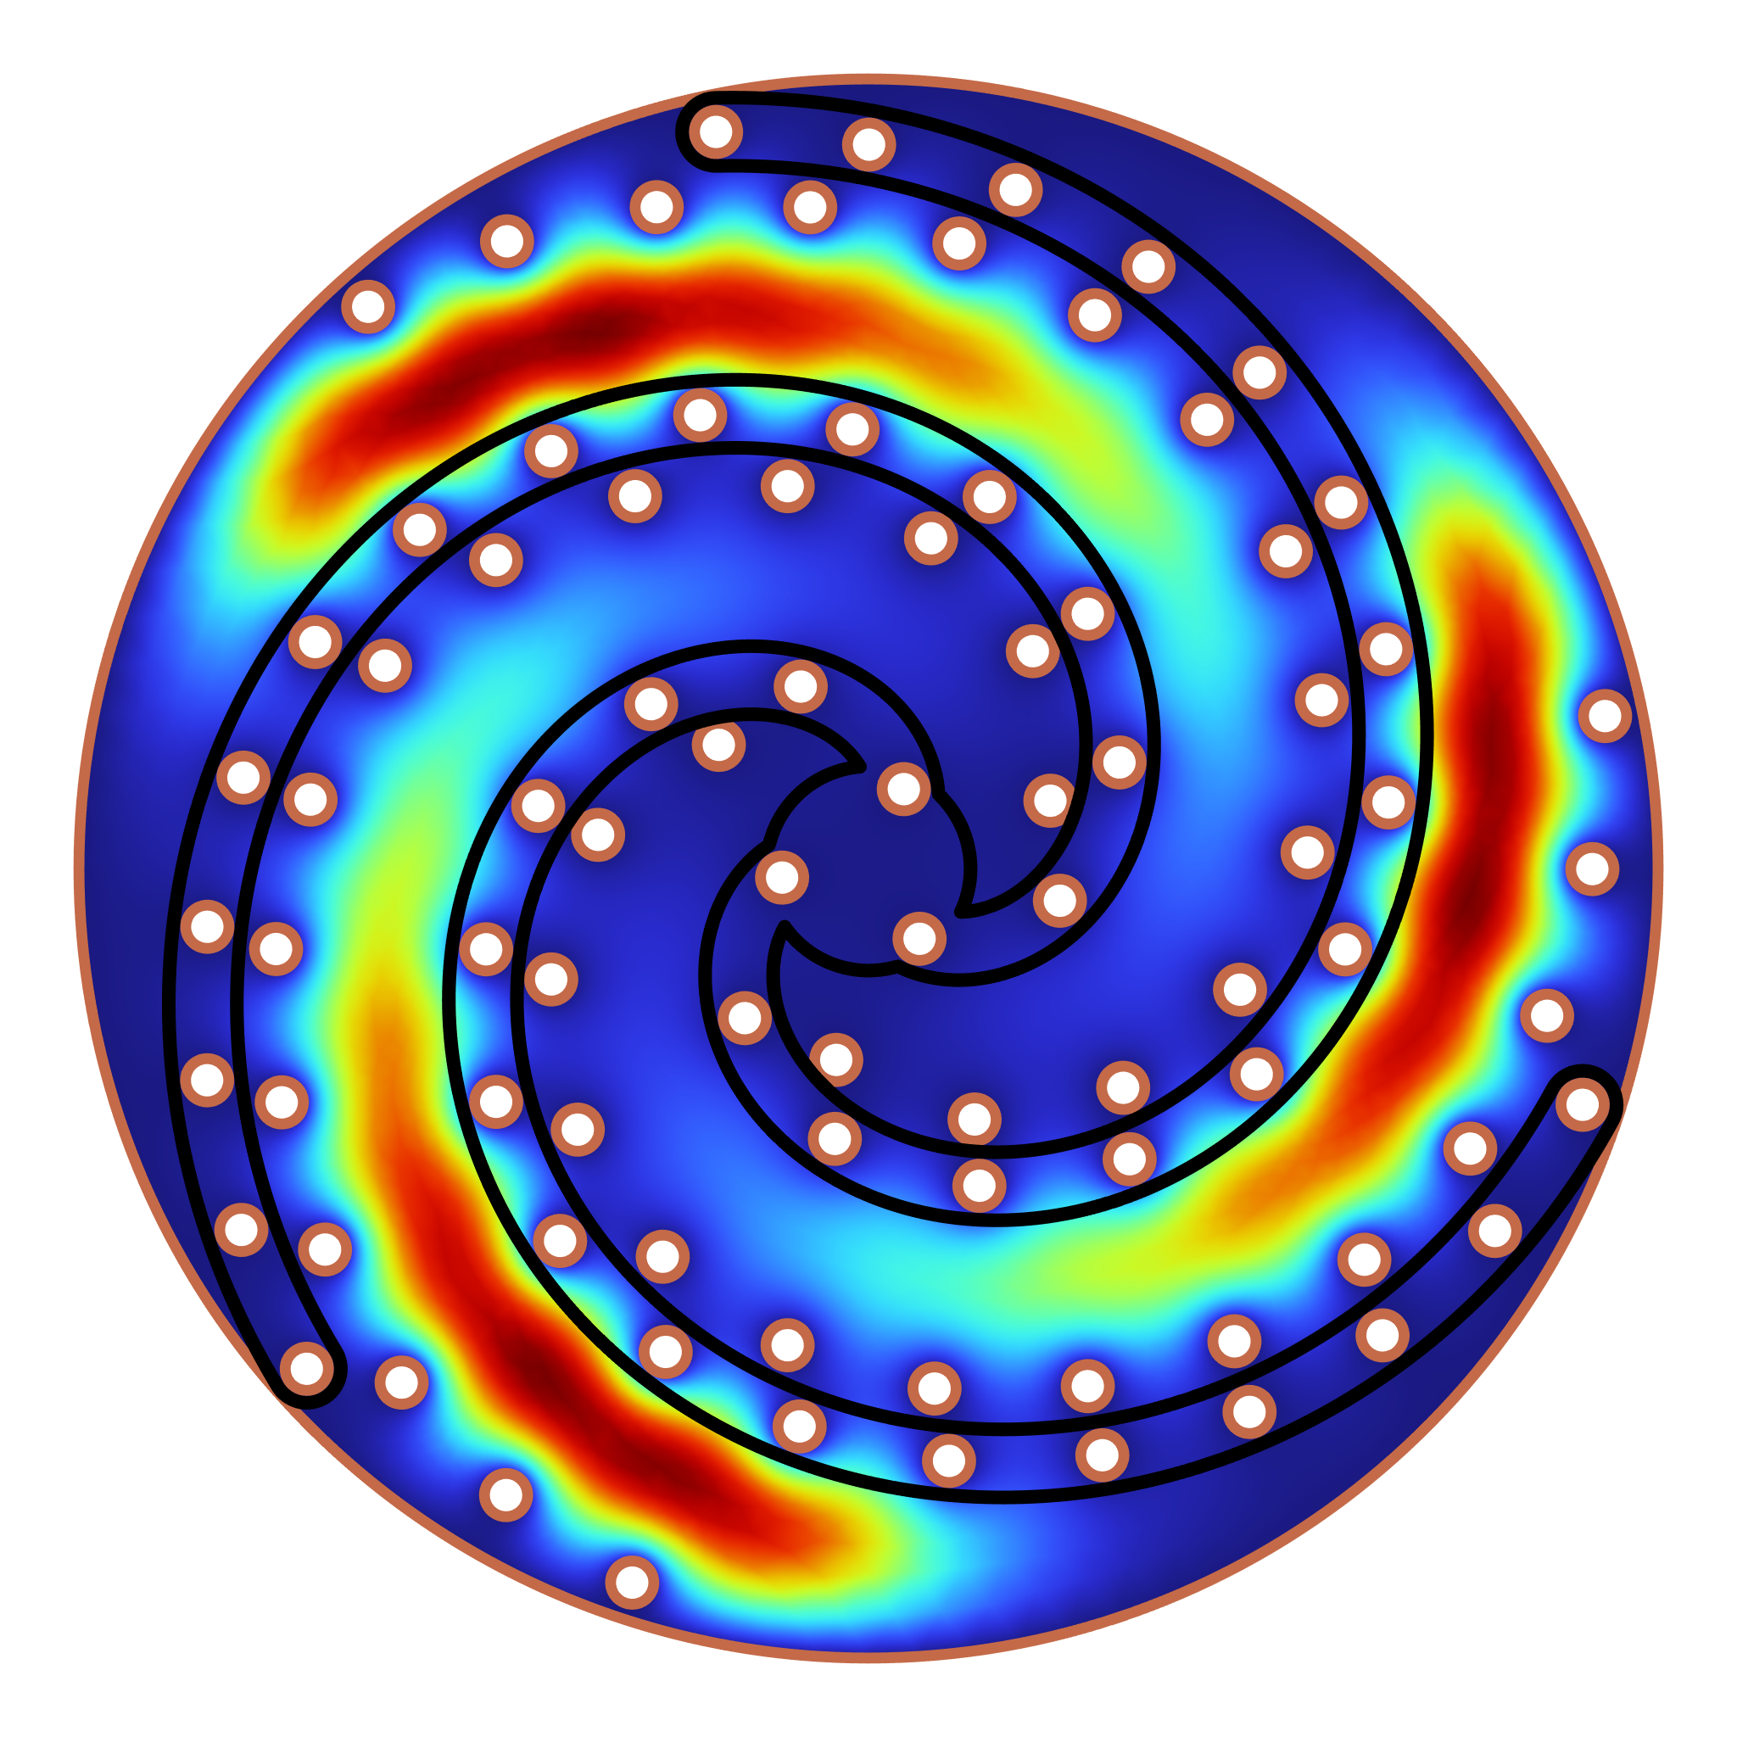


6-arm Prototype
$$0^{∘}$$
$${30}^{∘}$$
Frequency

Slide 16
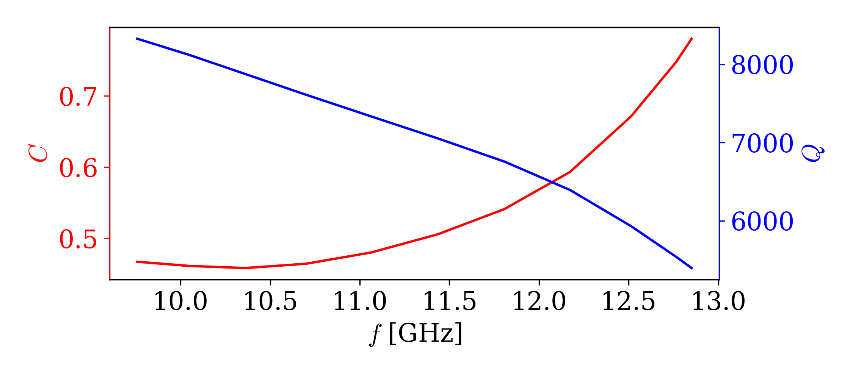
2D Spiral Simulation
The form factor and quality factor for 2D simulation of a 6-arm Spiral resonator [arXiv:2508.18145]

Slide 17
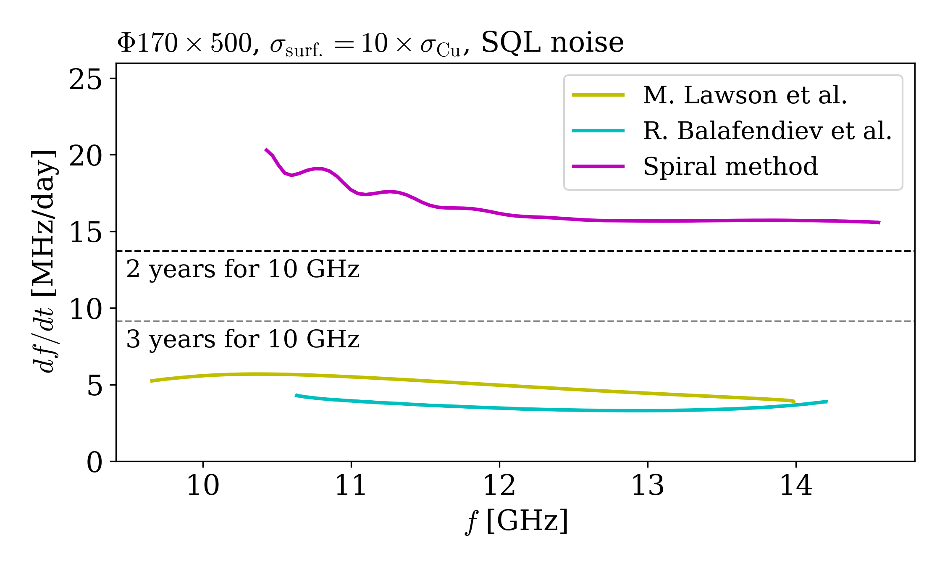
Scanning Rates
Comparison of Scanning Rates for 8-arm spiral [arXiv:2508.18145]

Slide 18
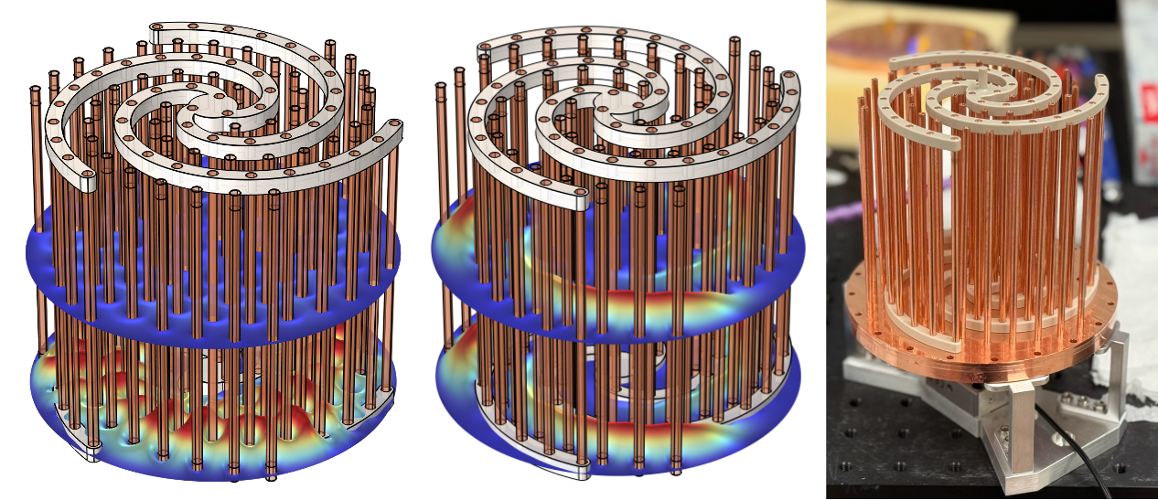


6-arm Prototype
$$0^{∘}$$
$${30}^{∘}$$

Slide 19
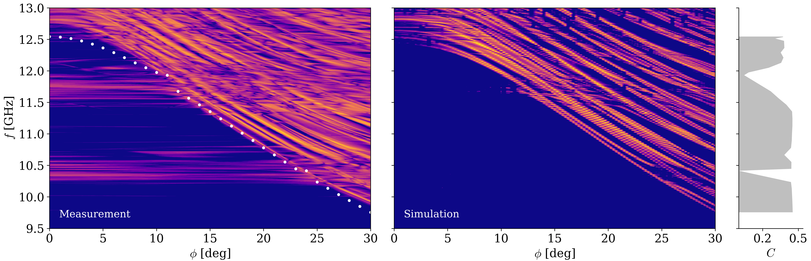
6-arm Mode Map
Mode Map and Form Factor of 6-arm prototype

Slide 20
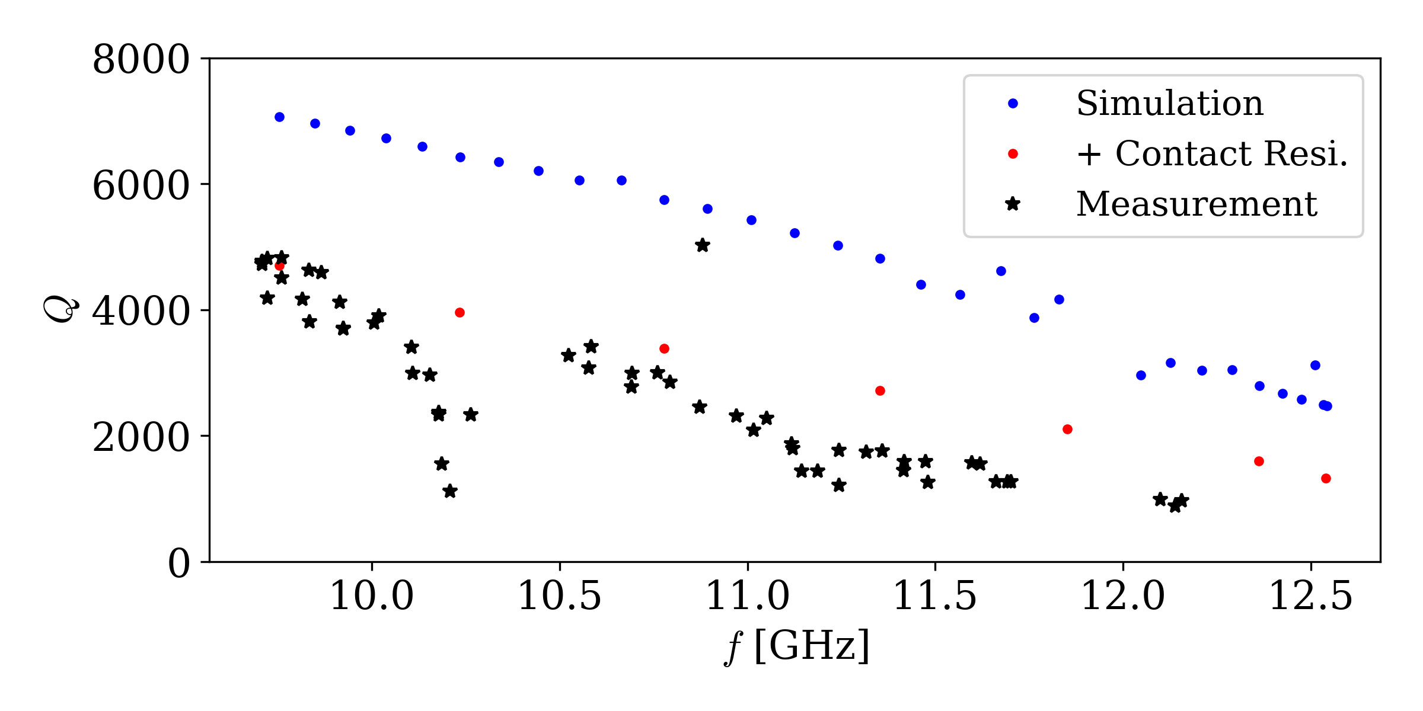
6-arm Quality Factor and Bead Pull
Simulated and Measured Quality Factor of 6-arm

Slide 21
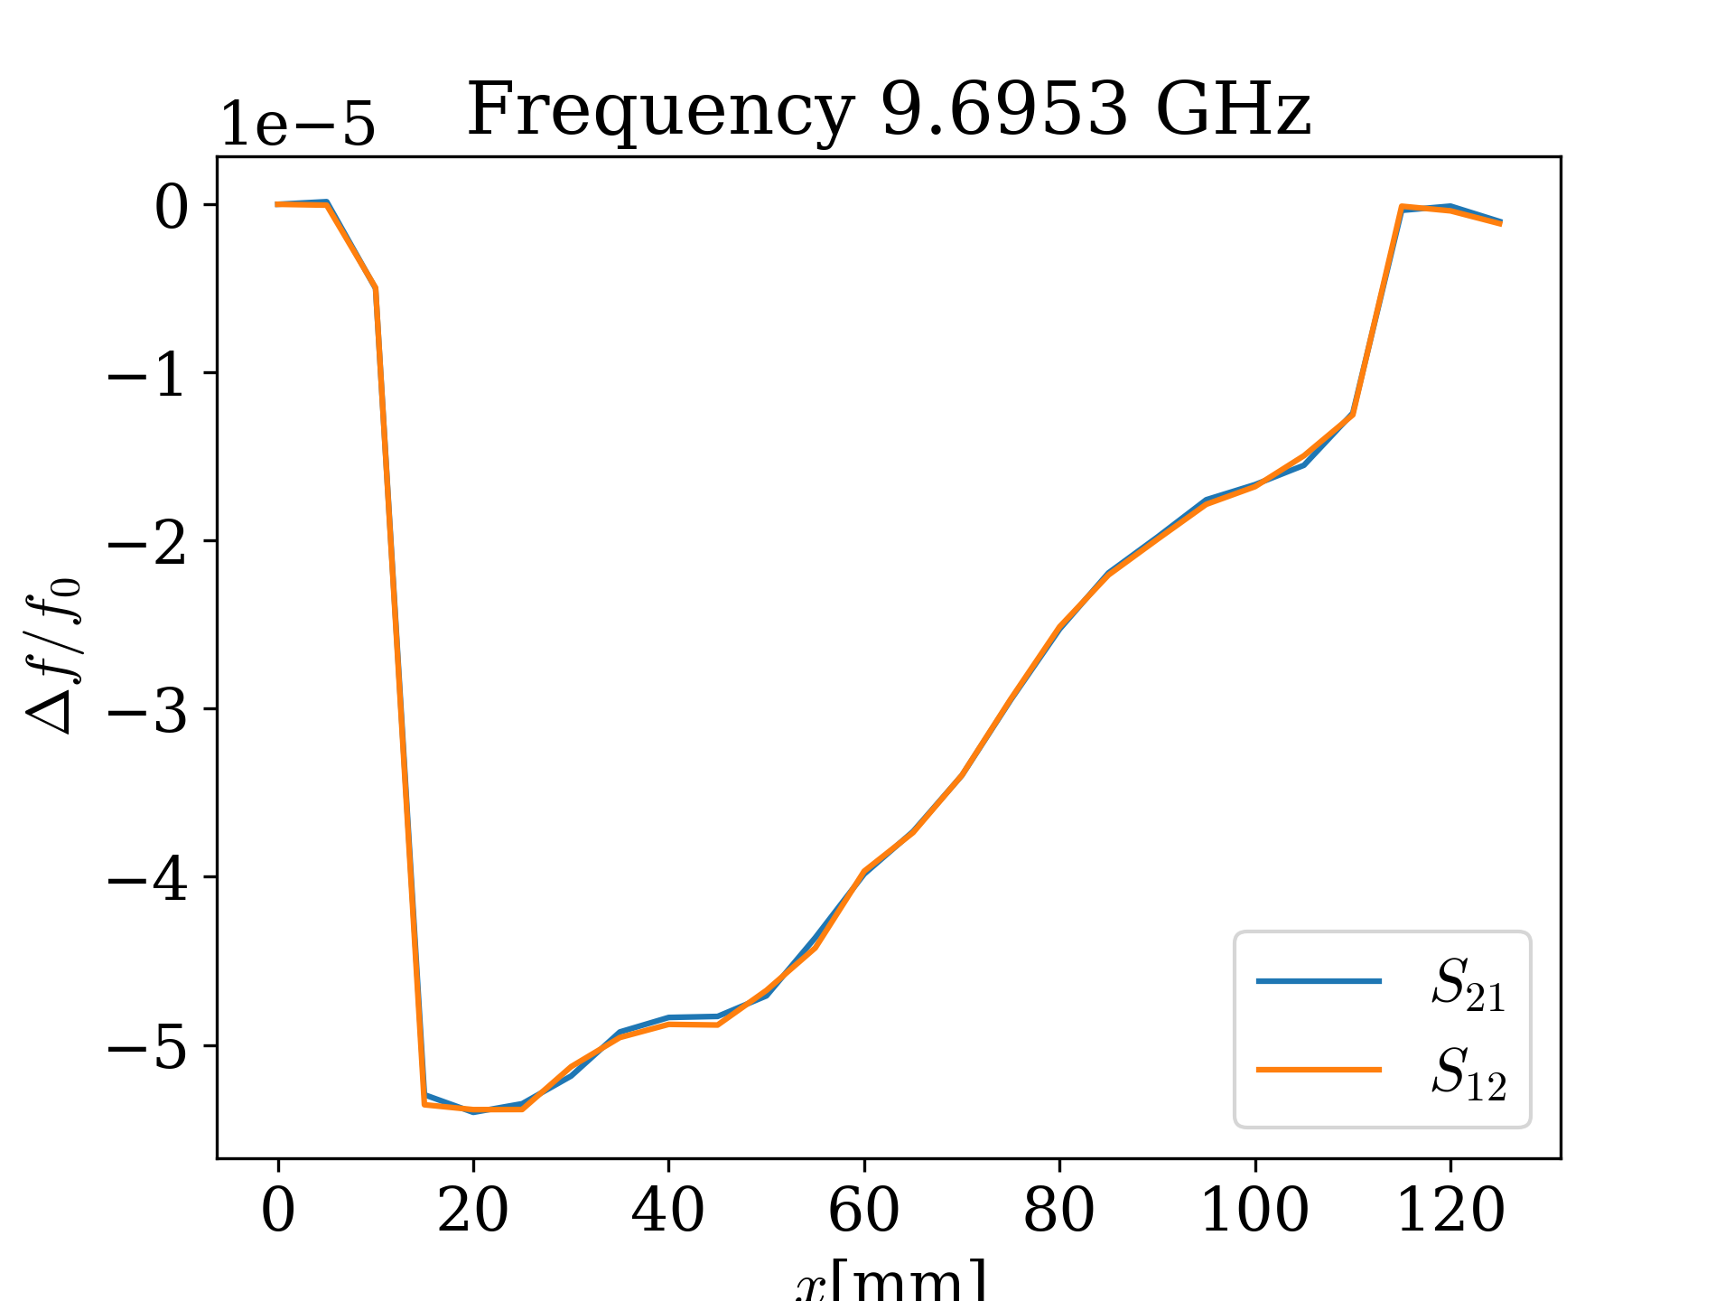
6-arm Quality Factor and Bead Pull
Bead Pull Measurement of 6-arm Lowest Frequency

Slide 22
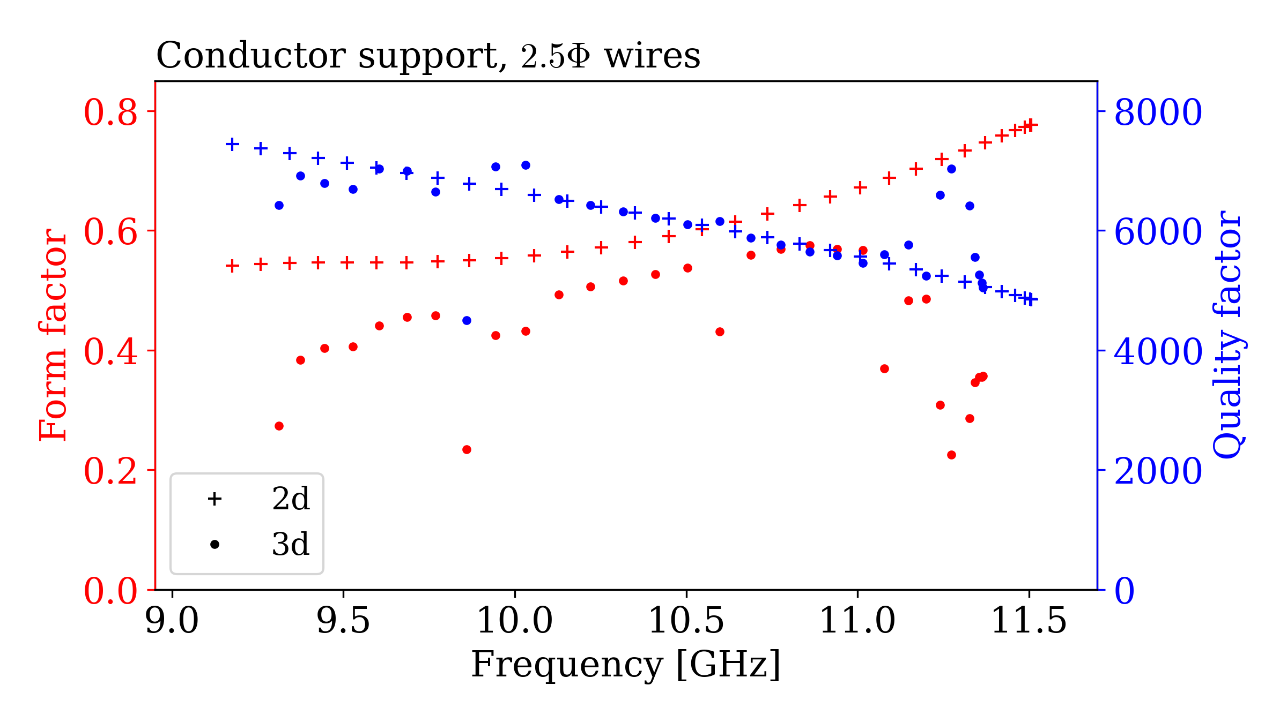
Dark Photon Run
Using 6-arm design
Aiming for 2026
Fully Conductive Support
9-12GHz
2D and 3D Simulations for the Dark Photon Spiral Resonator

Slide 23
Summary
ALPHA is a collaboration dedicated to exploring the high-mass axion range via plasma haloscopes
The Spiral approach allows for enhanced scanning speed and low mechanical complexity
The 6-arm prototype has demonstrated its feasibility and convergence between simulation and measurements
Aiming for a Dark Photon Run next year

Slide 24
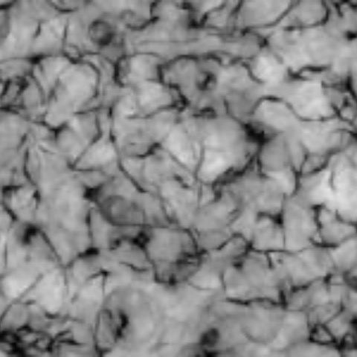
Back Up: Production: Post-inflation
Buschmann, M., Foster, J.W., Hook, A. et al. Dark matter from axion strings with adaptive mesh refinement. Nat Commun 13, 1049 (2022). https://doi.org/10.1038/s41467-022-28669-y

