Slide 1



Slide 2

ABOUT US.
Anywhere (remote)
Gothenburg (HQ),
Stockholm and Linköping
Founded in 2001
5
Locations
Denver
(and one fully remote office)
130
35%
outstanding people
have a PhD
Proud roots in Gothenburg,
one of Scandinavia’s most vibrant innovation hubs
Wellington
16
Average years
of experience

Slide 3
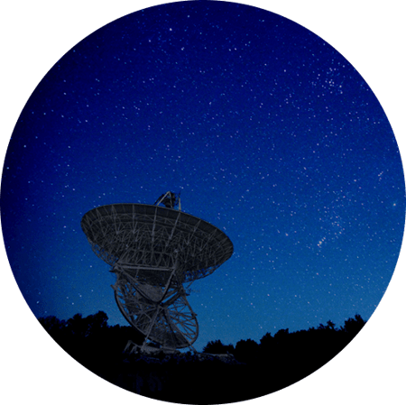
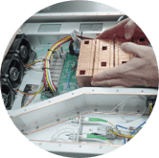
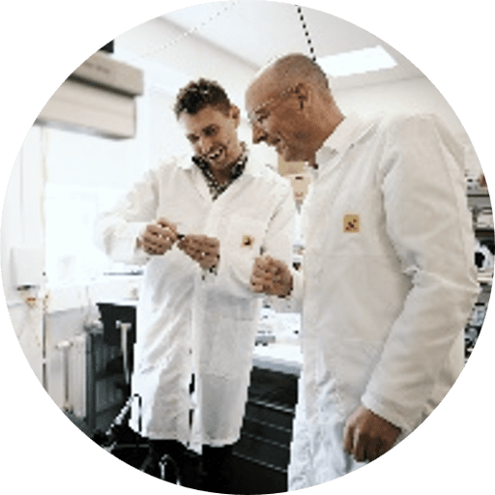
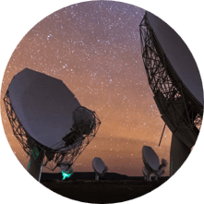
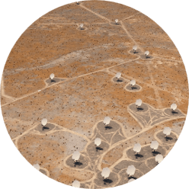
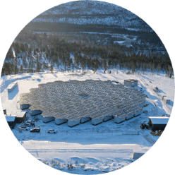
BIG SCIENCE
Innovating space and atmospheric exploration
From atmospheric insights to deep space signals
EXPERIENCE
CAPABILITIES
Delivering complete solutions for aerospace projects.
Advanced signal processing
Extracting meaningful data from complex signals.
Expertise and experience in designing and developing HW, SW and Algorithms for radio-based systems.
High-precision antenna & RF systems
Designing scalable and stable communication systems.
Supporting global initiatives like SKA Observatory & EISCAT.
Custom FPGA & embedded systems
Enabling fast, flexible processing.
System integration & industrialization
From prototype to scalable solutions.
KEY PROJECTS AND SOLUTIONS
Square Kilometre Array Observatory (SKAO)
EISCAT 3D – Atmospheric Radar
We develop low-noise digitizers that convert analog space signals into high-quality digital data, enabling higher resolution, faster processing, and seamless integration into scalable telescope systems.
We delivered over 400 waveform generators for precise RF signal steering, enabling accurate radar control and improved atmospheric measurements for space weather, meteor tracking, and climate research.

Slide 4




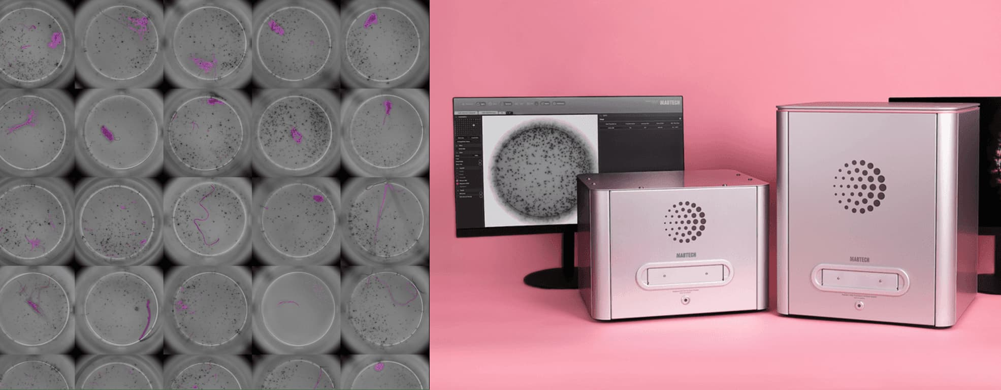
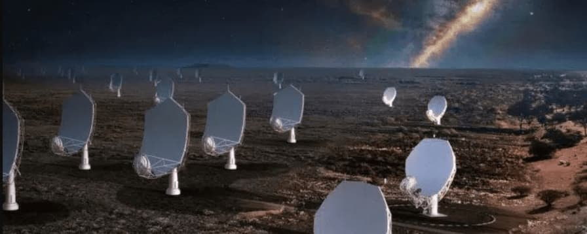




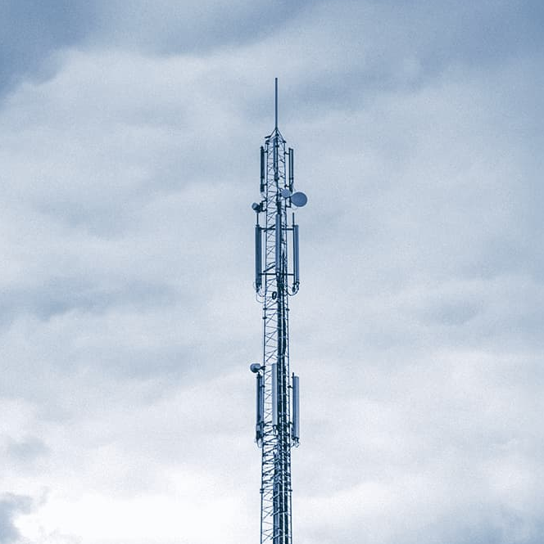




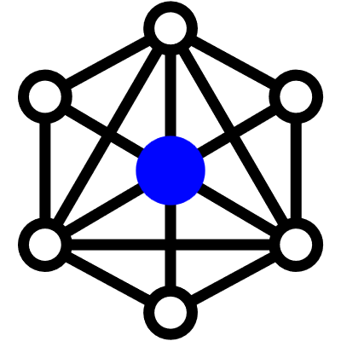
R&D
A flexible in-house R&D department with our experts ready to take on cutting-edge challenges – from idea through concept to finished product or system.
Our on-site labs
From idea to solution
EMC Chamber
Electronics lab
Mechanics lab
10m RF/antenna measurement lab
Optics lab
EMA/Antenna distance measurement lab
System engineering
Application area
Signal processing
Cases
AUTOMOTIVE
BIG SCIENCE
EMBEDDED SYSTEMS
Biotech/MedTech – Mabtech
Big Science – SKAO
Advanced image processing for precise artefact masking and analytics.
Reveal the secrets of the universe with the world’s largest telescope
DEFENSE
MEDTECH
SENSOR SYSTEMS
MANUFACTURING
TELECOM
WIRELESS COMMUNICATION
Industrial AI – INCA
Automotive – Sensrad
AI for better fire prevention, detection and response
Enabling new perspectives through 4D imaging radar
INDUSTRIAL AI AND IOT
AND MANY MORE

Slide 5
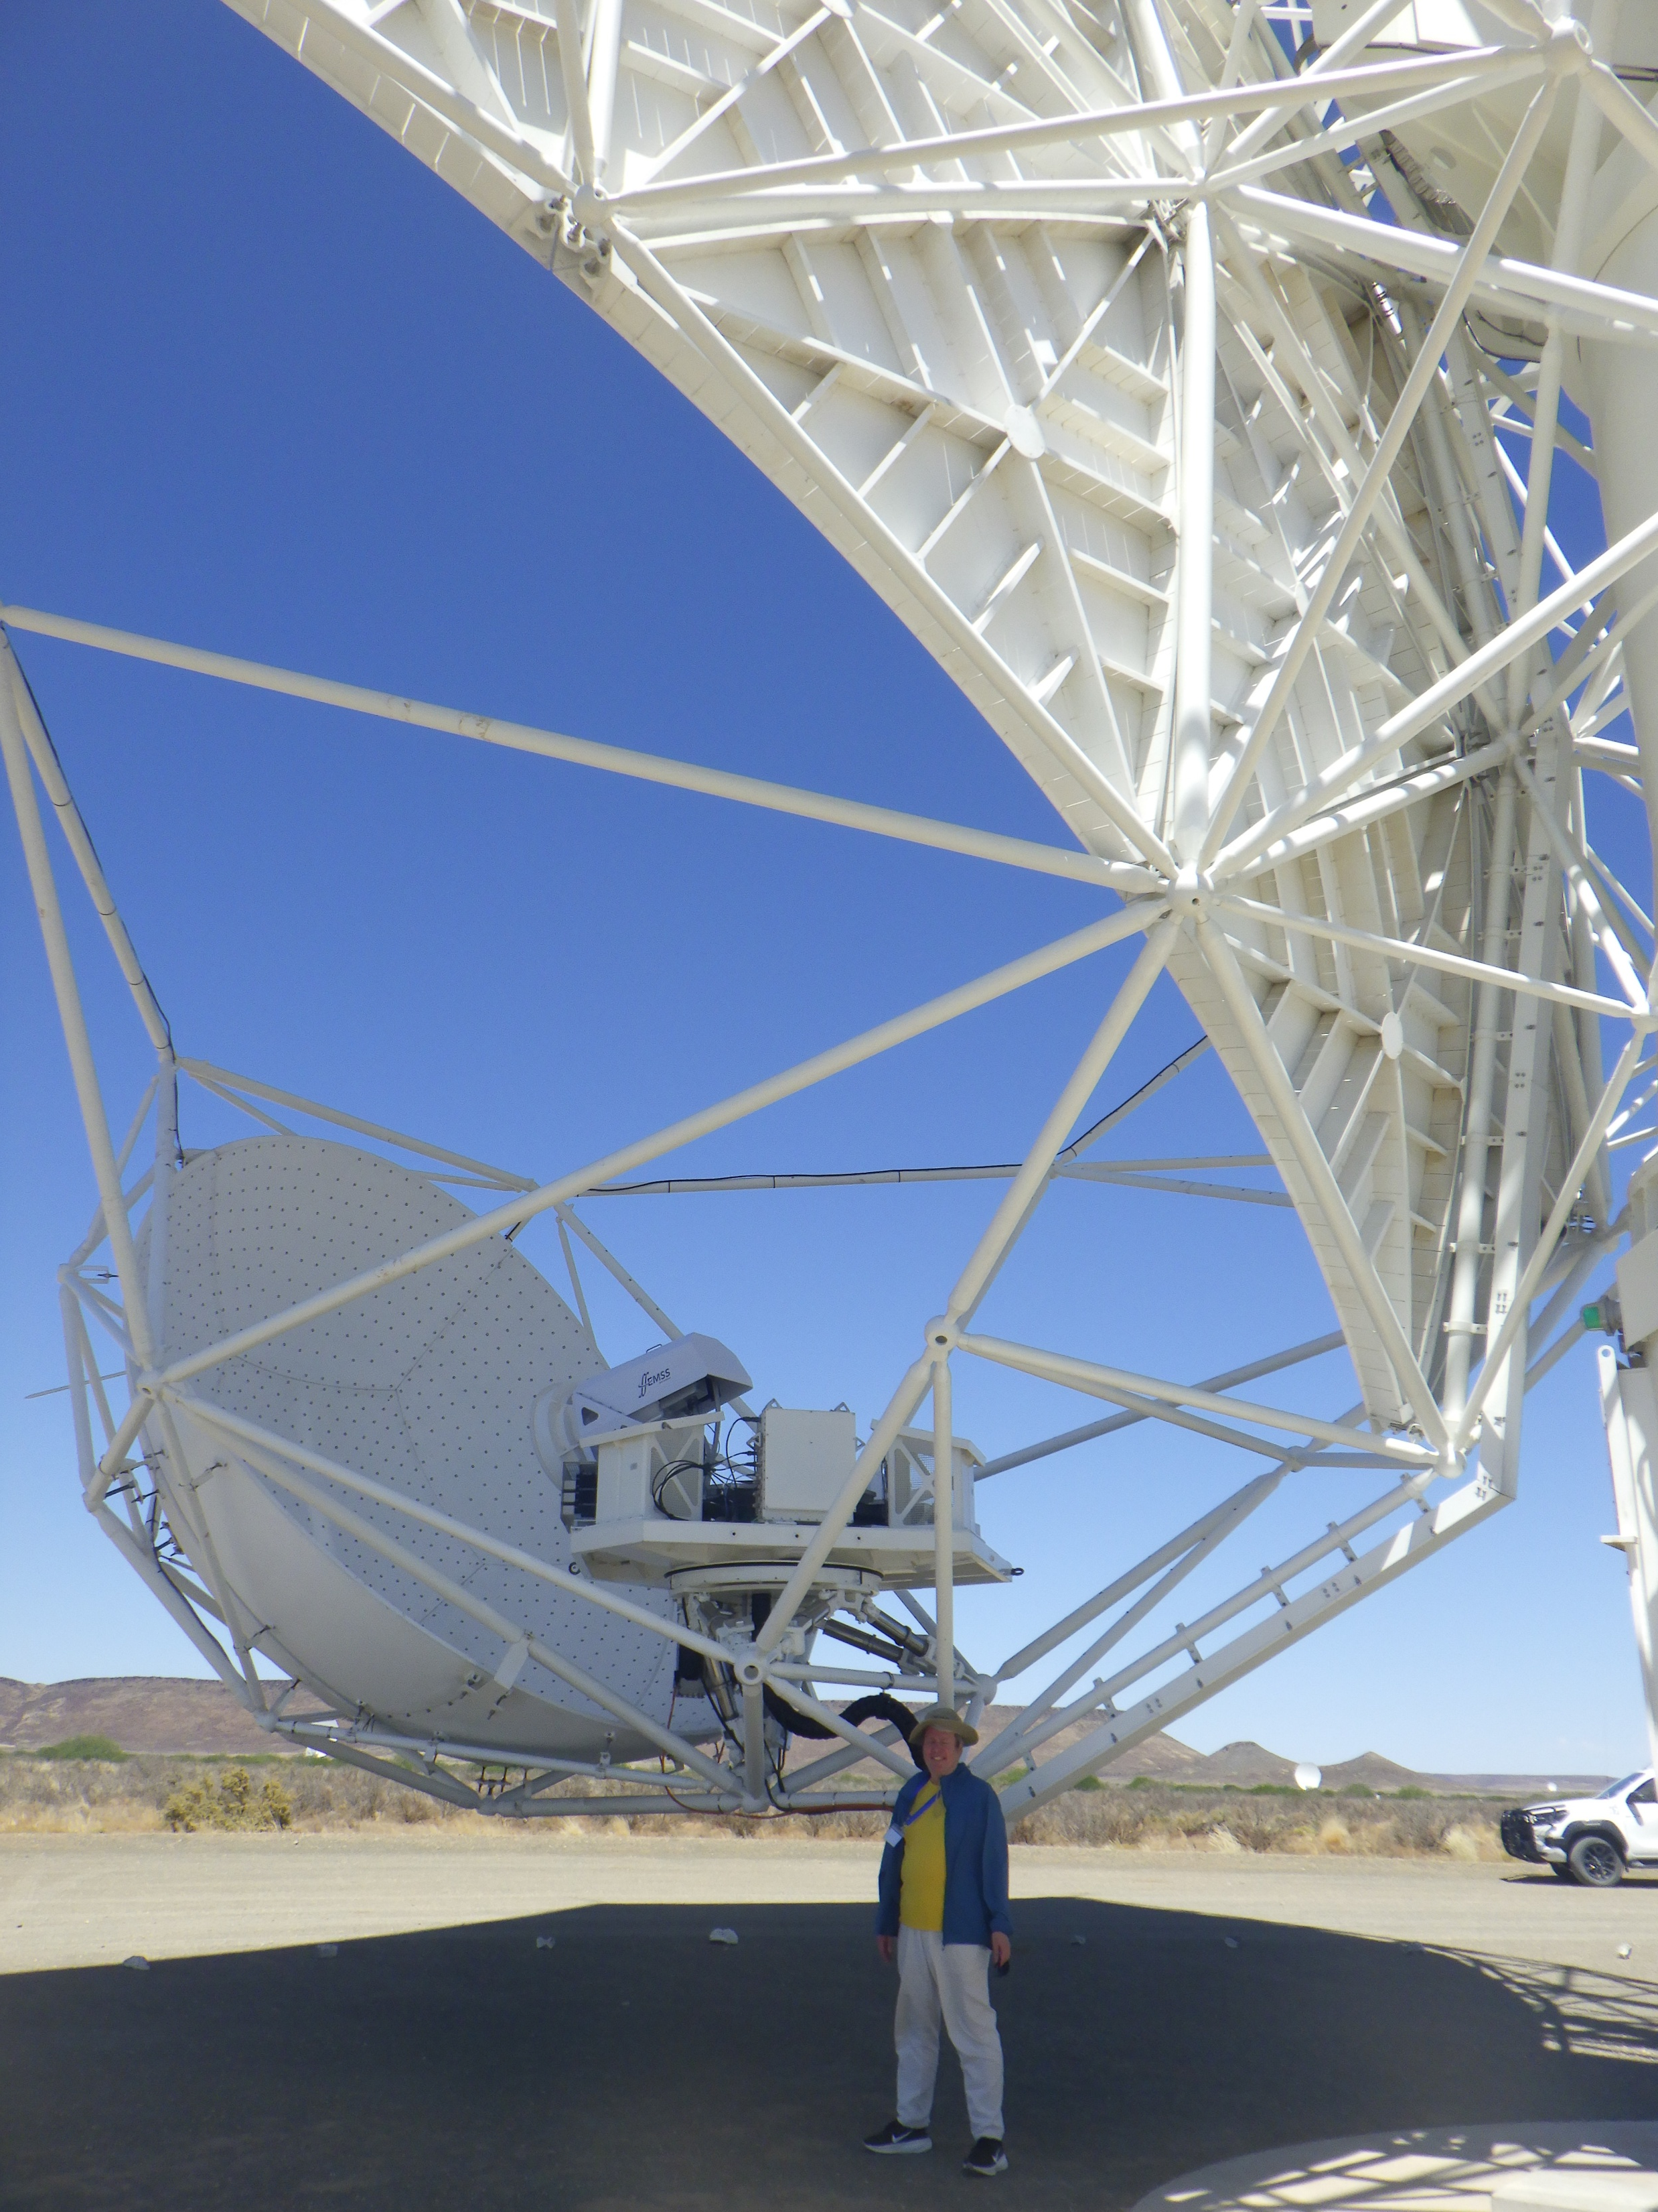
SPFRX123
Relation started through Chalmers in ~2017 with design of RXS123 (digitizer subsystem)
Mid-2023, Qamcom was awarded responsibility for final design, industrialization, and delivery of SPFRx123
April 2025 new contract to build alternative synchronization solution
Current plan – delivery of industrialized units starting May 2026, including original and new clock solution

Slide 6
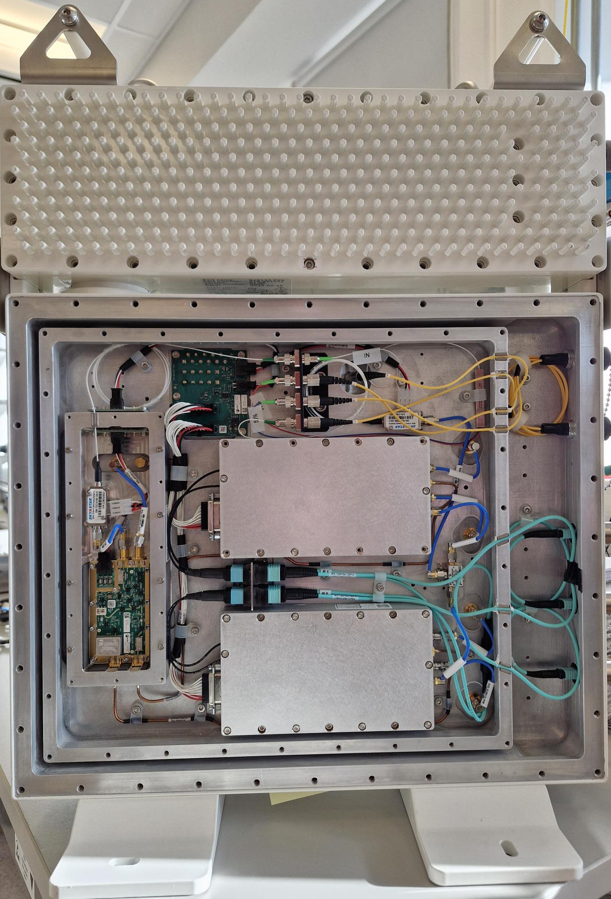
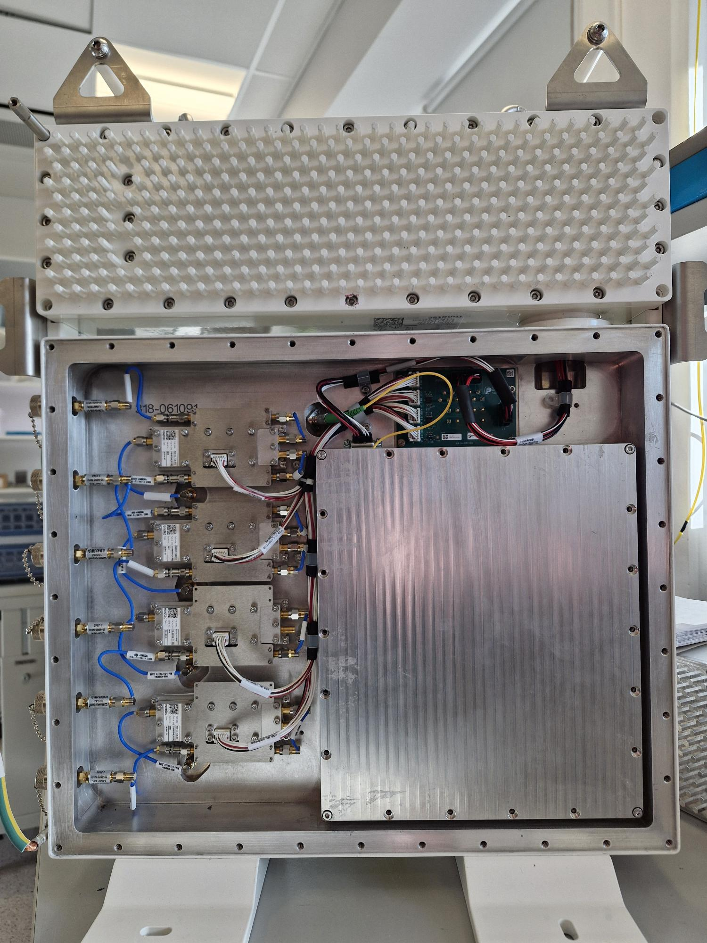
RXS123
Receiver
Bands 1 and 2,
Band 3 has been removed
Signal condition
Digitalization

Slide 7
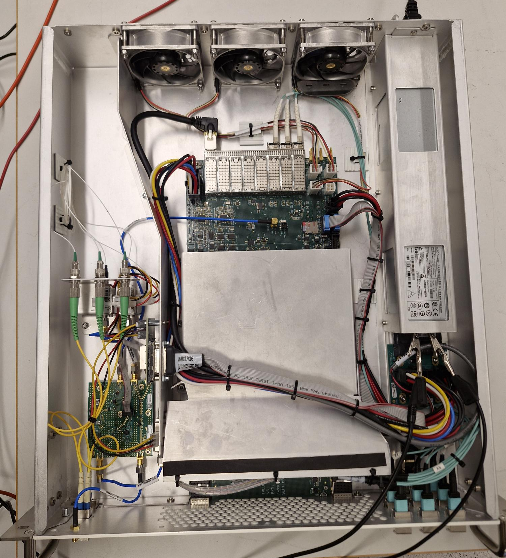
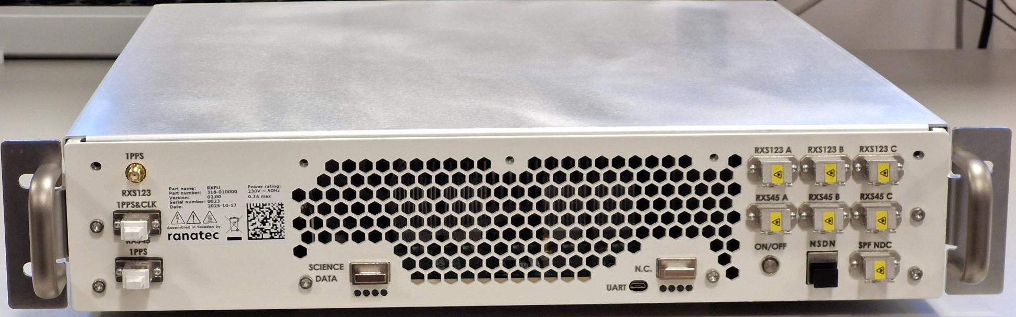
RXPU
Receiver Pedestal Unit
Receives data streams from RXS123 and RXS45
Writes data to Ethernet frames and send it to the CPF

Slide 8
Alternative solution for synchronization
Sampling frequency generation turns out to be in the critical path of the SKA-Mid installation.
Qamcom was asked during the Spring 2025 to produce a temporal solution to be used for the first 20-30 Dishes. Solution should be good enough for scientific data.
We took the challenge.

Slide 9
Alternative solution for synchronization
RXS.WR
Frequency reference:
  Selected solution is to use already available White Rabbit synchronization network for the frequency and time reference
Deliver a 3.96GHz electrical signal to the clock synthesizer inside the RXS123
  RXS.WR has been designed to be replaceable with the SAT.RM with same functionalities
The solution must ensure a sufficiently stable 3.96GHz signal (i.e. 3.96GHz + k*1800Hz, k= 1..2222)
  Selected PLL and CRO can produce required signals without frequency error.
That meets the RXS123 requirements (e.g. ENOB, sampler jitter noise, RFI/EMC etc.) and SAT’s 1% coherence loss requirement, with a target of achieving stability as close as possible to the SAT RM.
  Requirements are still under first verification tests but with high confident we can say that:
    With RXS.WR installed the coherent loss is less than 1% for the bands 1 and 2 or close to 2 % for band 5
    RFI emissions are comparable to present configuration
First version of the RXS.WR modules are tested and second version is in production. We have been asked to deliver first two SPFRXS123 with the new clock solution at the end of the April for site testing.

Slide 10
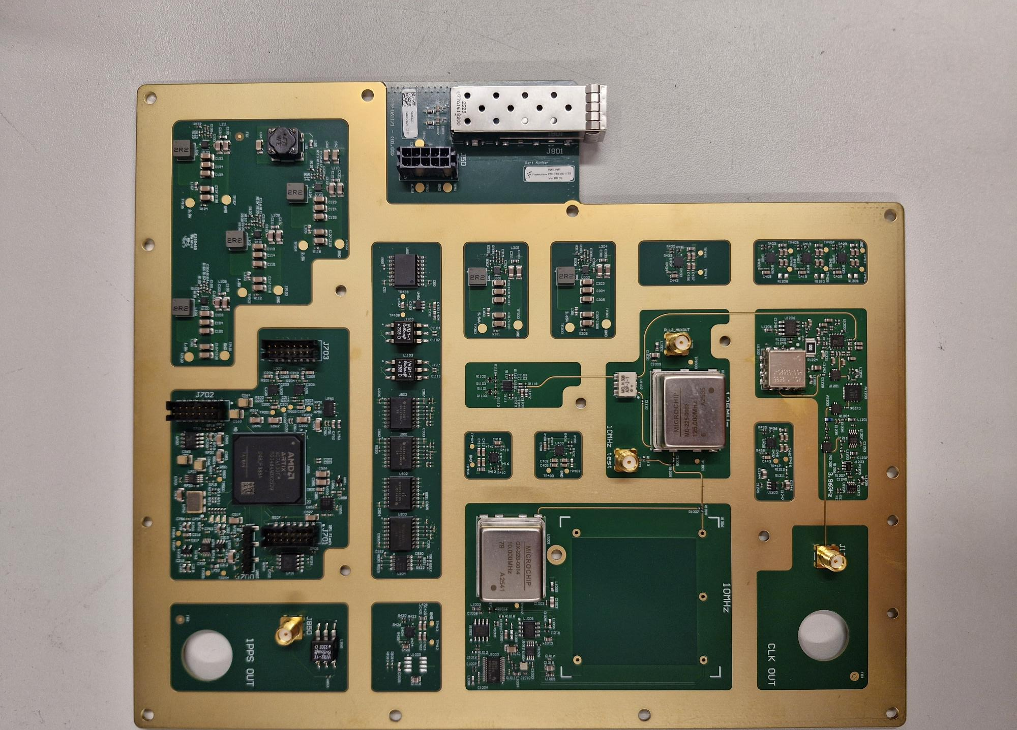
RXS.WR

Slide 11
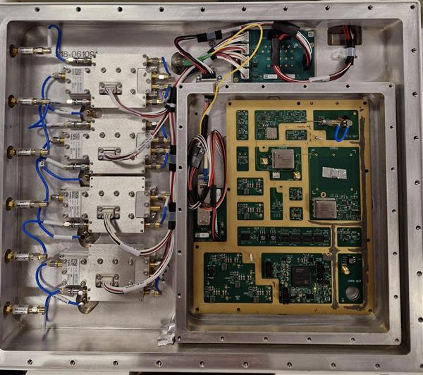
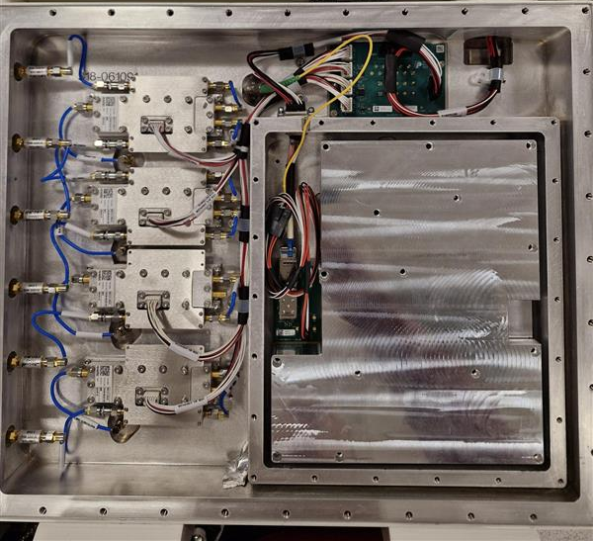
RXS.WR card

Slide 12
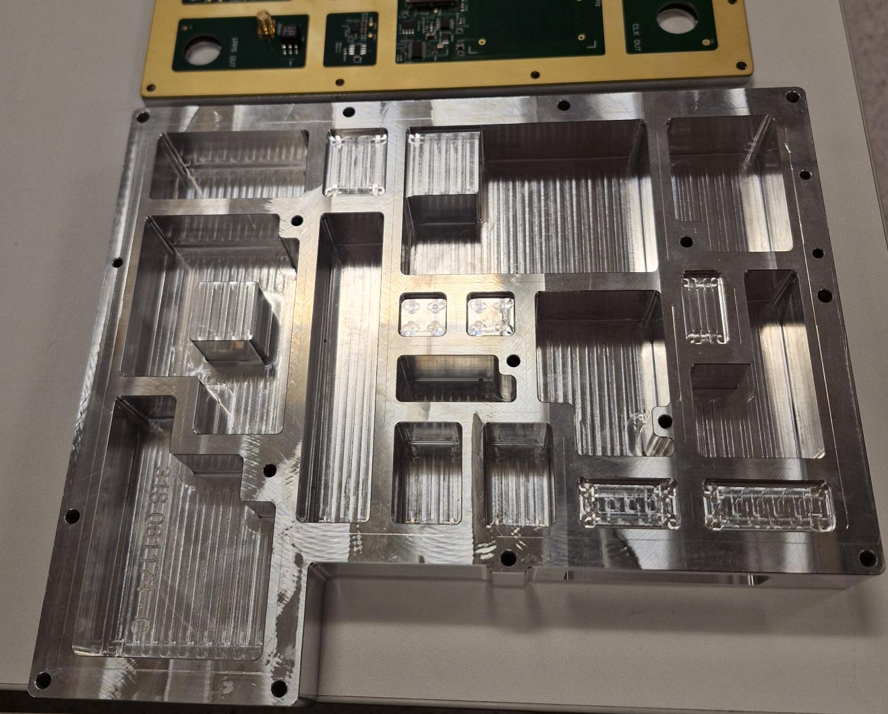
RXS.WR Mechanics
RFI shielding and cooling.

Slide 13

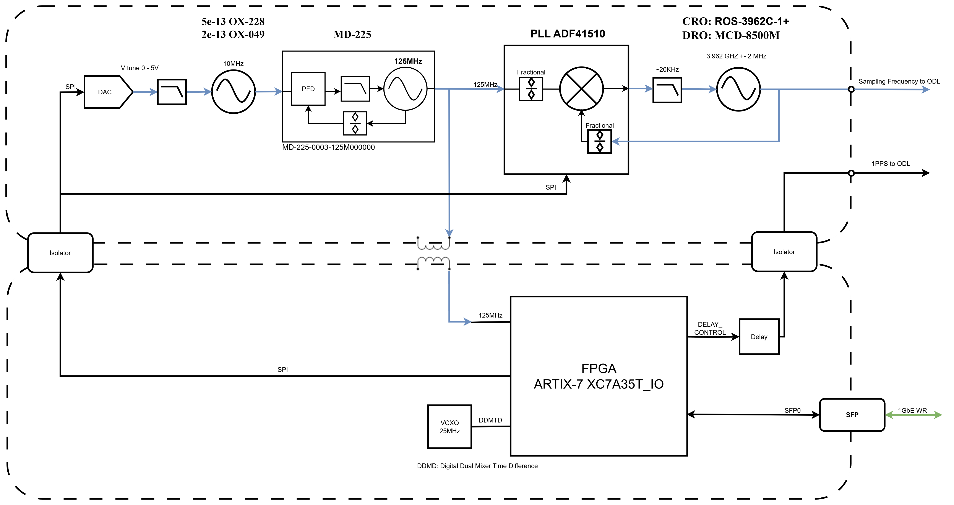
RXS.WR
Simplified block diagram

Slide 14
RXS.WR Phase Noise
Requirements and Measurements
Clock jitter from 10 Hz to 2GHz is required to be <100 fs. Measurements shows that new solution can deliver close to 90 fs jitter.
Phase noise in the sampling clock will add jitter and thus increase noise to the data.
ENOB (Equivalent Number of Bits) shows how close to the theoretical values ADC performance is.
We measured the new solution to have ENOB of 8.5 bits when SKA_Mid requirement is 8.0. Results are comparable to the original solution.

Slide 15
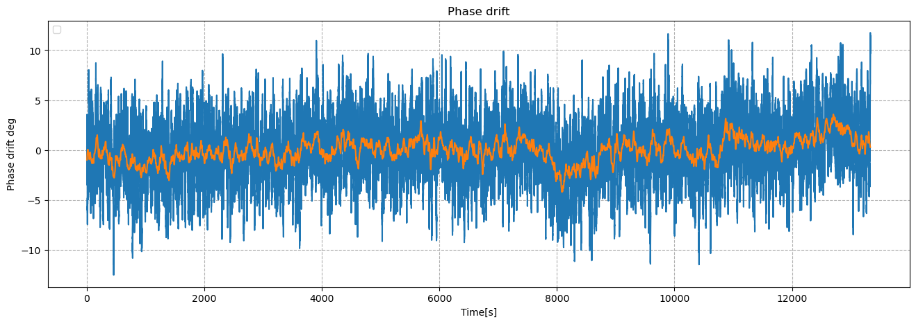
RXS.WR Phase noise
RXS.WR board 3.962 GHz 4-hour data, RMS phase error 3.0 deg .
Blue: Raw 1.5 KHz bandwidth
Orange: 1 min average
ENOB (Equivalent Number Of Bits) Better than 8.0
Measured ENOB is 8.5 which is same as with the present solution

Slide 16
RXS.WR Frequency Stability
Requirements
Table 1: The requirements of the frequency distribution stability on one link in
terms of Allan deviation at 1 second, at 15.4GHz operating frequency in the two
cases white phase and white frequency phase noise, for coherence loss of 1% and 1,9%.
 | Coherence loss 1% | Coherence loss 1.9%
Allan deviation at 1 second on one link for White phase noise | 1.77e-12 | 2.47e-12
Allan deviation at 1 second on one link for White frequency noise | 3.25e-13 | 4.52e-13

Slide 17
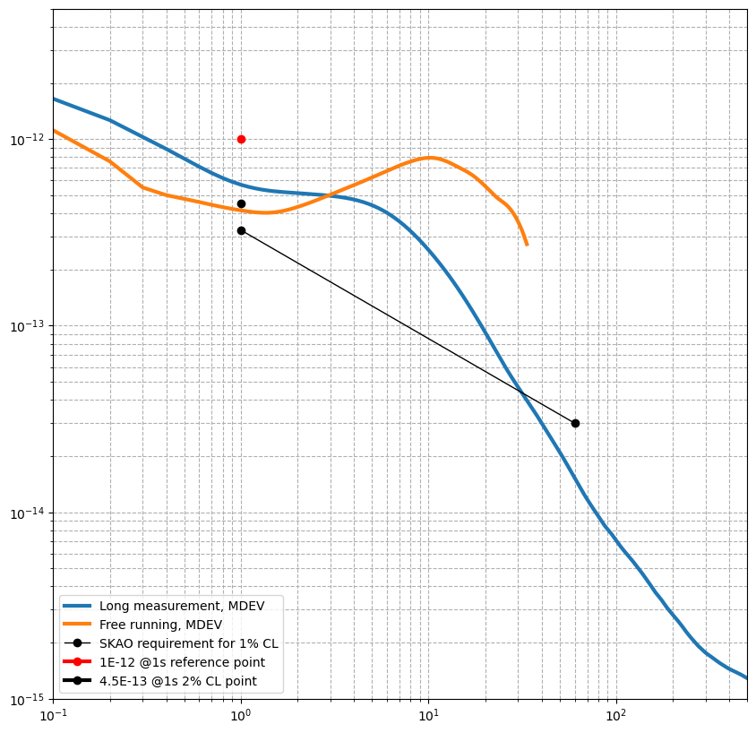
RXS.WR Frequency Stability
RXS.WR board 3.962 GHz MDEV measurements
Free running clock
2 % (1 link) CL limit for
15 GHz (Band 5)
1 % (1 link) CL limit for
15 GHz (Band 5)
Modified Allan Deviation

