Slide 1
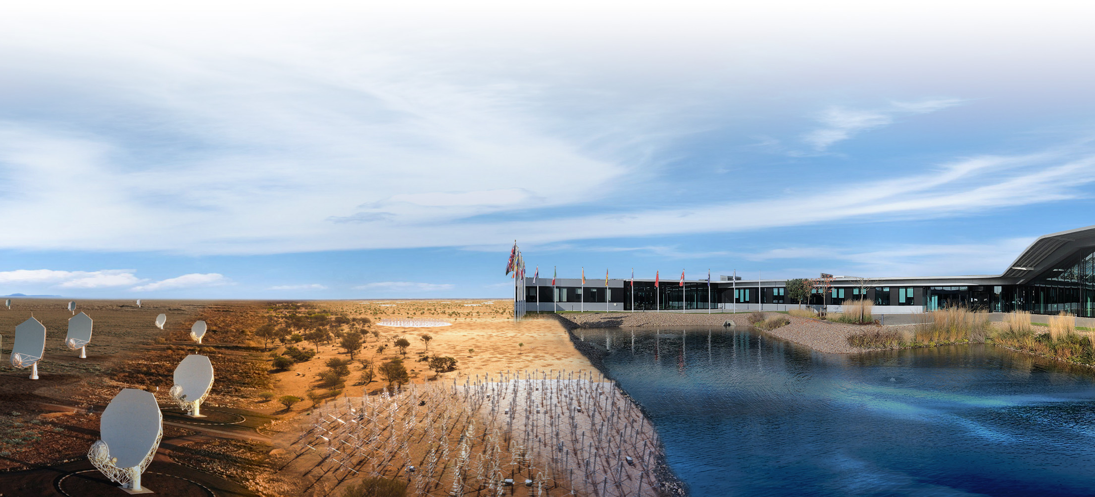
Science with the SKA Observatory
Dr Anna Bonaldi, Senior Scientist
Sweden SKA Science days, 10/9/24

Slide 2
Science drivers and requirements

Slide 3
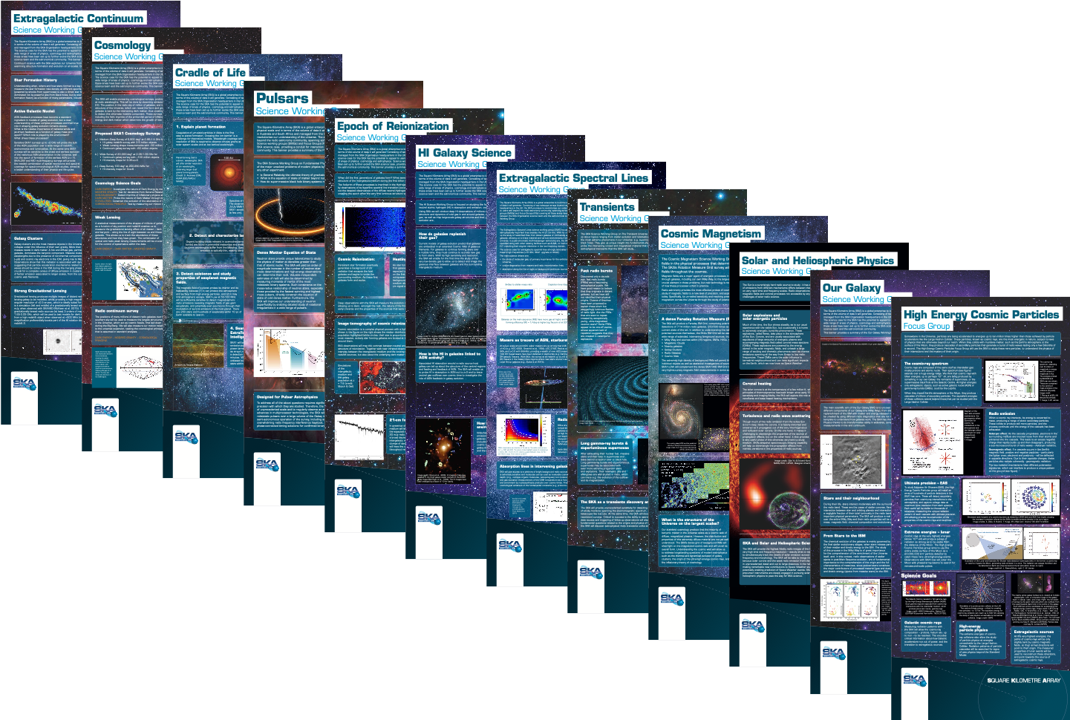

Slide 4
Cosmology Cosmic Dawn and Epoch of reionization
Studying the Universe as a whole with wide and deep surveys
Exploring the formation of the first stars and galaxies in the Universe
Haynes et al. 2011
230-50 MHz, SKA Low

Slide 5
Evolution of galaxies:
Extragalactic continuum
HI galaxy science
The whole lifecycle of a galaxy, from gas, to stars, to accretion into a central black hole

Slide 6
Extragalactic spectral line
Our Galaxy
Evolution of galaxies:
The spectra of galaxies reveal their composition, and there’s much more than hydrogen!
Muller et al 2013
GHz
Credit: SARAO
Credit: SARAO
And, of course, our own Galaxy, the Milky Way, has VIP status!

Slide 7
Cosmic magnetism
We can measure the magnetic fields in galaxies and clusters

Slide 8
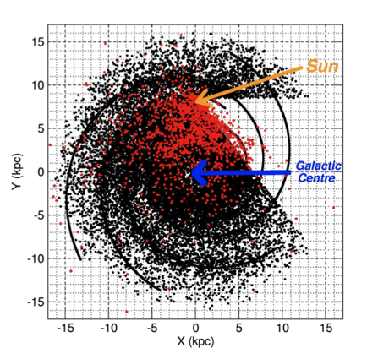
Pulsars
Transients
Gravitational waves
The Transient radio sky
Artist’s conception of a long gamma-ray burst. Image credit: NASA
Pulsar survey of the galaxy – 50% of all Galactic pulsars detectable with SKA
Pulsars are incredible tools to study the theory of Gravity and much more…
Artist’s conception of a gravitational wave. Image credit: NASA
The transient Universe is still largely unexplored

Slide 9
Cradle of life
What makes life possible? From planet formation to life and intelligent life on other planets!
Image credit: Daria dall’Olio
Credit: S. Andrews (CfA), ALMA (ESO/NAOJ/NRAO)

Slide 10
Solar and Heliospheric and Ionospheric Physics
…and finally home, to our own Sun
Image credit: Mondal et al. 2019
Image credit: SOHO, ESA & NASA

Slide 11
VLBI
The sharpest and deepest view of the Universe

Slide 12

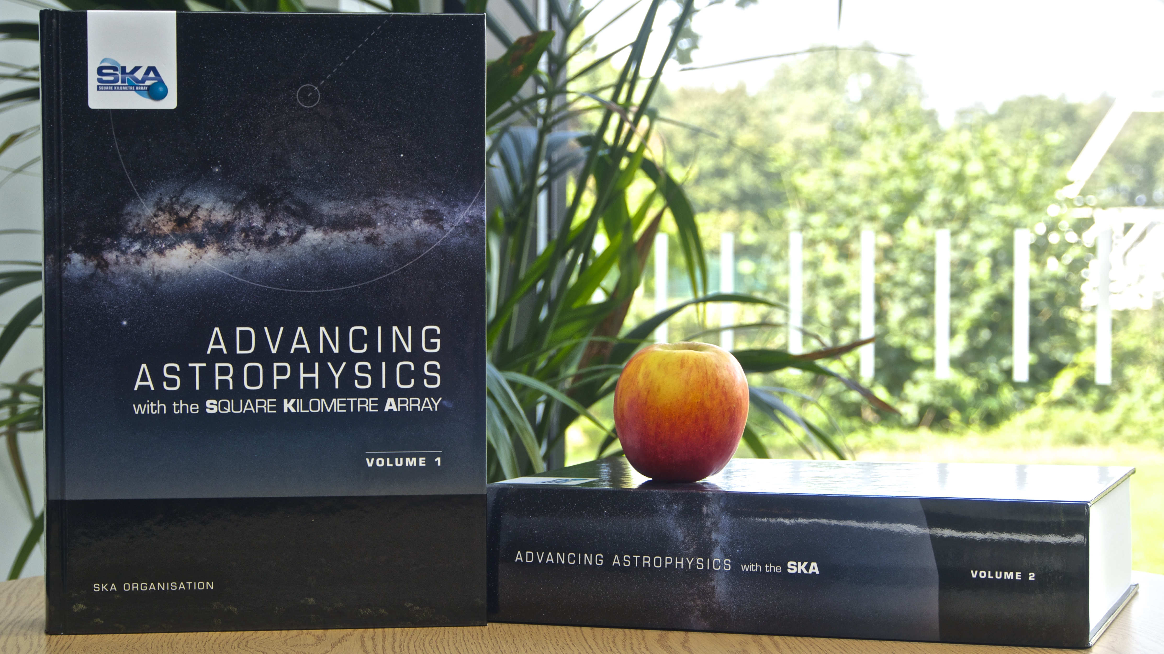
Update to the 2015 science book
Evolution of science cases and priorities
Larger set of SWGs
Mature set of telescope specifications, accessible through tools (e.g. sensitivity calculator) as well as documentation
2015 science book
2025 science book
9 -13 June, 2014
Giardini Naxos, Italy

Slide 13
Update to the 2015 science book
How do I get involved?
Within SWG
Outside SWG
SWG chairs are inviting proposals for intended contributions
Answer to the call of your chairs, contribute to chapter list definition and the articles themselves!
Expression of interest to contribute to a chapter by 30th September
Expression of interest to contribute to a chapter by 30th September
              Submission of title and short abstract
Indicate relevant SWG (if applicable)
Option to ask to join relevant SWG
SWG chairs/SKAO will review your request (check for duplication, etc.) and confirm
More details available at https://www.skao.int/en/science-users/557/advancing-astrophysics-ii-preparing-science-skao
For all enquiries about the new SKAO science book please contact us at advancingastrophysicsii@skao.int

Slide 14
2025 conference and book dates
30th Sept: deadline for expression of interest
1st Oct - 31st Jan: advanced chapter drafts submission
Jan 2025: registration open for the conference
Feb-March: selection of talks/posters for the 2025 science meeting from the draft chapters
Mid-March: speaker notification
March-May 2025: science meeting registration
16-20 June 2025: science meeting
Final chapter submission and peer review after the meeting
More details available at https://www.skao.int/en/science-users/557/advancing-astrophysics-ii-preparing-science-skao
For all enquiries about the new SKAO science book please contact us at advancingastrophysicsii@skao.int

Slide 15
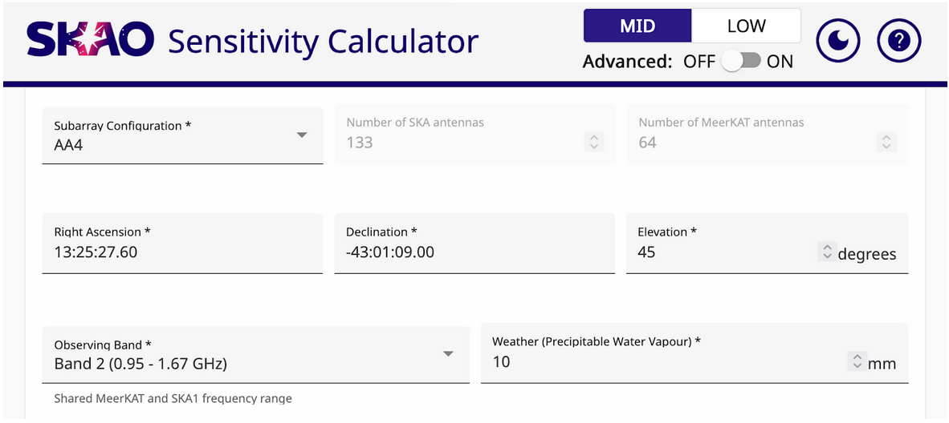
SKA Mid sensitivity calculator

Slide 16
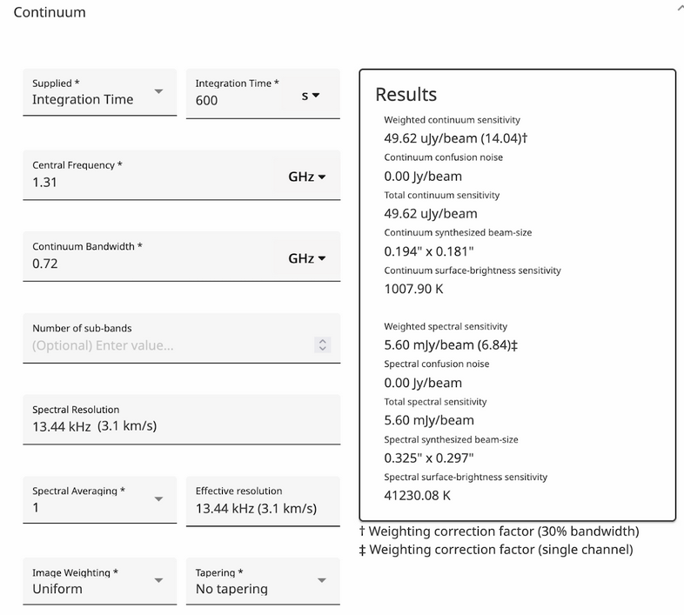
SKA Mid sensitivity calculator

Slide 17
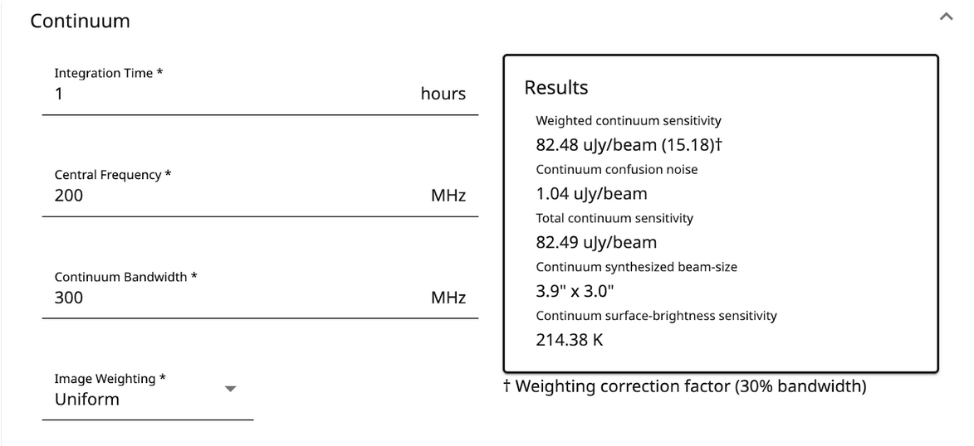
SKA Low sensitivity calculator

Slide 18
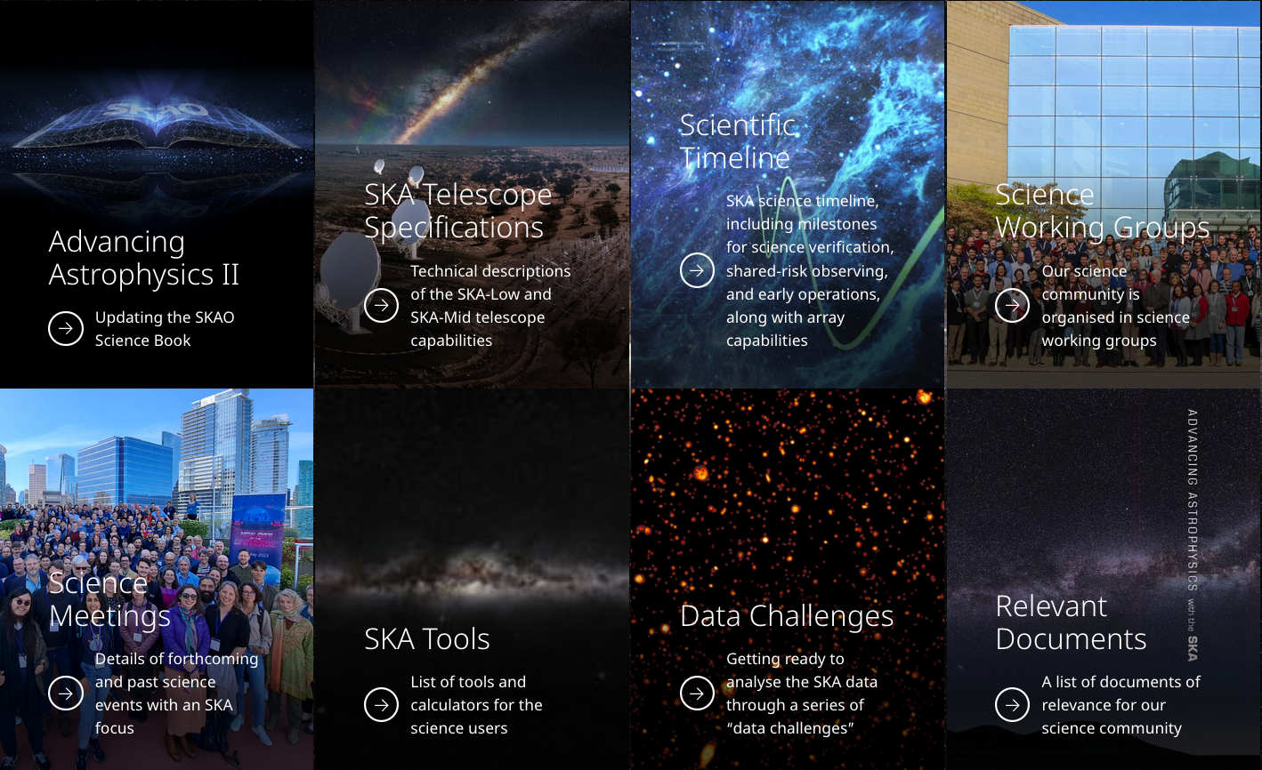

Slide 19
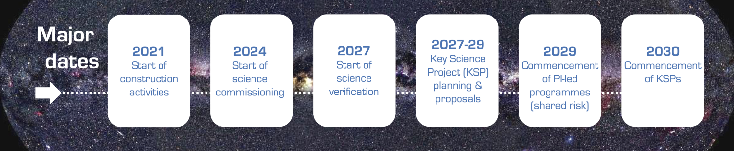
SKAO Construction timeline

Slide 20
Telescope Access
PI-led
(~30-50%)
KSPs
(~50-70%)
Members (and Associate Members)
Can lead any program (KSP, PI)
Can be part of KSP leadership teams
Access in proportion to member share
Non-Members
Can lead PI programs
Can be team members of KSPs, but not part of leadership team
Access capped at 5% (”Open Time”; TBC by Council)
Access to any individual non-member entity may be capped
Member Access
Open Time

Slide 21
Proposal Types
Key Science Projects (KSPs)
Large programs that require the allocation of significant observing time (at least a few x 100h ? - TBC) and resources, performed over multiple cycles (nominally 1 cycle = 1 year)
Leadership team from SKA-member countries; co-Is from any country (latter may be limited)
Expected to provide added-value data products and tools back to SKAO
Regular reviews to track progress toward goals
Principal Investigator (PI) Projects
Smaller programs (< KSP) performed within a single cycle
Director-General’s Discretionary Time
Time allocated by the D-G outside of the normal TAC process
PI-led
(~30-50%)
KSPs
(~50-70%)
Indicative allocation split over first 5 years of normal operations

Slide 22
Science Data Challenges: What are we trying to achieve ?
Prepare Science Community
    Science extraction from SKA Observatory Data Products (ODPs)
    Stimulate advance of state-of-the-art data analysis techniques that are relevant for SKAO
    Promote reproducibility and analysis pipeline sharing
Provide test cases for SRCNet development
    Test increasingly realistic data transfer, user access and customised user processing
Constrain SDP Pipeline development
    Identify gaps in sky, telescope and error models
    Determine necessary calibration quality and identify any other factors that might inhibit science extraction from ODPs

Slide 23

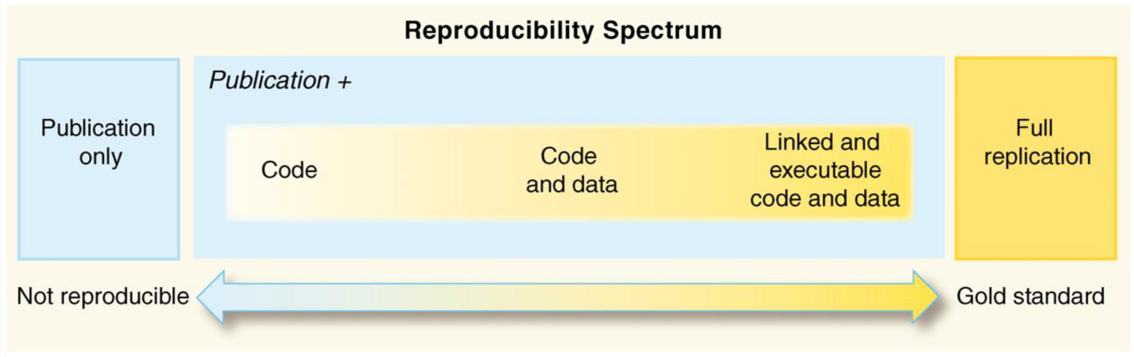
Reproducibility awards/badges – SDC2 onwards
Reproducibility
Is the pipeline:
Well-documented
Easy to install
Easy to use
Reusability:
Does the pipeline:
Use an open licence
Have findable code
Use code standards
Use built-in tests
Teams are evaluated on the reproducibility of their results
Separate evaluation from the main challenge score

Slide 24
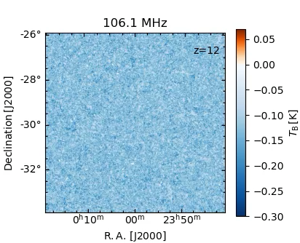
Science Data Challenge 3 2023+
Epoch of reionization
  SDC3a ”Foregrounds” (SDC3a; SWG Coordinators: C. Trott, V. Jelic)
    Foreground removal exercise
    SDC3a started 1 March 2023, closed 30 Oct 2023
  SDC3b “Inference” (SDC3b; SWG Coordinators: A. Mesinger, G. Mellema)
    Extraction of cosmological parameters
    SDC3b ongoing
Pause and reconfigure
1 March – 30 October
9 months
Foregrounds (SDC3a) challenge runs
Inference (SDC3b) challenge runs

Slide 25
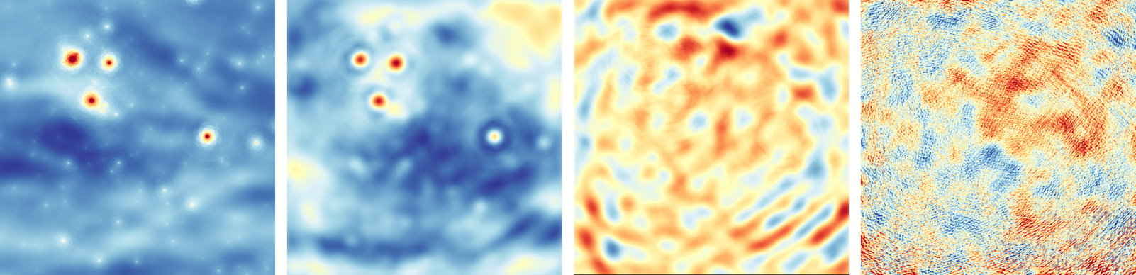
SDC3 Foregrounds: challenge concluded
Example from the Himalaya team, which uncovered the underlying signal from the era of the first stars (far-right) by iteratively removing layers of galaxy 'foregrounds' (from left to right). Credit: Dr Le Zhang, Sun Yat-Sen University.

Slide 26
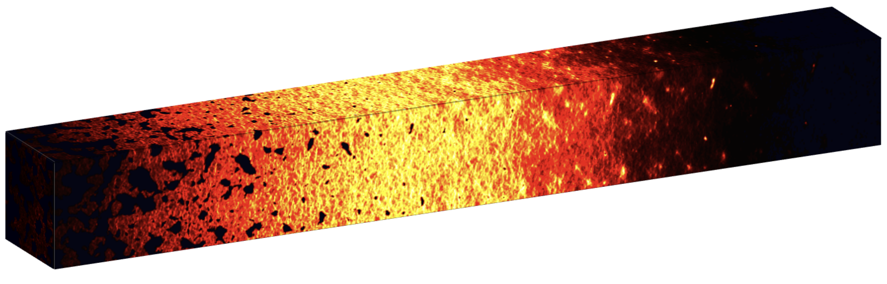
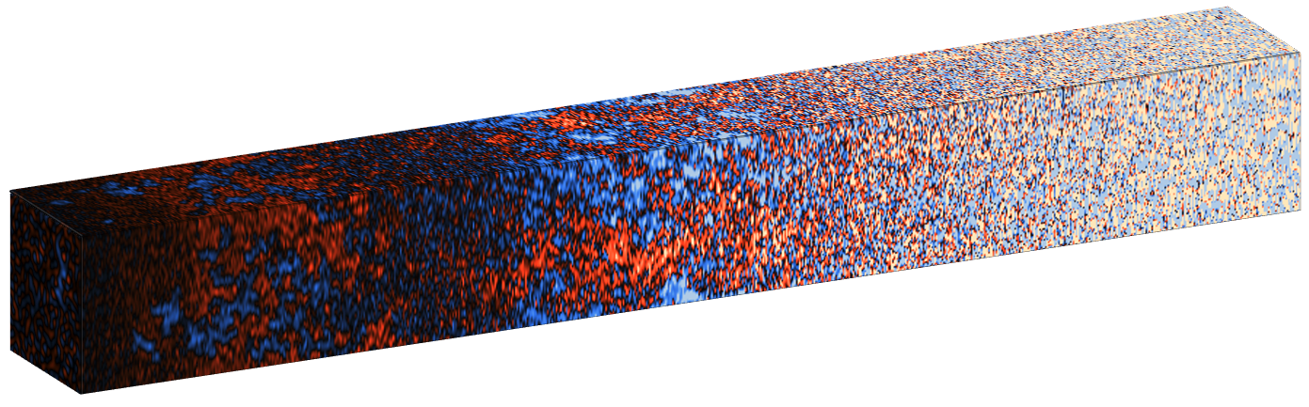
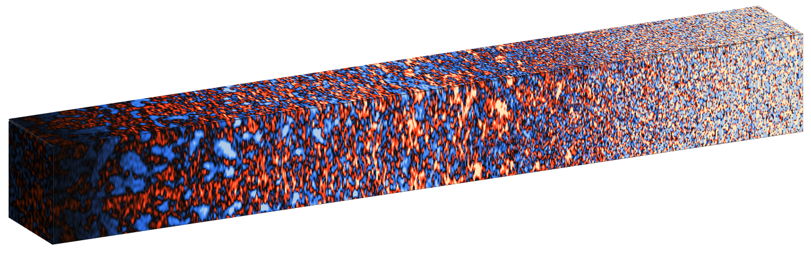
Simulation
Astrophysics
Observation
GIVEN
Cosmology
Park+2019
Ts>>Tcmb
Cleaning
(backward modeing)
Telescope
simulator
given noise PS (tbc)
Compression
Compression
sim 2D PS
Likelihood (analytic / LFI)
data 2D PS
the first step in bringing together the global 21cm interpretation community
slide courtesy of A. Mesinger
P( x_{HI}(z) | data 2D PS)

Slide 27
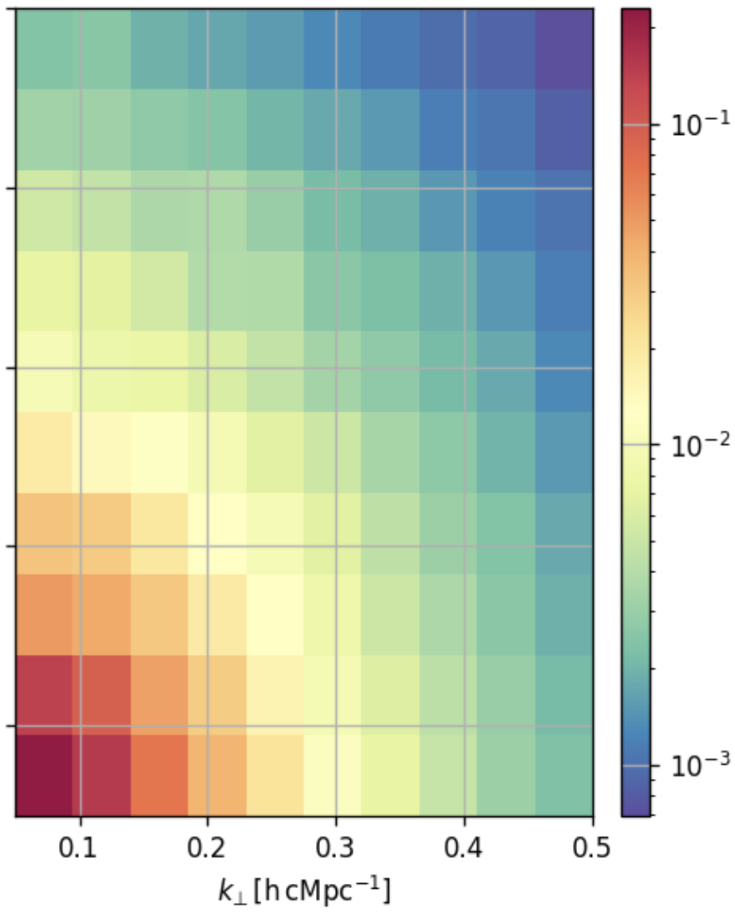

Science Data Challenge 3b: EoR Inference
The challenge:
  Infer the reionization properties of the Universe from power spectra of the hydrogen-21cm signal from the Epoch of Reionisation corresponding to different redshift ranges.
  Submission will consist of inferred reionization fraction of the Universe for all the redshifts for which power spectra have been provided, and the associated uncertainty.
Computation support
  SDC3 receives generous support from our international HPC partner facilities, who will provide computational resources to teams for processing the challenge data.

Slide 28
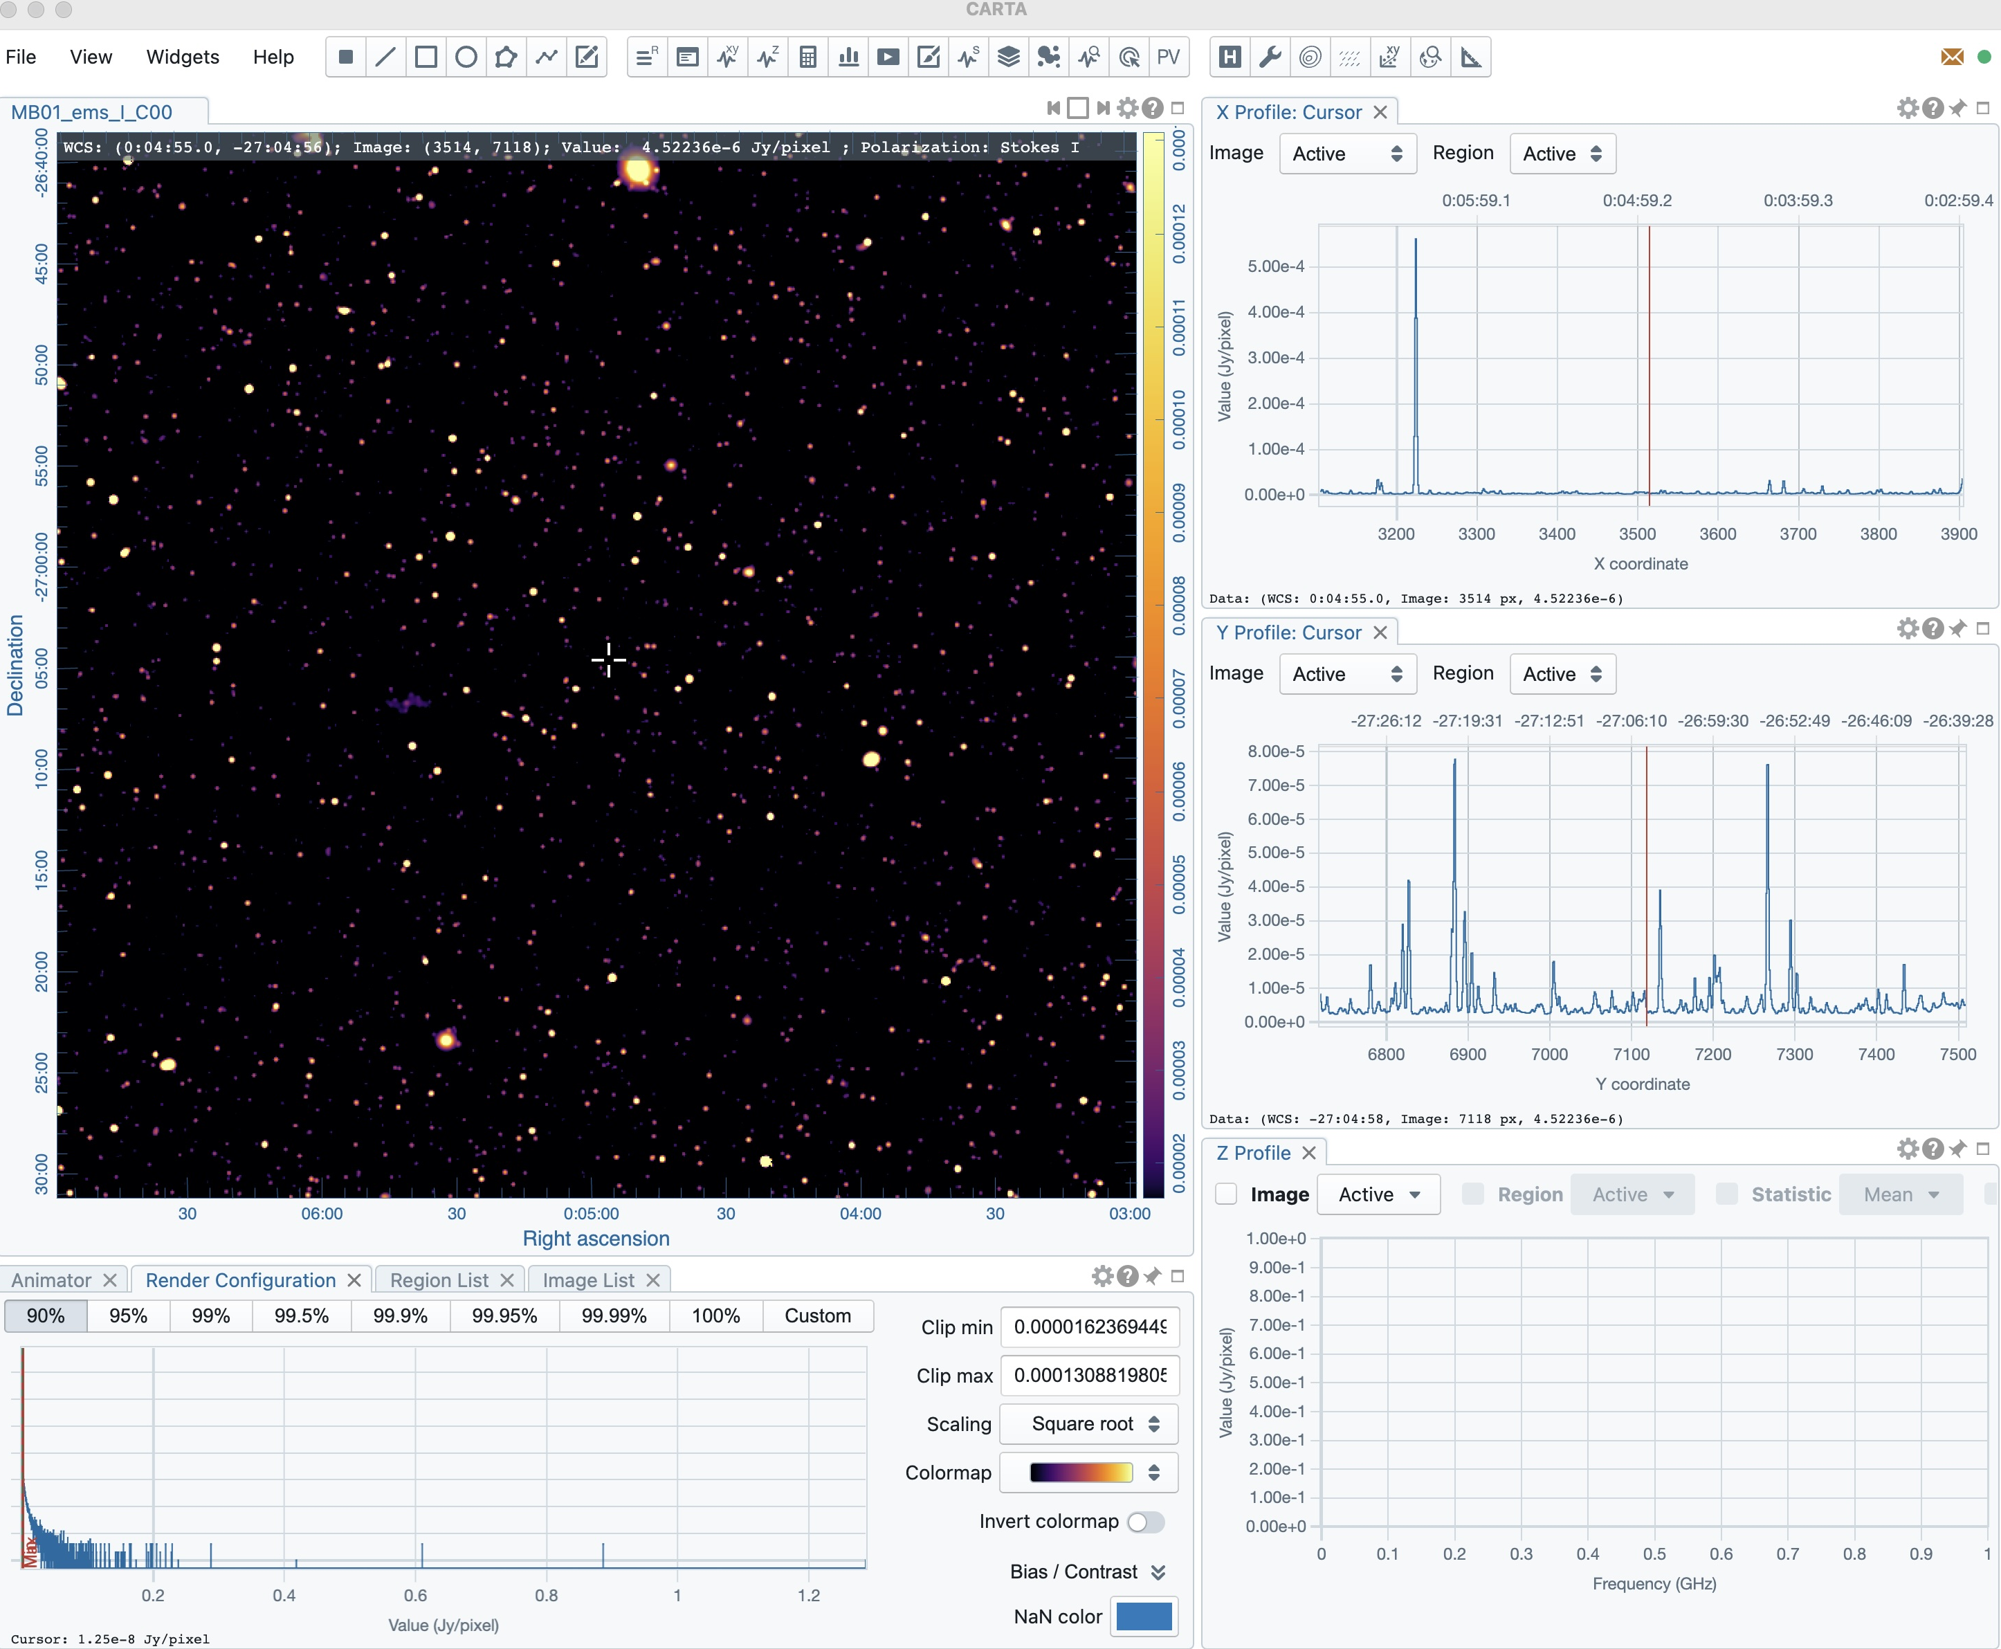
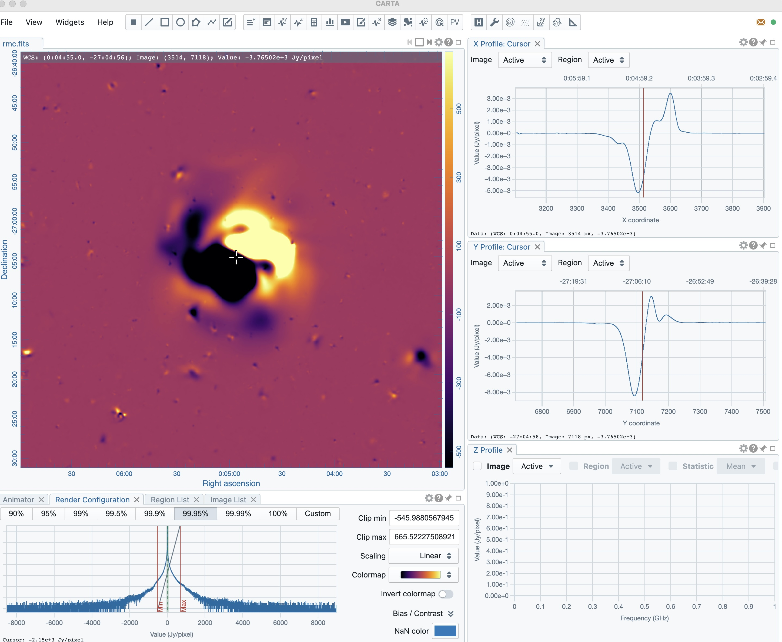
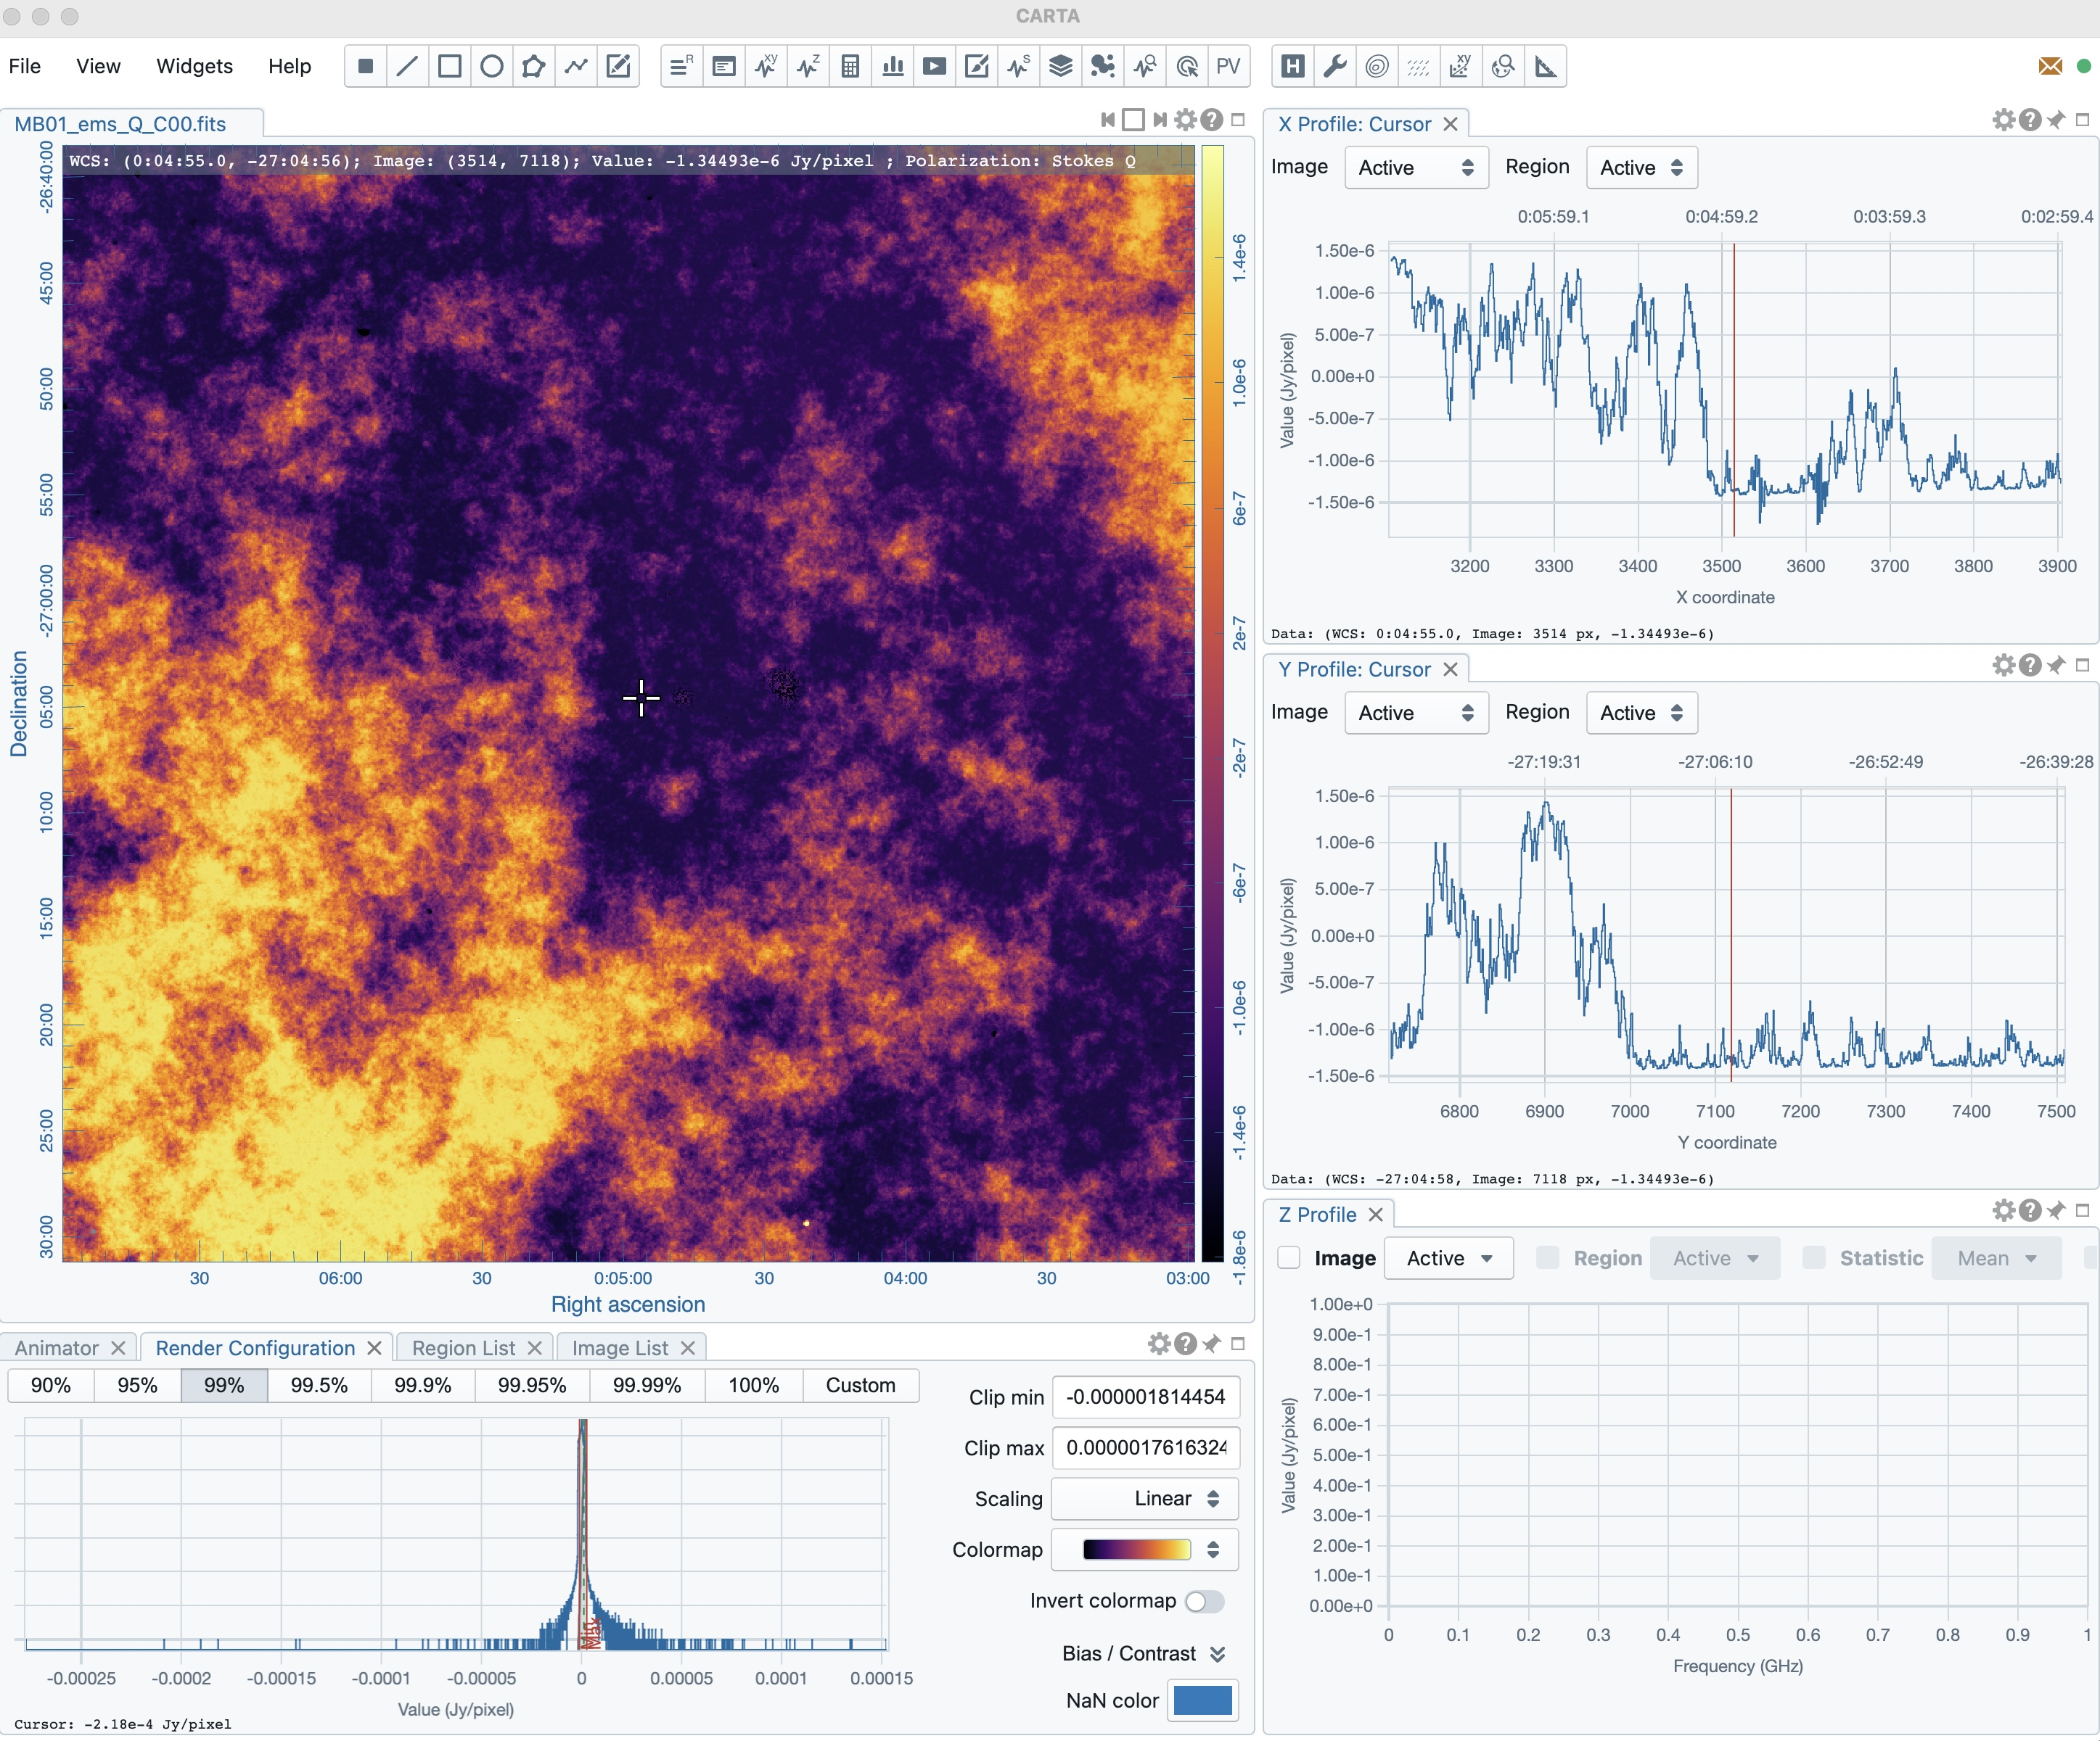
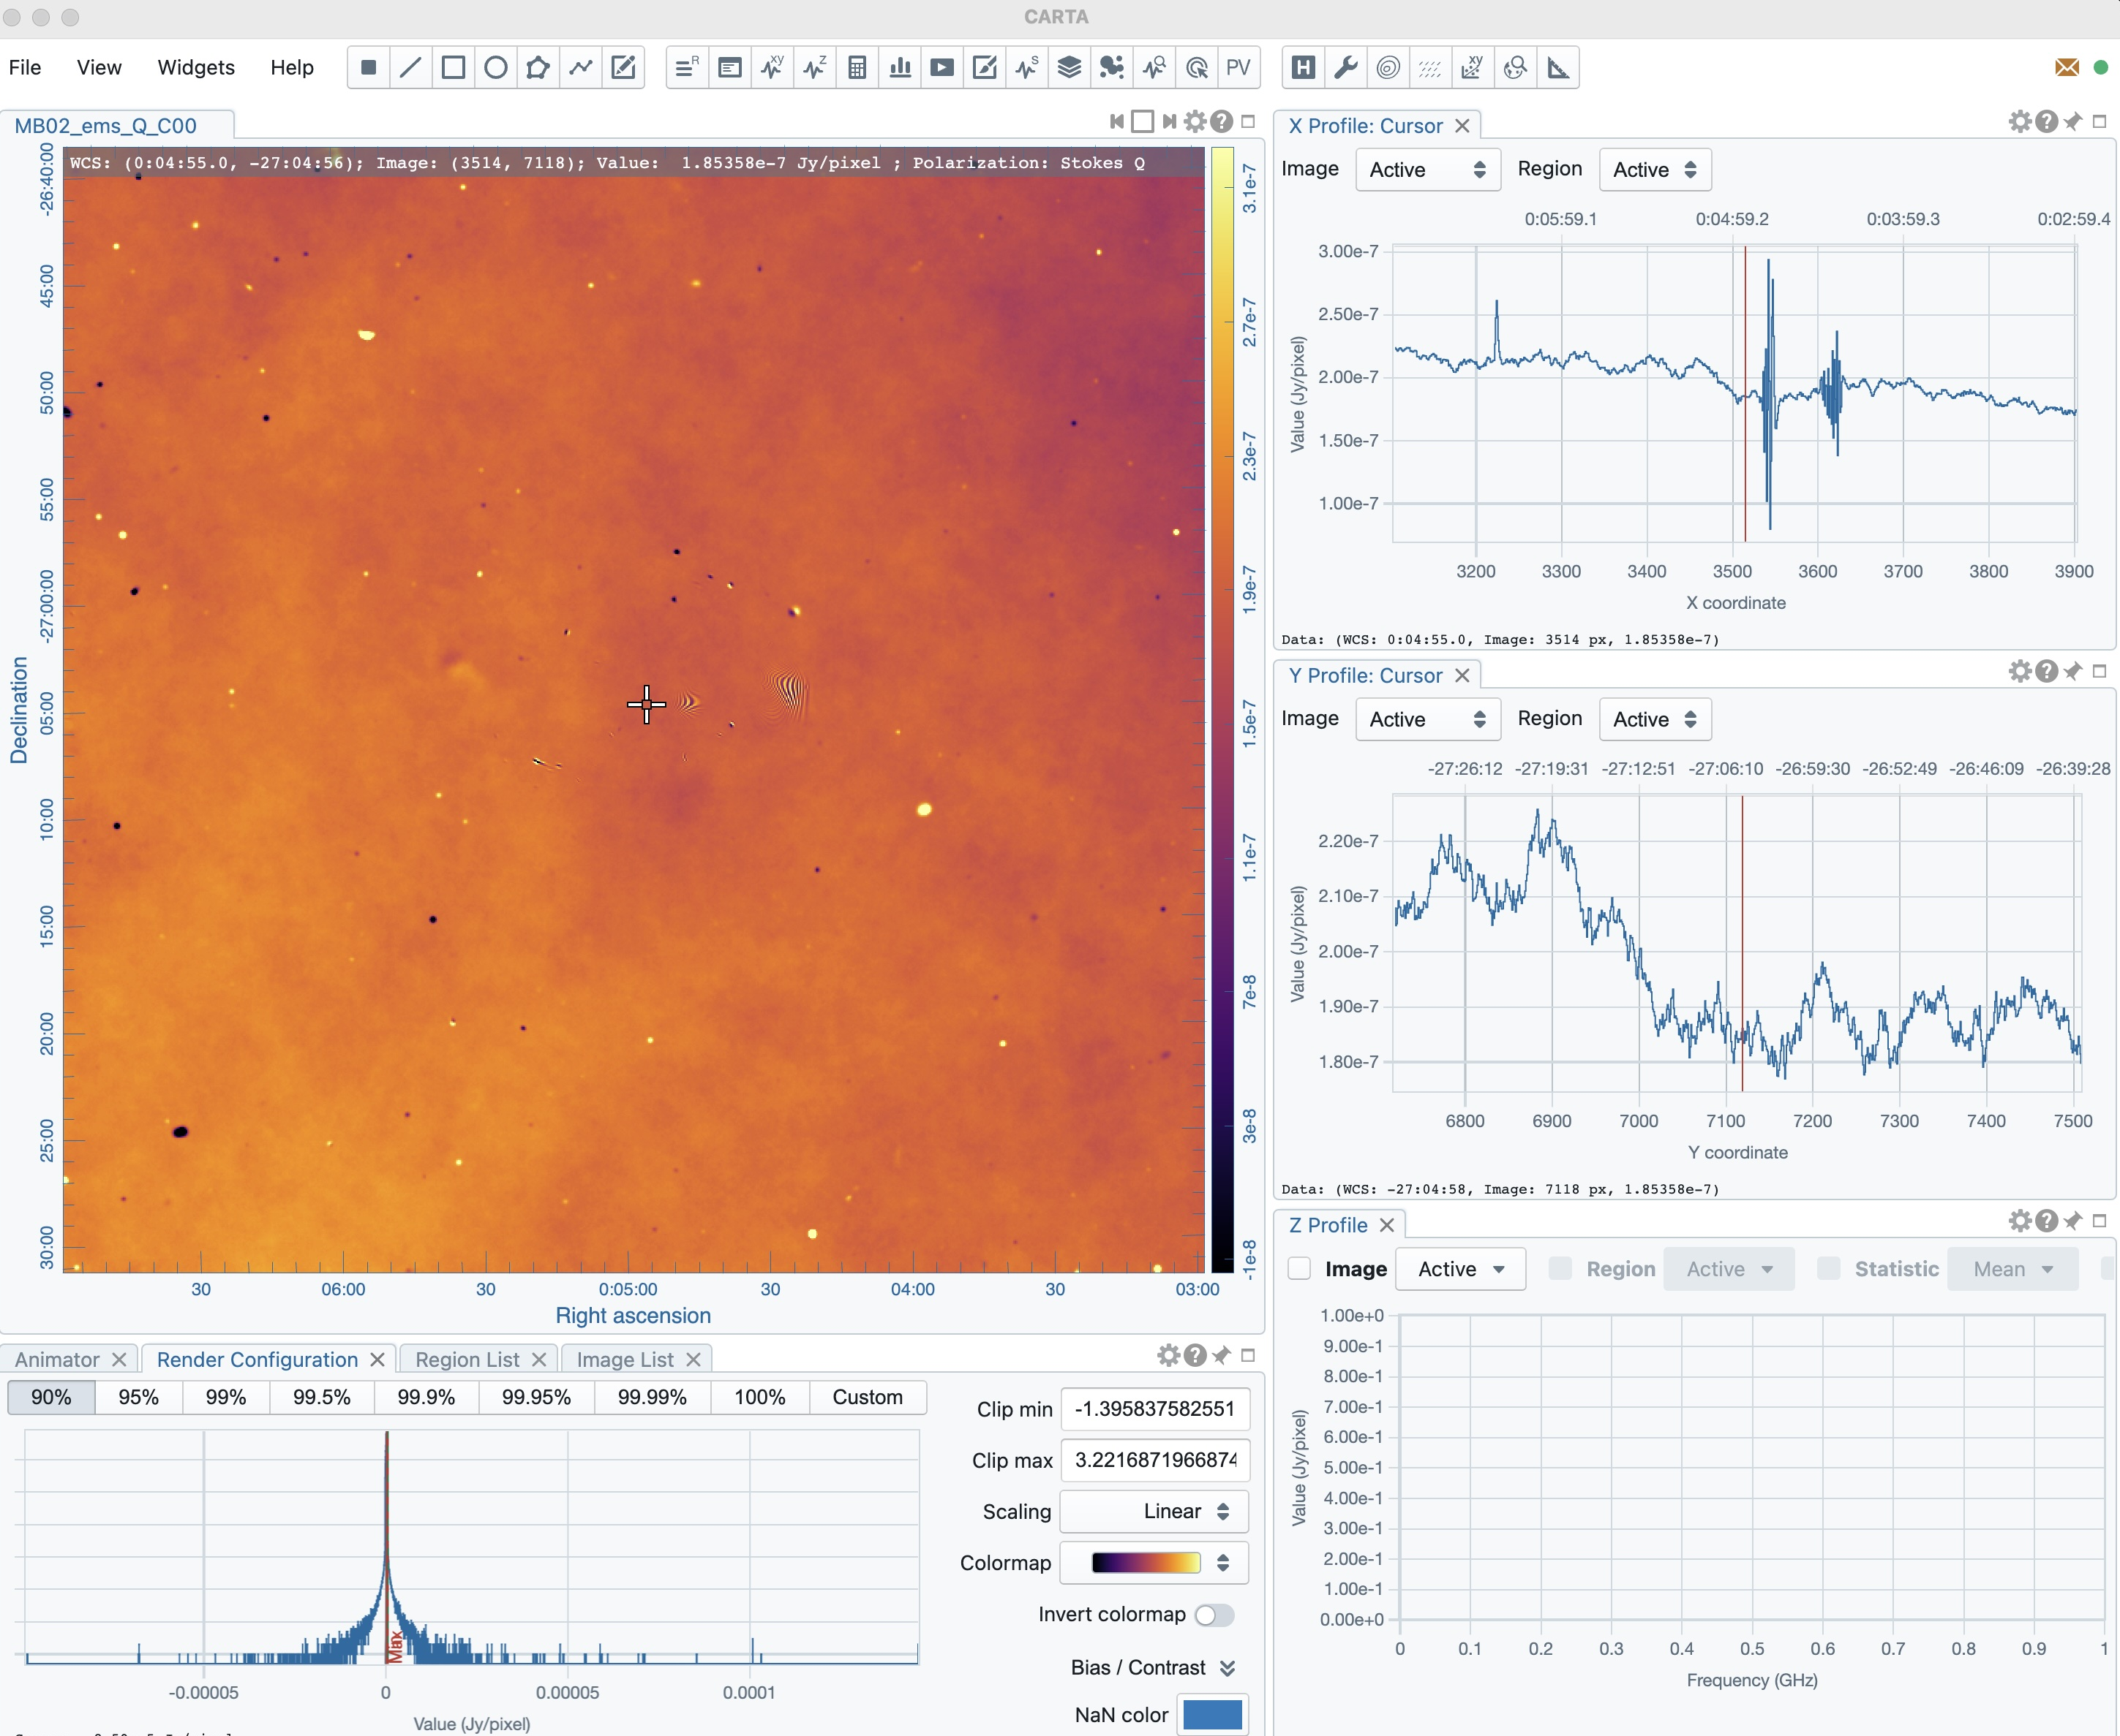
SDC4: Magnetism
Stokes I
Stokes I
Total RM
Developed in collaboration with Magnetism SWG (Akahori, Vernstrom, Vacca, …)
Source finding and characterization in polarization. SKA Mid and Low.
  Full Stokes compact plus diffuse sky model with IGM, ISM, and ionosphere propagation
  Thermal noise equivalent few 1000 h
Telescope and Error Models
Stokes Q 0.35 GHz
Stokes Q 0.35 GHz
Stokes Q 1.0 GHz

