Slide 1
Probing the Epoch of Reionization using the Square Kilometre Array
Sambit Giri NORDITA fellow
10 September 2024
Notes:
Hello everyone, I would like to thank the organisers for inviting me. I will discuss try my best to give an overview about how we can study the Epoch of Reionization with SKA.
I should mention that even though most of the results that I show today are taken from my work, there are numerous contemporary work going in this direction.

Slide 2
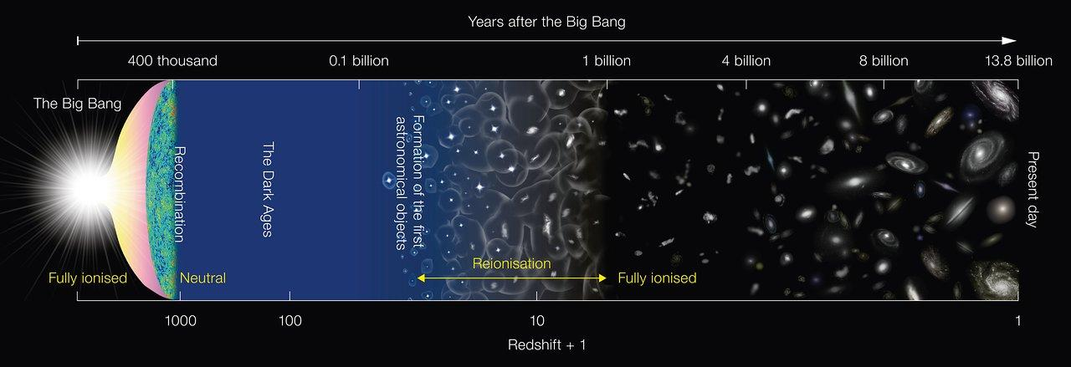
Credits: NAOJ
Cosmic Dawn
Cosmic Reionization
Telescopes are time machines that can help probe these past periods of our Universe.
Notes:
I will now use this popular illustration of the history of our universe to define the epoch of reionization. Our Universe began from a hot and dense state....

Slide 3
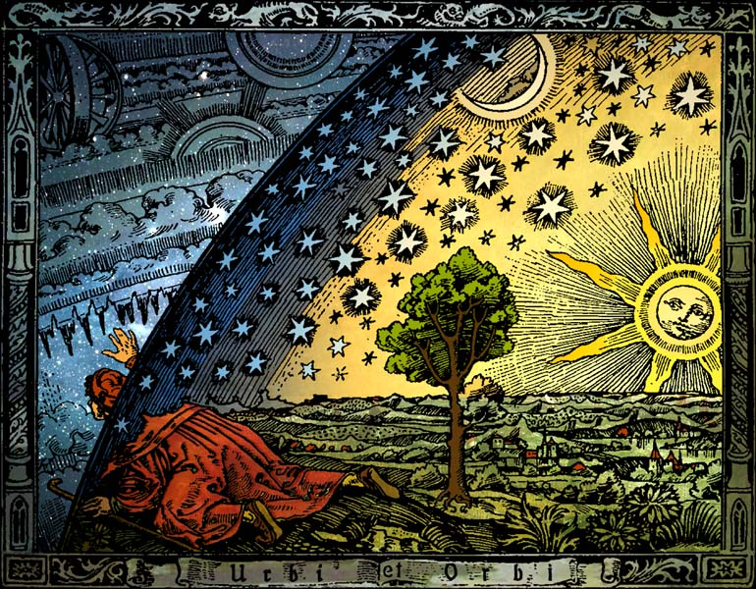
Quest to know our cosmic origins
“Man must rise above the Earth—to the top of the atmosphere and beyond—for only thus will he fully understand the world in which he lives.”
– Socrates
Flammarion engraving
Notes:
I want to start with this allegory to motivate why we are building the SKA. For me, this image represents our quest to know our cosmic origins. This represents our desire to go beyond the familiar framework to explore the unknown. Socrates has nicely put this while quoting “Man must rise…”

Slide 4
Content
The Birth of the First Galaxies
Probing the Early Universe with the 21-cm Signal
Current Constraints on the 21-cm Signal
Future Prospects with the SKA Telescope

Slide 5
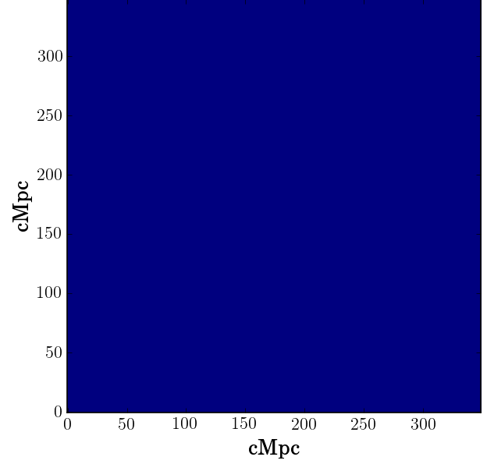
Simple picture of reionization
Blue represents neutral hydrogen
Notes:
I like to start with a simple picture to understand what happens during reionization. Here I have a blue canvas representing neutral hydrogen.

Slide 6
Galaxy formation in a metal-poor universe
Blue represents neutral hydrogen
(Nebrin, Giri & Mellema 2023)
Notes:
This early times was quite metal poor. Therefore the gas cooling was difficult to start all the other necessary processes to form. Several models have been proposed such as

Slide 7
Galaxy formation in a metal-poor universe
Blue represents neutral hydrogen
Molecular Hydrogen Cooling (e.g. Tegmark et al. 1999)
Dark Stars (e.g. Freese et al. 2016)
…
(Nebrin, Giri & Mellema 2023)
Notes:
Several models have been proposed such as molecular hydrogen cooling and metals formed in dark stars…

Slide 8
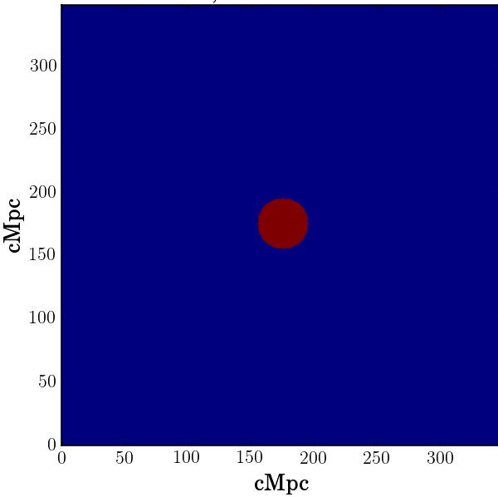
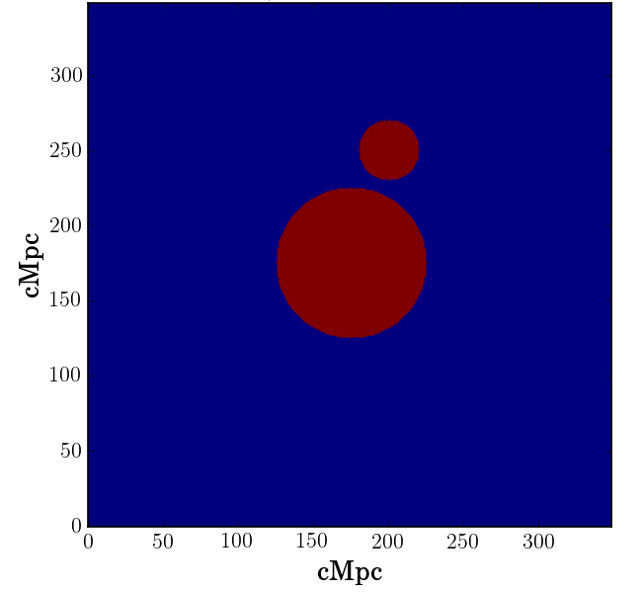
First galaxies form and ionized the IGM
Notes:
Once the first stars and galaxies form, they will emit photons into the intergalactic medium. These photons will ionize the gas creating ionization bubbles….

Slide 9
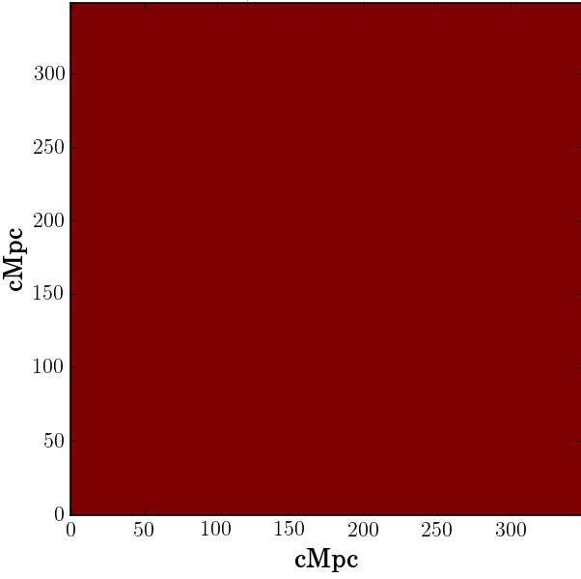
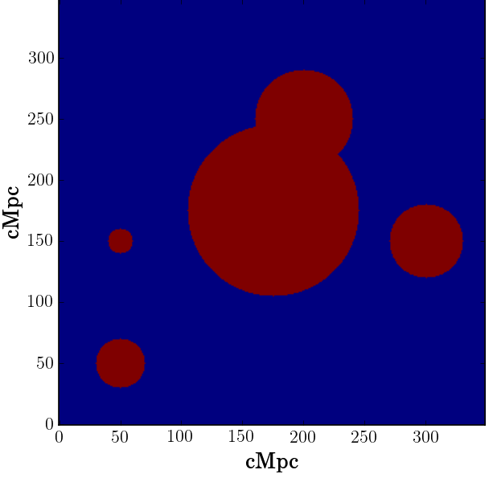
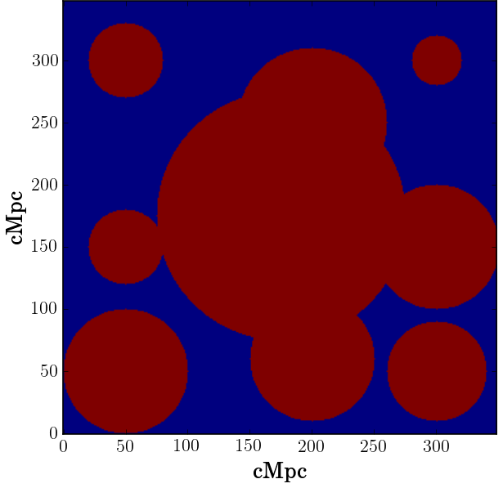
Ionized regions trace the early galaxies until the end of reionization
Notes:
- Reionization of the intergalactic gas is caused by galaxies that reside within less than a megaparsec
- The impact is see at very large scales.
- define the term “epoch of reionization”

Slide 10
Real picture is more complex
Simple picture
Cosmological radiative transfer (RT) simulation
Notes:
The real picture of reionization is much more complex.
The number of sources could be 90,000 instead of 9.
The data is 3D.

Slide 11
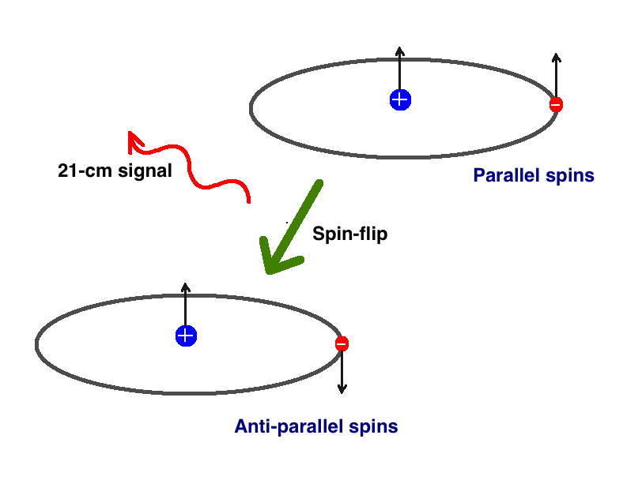
21-cm signal: spin-flip transition of neutral hydrogen
Neutral fraction
Baryon distribution
Gas temperature
Notes:
We can explore this complex pattern using the 21-cm signal. This signal is ….

Slide 12
Ionized regions are imprinted onto the 21-cm signal
Notes:
The reason why simulating, modelling and trying to understand these network of ionized regions is the 21-cm signal.

Slide 13
Reionization seen with 21-cm signal
Radiative transfer simulation (e.g. Giri+2018a; Giri & Mellema 2021)
Notes:
Speak about the axis and the colorscales. Dark blue is ionized.
Point out that these are results from C2Ray simulations
Point out the small ionized regions in the maps. This acts as a transition to the next slide where the small regions are not visible.
No observations yer. But it is future

Slide 14
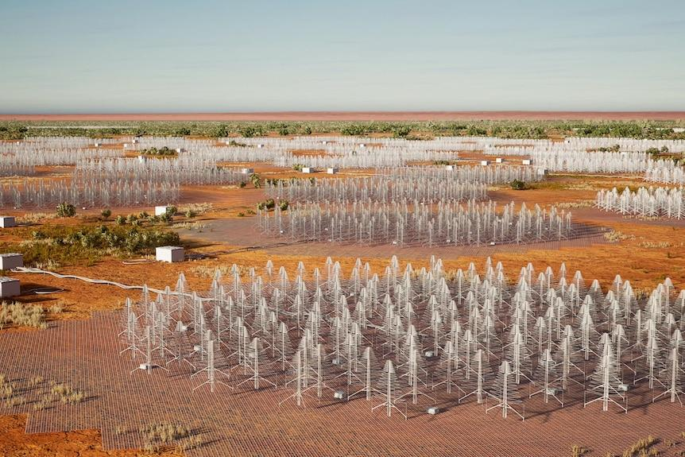
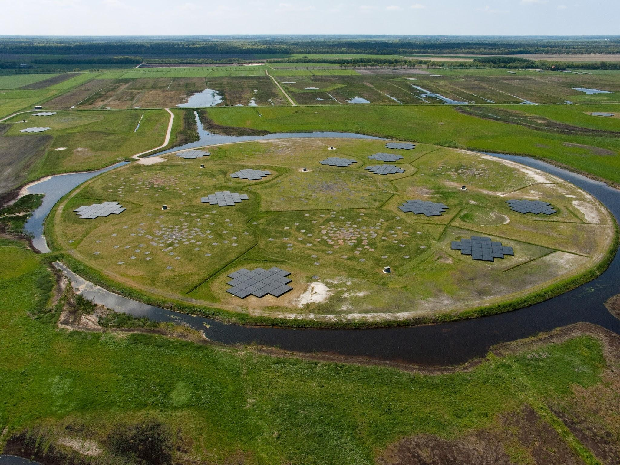
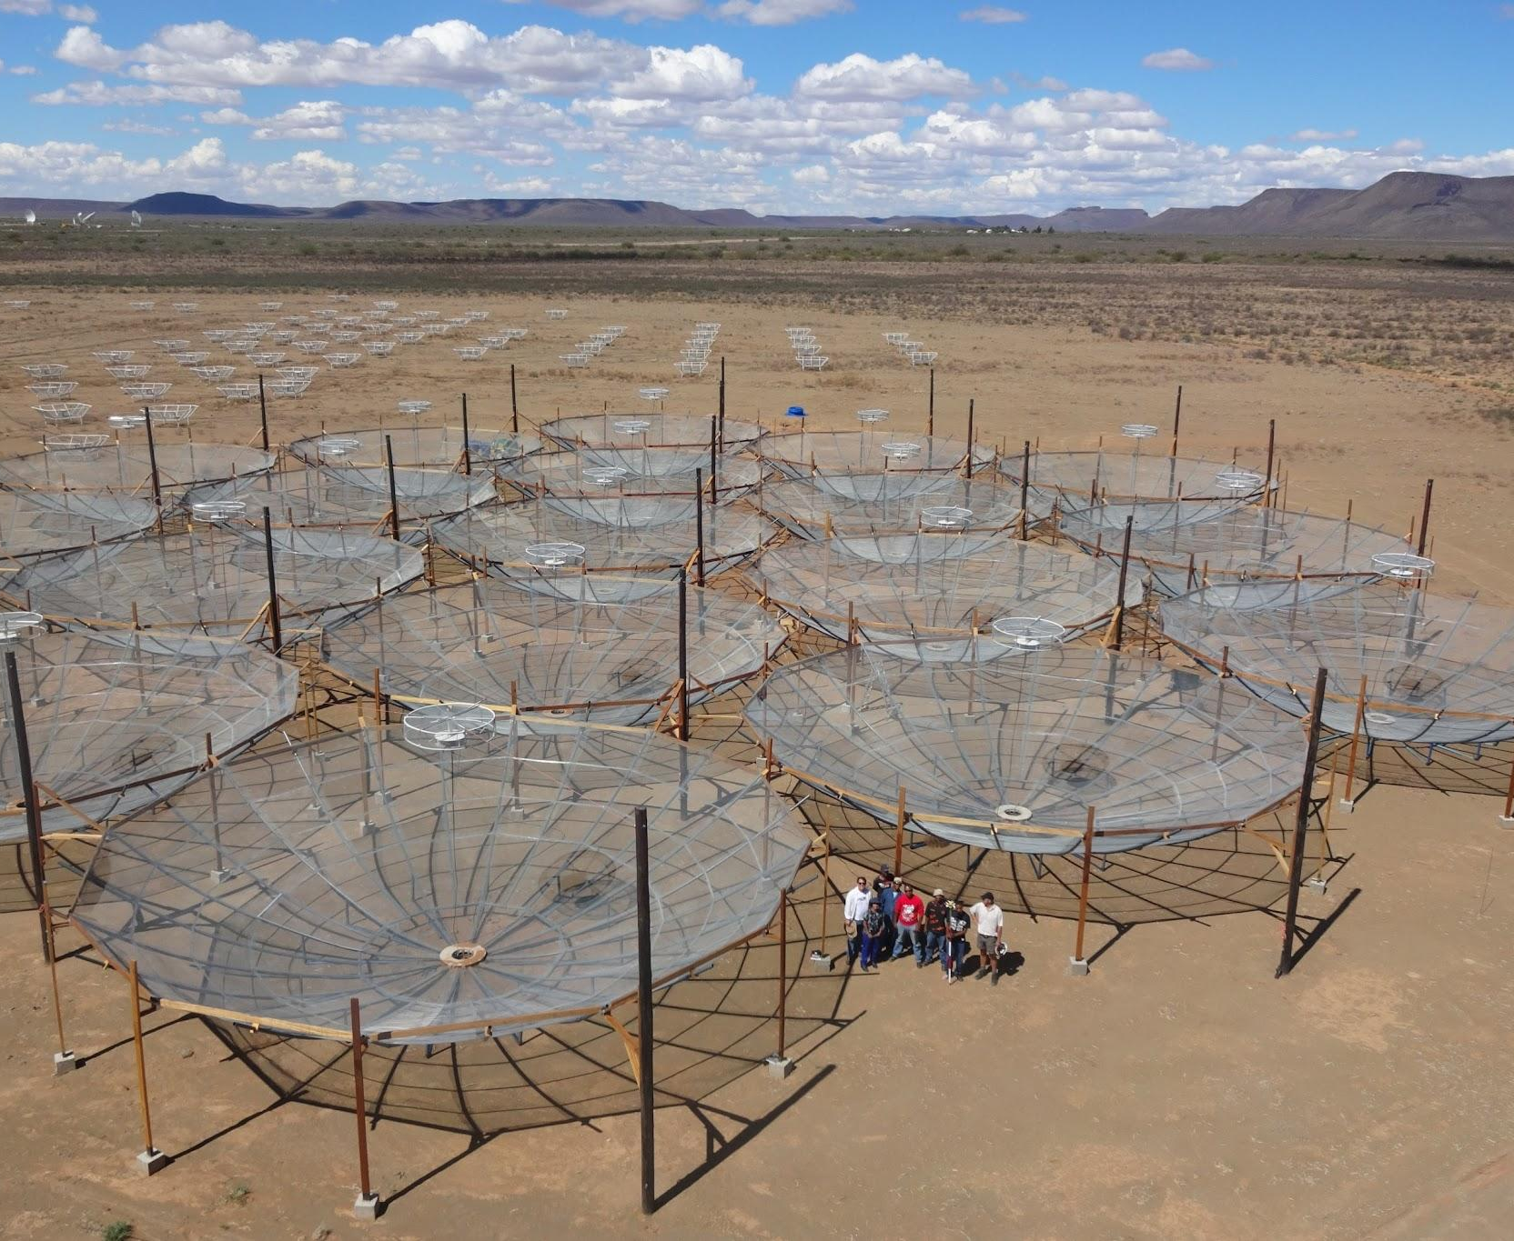
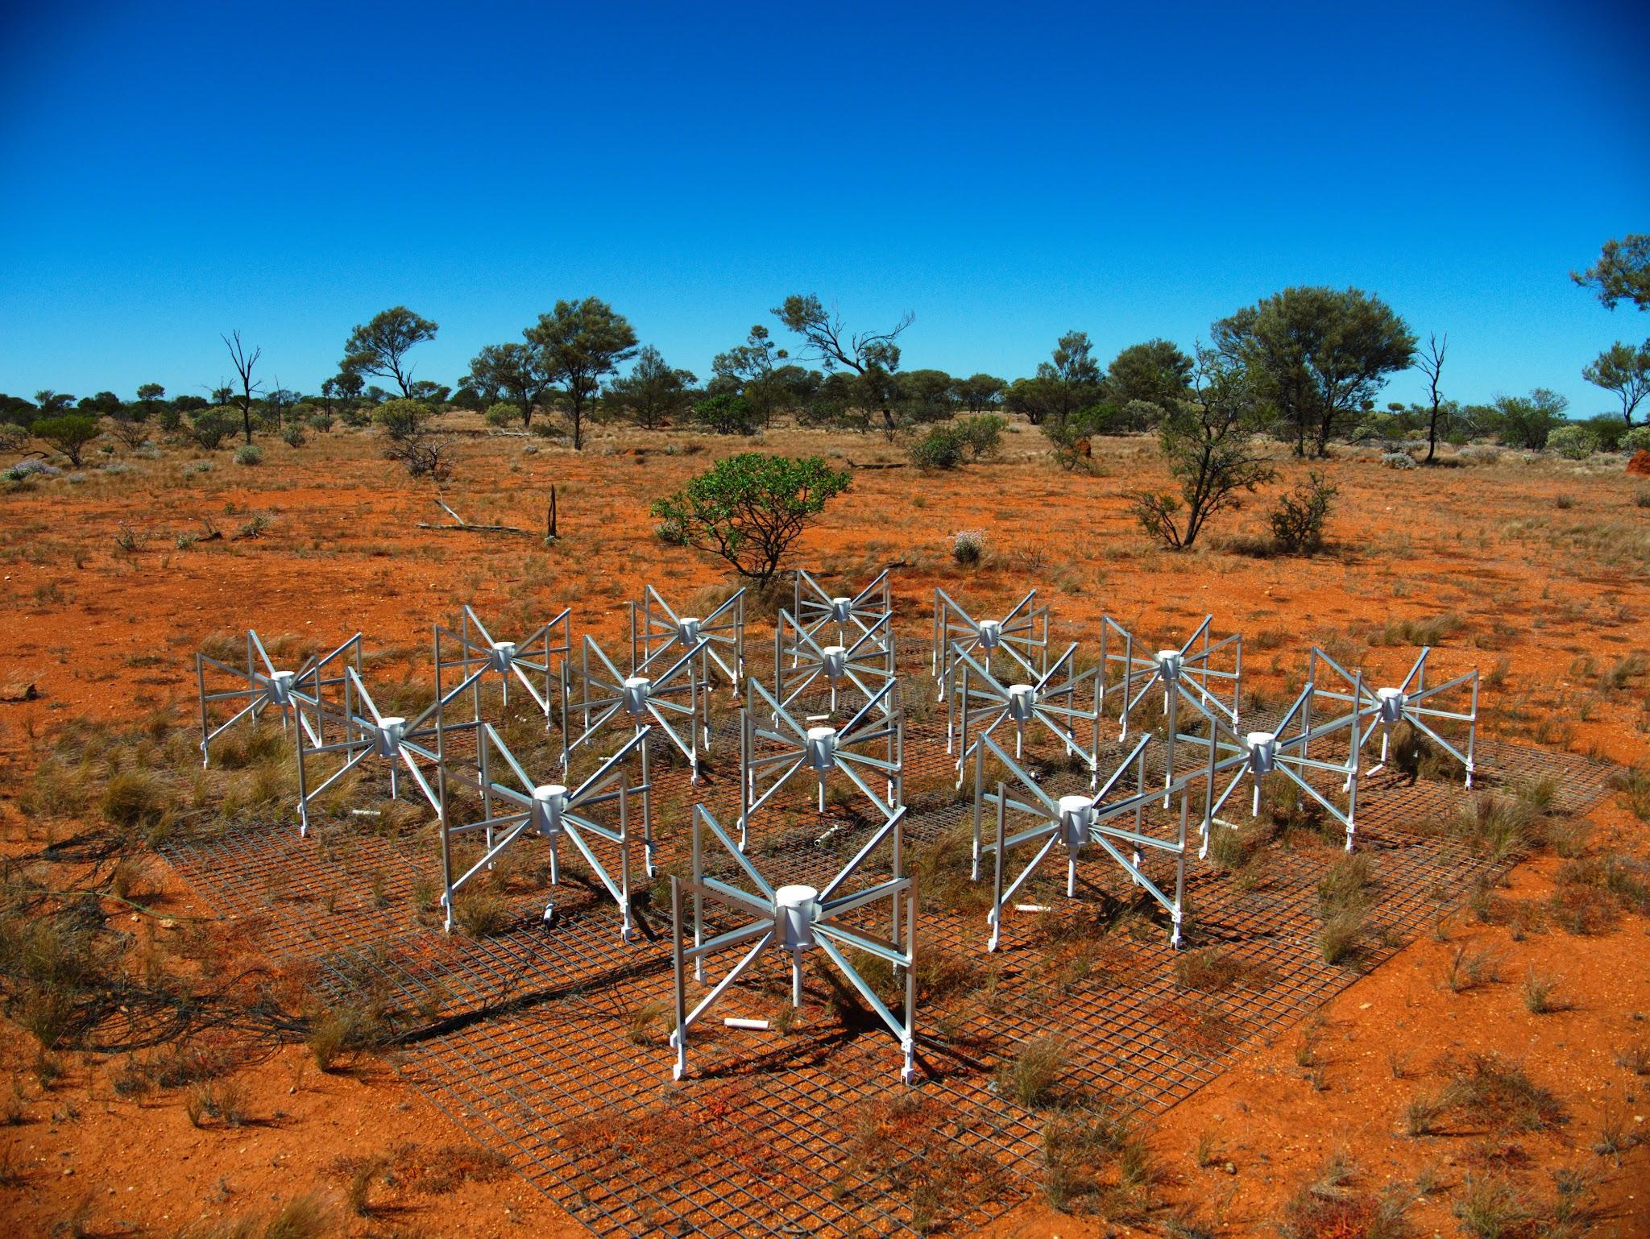
Incomplete list of Radio Experiments exploring the 21-cm Signal
EDGES
SARAS
Low frequency component of the Square Kilometre Array (SKA)
Low-frequency Array (LOFAR)
Hydrogen Epoch of Reionization Array (HERA)
Murchison Widefield Array (MWA)

Slide 15
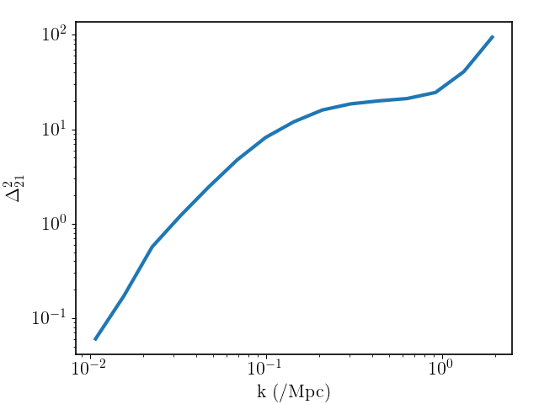
Current Radio Telescopes focussing on statistical detection
LOFAR, MWA etc. are trying to detect it
〜1000 Mpc
〜100 Mpc
〜10 Mpc

Slide 16
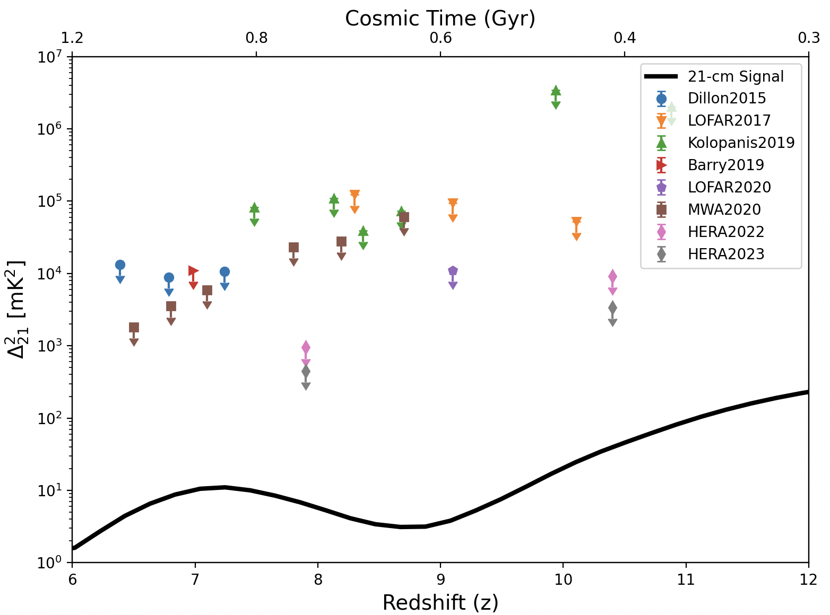
Current status of 21-cm Power Spectrum Measurement
Notes:
This is a collection of all the upper limits put on the 21-cm power spectrum. The true signal is several orders of magnitude away. This is due to instrumental noise…

Slide 17
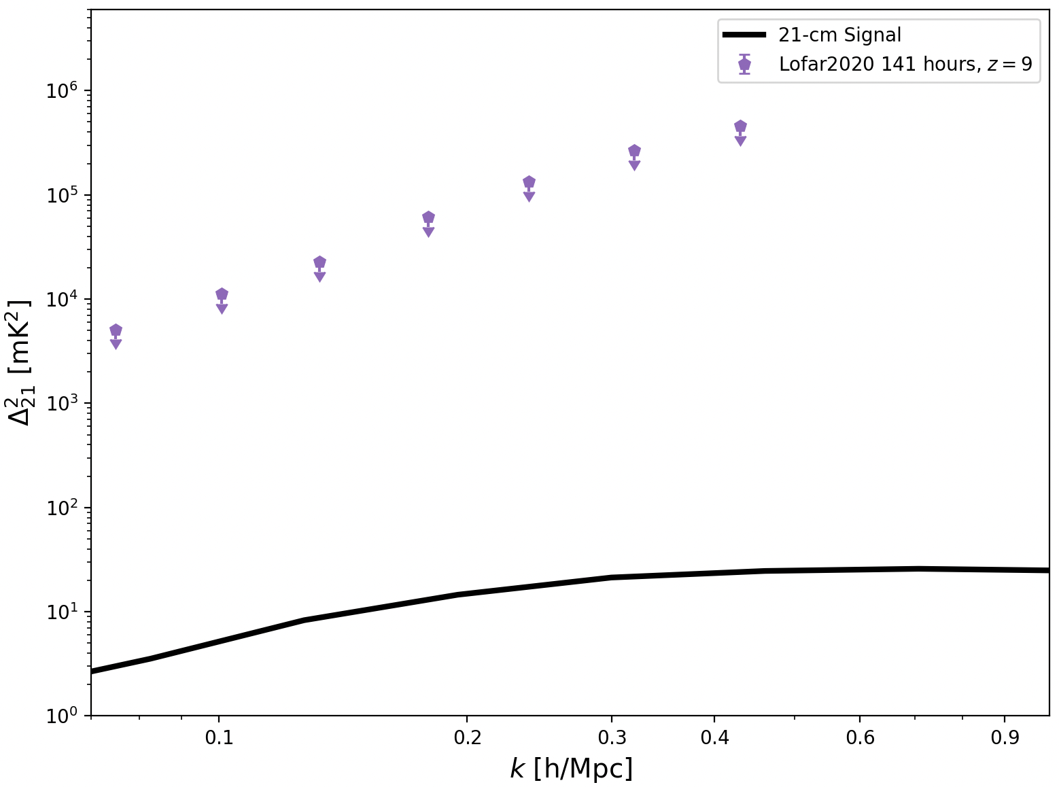
LOFAR upper limit at Redshift 9.1
〜100 Mpc
〜10 Mpc
Notes:
Let’s now look at one redshift. Here I show the LOFAR upper limits at redshift 9 given at multiple scales. When we received this upper limits, we told ourselves that we can still learn something about the intergalactic medium because the 21-cm signal is a direct probe of the IGM and not the sources. The fiducial model put here is generated based on our current understanding of the ionizing sources, not the topology of the IGM.

Slide 18
Intuition about the IGM
Density Driven Fluctuations:
〜100 Mpc
〜10 Mpc
Notes:
We started with trying to build an intuition about what could the property of the IGM be that the power spectrum probes.

Slide 19
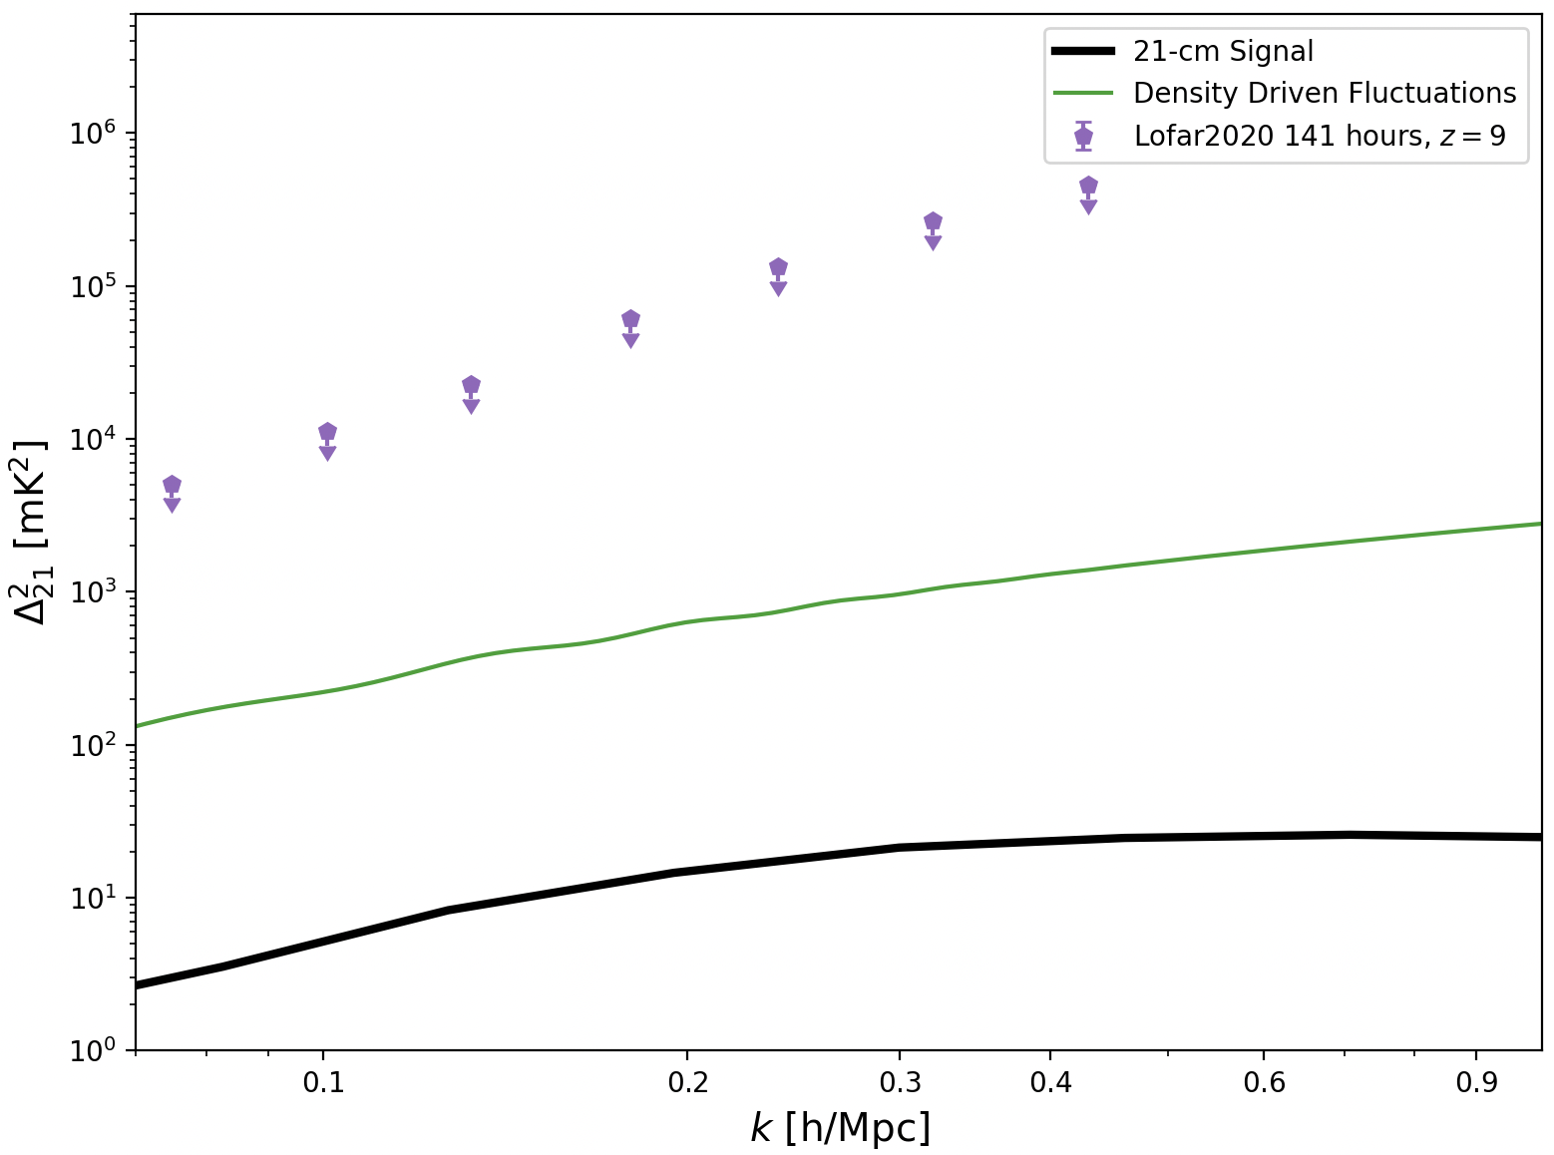
Intuition about the IGM
Density Driven Fluctuations:
〜100 Mpc
〜10 Mpc

Slide 20
Intuition about the IGM
Density Driven Fluctuations:
Unheated Density Driven Fluctuations:
〜100 Mpc
〜10 Mpc
(HERA Collaboration et al. 2022b)

Slide 21
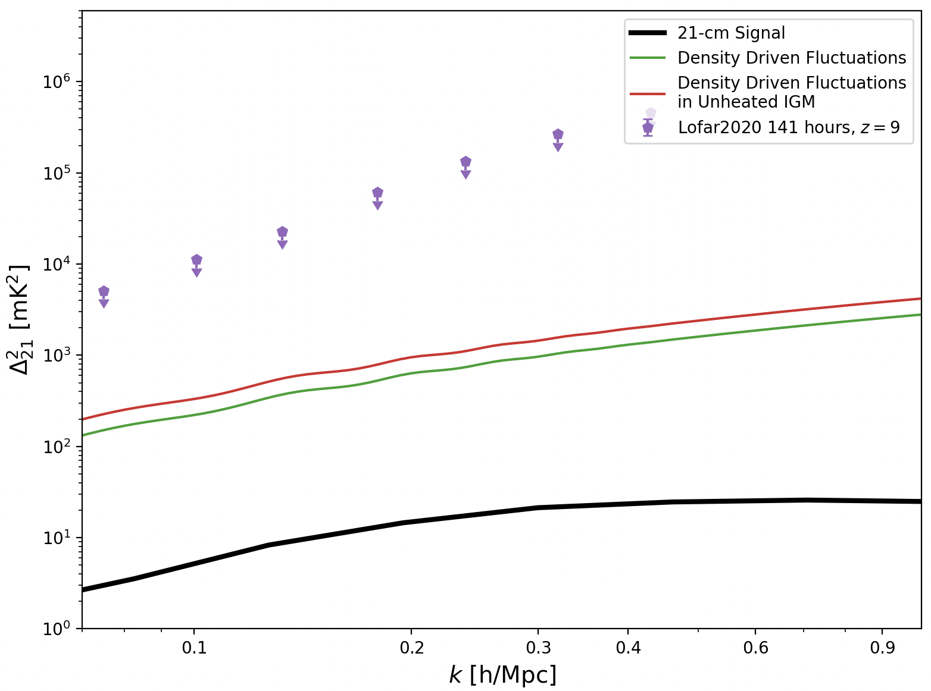
Intuition about the IGM
Density Driven Fluctuations:
Unheated Density Driven Fluctuations:
〜100 Mpc
〜10 Mpc
(HERA Collaboration et al. 2022b)

Slide 22
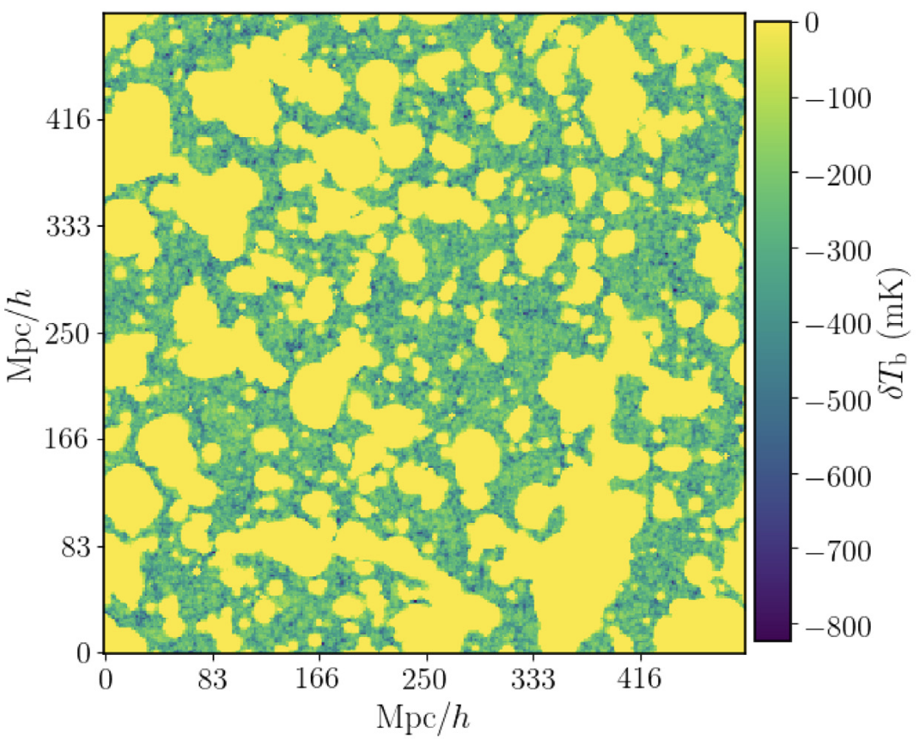
Extreme interaction between sources and IGM
(Ghara, Giri et al. 2020)

Slide 23
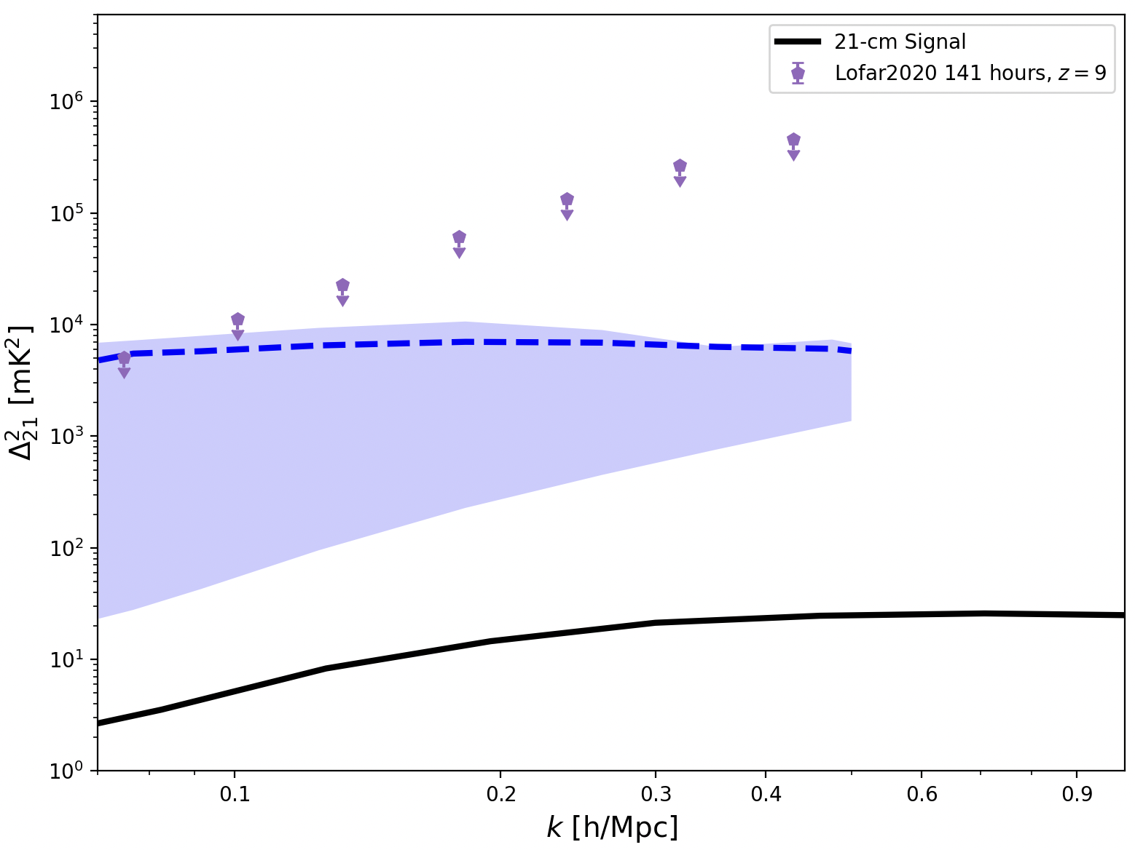
Extreme interaction between sources and IGM
〜100 Mpc
〜10 Mpc
(Ghara, Giri et al. 2020)

Slide 24
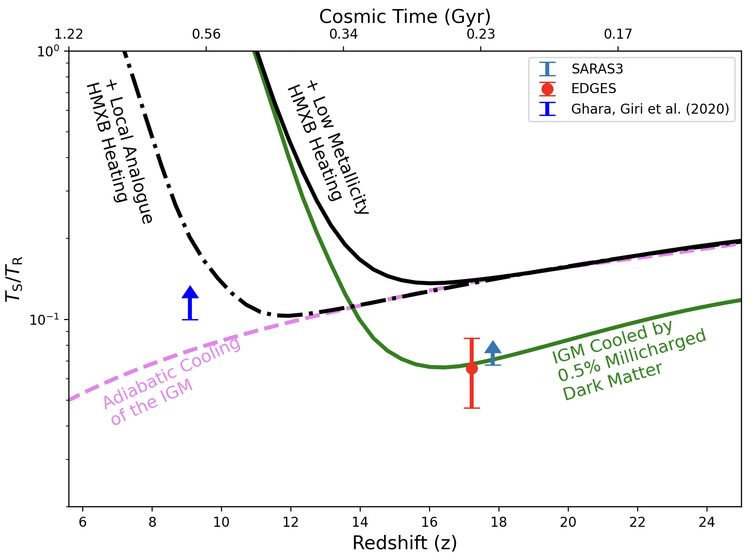
Constraint on IGM temperature by LOFAR
〜100 Mpc
〜10 Mpc

Slide 25
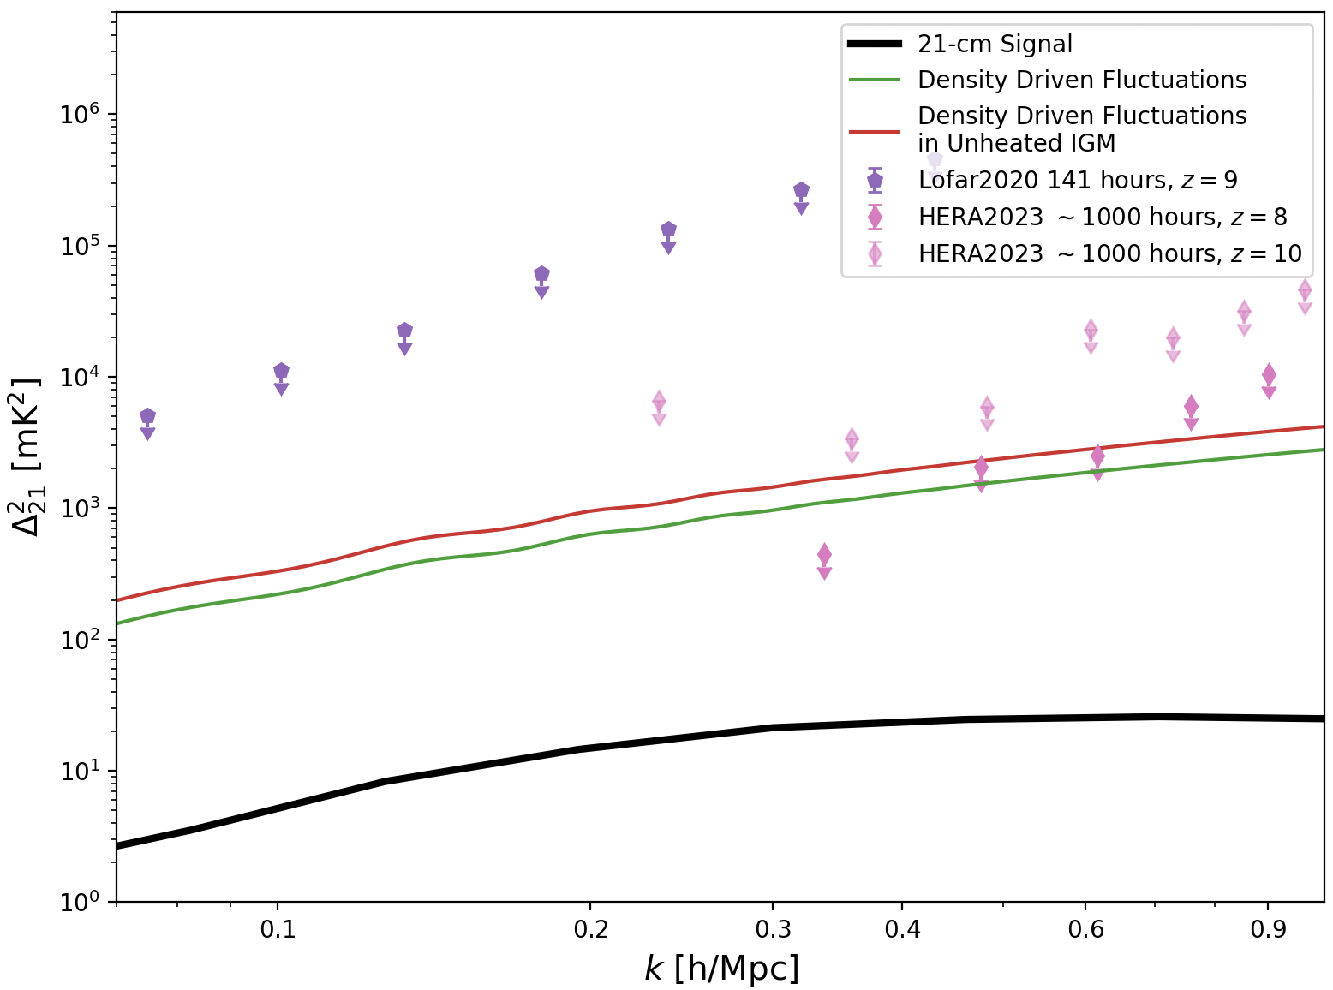
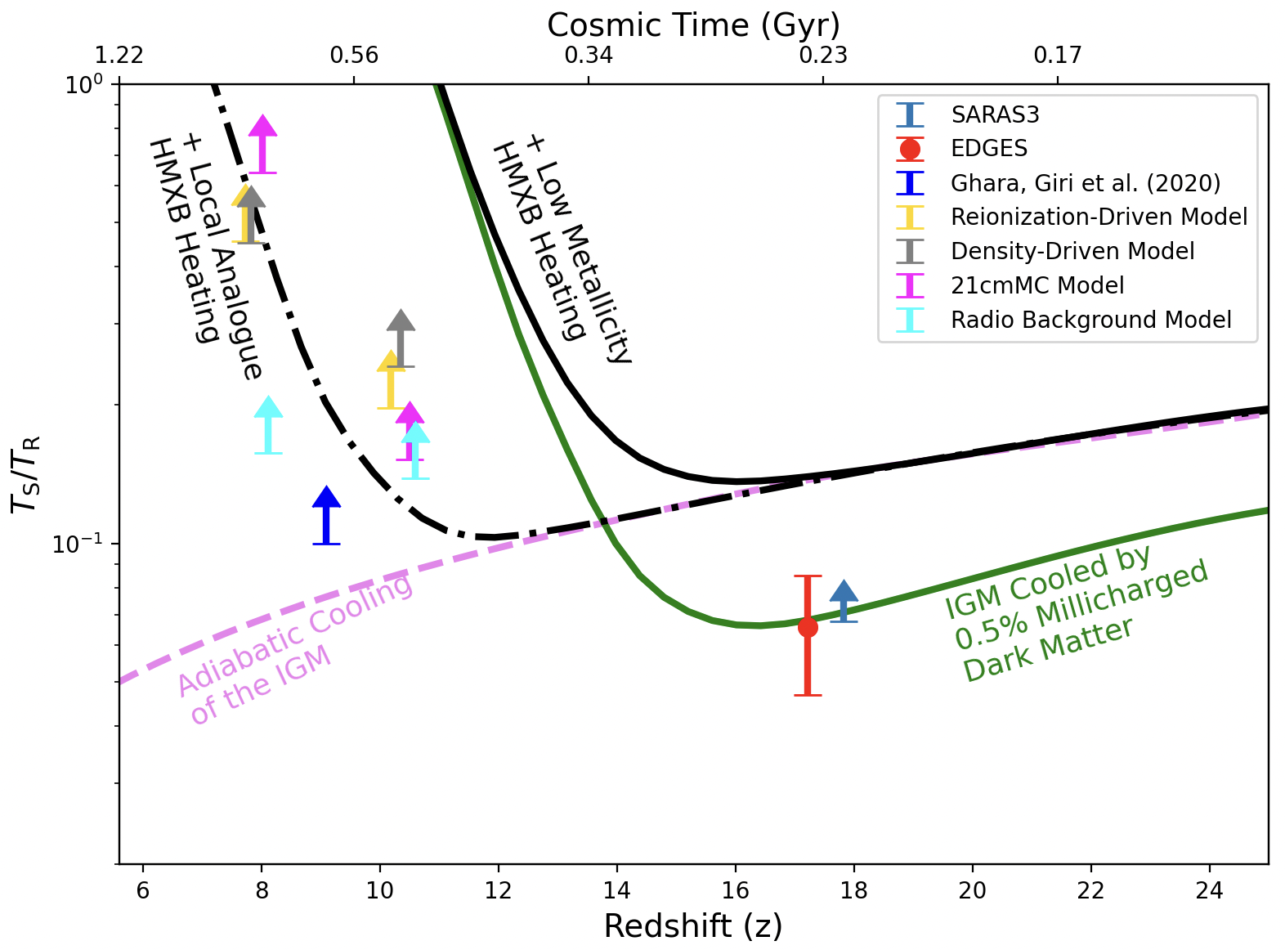
Constraint on IGM temperature by HERA
〜100 Mpc
〜10 Mpc
(HERA Collaboration et al. 2023)

Slide 26
Forecast study for the SKA-Low
EDGES
SARAS
Low frequency component of the Square Kilometre Array (SKA)
Low-frequency Array (LOFAR)
Hydrogen Epoch of Reionization Array (HERA)
Murchison Widefield Array (MWA)

Slide 27
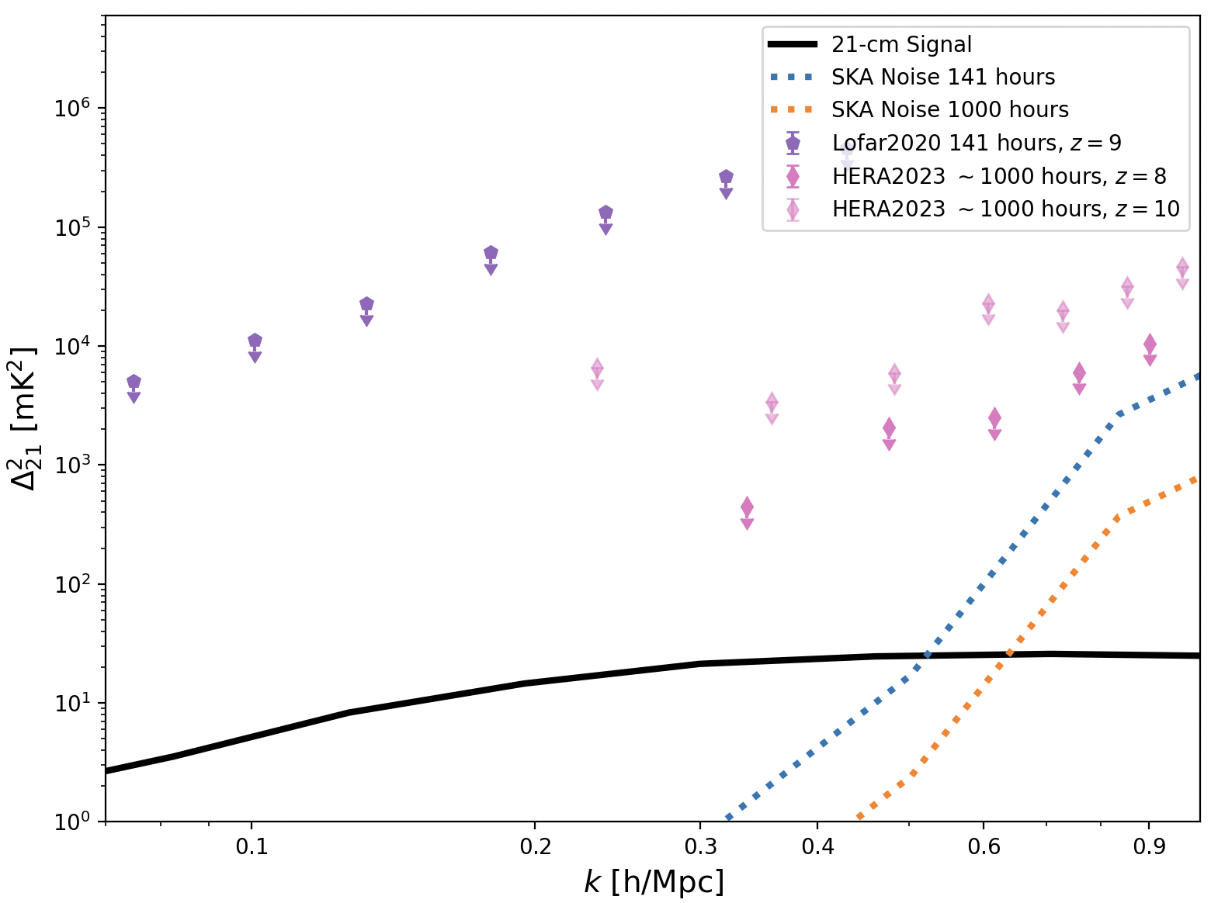
Much better Sensitivity of SKA-Low
〜100 Mpc
〜10 Mpc

Slide 28
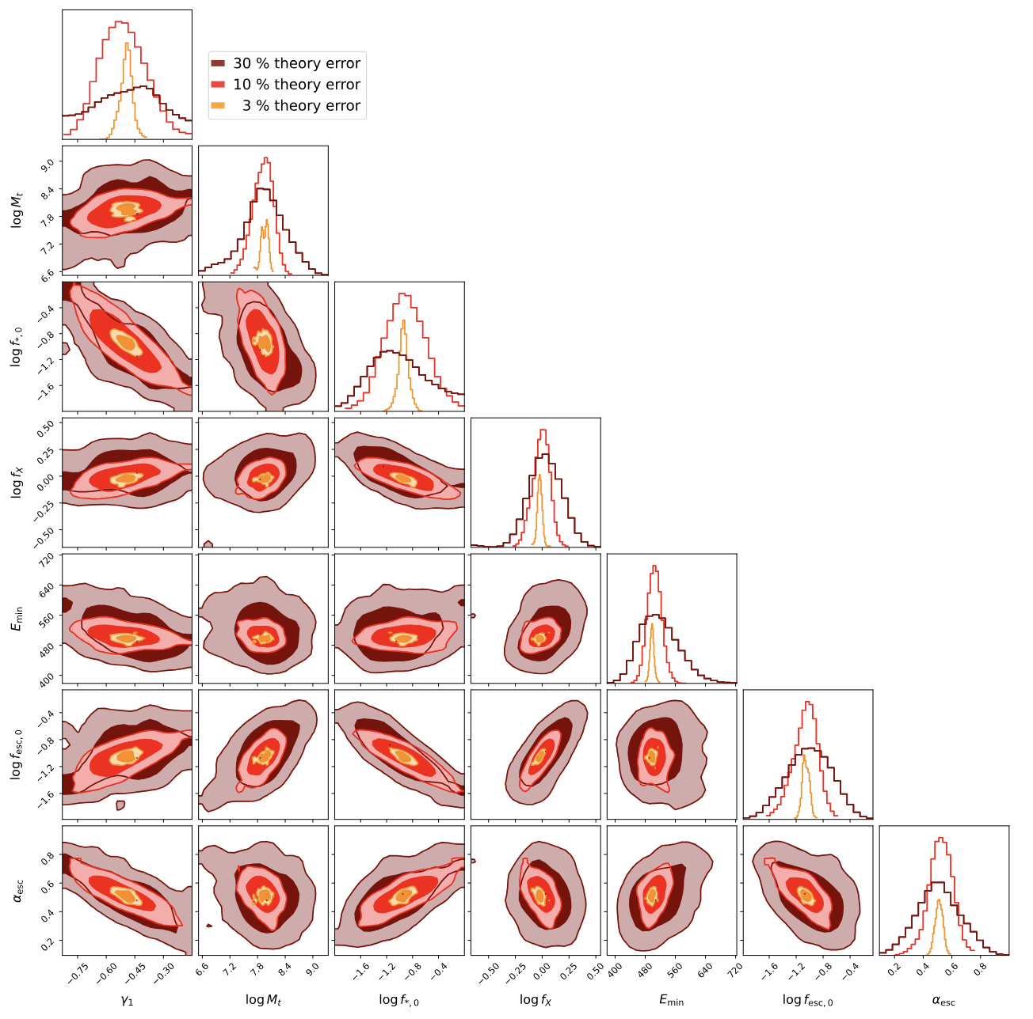
SKA-Low can constraint the astrophysics
Mass dependence of the stellar-to-halo relation
Minimum Mass of Haloes with Sources
Amplitude of the stellar-to-halo relation
Escape fraction of X-ray Photons
Minimum energy of the Source SED
Escape fraction of Ionising Photons
Mass dependence of Escape fraction
(Schneider, Schaeffer & Giri 2023)

Slide 29
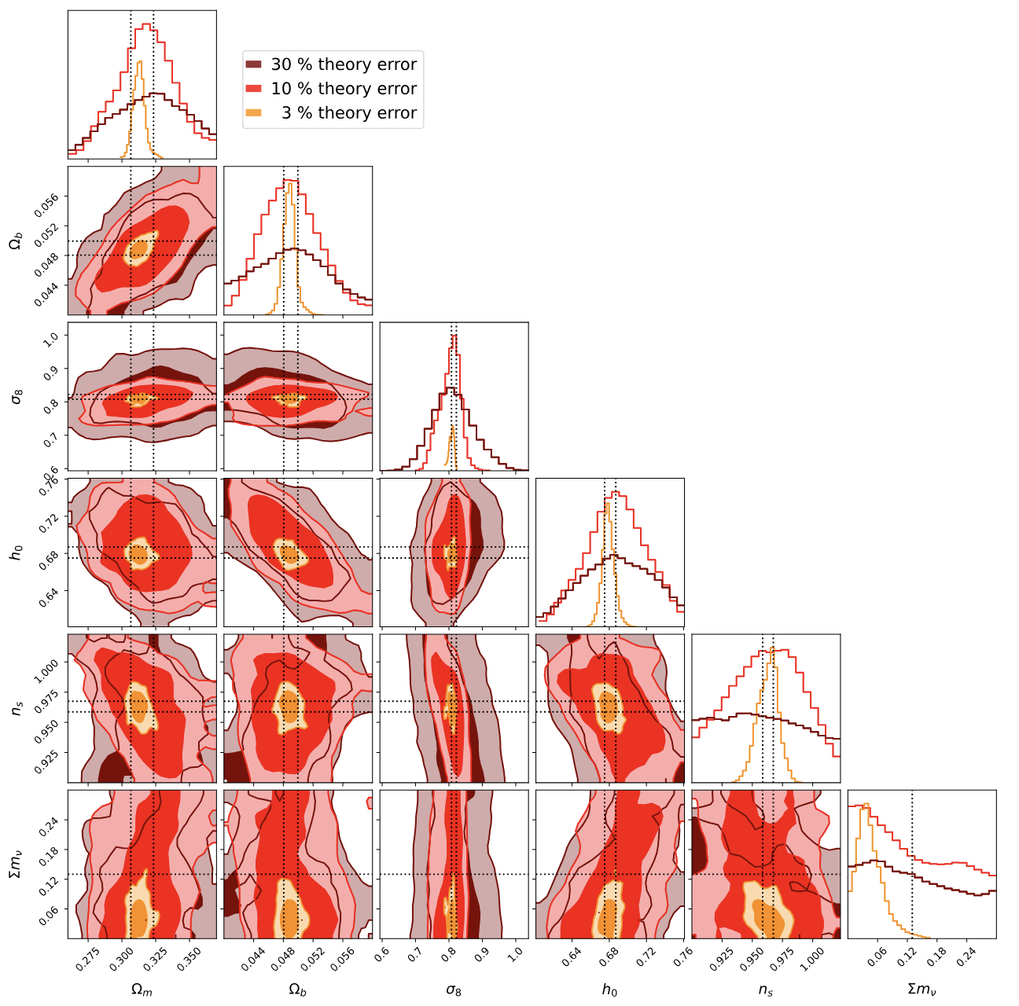
SKA-Low can constraint the cosmology
Matter Overdensity
Baryon Overdensity
Matter Clustering Amplitude
Hubble Constant
Initial Power Spectrum Index
Total Neutrino Mass
(Schneider, Schaeffer & Giri 2023)

Slide 30
SKA-Low Constraining Beyond Standard Models: Warm+Cold Dark Matter
Cold Dark Matter
(Giri & Schneider 2022)
Notes:
However, in this talk, I will focus on the constraints on the warm dark matter mass and the species fraction with respect to the cold particles.
Here I show the 95% credible regions. The dashed and dash-dotted lines show the current best constraints on these mixed dark matter models.
We see here that the constraints will be improved with the SKA observations. As expected, the constraints will be most significant when sources in the small mass haloes impact the intergalactic gas.

Slide 31
SKA-Low can go beyond the Power Spectra
Radiative transfer simulation (e.g. Giri+2018a; Giri & Mellema 2021)
Notes:
Speak about the axis and the colorscales. Dark blue is ionized.
Point out that these are results from C2Ray simulations
Point out the small ionized regions in the maps. This acts as a transition to the next slide where the small regions are not visible.
No observations yer. But it is future

Slide 32
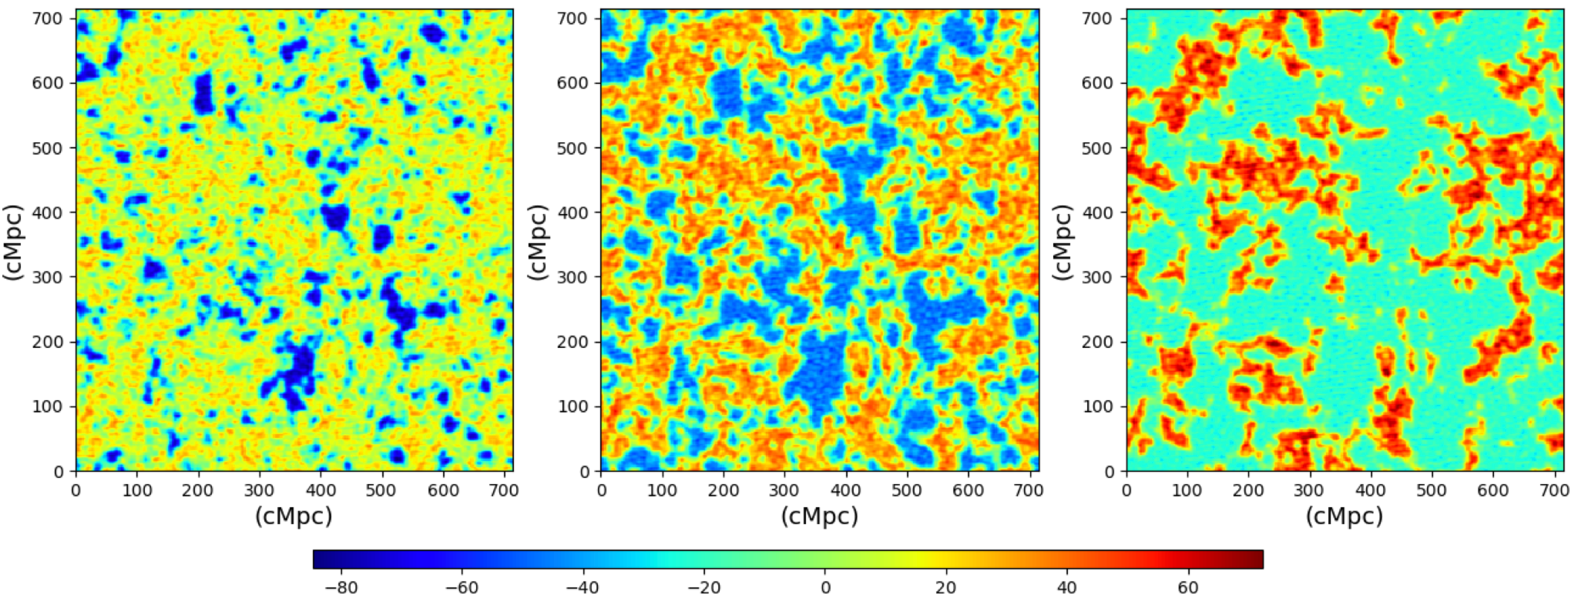
Simulated SKA-Low images
Instrumental effects using Tools21cm (e.g. Giri+2018b; Giri+2020)
Notes:
Here I show you images expected from SKA, which will be powerful enough to produce them.

Slide 33
Derive Model-Independent Properties of the IGM
(Bianco,Giri+2021;2024)
Notes:
Once we identify the ionized regions in the SKA images, we can point the telescopes, such as JWST, to observe the galaxies inside these regions.

Slide 34
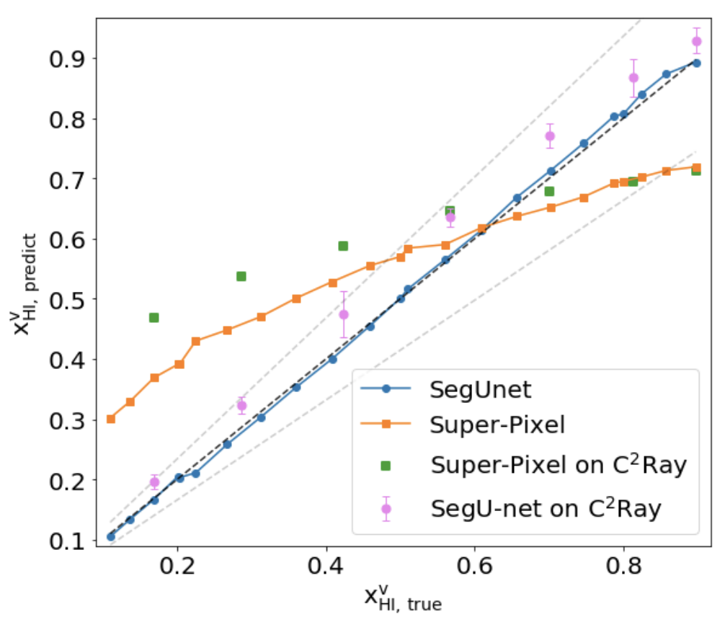
Estimate the mean neutral fraction
(Bianco,Giri+2021)
Notes:
Once we identify the ionized regions in the SKA images, we can point the telescopes, such as JWST, to observe the galaxies inside these regions.

Slide 35
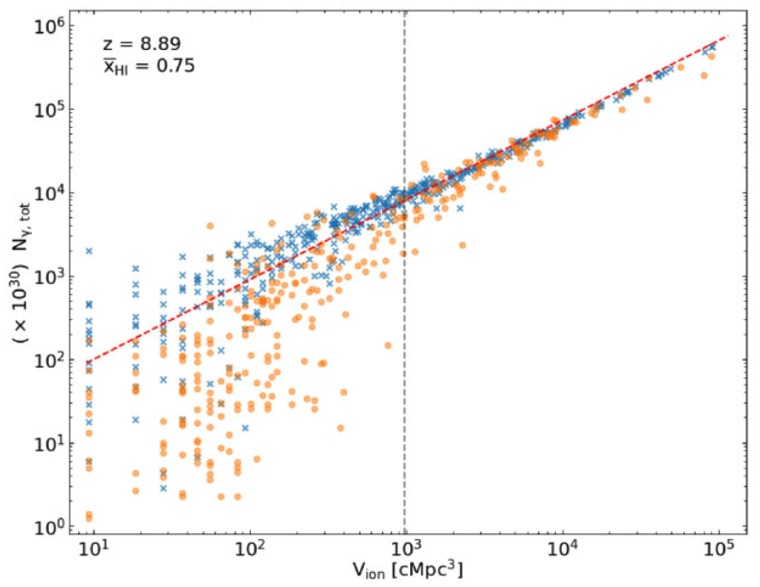
Estimate number of galaxies inside ionized regions
(Zackrisson,…,Giri+2020)
Number of ionizing photons produced inside ionised region [x10³⁰]
Volume of ionized regions [Mpc³]
(Bianco,Giri+2024)

Slide 36
How to compare these with astrophysical models?
(Bianco,Giri+2021;2024)
Notes:
Here I show you images expected from SKA, which will be powerful enough to produce them.

Slide 37
Size distributions of ionized regions
(Giri+2018a)

Slide 38
Topology: any geometrical property that is unaffected by the continuous change of shape or size of the structure
Notes:
If our eyes could only detect the topology of an object, we will not be able to differentiate between a cup and a donut.

Slide 39
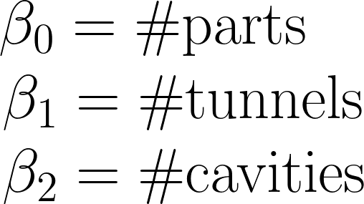
Better measure of topology: Betti numbers

Slide 40
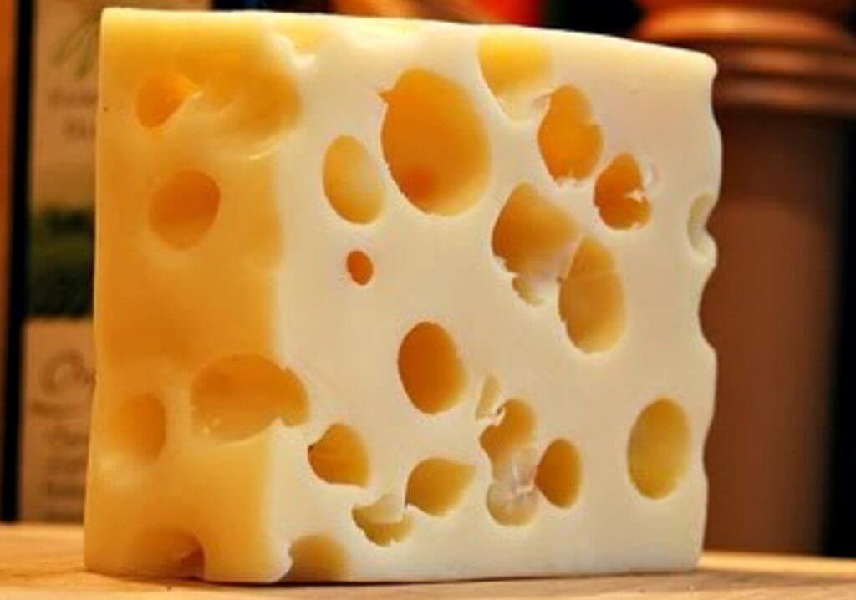
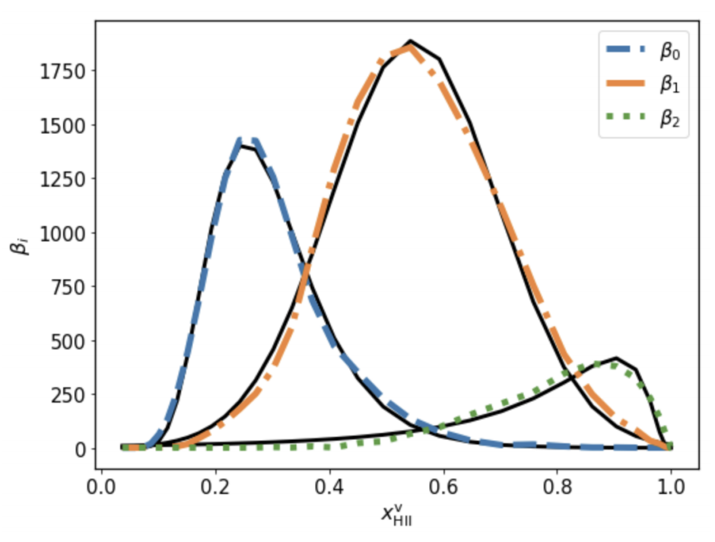
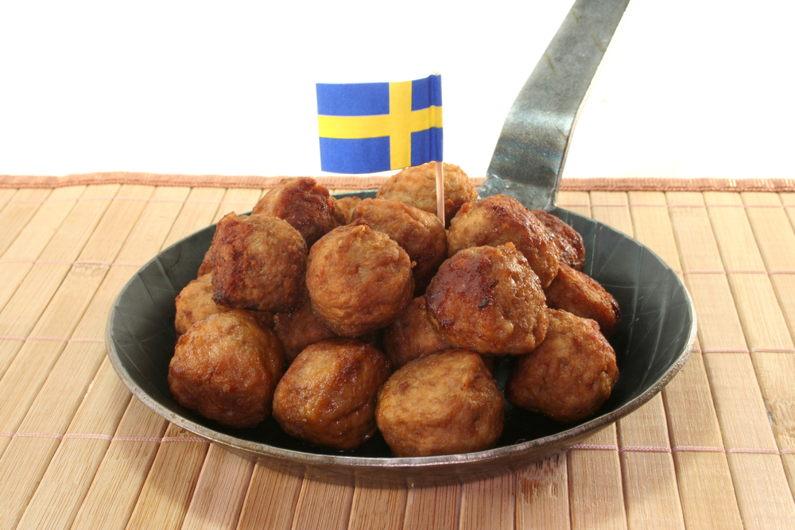
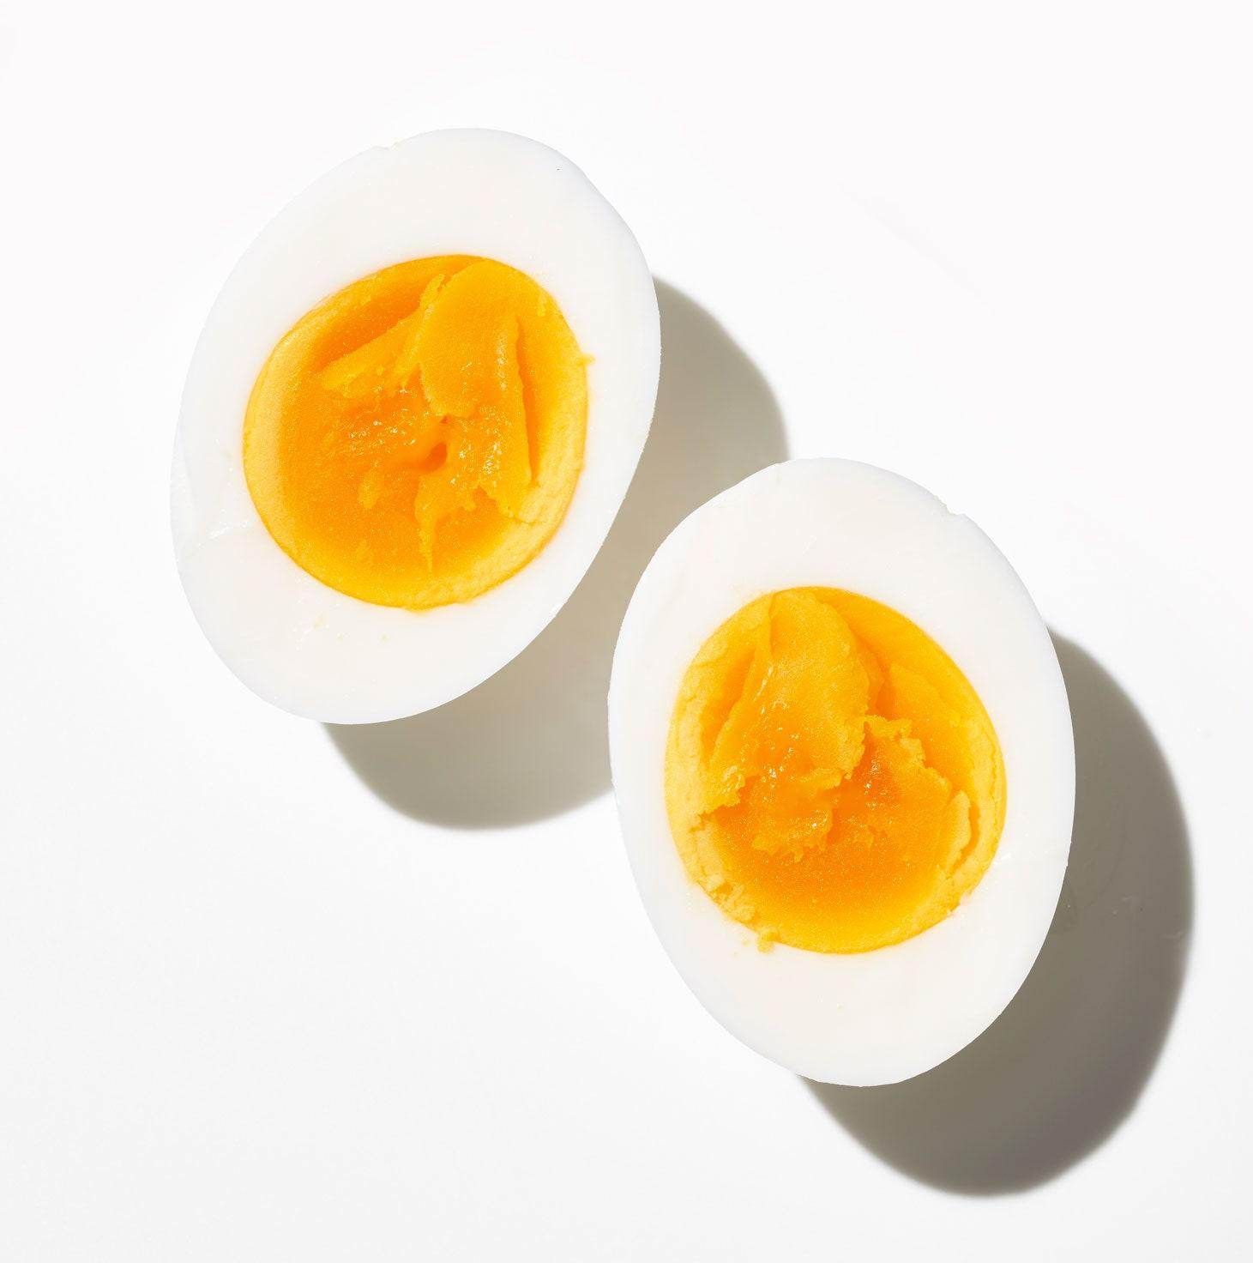
Different stages of reionization
Overlap stage
Pre-overlap stage
Post-overlap stage
(Giri & Mellema 2021)

Slide 41
Distinguish between different reionization scenarios
(Giri & Mellema 2021)

Slide 42
Towards Field-Level Inference
(Zhao et al. 2022)

Slide 43
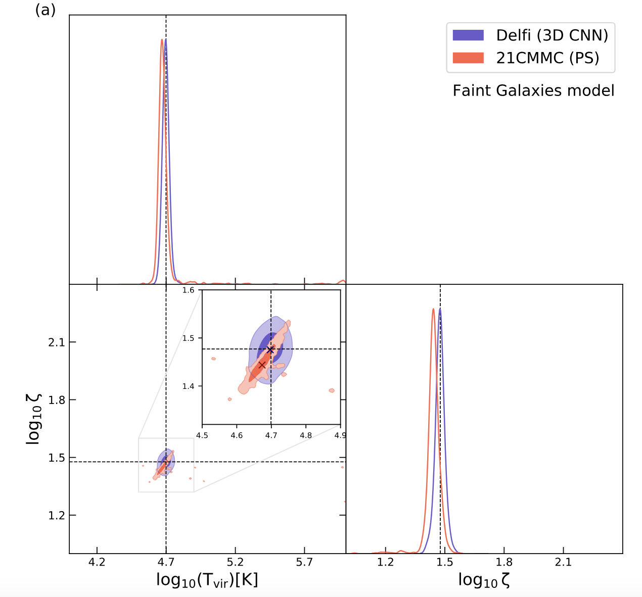
Improved constraints using 3D CNNs
Photon Production Efficiency
Minimum Halo Mass with Sources
(Zhao et al. 2022)

Slide 44
Summary
Current upper limits of the 21-cm signal have put useful constraints on the properties of the IGM
SKA-Low will be capable of not only detecting the signal but also imaging its distribution on the sky
21-cm images will allow model independent constraints on the properties of the IGM
We can explore the non-Gaussian information contained in the signal with SKA-Low
Notes:
In summary, our study found that the epoch of reionization observations are a new-window onto understanding the nature of dark matter. This is because the differences in the dark matter models are more distinct at earlier times.
The most significant impact of the dark matter models is on the timing of the reionization process. The non-cold dark matter models will delay the cosmic reionization compared to the cold dark matter scenario.
We have also found that the constraints on the dark matter models will significantly improve with upcoming observations of this era.

Slide 45
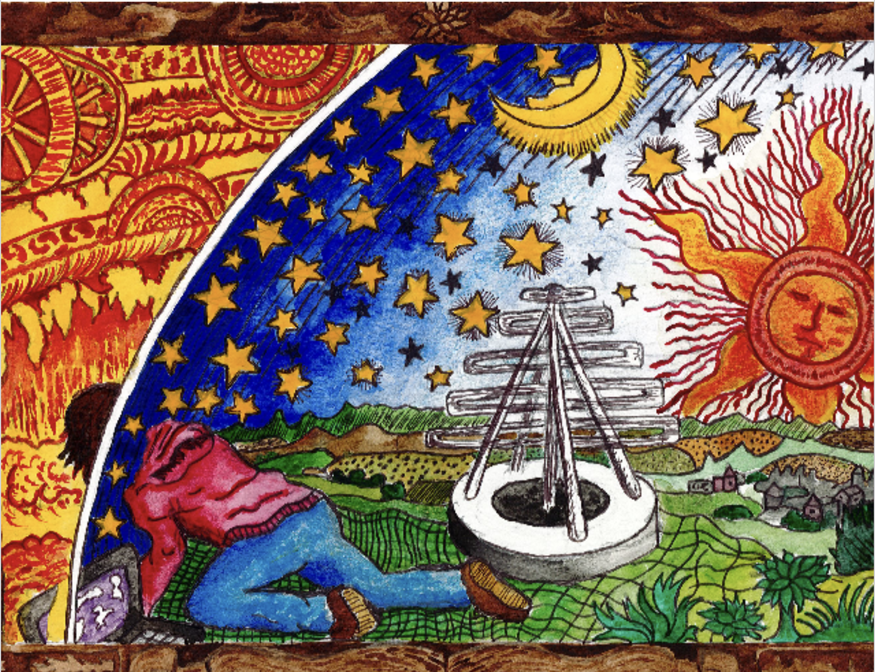
Modern methods for exploring our cosmic origins
A modern rendition of Flammarion engraving (H. E. Ross & S. K. Giri)
Notes:
I want to end with my own rendition of the Flammarion engraving. Here a modern person is exploring the unknown using modern tools, such as the latest computers and telescopes.
I will stop now and take any questions that you may have.

Slide 46
Backup slides
Notes:
In summary, our study found that the epoch of reionization observations are a new-window onto understanding the nature of dark matter. This is because the differences in the dark matter models are more distinct at earlier times.
The most significant impact of the dark matter models is on the timing of the reionization process. The non-cold dark matter models will delay the cosmic reionization compared to the cold dark matter scenario.
We have also found that the constraints on the dark matter models will significantly improve with upcoming observations of this era.

Slide 47
Why should we care about these ionized regions?
Notes:
Before we try to extract the ionized regions from these noisy images, we should ponder again what we will learn from these regions. Stage of reionization
Properties of the ionizing sources

Slide 48
Why should we care about these ionized regions?
LOFAR, MWA etc. are trying to detect it

Slide 49
Power spectrum will not give complete description

Slide 50
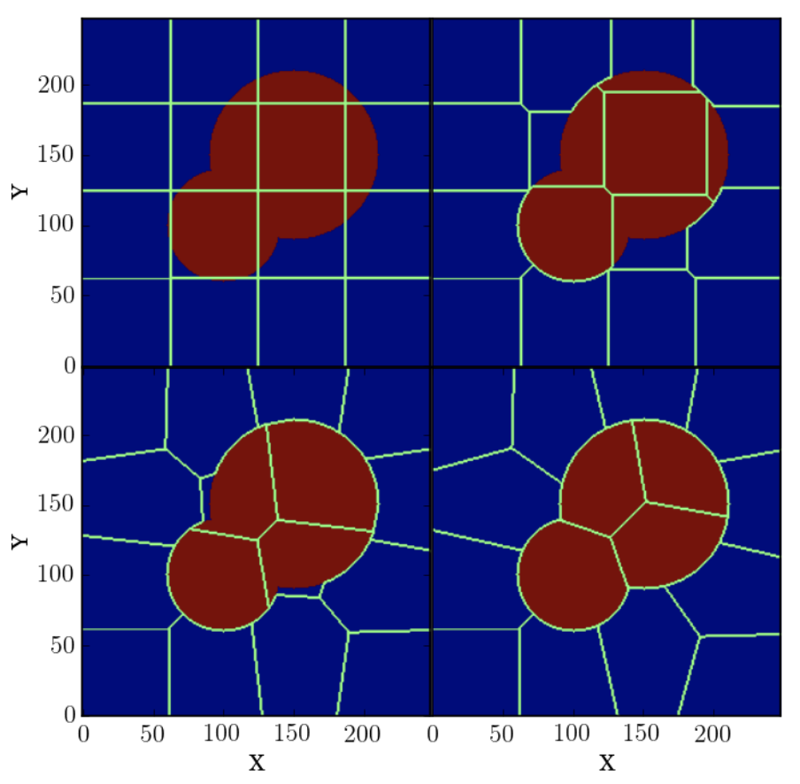
Superpixel method

Slide 51
SERENet recovering the 21-cm power spectrum
(Bianco,Giri+in prep)

Slide 52
SERENet learns the topology quite well
(Bianco,Giri+in prep)

Slide 53
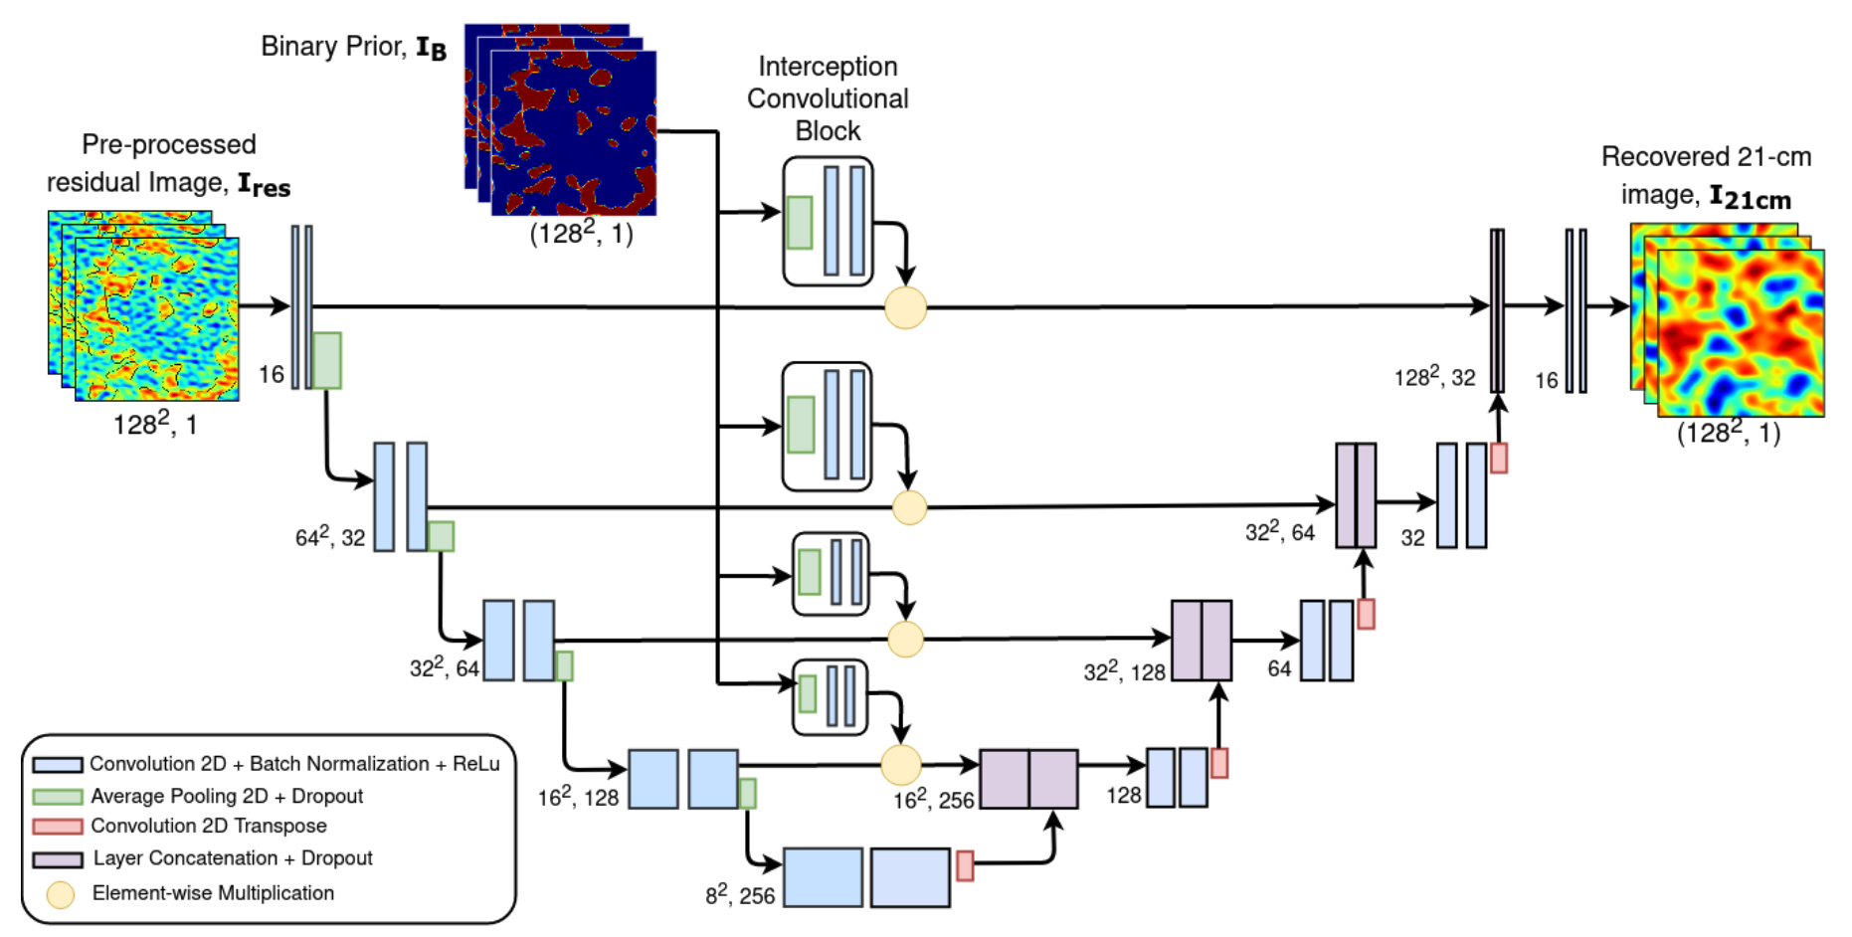
SERENet for foreground mitigation
(Bianco,Giri+in prep)

Slide 54
SERENet recovering the 21-cm image
(Bianco,Giri+in prep)

Slide 55
SERENet with prior knowledge (ionized regions)
(Bianco,Giri+in prep)

Slide 56
SERENet recovering the 21-cm image with prior
(Bianco,Giri+in prep)

