Slide 1
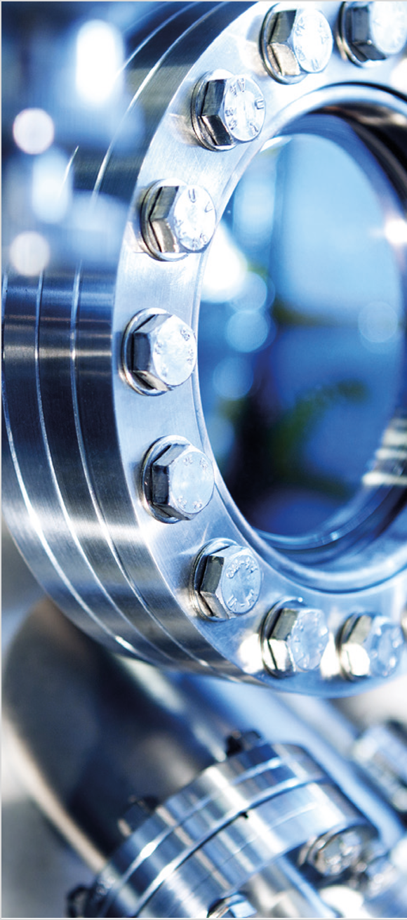
CATARINA SAHLBERG
PROGRAMME DIRECTOR
INDUSTRIAL RETURN FROM
LARGE-SCALE RESEARCH FACILITIES
BIG SCIENCE SWEDEN
INDUSTRIAL LIAISON OFFICE (ILO)
KNOWLEDGE TRANSFER OFFICE (KTO)

Slide 2
BiSS MISSION, ORGANISATION, METHODOLOGY
SWEDISH ENGAGEMENT IN SKA, SUCCESS FACTORS, LESSONS LEARNED

Slide 3
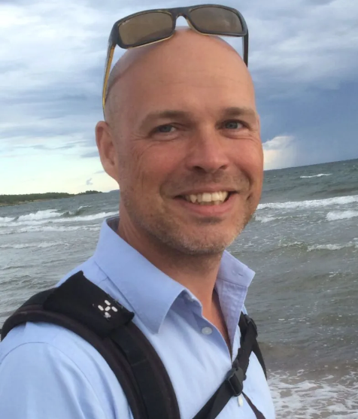
FIRST….
Patrik Carlsson
1970 - 2024
Co-director of Big Science Sweden
ILO for SKA
ILO for ESO
ILO for F4E/ITER
Colleague
Friend

Slide 4
I. BiSS MISSION, ORGANISATION, METHODOLOGY

Slide 5
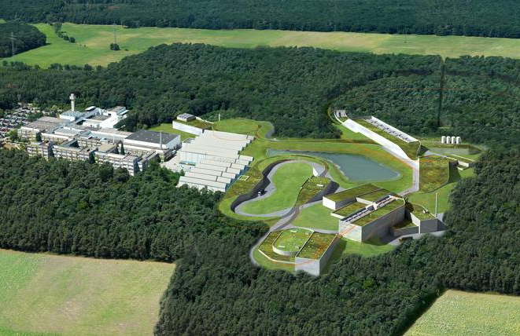
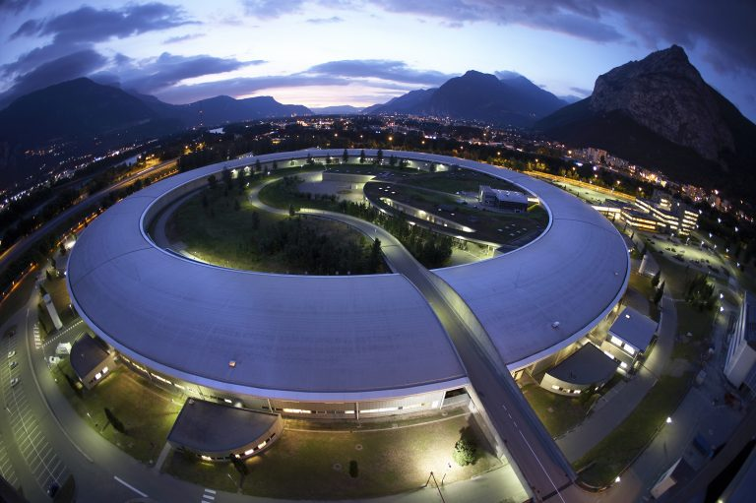
SWEDISH RETURN FROM LARGE-SCALE RESEARCH FACILITIES
Sweden pays over 2 billion SEK per year to ground-based large-scale international research facilities (excl ESA)
Generally well-represented when it comes to usage
For most facilities, underrepresented when it comes to:
Procurement
Collaboration R&D-projects
Employees
Fellowships
Technical students
Visits
…

Slide 6
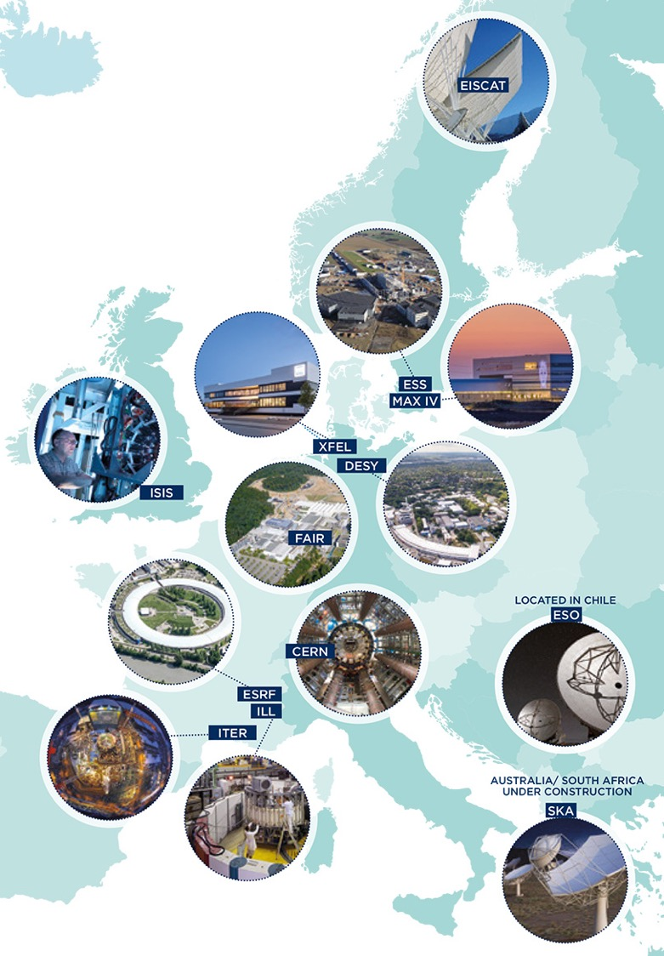
BIG SCIENCE SWEDEN MISSION
Assignment from the Ministry of Enterprise
via the Swedish Innovation Agency (Vinnova):
Support Swedish industry, institutes and academia to contribute to the construction, development and upgrade of Big science facilities.
Focus on high-tech contributions that drive research, development, innovation, international cooperation and generate good business for Sweden.
Create value for Swedish industry and society by transferring new knowledge, technology and competence to diverse areas of application.

Slide 7
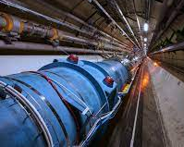
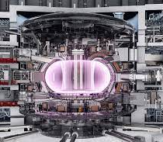
SCOPE
RESEARCH
FACILITIES
Industrial deliveries
Academic deliveries
Collaborations between academia, industry and research facilities
Innovation and development
Tech transfer
Knowledge transfer
UNIVERSITIES
INSTITUTES
INDUSTRY
Student and career opportunities
Professional development

Slide 8
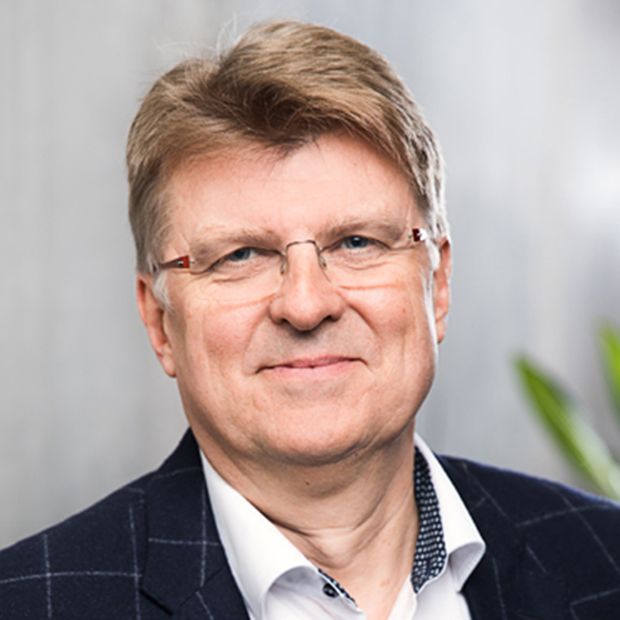
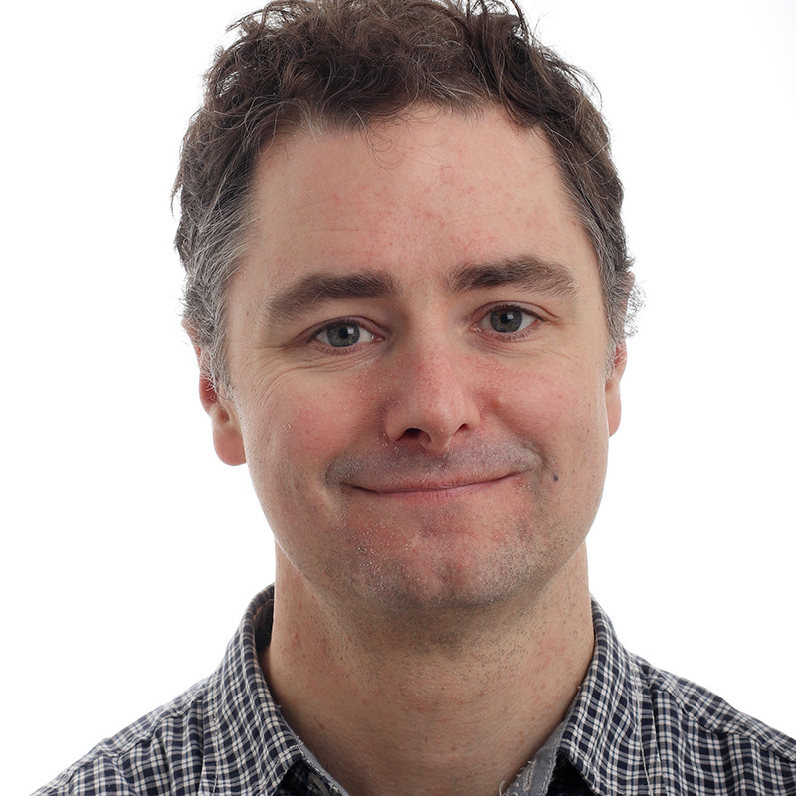
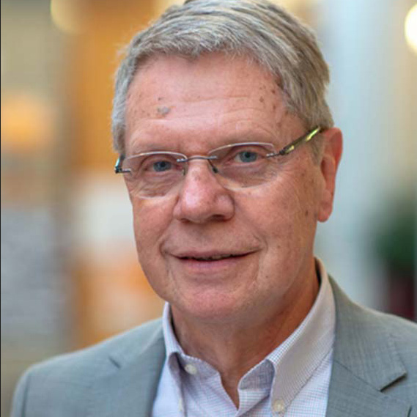
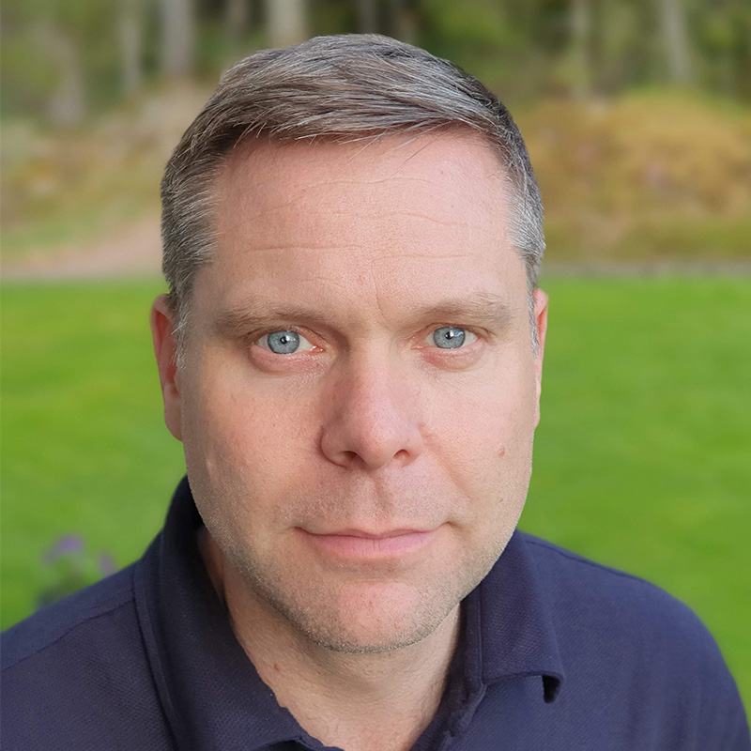
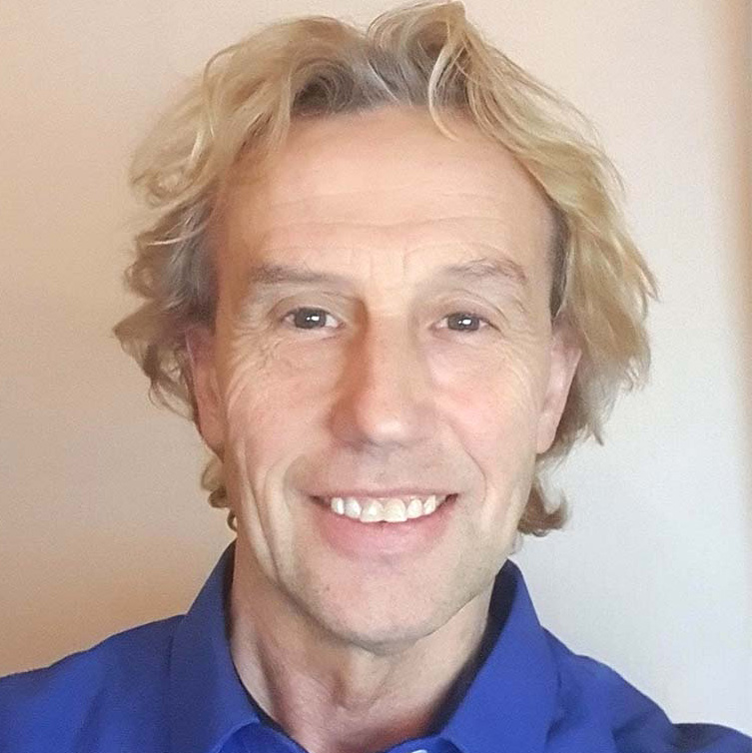
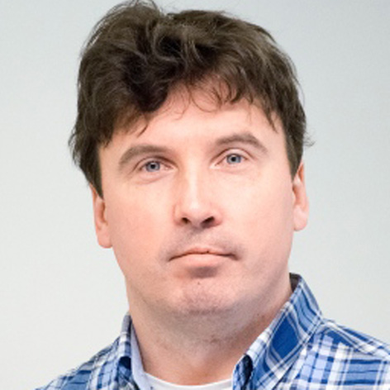
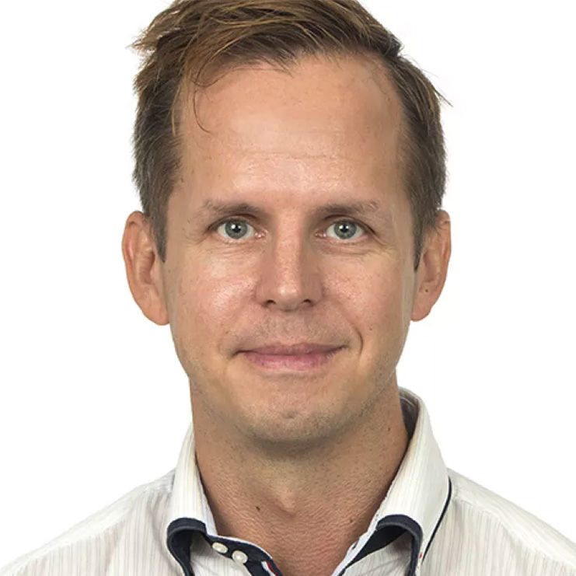
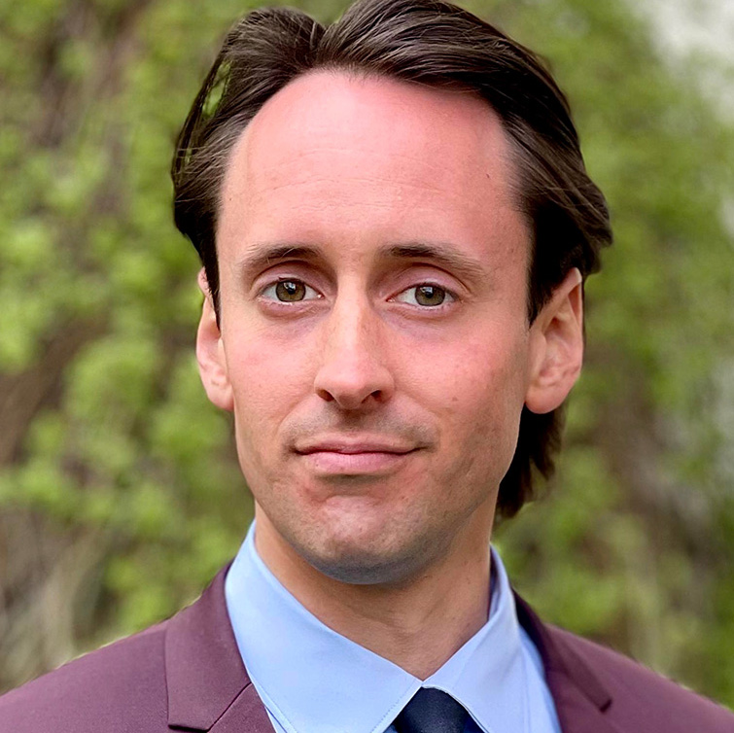
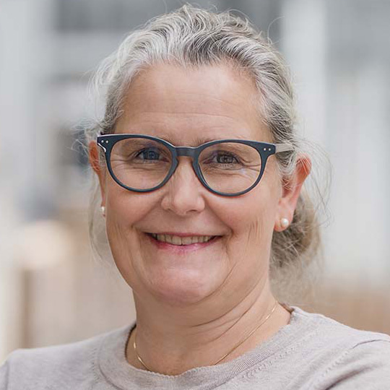
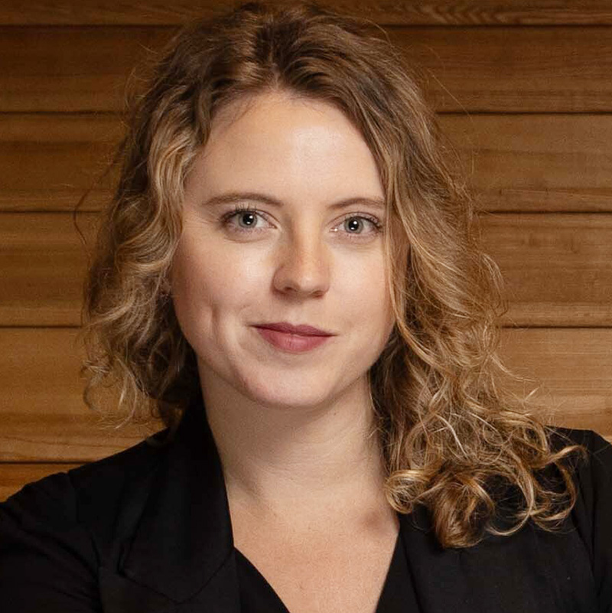
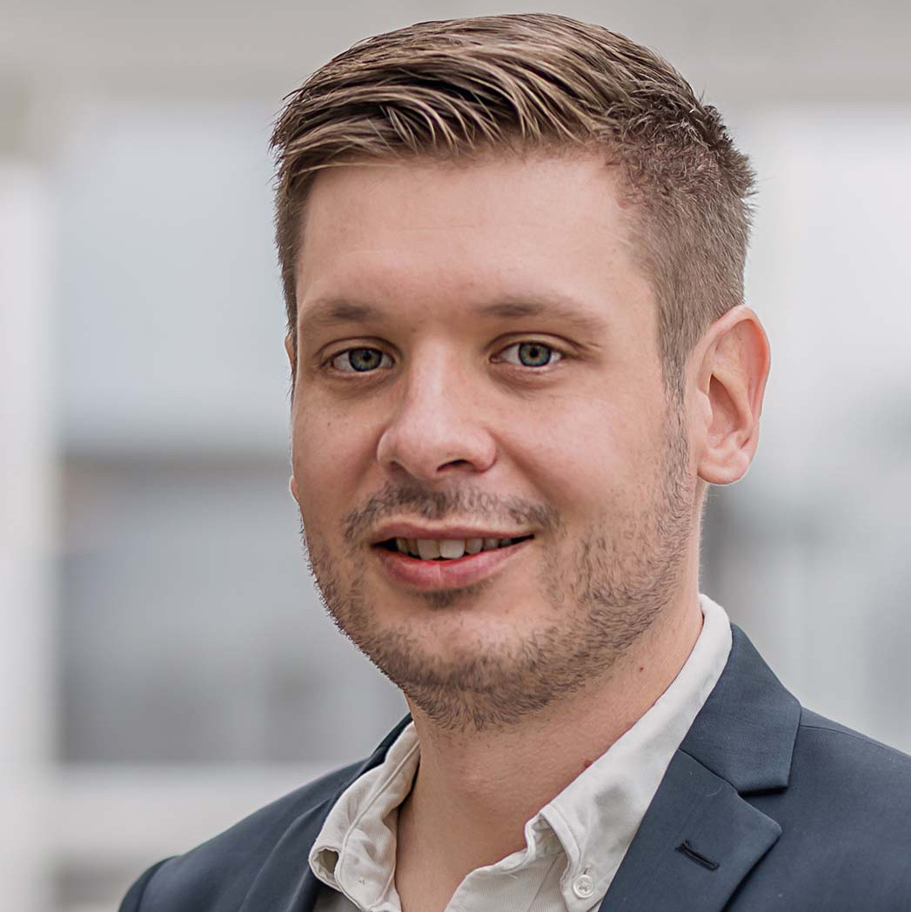
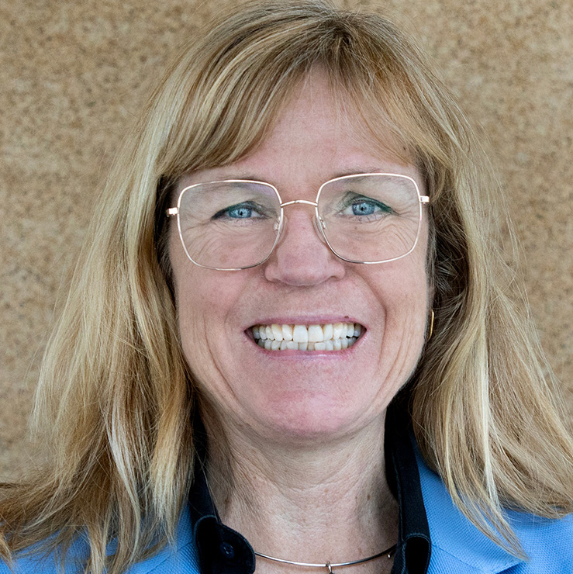
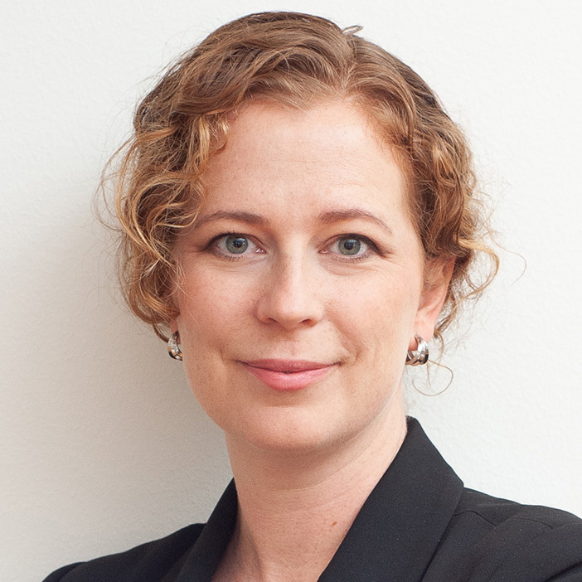
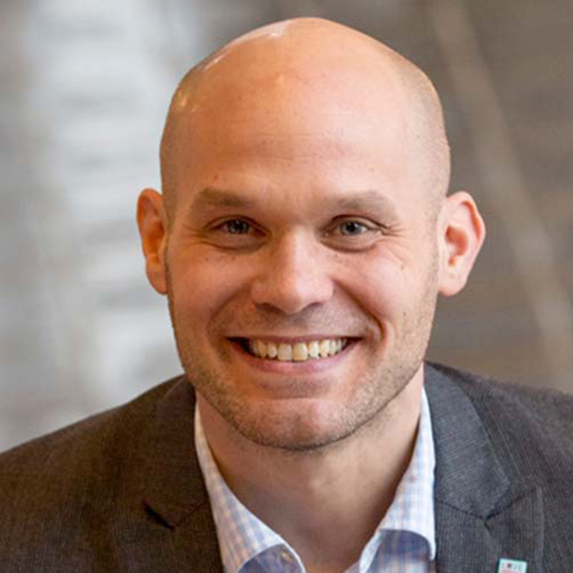
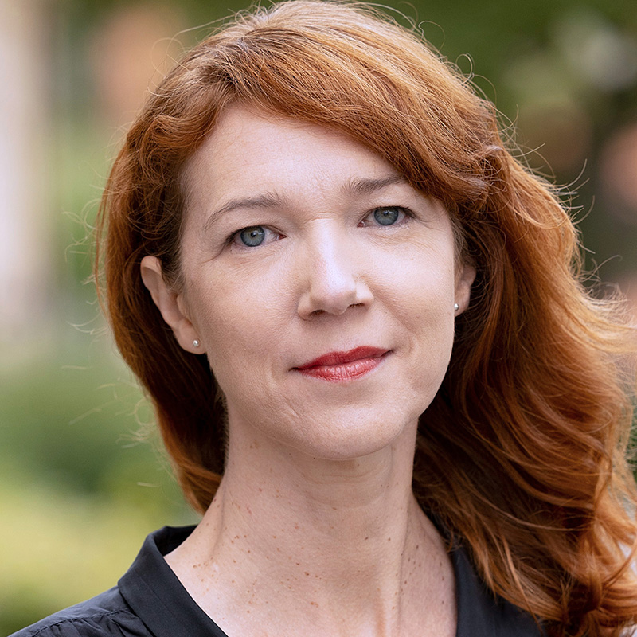
ORGANISATION
Luleå
Offices in Lund, Uppsala, Göteborg/Borås and Luleå
Most team members work part-time
Göteborg/Borås
Luleå
Uppsala
Paul Häyhänen
Business Developer
Industrial Liaison Officer (ILO): SKA
Oscar Isoz
Business Developer
Industrial Liaison Officer (ILO): ESO
Håkan Nilsson
Business Developer
Mattias Viktorsson
Business Developer
Göteborg
Lars-Åke Isaksson
Business Developer
Adam Wikström
Business Developer
Contact point: EISCAT
Mattias Vesterlund
Business Developer
Lund
Lund
Uppsala
Max Collins
Business Developer
Industrial Liaison Officer (ILO): F4E/ITER
Cajsa Fredlund
Communication Manager
Amelie Hallin
External Relations Manager
Mike Olsson
Business Developer
Frida Tibblin Citron
Business Developer
Catarina Sahlberg
Programme Director
Fredrik Engelmark
Business Developer
Industrial Liaison Officer (ILO): CERN, FAIR, EuXFEL
Contact point DESY
Marie-Louise Olsen
Communications Specialist

Slide 9
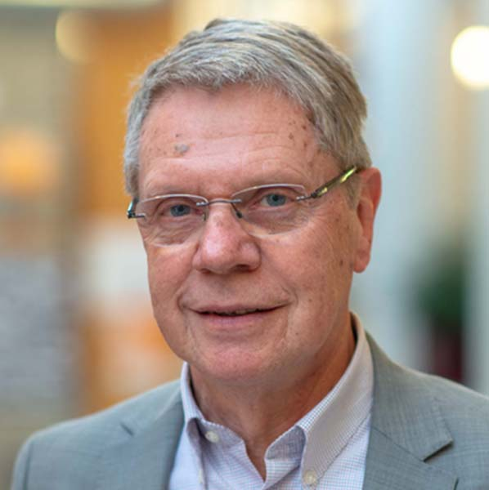
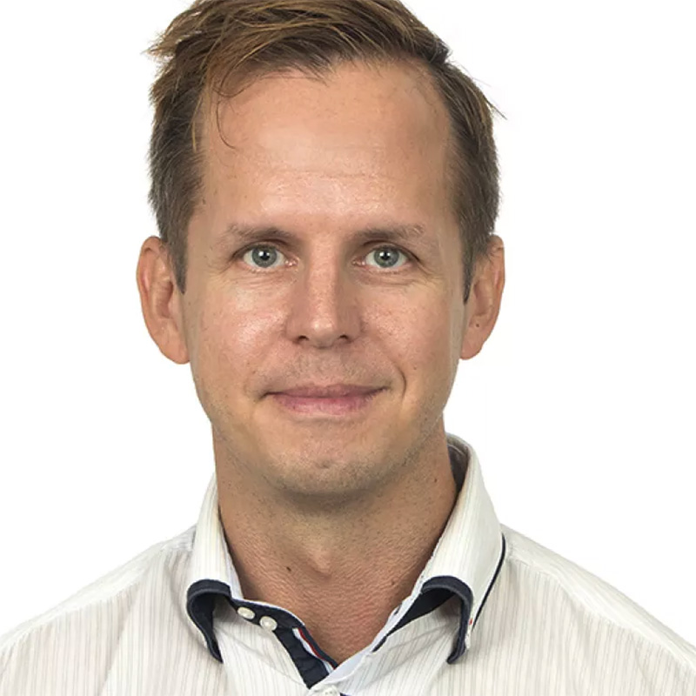
ORGANISATION
Luleå
Offices in Lund, Uppsala, Göteborg/Borås and Luleå
Most team members work part-time
Göteborg/Borås
Luleå
Uppsala
Paul Häyhänen
Business Developer
Industrial Liaison Officer (ILO): SKA
Oscar Isoz
Business Developer
Industrial Liaison Officer (ILO): ESO
Håkan Nilsson
Business Developer
Mattias Viktorsson
Business Developer
Göteborg
Lars-Åke Isaksson
Business Developer
Adam Wikström
Business Developer
Contact point: EISCAT
Mattias Vesterlund
Business Developer
^{Paul Häyhänen}
^{ILO SKA}
^{Håkan Nilsson}
^{Business Developer}
Lund
Lund
Uppsala
^{Mattias Vesterlund}
^{Business Developer}
Max Collins
Business Developer
Industrial Liaison Officer (ILO): F4E/ITER
Cajsa Fredlund
Communication Manager
Amelie Hallin
External Relations Manager
Mike Olsson
Business Developer
Frida Tibblin Citron
Business Developer
Catarina Sahlberg
Programme Director
Fredrik Engelmark
Business Developer
Industrial Liaison Officer (ILO): CERN, FAIR, EuXFEL
Contact point DESY
Marie-Louise Olsen
Communications Specialist

Slide 10
METHODOLOGY
Matchmaking
Communication
Networking event
Challenge-driven technical seminars and events
Matching procurements with Swedish industry
Proactive work with finding opportunities for Swedish industry, institutes and academia
Outreach activities
to students

Slide 11
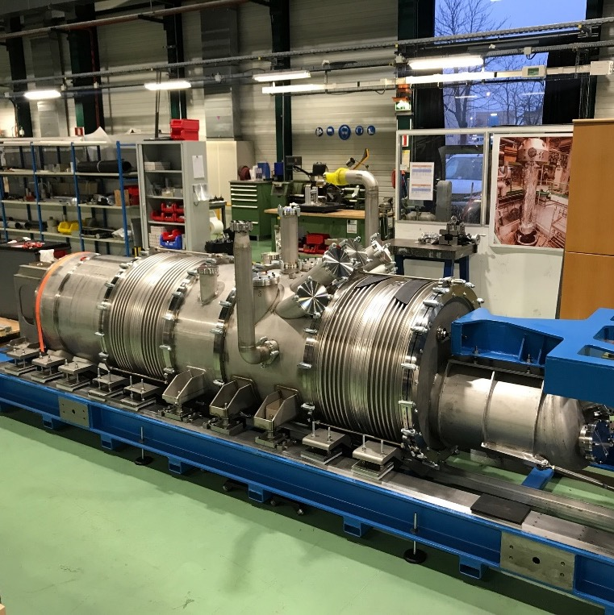
Development of novel mirror washing system for the ELT
Development of interconnection of superconductive cables at LHC upgrade
Notes:
ESO
Fagerström bygger ett system för att rengöra spegelelementen vid världens största spegelteleskop som uppförs på ett berg vid ESO Paranal Observatory i Chile, 3 000 meters höjd. Skånska företagen Examec och RFR är också med och bygger.
CERN
RFR Solutions
RFR Solutions har vunnit en viktig order från CERN, där partikelacceleratorn HL-LHC uppgraderas.
Kontraktet innebär att utveckla kryostater för sammankoppling av supraledande kablar.

Slide 12
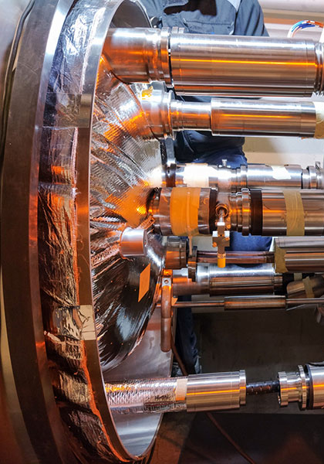
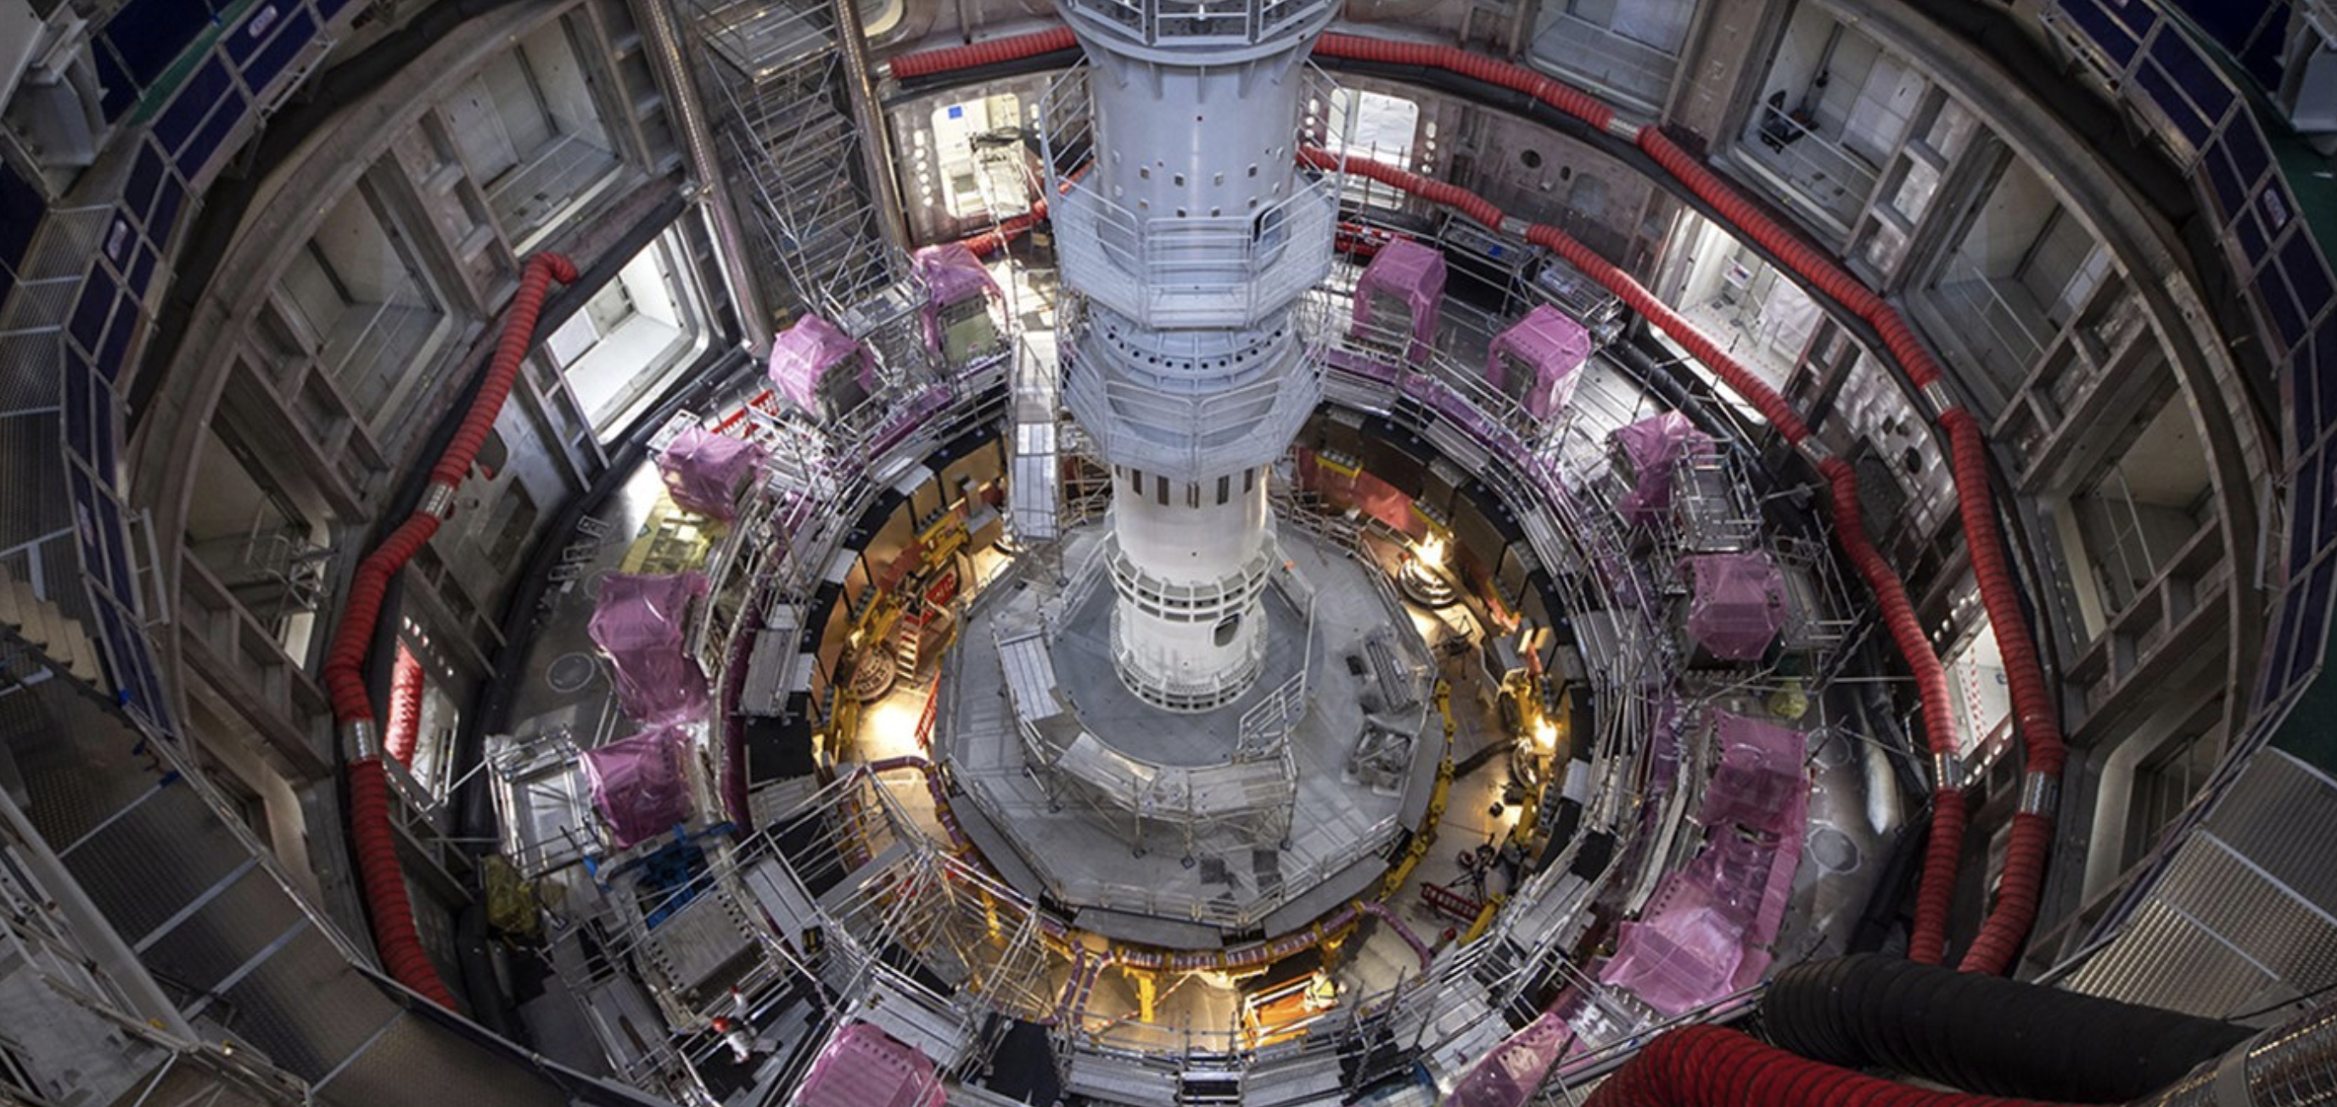
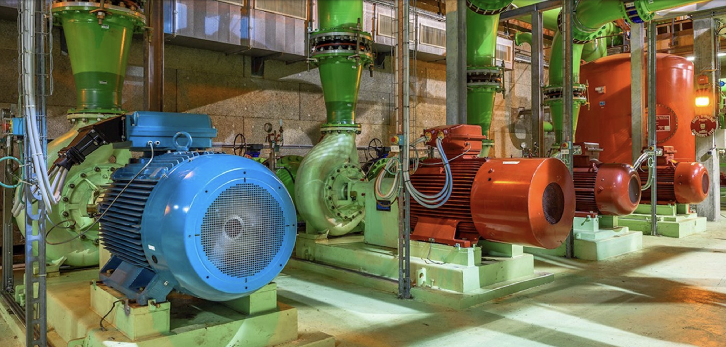
Development of superconducting magnets for the LHC upgrade at CERN
Pre study of power converters for ITER
Energy efficiency study at CERN
Notes:
Vad gäller utvecklingsprojekt så vill jag ge några exempel på vad det är vi pratar om:
Utveckling av nya mer kompakta och energisnåla supraledande magneter till uppgraderingen av LHC på CERN
Samarbete mellan två lärosäten, tre företag och CERN.
Finansiering från CERN, ERUF, Region Kronoberg och UU
---
Kontrakt på In-Vessel Coil Power Converters, vunnit i konkurrens
Helfinansierat av ITER, ca 540 k€
Samarbete lett av RISE och LU, med deltagande även från ESS och ett företag.
Första gången Sverige vinner ett kontakt på ITER – öppnar dörrar
Nästa steg upphandling värd ca 100 M€
----
Samarbete mellan ABB och CERN
Energieffektivisering av kyl- och ventileringssystem
Hoppas kunna minska elkonsumtionen med ca 15%
Skulle vara tillämpbart på andra anläggningar i världen

Slide 13
II. SWEDISH ENGAGEMENT IN SKA, SUCCESS FACTORS, LESSONS LEARNED

Slide 14
TIMELINE
Work begins on SKA design via international consortia, involving OSO
Funding proposal to Swedish Research Council
Sweden involved in negotiations of SKA Convention
Chalmers – SKA sign collaboration agreement
Sweden signs and ratifies SKA Convention?
2012
2014
2016
2018
2020
2022
2024
Sweden joins the SKA Organisation
Discussions on contributions
Gauging of Swedish capabilities and interests
Swedish funding secured
Negotiations on deliveries
BiSS involvement and support

Slide 15
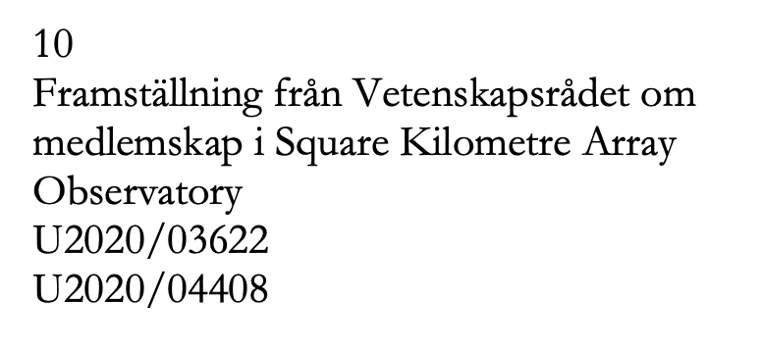
SWEDEN’S ENGAGEMENT IN SKAO
Funding
25.8 M€, from the Innovation Agency Vinnova and the Swedish Research Council
55% for construction (15 M€)
70% of construction funds (10 M€) guaranteed industry return
Convention
Not yet signed and ratified, but hopefully soon
Role of BiSS
Support to industry partners, OSO/Chalmers, funding agencies, SKAO
Support in strategy, industry engagement, allocations of work, negotiations with SKAO and other countries

Slide 16
SWEDISH RETURN FROM SKAO
MID Digitisers RXS123, RXPU
MID Band 1
LNAs Band 1 & Band 5
RXS45 study
EMC tests
In total over 30 M€

Slide 17
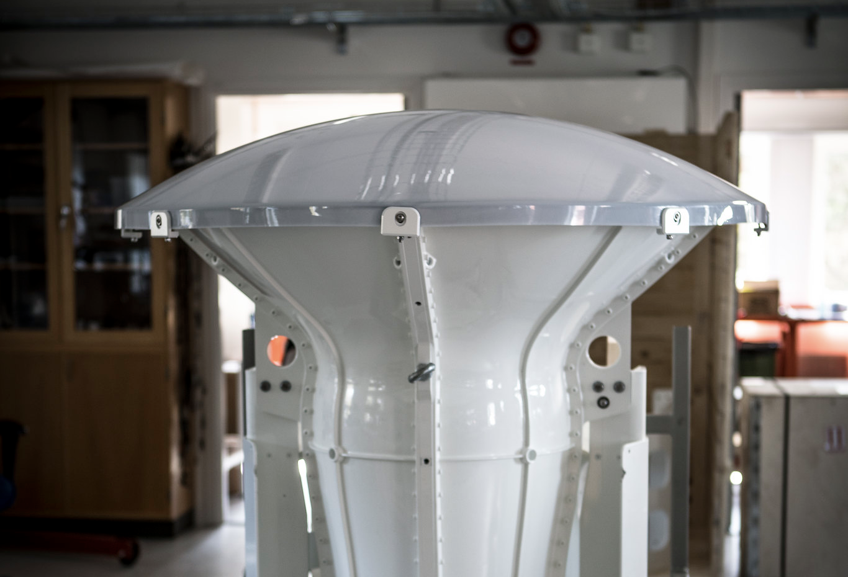
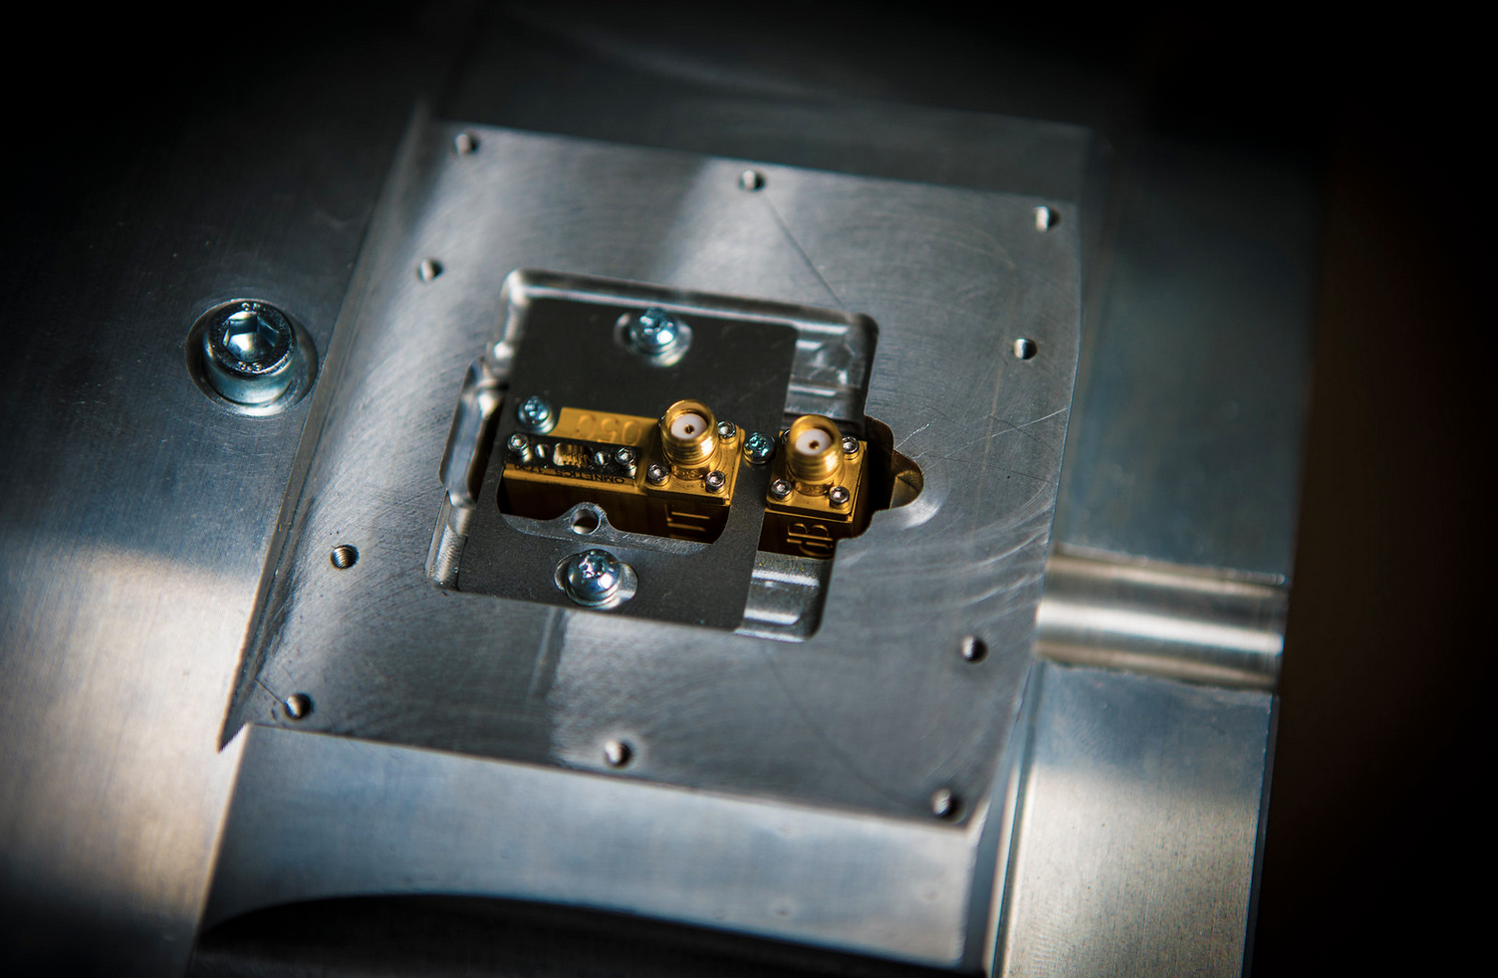
SUCCESS FACTORS WITH SKA
Scientific and technical expertise at Chalmers and Onsala Space Observatory
Industrial ability and capacity within relevant areas
Early engagement
Credibility
Coordinated Swedish stakeholders
Clear (and broad) strategy right from the onset

Slide 18
LESSONS LEARNED, FOR FACILITIES IN GENERAL
Long business cycles
Often starting in small pre-studies
Early engagement is the key to technologically interesting contracts
High-value contracts
Strong technology development, innovation potential and multiplicative factors
Generates transfer of knowledge and know-how
Pre-studies
Prototypes
Tests
Deliveries

Slide 19
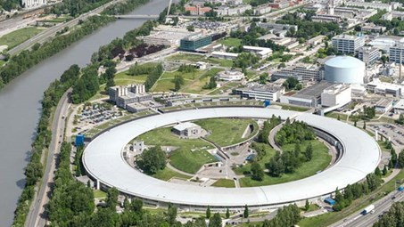
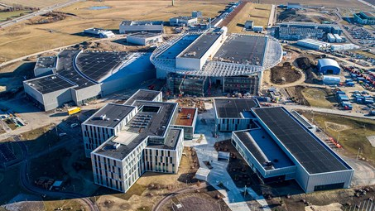
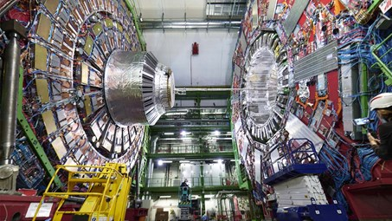
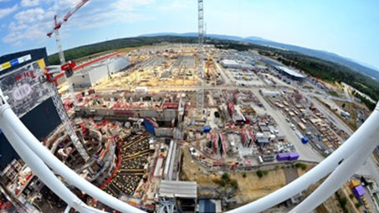
TAKE-HOME-MESSAGES, FOR SWEDEN
Important to have a national system with
Symbiosis between industry and academia
Highly specialised academic environments (like the ones at OSO/Chalmers)
Structures for funding (and co-funding), e.g., for initial pre-studies
Helps to have:
Long-term ILO-organisation
Clear interest and long-term strategies within industry
For some facilities, sometimes also necessary to have:
Political support
Strong international networks

